Slide 1
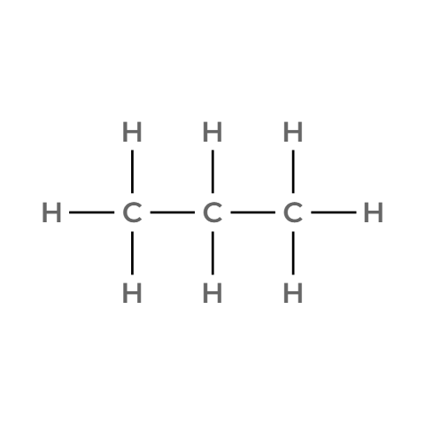

01.
Propane
Molecular Formula
Lewis Structure
C₃H₈
Compound Identity
Common Name: Propane
Iupac Name: Propane
Molecular Weight:
Bond-Line Formula
Condensed Structural Formula
CH₃CH₂CH₃
valence checked
same connectivity confirmed
atom count verified
bond order checked

Slide 2
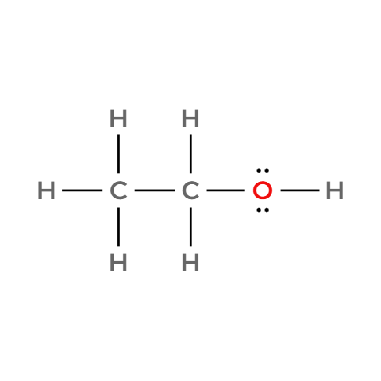
02.
Ethanol
Molecular Formula
Lewis Structure
C₂H₆O
Compound Identity
Common Name: Ethyl Alcohol
Iupac Name: Ethanol
Molecular Weight: 46.0684 g/mol
Bond-Line Formula
Condensed Structural Formula
CH₃CH₂OH
valence checked
same connectivity confirmed
atom count verified
bond order checked

Slide 3
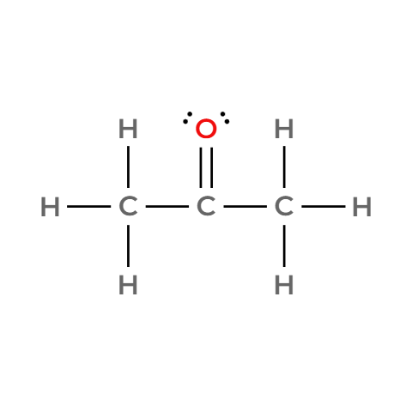
03.
Acetone
Molecular Formula
Lewis Structure
C₃H₆O
Compound Identity
Common Name: Acetone
Iupac Name: Propan-2-one
Molecular Weight: 58.0791 g/mol
Bond-Line Formula
Condensed Structural Formula
CH₃CH₃OH
valence checked
same connectivity confirmed
atom count verified
bond order checked

Slide 4
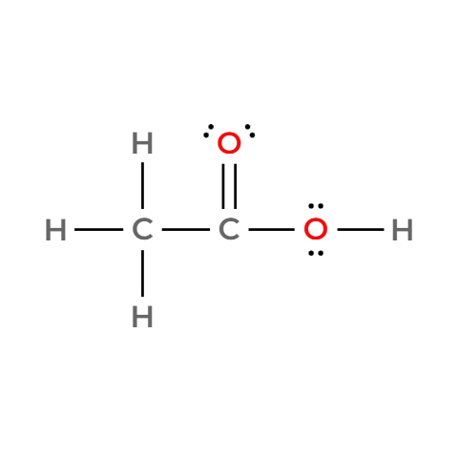
04.
Acetic Acid
Molecular Formula
Lewis Structure
C₂H₄O₂
Compound Identity
Common Name: Acetic Acid
Iupac Name: Ethanoic Acid
Molecular Weight: 60.0520 g/mol
Bond-Line Formula
Condensed Structural Formula
CH₃COOH
valence checked
same connectivity confirmed
atom count verified
bond order checked

Slide 5
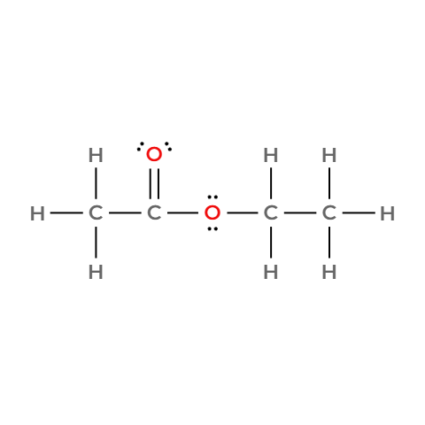
05.
Ethyl Acetate
Molecular Formula
Lewis Structure
C₄H₈O₂
Compound Identity
Common Name: Ethyl Acetate
Iupac Name: Ethyl Ethanoate
Molecular Weight: 88.1051 g/mol
Bond-Line Formula
Condensed Structural Formula
CH₃COOCH₂CH₃
valence checked
same connectivity confirmed
atom count verified
bond order checked

Slide 6
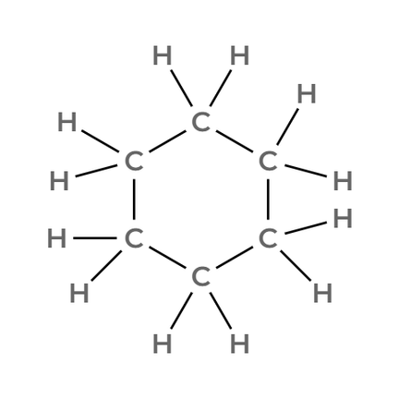
06.
Cyclohexane
Molecular Formula
Lewis Structure
C₆H₁₂
Compound Identity
Common Name: Cyclohexane
Iupac Name: Cyclohexane
Molecular Weight: 84.1595 g/mol
Bond-Line Formula
Condensed Structural Formula
CH₂CH₂CH₂CH₂CH₂CH₂
valence checked
same connectivity confirmed
atom count verified
bond order checked

Slide 7
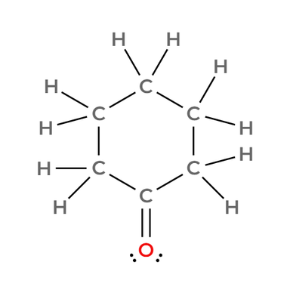
07.
Cyclohexanone
Molecular Formula
Lewis Structure
C₆H₁₀O
Compound Identity
Common Name: Cyclohexanone
Iupac Name: Cyclohexanone
Molecular Weight: 98.1430 g/mol
Bond-Line Formula
Condensed Structural Formula
CH₂CH₂CH₂CH₂CH₂O
valence checked
same connectivity confirmed
atom count verified
bond order checked

Slide 8
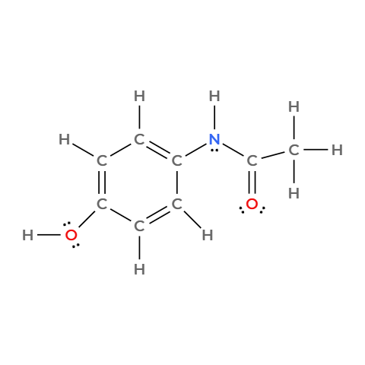
08.
Acetaminophen
Molecular Formula
Lewis Structure
C₈H₉NO₂
Compound Identity
Common Name: Paracetamol
Iupac Name: N- (4 hydroxyphenyl)acetamide
Molecular Weight: 151.1626 g/mol
Bond-Line Formula
Condensed Structural Formula
HOC₆H₄NHCOCH₃
valence checked
same connectivity confirmed
atom count verified
bond order checked

Slide 9
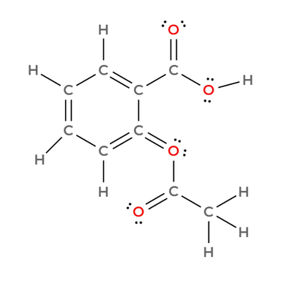
09.
Aspirin
Molecular Formula
Lewis Structure
C₉H₈O₄
Compound Identity
Common Name: Aspirin/ Acetylsalicylic acid
Iupac Name: 2-Acetoxybenzoic Acid
Molecular Weight: 180.1574 g/mol
Bond-Line Formula
Condensed Structural Formula
CH₃COOC₆H₄COOH
valence checked
same connectivity confirmed
atom count verified
bond order checked

Slide 10
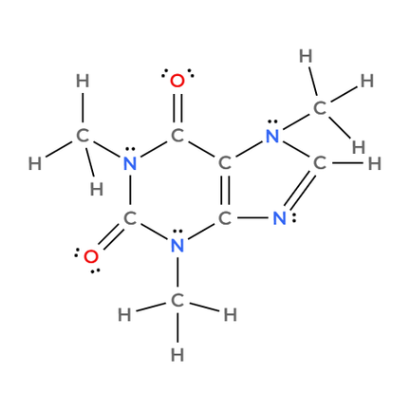
10.
Caffeine
Molecular Formula
Lewis Structure
C₈H₁₀N₄O₂
Compound Identity
Common Name:
Iupac Name: 1,3,7-Trimethyl-3,7-dihydro-1H-purine-2,6-dione
Molecular Weight: 194.1906 g/mol
Bond-Line Formula
Condensed Structural Formula
CH₃CH₃C₆H₄N₄O₂
valence checked
same connectivity confirmed
atom count verified
bond order checked

