Slide 1
~/data_mining/final_project.py
# BSIT 3-D | ITSPEC 3
from data_mining import *
APPLICATION OF
DATA MINING TECHNIQUES
Classification
Clustering
Regression
Association
Instructor: Ian Val Delos Reyes | April 22, 2026
# group_members
Alimpolos, Aldrich A. Batawang, Homer J. Madrona, Cristian Li G. Labad, Rodsteven S. Perono, Jenny Mae P. Sulana, Pearl Paulene S.

Slide 2
data_mining.ipynb
>
Introduction & Objectives
// overview and specific goals of this study
core_challenge.md
general_objective.md
Educational institutions generate large volumes of student data
but struggle to extract predictive, actionable academic insights.
Apply four data mining techniques to uncover patterns,
predict outcomes, and support data-driven decisions.
// core_techniques & specific_objectives
Classification
Clustering
01
Gaussian Naive Bayes
02
Hierarchical (Ward)
Predicting student pass/fail outcomes early.
Grouping students by behavioral engagement tier.
Regression
Association
03
Polynomial (Degree 2)
04
Apriori Algorithm
Modeling study hours vs. final grade.
Discovering item co-purchase patterns.
* main
BSIT 3-D | Data Mining | April 22, 2026

Slide 3
data_mining.ipynb
>
Dataset Description
// four datasets loaded from local CSV files
import pandas as pd # 4 files loaded
#
DOMAIN
DATASET
ALGORITHM USED
RECORDS
01
Education
student_performance.csv
Gaussian Naive Bayes
200 students
02
Education
student_behavior.csv
Hierarchical Clustering
200 students
03
Education
student_grades.csv
Polynomial Regression
150 students
04
Commerce
transactions.csv
Apriori Algorithm
300 transactions
// dataset_summary
4
850
2
2
CSV Files
Total Records
Supervised
Unsupervised
* main
BSIT 3-D | Data Mining | April 22, 2026

Slide 4
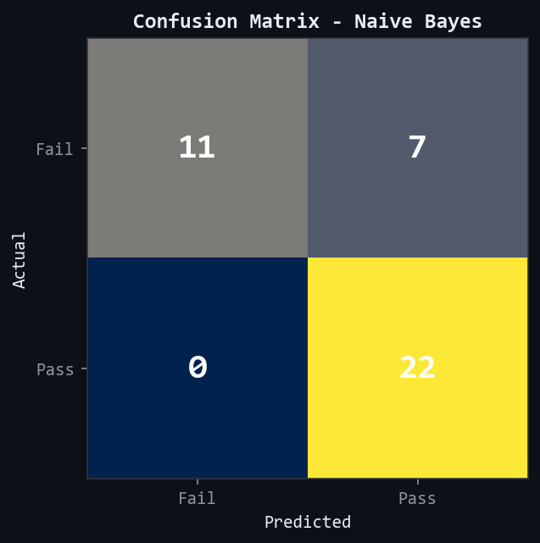
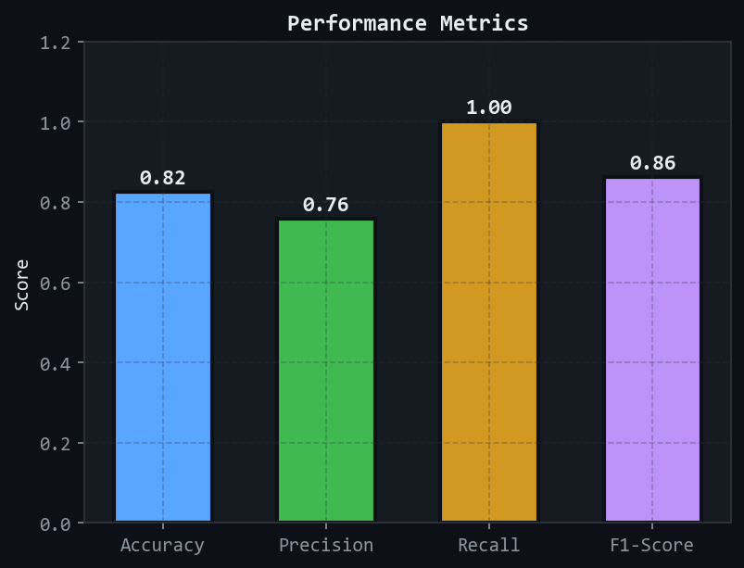
data_mining.ipynb
>
Methodology & Analysis
P1 - NAIVE BAYES
// Problem 1 - Education (Classification)
problem.txt
methods.py
Teachers cannot early-identify at-risk students without
a predictive tool. Intervention often happens too late.
X = [Study_Hours, Attendance, Quiz_Score]
GaussianNB().fit(X_train, y_train)
confusion_matrix.png
metrics_report.png
>> RESULT
82.50% Accuracy | 100% Recall - no passing student was ever missed (0 FN).
* main
BSIT 3-D | Data Mining | April 22, 2026

Slide 5
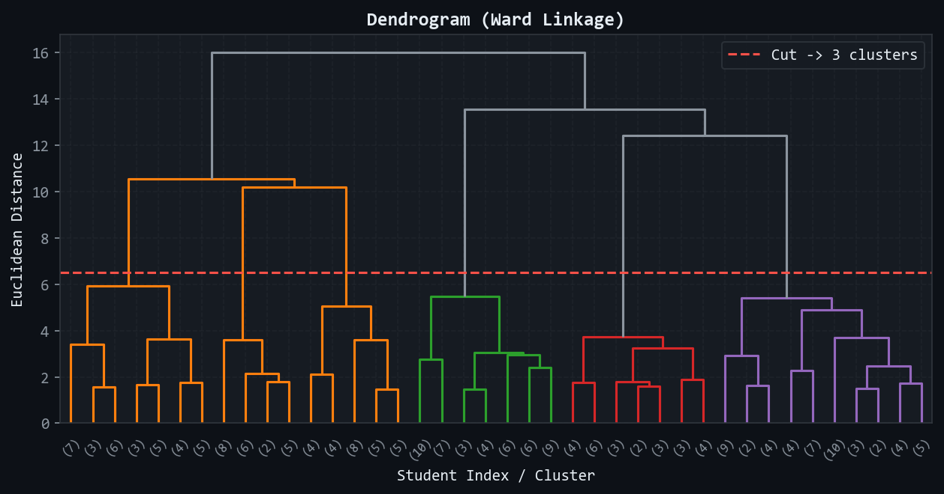
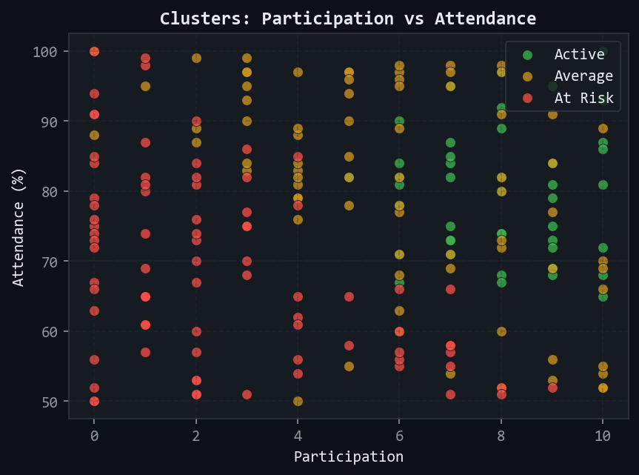
data_mining.ipynb
>
Methodology & Analysis
P2 - CLUSTERING
// Problem 2 - Education (Clustering)
problem.txt
methods.py
Student behavioral data is unlabeled - no pre-existing
groupings or engagement tiers exist.
Z = linkage(X_scaled, method='ward')
labels = fcluster(Z, t=3, criterion='maxclust')
dendrogram.png
cluster_scatter.png
>> RESULT
3 natural behavioral tiers: Active (45) | Average (75) | At Risk (80).
* main
BSIT 3-D | Data Mining | April 22, 2026

Slide 6
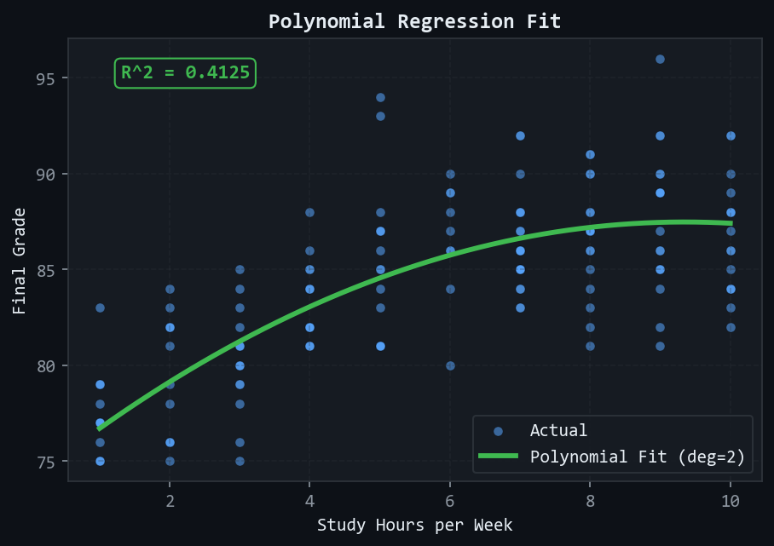
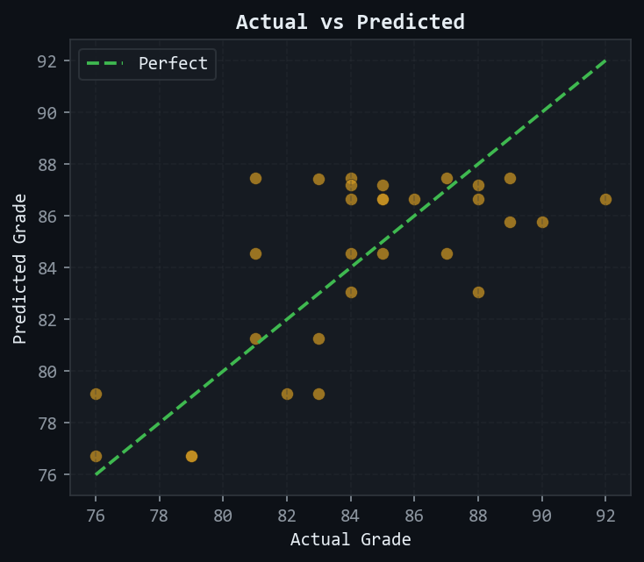
data_mining.ipynb
>
Methodology & Analysis
P3 - REGRESSION
// Problem 3 - Education (Regression)
problem.txt
fitted_equation.py
Grade vs. study hours is non-linear - students hit
diminishing returns past a certain threshold.
Grade = 73.98 + 2.89h - 0.1546h^2
R^2 = 0.4125 | RMSE = 2.91
polynomial_fit.png
actual_vs_predicted.png
>> RESULT
41.25% of grade variance explained | RMSE = 2.91 pts | peak at ~9.35 hrs/week.
* main
BSIT 3-D | Data Mining | April 22, 2026

Slide 7
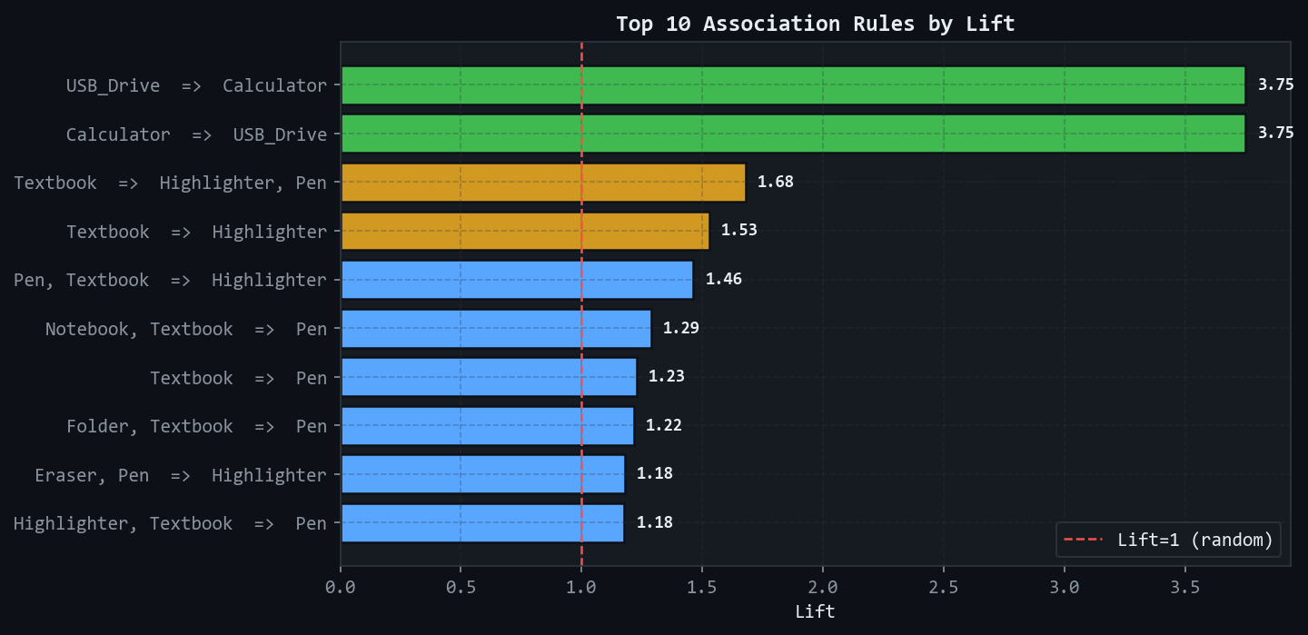
data_mining.ipynb
>
Methodology & Analysis
P4 - APRIORI
// Problem 4 - Commerce (Association Rule Mining)
problem.txt
methods.py
Campus bookstore has no data-driven strategy for
product bundling or shelf placement.
freq = apriori(df, min_support=0.10)
rules = association_rules(freq, min_threshold=0.50)
top_10_rules_by_lift.png
37
Rules
34
Itemsets
3.75
Max Lift
0.97
Max Conf
>> RESULT
USB_Drive <-> Calculator strongest pair (Lift = 3.75). 37 rules extracted.
* main
BSIT 3-D | Data Mining | April 22, 2026

Slide 8
data_mining.ipynb
>
Integration of Results
// cross-technique synthesis
// comparative_summary
PROBLEM
TECHNIQUE
TYPE
KEY RESULT
P1 - Pass/Fail
Gaussian Naive Bayes
Supervised
Accuracy 82.50% | Recall 100%
P2 - Behavior
Hierarchical Clustering
Unsupervised
3 clusters - Active / Average / At Risk
P3 - Grade
Polynomial Regression (d=2)
Supervised
R^2 = 0.4125 | RMSE = 2.91
P4 - Purchases
Apriori Algorithm
Unsupervised
37 rules | Max Lift = 3.75
insights.md
> P1 -> P2 -> P3 form a pipeline: identify failing students -> profile them -> prescribe study hours.
> P4 applies the same analytical logic to a business domain (campus bookstore).
> Supervised models (P1, P3) use labeled data with measurable prediction accuracy.
> Unsupervised models (P2, P4) reveal natural structures without labels or train-test split.
* main
BSIT 3-D | Data Mining | April 22, 2026

Slide 9
data_mining.ipynb
>
Conclusion
// summary of findings
// findings.log
[OK]
Naive Bayes
82.50% accuracy | 100% recall | proven early warning tool.
[OK]
Hierarchical Cluster
3 behavioral tiers discovered from unlabeled student data.
[OK]
Polynomial Regression
41.25% of grade variance explained | RMSE = 2.91 pts.
[OK]
Apriori Algorithm
37 rules uncovered | USB Drive <-> Calculator at Lift 3.75.
"Raw data contains latent, predictable structures - the right algorithm surfaces them."
* main
BSIT 3-D | Data Mining | April 22, 2026

Slide 10
data_mining.ipynb
>
Recommendations
// actionable next steps
01
Early Warning System
Deploy Naive Bayes for real-time academic alerts at term start.
02
Targeted Support
Use cluster profiles to design tier-specific academic programs.
03
Study Plan Optimization
Share the regression curve - peak benefit around 9 hrs/week.
04
Campus Store Optimization
Bundle USB + Calculator; place Pens near Textbook displays.
* main
BSIT 3-D | Data Mining | April 22, 2026

Slide 11
data_mining.ipynb
>
Limitations
// known constraints & caveats
!
Synthetic datasets (150-300 records) - less noisy than real institutional data.
!
Naive Bayes assumes feature independence - likely violated in reality.
!
Polynomial Regression uses 1 predictor - 59% of grade variance unexplained.
!
Apriori results depend on min_support threshold - chosen by judgment.
!
Cluster labels based on a weighted formula - introduces subjectivity.
// NOTE: metrics should be interpreted with these constraints in mind.
* main
BSIT 3-D | Data Mining | April 22, 2026

Slide 12
data_mining.ipynb
>
Future Works
// roadmap for extension
v2.0
Replace synthetic data with real university and bookstore records.
v2.1
Benchmark Naive Bayes vs. Decision Tree vs. SVM for classification.
v2.2
Compare K-Means vs. DBSCAN against Hierarchical Clustering.
v2.3
Expand P3 to multi-feature regression (add Attendance + Quiz_Score).
v2.4
Integrate all 4 models into a live student performance web dashboard.
>> GOAL: Deploy these models as real-time, continuously learning institutional tools.
* main
BSIT 3-D | Data Mining | April 22, 2026

Slide 13
data_mining.ipynb
>
References
// sources & citations
[01]
I. H. Witten et al., Data Mining: Practical Machine Learning Tools and Techniques, 4th ed., Morgan Kaufmann, 2016.
[02]
A. Geron, Hands-On Machine Learning with Scikit-Learn, Keras, and TensorFlow, 2nd ed., O'Reilly Media, 2019.
[03]
C. M. Bishop, Pattern Recognition and Machine Learning, Springer, 2016.
[04]
K. P. Murphy, Machine Learning: A Probabilistic Perspective, MIT Press, 2022.
[05]
R. Agrawal & R. Srikant, Fast Algorithms for Mining Association Rules, VLDB Conf., pp. 487-499, 1994.
[06]
S. Raschka & V. Mirjalili, Python Machine Learning, 3rd ed., Packt Publishing, 2019.
* main
BSIT 3-D | Data Mining | April 22, 2026

