Slide 1
MASTER'S THESIS (TFM) — DEFENSE
Madroño
An End-to-End Urban Mobility Data Platform for Madrid,
from Open Data to a Graph-Aware Conversational Assistant
Filippos Dorezi · Víctor Huaman
Sistema track (code, data, ML, infrastructure) & Memoria track
Universidad Complutense de Madrid · 2026

Slide 2
MOTIVATION
Three Real Constraints Drive Every Design Choice
01
02
03
Two people, no ops role
A short real data window
Zero-cost data only
No dedicated infra/SRE. Anything that must be “kept running” (a Kafka broker, a Spark cluster, a self-hosted graph DB) is a liability the team cannot absorb → serverless-first stack.
Continuous ingestion started 2026-08-14 — only ~3–4 weeks of hourly history by training time. Forces an honest framing: ML is a methodology demonstration, not a performance claim.
Every source is open data. Google Maps’ popularity signal was investigated, verified to need a billing account even on the free tier, and replaced by a graph-derived signal instead.
Bottom line: every architectural decision in this project traces back to one of these three constraints.
Madroño — TFM Defense
02 / 11

Slide 3
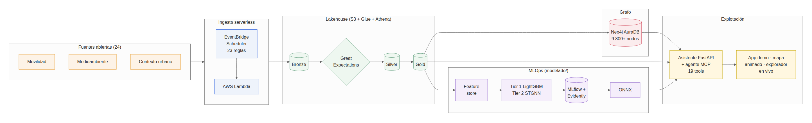
ARCHITECTURE
One Pipeline, One Backend, Three Public Surfaces
All three public surfaces share the same conversational backend — one agent, one chat, three presentation layers.
Madroño — TFM Defense
03 / 11

Slide 4
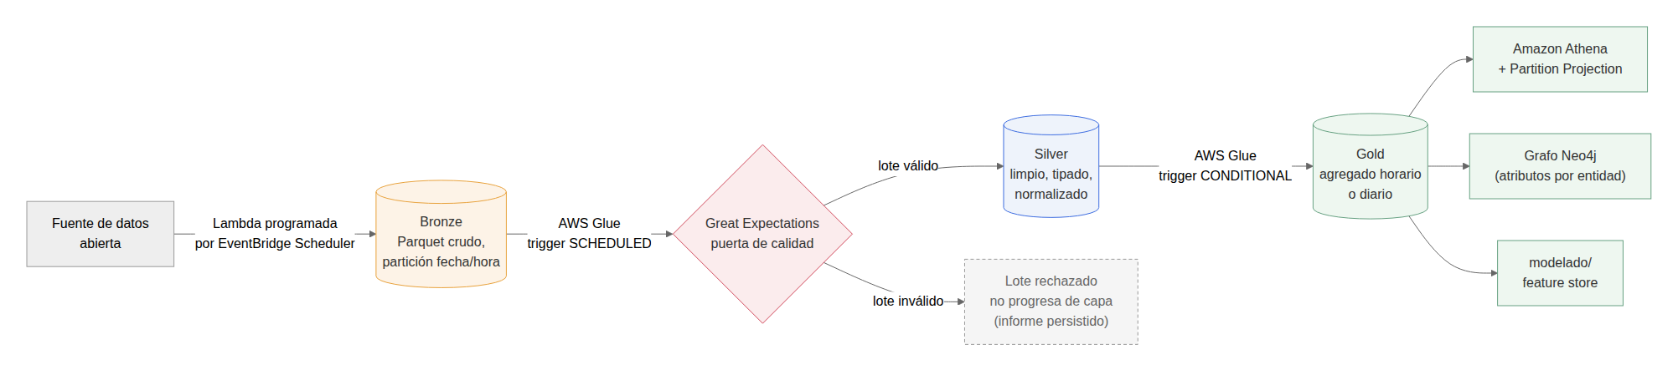
DATA LAYER
Medallion Lakehouse: Bronze → Silver → Gold
THE PIPELINE AT A GLANCE
14+
open municipal / regional sources
▪ 16 continuous producers (Lambda + EventBridge Scheduler) + 7 one-off reference loads.
▪ Quality gates at every step: plausibility rules + Great Expectations, run inside the real AWS Glue job.
▪ Key decision: business logic is pure Python — zero pyspark/pandas import dependency; only a thin adapter touches Spark.
▪ Real incident, found & fixed: a stale S3 key broke 37/48 Glue jobs (~28h outage) — resolved with a stable key.
3
S3 buckets (Bronze / Silver / Gold)
46+
AWS Glue ETL jobs, serverless Spark
$0
cost per data source (open data)
~$280
total AWS spend before freeze
Madroño — TFM Defense
04 / 11

Slide 5
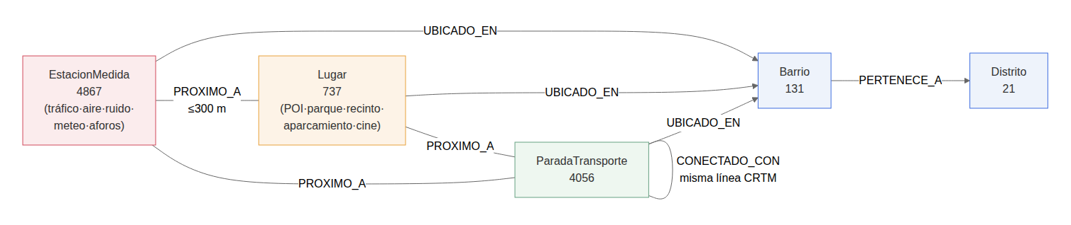
GRAPH LAYER
Modeling the City as a Graph (Neo4j)
LIVE GRAPH SNAPSHOT
~9,800
▪ 5 node types, 4 relationships — built once, reused by 7 of the 19 assistant tools.
▪ Resilience analysis (offline networkx): 683 articulation points, 740 bridges — 20.3% of all edges.
▪ Targeted vs. random failure: 5% targeted node removal → 39.6% largest-component survival, vs. 89.1% under random removal.
▪ Honest caveat: the graph models one representative trip per line — a structural finding, not an operational diagnosis.
nodes
~76,000
relationships
AuraDB Free
$0 / month, APOC enabled
Node types: District, Neighbourhood, Place,
Sensor Station, Transit Stop
Madroño — TFM Defense
05 / 11

Slide 6
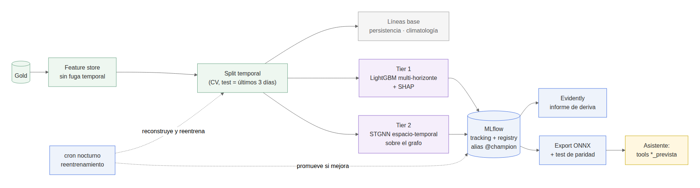
MACHINE LEARNING
Forecasting: Two Tiers, One Honest Comparison
Skill vs. a persistence baseline (production window, temporal holdout) — LightGBM, per horizon:
MODEL PIPELINE (modelado/)
Target | h1 (1h) | h3 (3h) | h6 (6h)
Air quality | −0.16 | −0.13 | +0.24
Traffic | +0.34 | +0.58 | +0.75
Feature store (no leakage) → training →
MLflow registry (@champion) → ONNX export.
19-feature contract (lags, rolling stats,
calendar, cyclical encodings) shared by
LightGBM and the ONNX runtime.
▪ Anti-leakage discipline: every feature carries a known_at timestamp — only known-at-t data enters the panel for hour t.
▪ Air quality loses at h1/h3: persistence is a genuinely strong baseline on a calm, short window.
▪ Traffic wins clearly: real intraday dynamics that persistence cannot capture; margin grows with horizon.
Madroño — TFM Defense
06 / 11

Slide 7
MACHINE LEARNING
Tier 2: A Hand-Built Spatio-Temporal GNN
▪ Architecture: GraphSAGE (message passing) + GRU (temporal) + linear head — CPU only, ~100 lines of torch.
▪ Hand-rolled graph convolution, deliberately: keeps edge_weight inside the autograd graph — ∂loss/∂edge_weight IS the edge-importance metric.
▪ Honest result on the production window: loses to LightGBM on accuracy; served for explainability, reliability capped “LOW” end-to-end.
▪ External validation (MTD, 300 sensors / 29 months): skill +0.37 / +0.70 / +0.85 (h1/h3/h6) — margin grows with horizon.
▪ ONNX export (dynamo exporter): parity ~6e-8; serves in production with zero torch dependency.
WHY THIS RESULT IS A STRENGTH
The production shortfall is a data-volume
problem specific to a 3-week window —
not an architecture flaw.
On a properly-sized external dataset, the
same architecture clearly beats persistence,
with a margin that grows with horizon:
exactly the signature of real learning.
Distinguishing “wrong architecture” from
“not enough data yet” required an
independent benchmark — stronger than
asserting it without proof.
Madroño — TFM Defense
07 / 11

Slide 8
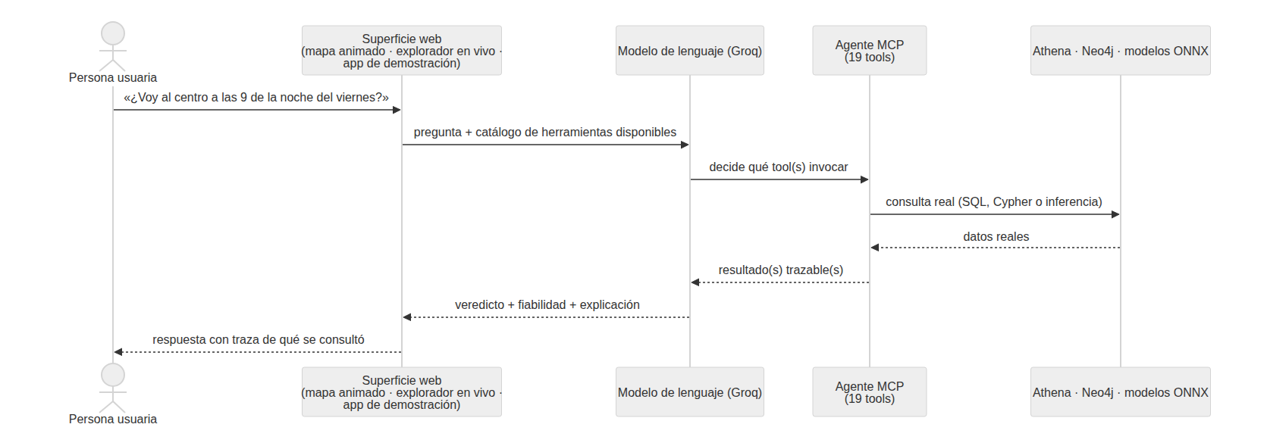
CONVERSATIONAL ASSISTANT
FastAPI + Model Context Protocol (MCP)
▪ Why MCP: the open protocol LLM clients use for typed tool calls — any conforming client integrates with zero custom code.
▪ 19 MCP tools, 0 NotImplementedError — air quality, traffic, forecasts (LightGBM + graph STGNN), healthy routing, graph queries, and more.
▪ One uniform contract: no tool ever raises an exception — missing data degrades to a labeled “not available” response.
▪ Verified against reality: every tool run against the real AWS account and live Neo4j — real bugs found and fixed.
REQUEST FLOW
opciones_movilidad never invents a travel
duration — no walkable street graph exists
yet. The tool states real conditions near
each endpoint instead of guessing.
Stating the system's boundary, not hiding
it, is applied across all 19 tools.
Madroño — TFM Defense
08 / 11

Slide 9
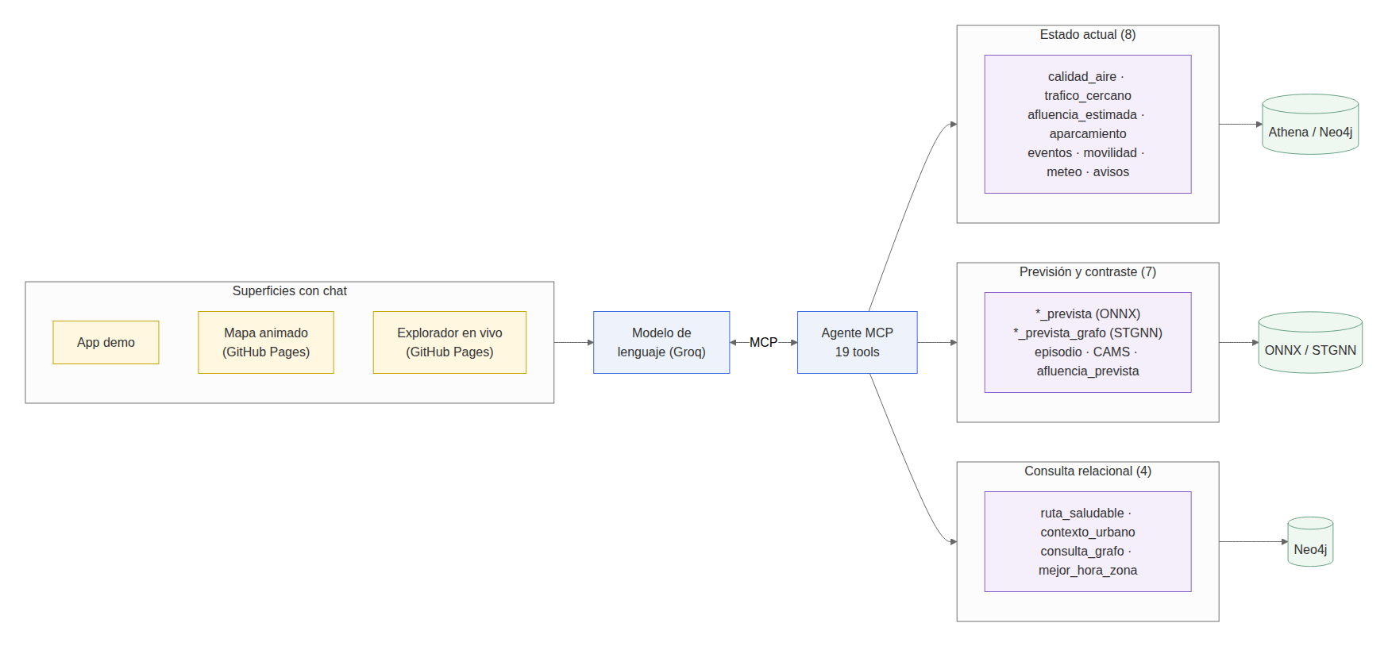
VISUALIZATION
The “Wow” Deliverable: An Animated City Map
▪ 1,798 traffic nodes, 8,758 edges, animated hour-by-hour across 3 curated days, colored by a 0–100 health index.
▪ Fully offline-generated: deck.gl + a frozen Gold snapshot — zero live AWS calls per viewer, hosted free on GitHub Pages.
▪ 9 sensitivity profiles, edge-importance arcs, model-vs-persistence layer, embedded chat.
▪ Limitations stated on the page itself: noise is daily, air quality is interpolated, STGNN < LightGBM on accuracy.
MCP CATALOG & PUBLIC SURFACES
madrono-ucm.github.io/madronoTFM
Free · no login · embedded chat — the
recommended entry point for evaluating
the project.
Madroño — TFM Defense
09 / 11

Slide 10
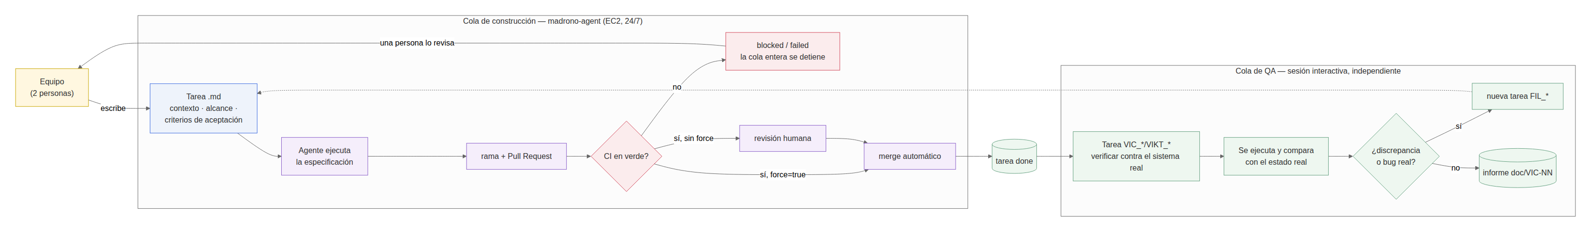
METHODOLOGY & LIMITATIONS
How It Was Built, and What's Left
ENGINEERING METHOD
HONEST LIMITATIONS
▪ Autonomous coding agent on a strict-order task queue, one PR per task.
▪ Sole hard safety net: nothing reaches main without a human-reviewed PR.
▪ A real process gap found & fixed: auto-merge originally didn't wait for CI.
▪ Short ingestion window (~3–4 weeks) — no seasonal claims possible.
▪ No hot streaming path — Kafka designed, deliberately never applied.
▪ No real street-routing graph — stated as a boundary, not hidden.
Every limitation above is stated in the thesis itself — proactively, not extracted by questioning.
Madroño — TFM Defense
10 / 11

Slide 11
Summary
19
16
~9,800
MCP tools
zero unimplemented
continuous
data producers
graph nodes
~76k relationships
~$280
1,143+
3
total AWS spend
before freeze
automated tests
zero real credentials needed
public surfaces
one shared backend
Thank you — questions welcome.

