Slide 1
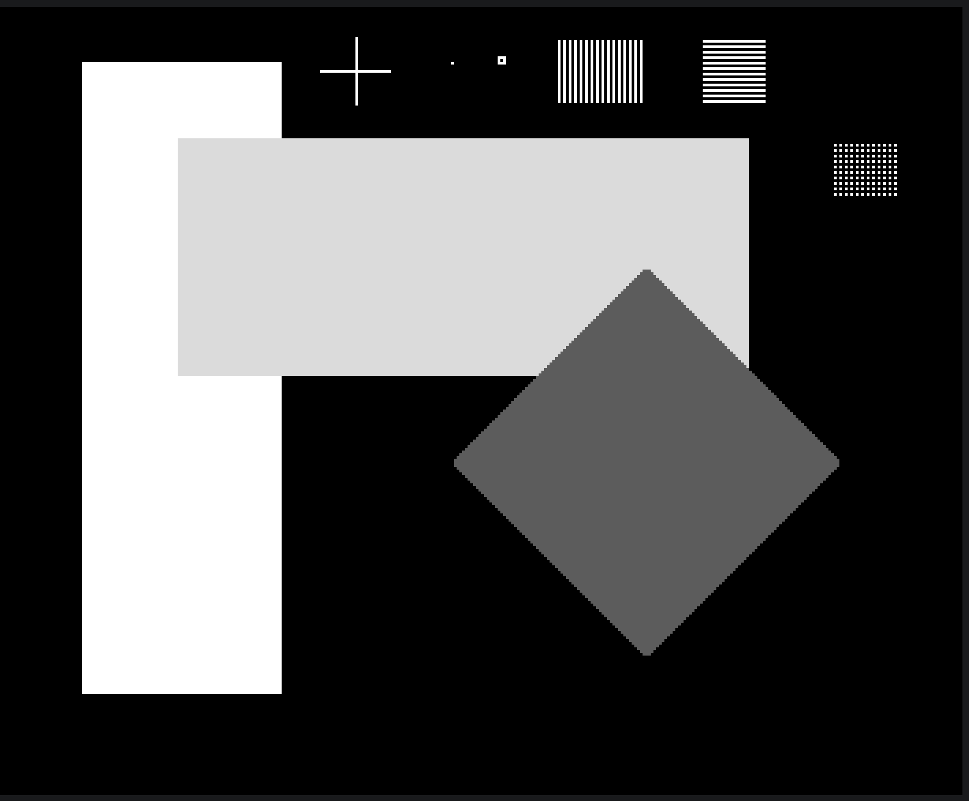

Slide 2
Group 75 | Sobel edge detector
Status
-Initial design completed
-Implementation in progress

Slide 3
Design
Four row buffers
top / mid / bot
+ next (prefetch)
Input buffer
32-bit words
3 × 3 window
byte selector
Gx + Gy
accumulators
Abs → sum → clamp
Pack → output buffer
Local pixel buffer: 4 rows × 352 bytes / row = 1,408 byte
Local pixel buffer stored in Flip-Flops.
Each pixel is fetched once from the input buffer.
Pixels are reused locally for overlapping windows.
Rotate buffer roles instead of copying rows.
Notes:
Reuse image rows. Compute and prefetch at the same time.
Process:
- Load first 3 rows
When finished, starting the sobel calculation
Each clock calculates both x and y kernel 1 pixel
Simutanously load next word each clock

Slide 4
Flow chart of State-Machine
IDLE
wait for start
LOAD
first 3 rows
RUN
compute + load
ROTATE
advance roles
DONE
finish pulse
Last row + both done → DONE
Cycles in LOAD: 352 / 4 × 3 = 264 clock cycles
Cycles in RUN: 350 × 286 = 100,100 clock cycles
≈ 1 ms / image frame at 100 MHz

Slide 5
Next: implement, verify, optimize
1. Implement initial design
2. Verify initial design
3. Optimize for speed
3.1 Calculate four pixel in parallel
3.2 Reduce latency
4. Extend functionality
4.1 Boundary conditions handling

