Slide 1
ZERO-KNOWLEDGE • PERMISSIONLESS • PRIVATE
ZERO XMR
Trustless Wrapped Monero on Ethereum
zeroxmr.com

Slide 2
The Problem
Two ecosystems, isolated by design
MONERO
ETHEREUM
Ultimate Privacy
DeFi Powerhouse
✓ Ring signatures hide sender
✓ Smart contracts
✓ Stealth addresses hide receiver
✓ DEXs, lending, yield farming
✓ Confidential transactions
✓ Composable protocols
✗ No DeFi access
✗ Fully transparent ledger
✗ Exchange delistings rising
✗ Every wallet exposed

Slide 3
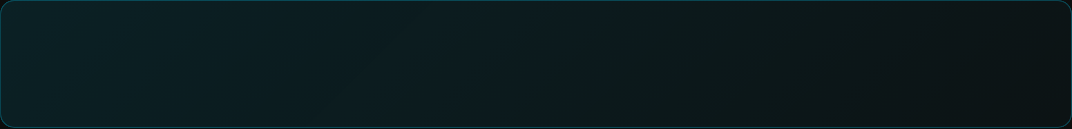
The Solution
Zero-knowledge proofs bridge the gap
Send XMR → Generate ZK Proof → Receive Wrapped Tokens
No intermediaries. No KYC. No revealed transaction details.
🔐
👁️
⚡
Trustless
Private
Permissionless
Cryptographic proofs replace trusted third parties
Transaction secrets never revealed on-chain
Anyone can bridge, anyone can provide liquidity
Ed25519 curve
Keccak256 hash
Groth16 SNARKs

Slide 4
How It Works
Four steps to trustless wrapped XMR
1
2
3
4
→
→
→
Send XMR
Generate Proof
Submit Proof
Receive zXMR
To LP stealth address
ZK-SNARK via circom
On-chain verification
ERC-20 tokens minted
THE ZK CIRCUIT PROVES
✓ Knowledge of tx secret
✓ Correct destination
✓ Payment to LP
✓ Encrypted amount

Slide 5
The Circuit
monero_bridge.circom — the cryptographic core
// Private inputs
r[255] → tx secret key
Prove R = r·G
Knowledge of transaction secret
v → amount
P_extended → stealth addr
Compute S = 8·r·A
Shared secret with cofactor
// Public inputs
Verify Destination
R_x → tx public key
Stealth address compression
ecdhAmount → encrypted
Decrypt Amount
A, B → LP keys
XOR with Keccak256 hash
// Output
~500k constraints • circom 2.1.0 • Groth16
verified_amount

Slide 6
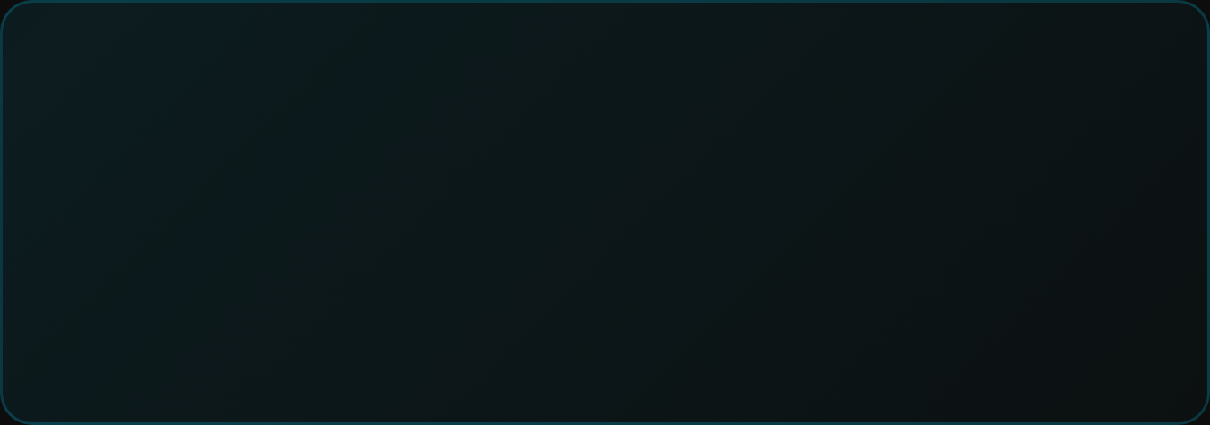

Security Model
Cryptographic guarantees at every layer
◉
#
8x
Ed25519 Curve
Keccak256 Hash
Cofactor Clearing
Monero-native elliptic curve operations ensure full compatibility
Standard Monero cryptographic primitive for all hashing
8·(r·A) ensures prime-order subgroup security
LP ADDRESS VERIFICATION
ON-CHAIN VERIFICATION
Public view/spend keys prevent address spoofing
Solidity verifier contract validates Groth16 proofs
LPs publish their keys on-chain. The circuit verifies payments are made to the correct address.
Every claim is cryptographically verified before tokens are minted.
Domain Separation: "amount" prefix in hash prevents collision attacks

Slide 7
Architecture
Four components working together
CIRCOM CIRCUIT
SOLIDITY VERIFIER
Proof Generation
On-chain Verification
Generates SNARK proof of Monero transaction validity
Groth16 proof verification in smart contract
↓
↓
LP NETWORK
TOKEN CONTRACT
Liquidity Providers
zXMR ERC-20
Decentralized LPs with published view/spend keys
Wrapped Monero with mint/burn capabilities
circom 2.1.0
snarkjs
ed25519-circom
keccak-circom

Slide 8
Why Zero XMR?
Value for every stakeholder
FOR USERS
FOR LPs
FOR DEVELOPERS
No KYC
Transparent Ops
Composable
No identity verification or trusted intermediaries
Published public keys enable verification
Standard ERC-20 token integrates anywhere
Privacy Preserved
Fraud-Proof
Auditable
Zero-knowledge proofs reveal nothing about your transaction
Cryptographic verification prevents fake claims
Open source circom + Groth16 proof system
Fee Revenue
Extensible
DeFi Access
Earn from bridge operations and liquidity provision
Use XMR in lending, DEXs, and yield protocols
Build privacy-preserving DeFi applications

Slide 9



Market Opportunity
Privacy demand is accelerating
$100M+
$3B+
$50B+
Daily XMR Volume
Monero Market Cap
Ethereum DeFi TVL
Locked out of DeFi
Seeking DeFi yield
Needs privacy options
MARKET DRIVERS
Exchange Delistings
On-chain Analysis
DeFi Maturation
CEX support for XMR declining globally
Surveillance increasing on public chains
Yields and products worth bridging for

Slide 10
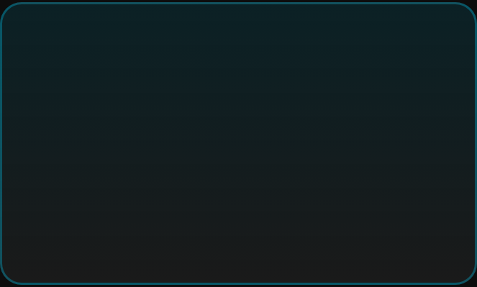
Roadmap
From proof-of-concept to production
NOW
Q1 2026
Q2 2026
Q3 2026
Circuit Complete
Testnet Launch
Mainnet Beta
Full Protocol
Ed25519 ops, ECDH decrypt, stealth verify, LP validation
Trusted setup, verifier, LP registry, testnet token
Security audits, frontend, LP onboarding, mainnet
DeFi integrations, SDK, multi-chain, governance
Current Implementation Status
Complete circom circuit
Ed25519 + Keccak256
ECDH amount decryption
Public input verification
Experimental software — not audited for production use

Slide 11
PRIVACY IS A RIGHT
Zero XMR
Bringing Monero's privacy to Ethereum through zero-knowledge cryptography
zeroxmr.com
github.com/zeroxmr
circom 2.1.0
Groth16 SNARKs
Ed25519
ERC-20

