Slide 1

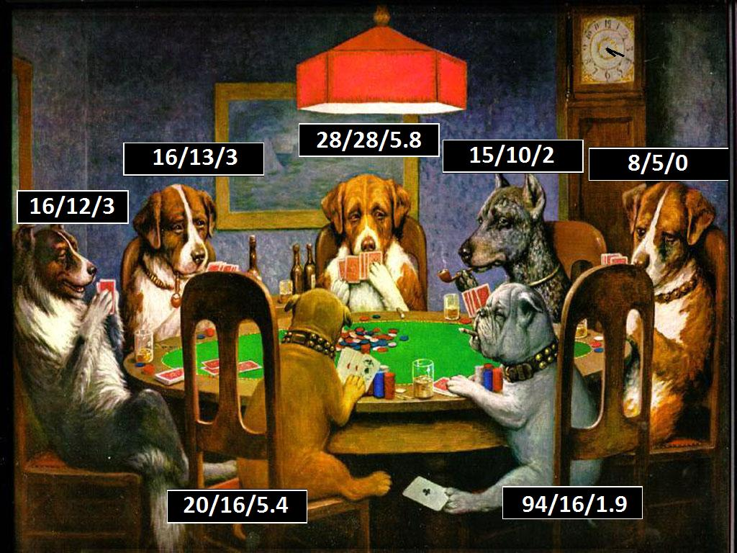
Data Collection Software And Online Poker: Is It Ethical?
By Zack McGinnis

Slide 2
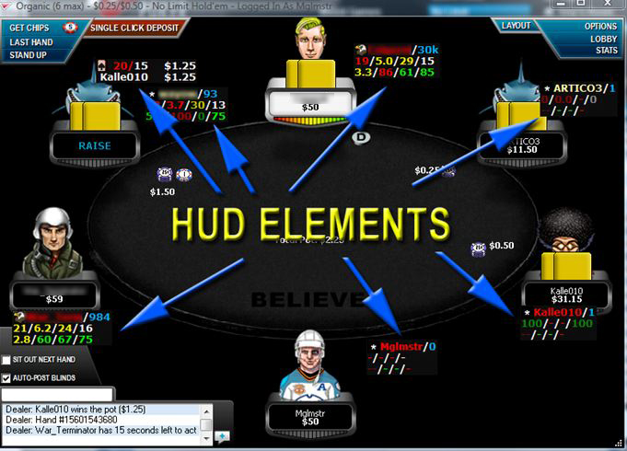
What Is It? How Does It Work?
Gathers hand history data from the poker client application (PokerStars, FullTilt Poker, etc...) for each unique player ID at the table with the user.
  A Heads Up Display (HUD) gives the user a breakdown of valuable statistics compiled for each player at the table.
    % of hands played, aggression factor, etc...
  PokerTracker ~ $159, HoldEm Manager ~ $100

Slide 3
Is It Legal?
These data collection applications can only track the play of other players while you are playing at a table with them.
  This ensures that the player would have access to the same data without the tracking software.
This type of tracking software is NOT illegal and does NOT violate the terms of use of most online poker sites.
  However, it is against the rules to import a database of statistics for players you have never played against.

Slide 4
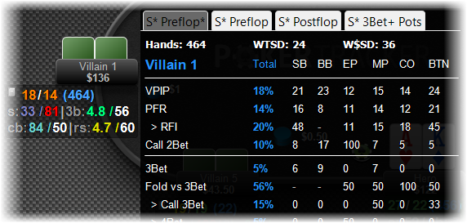
How Is It Useful?
These statistics can be used to give the user information about the tendencies of other players.
  E.g. Our HUD shows that, over a sample size of 1000 hands, our opponent is a tight player and doesn't play very many hands.
  We can infer that when he does play a hand, he more than likely has a quality holding.

Slide 5

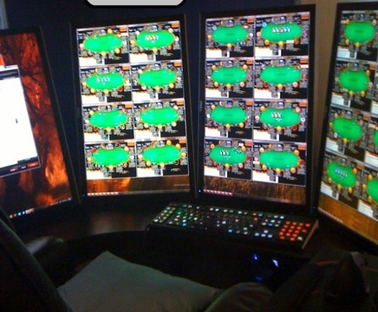
Is It Ethical?
Would we have this information otherwise?
  I suppose it is possible if we are only playing on one table.
    We can take notes, manually enter data into spreadsheets, etc...
What about players who play on multiple tables at the same time?

Slide 6
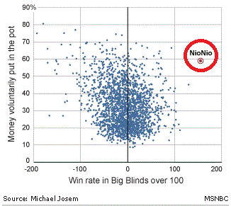
Cheating Scandals Exposed
UltimateBet.net - 2008
“NioNio” wins $300,000 in only 3,000 hands played.
Other players grew suspicious, began looking at gathered HUD data.
Compared NioNio's HUD data with ~1000 other players on UltimateBet.net
NioNio's win rate was 10 standard deviations above the mean.
“...the company acknowledged that NioNio and other player accounts 'did in fact have an unfair advantage' obtained through 'unauthorized software code that allowed the perpetrators to obtain hole card information during live play.'”
  ~$23,000,000 refunded to players.
  Investigation is ongoing.

Slide 7
Ethical Frameworks
Kantianism: would probably define the game of poker in general as morally wrong.
  Poker is a zero-sum game (in order to win, someone else must lose)
  You are directly taking advantage of others in order to achieve your goals.
Utilitarianism: weighs pro's and con's of tracking software as it applies to the greater good.
  Pro's: may help expose cheating, available to all players, may allow players to make more money,
  Con's: may gather data which a normal player would not be able to do manually
Where do you stand?

