Slide 1
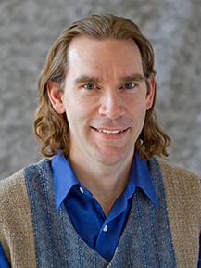
Data Enrichment Demo
Adding value to sales data through publicly available data sets
Martin Madsen
Ph.D. in Experimental Physics
16 years’ experience working with sensors, data collection, data analysis, and predictive model building

Slide 2


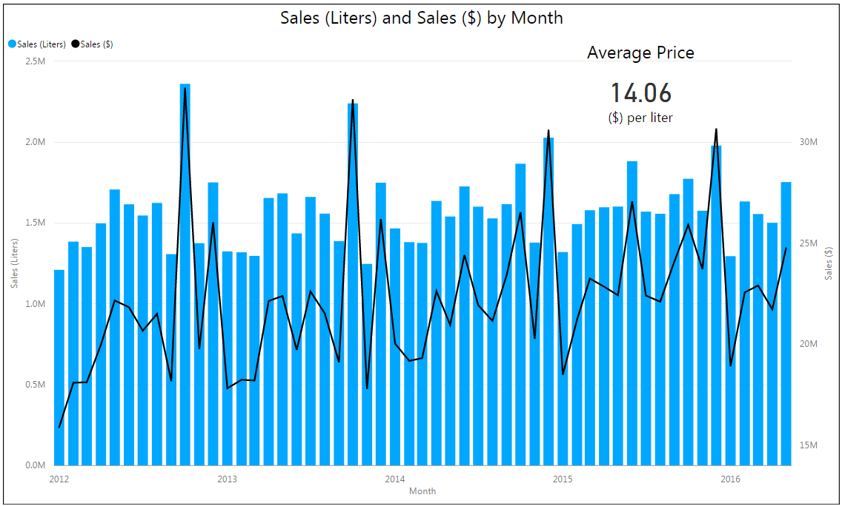
Data retrieved using REST API
Iowa Liquor Sales
This dataset contains the spirits purchase information of Iowa grocery stores, liquor stores, convenience stores, etc. of individual products at the store level.

Slide 3


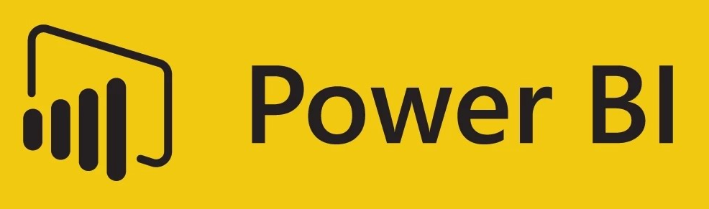
Data Enrichment Pipeline

Slide 4

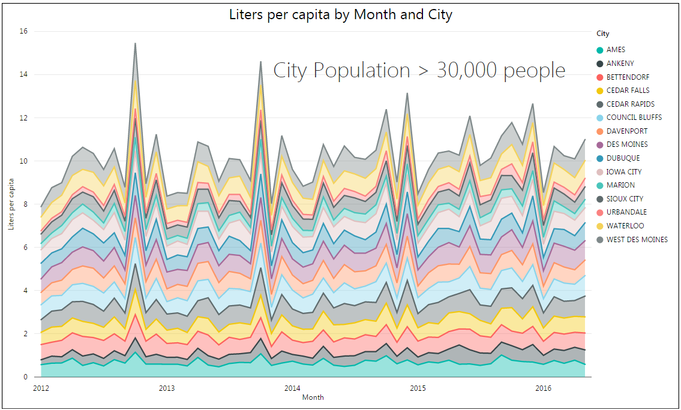
Data enriched by adding 2015 city population estimates from the US Census Bureau.

Slide 5
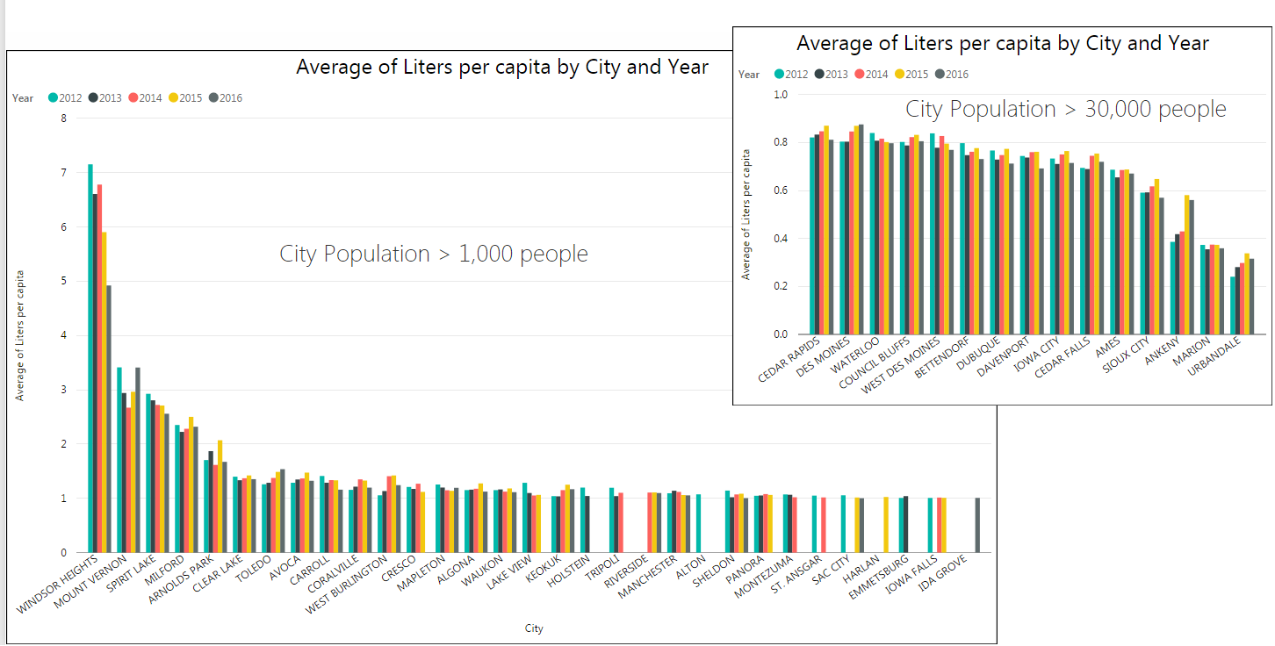
Which cities consume the most liquor?

Slide 6
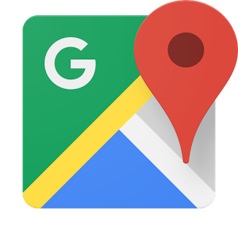
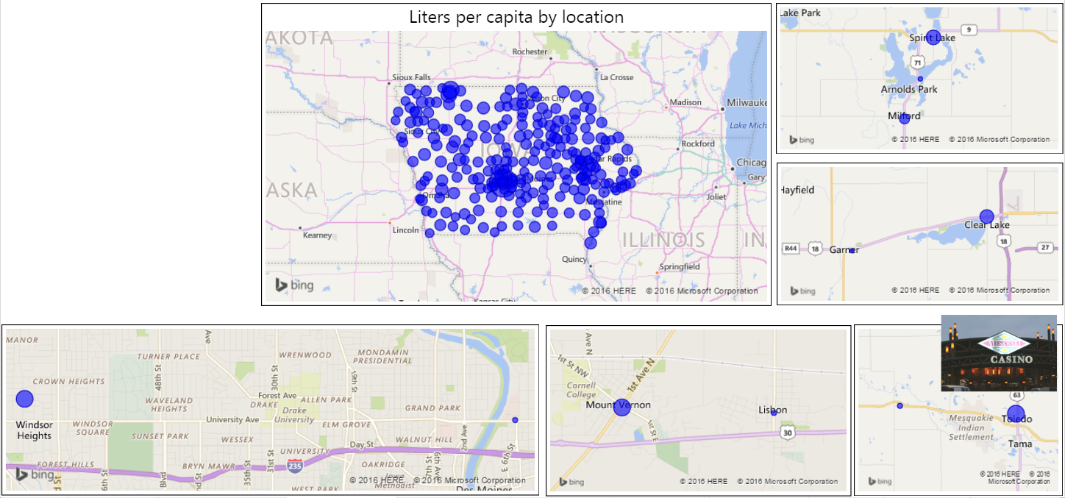
Data enriched using Google Maps API to get geographic latitude and longitude for cities.

Slide 7

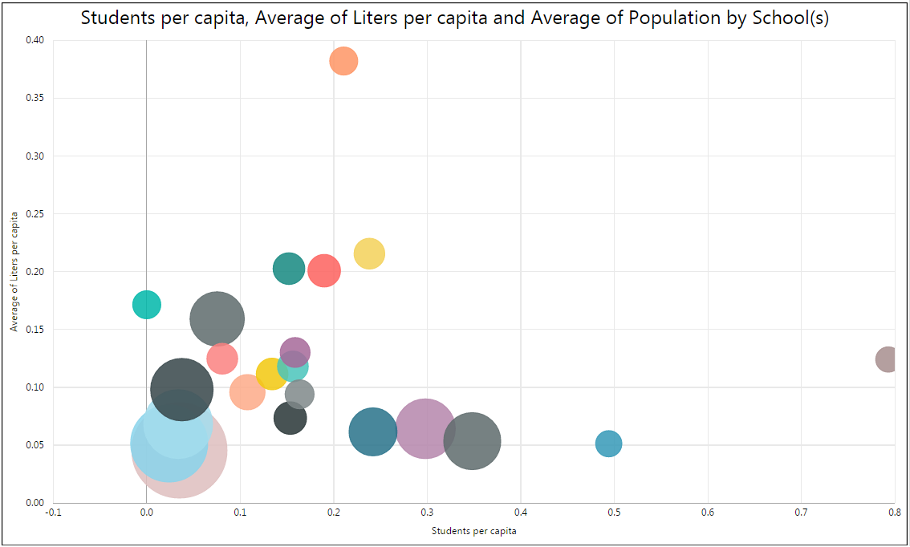
Cornell College
Data enriched using a Wikipedia list of colleges and universities in Iowa
Dataset limited to public and private, not-for-profit, 4-year colleges and universities.
Wartburg College
Cities with no college
Luther College
University
of
Iowa

Slide 8
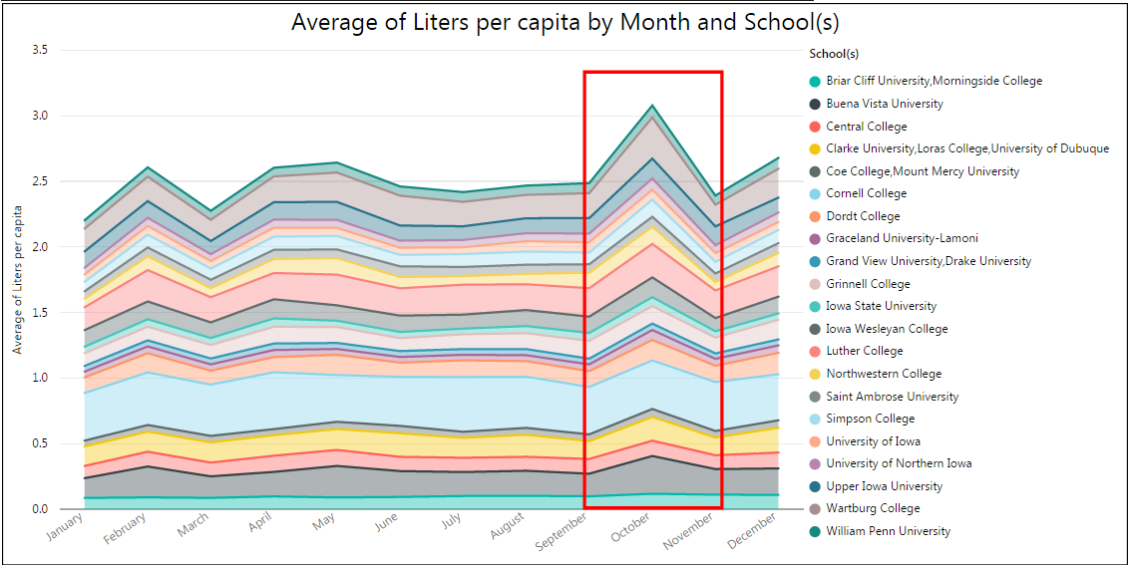
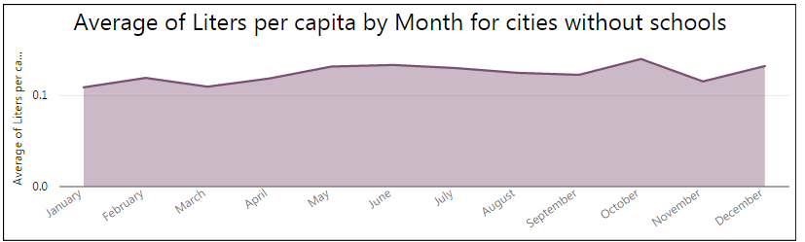
How does consumption change during the course of the year?
Cities with colleges tend to have a larger increase in October than cities without schools.

Slide 9


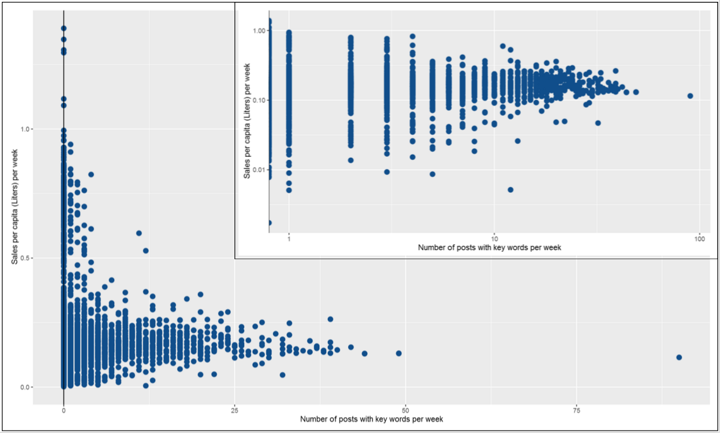
Do college athletics' social media posts correlate to sales?
Looked for key words: "game", "football", "basketball" - there is a slight correlation between the number of these key words in posts and the sales.

Slide 10
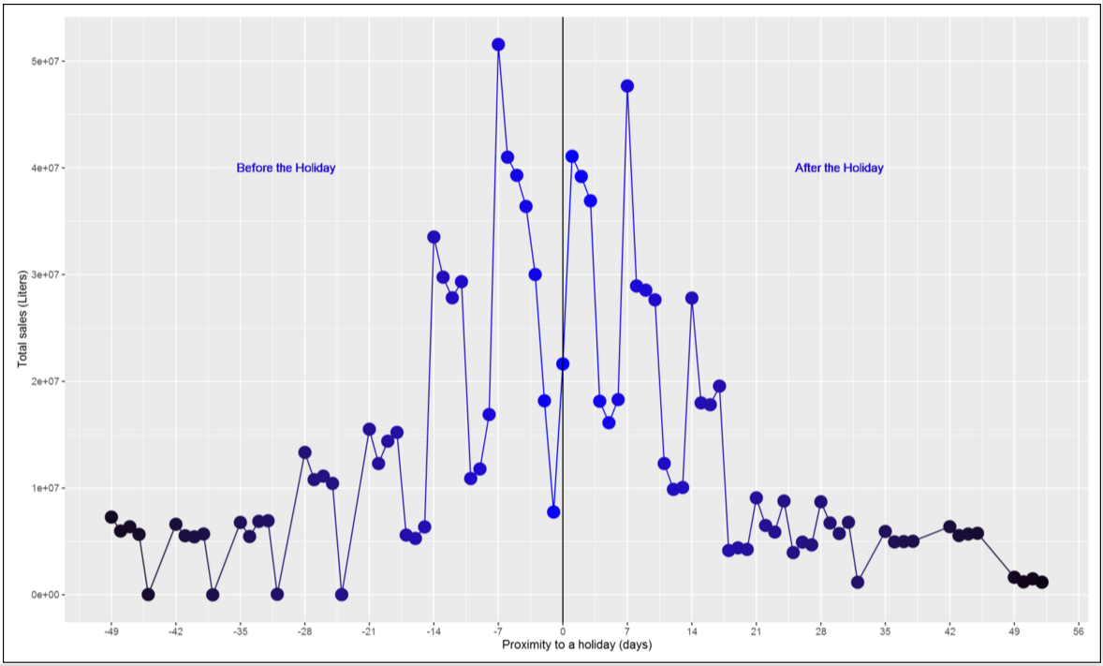
How does consumption change near holidays?
Data enriched by adding US Federal Holidays and then calculating the number of days to the nearest holiday.

Slide 11

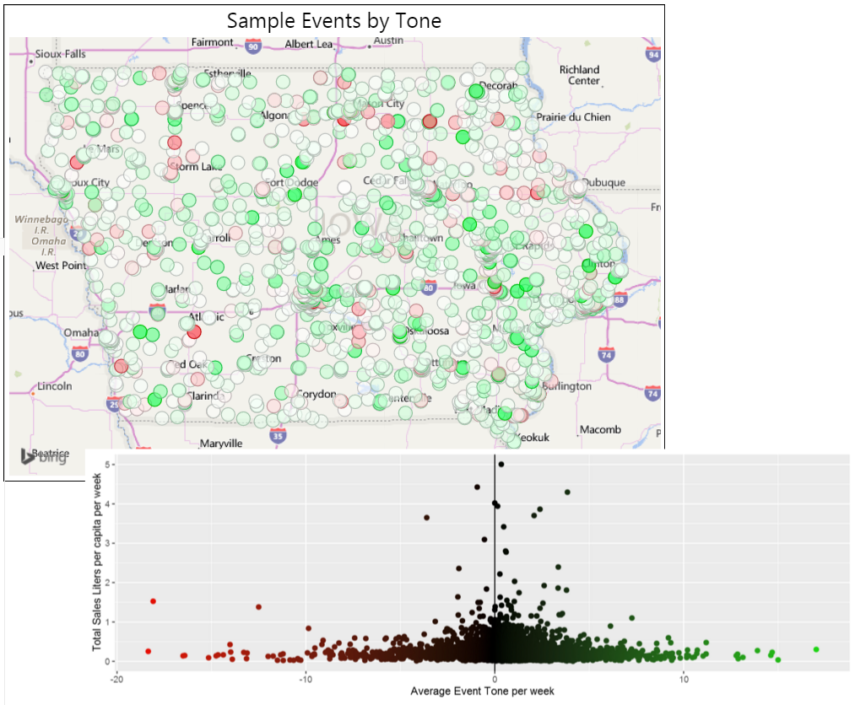
Global Database of Events, Language, and Tone (GDELT)
Events categorized by position and tone (positive or negative).
Iowa data from 2012-2016 extracted using Google BigQuery.
Proximity to cities in Iowa Liquor Sales data calculated and events assigned to nearest city.

Slide 12

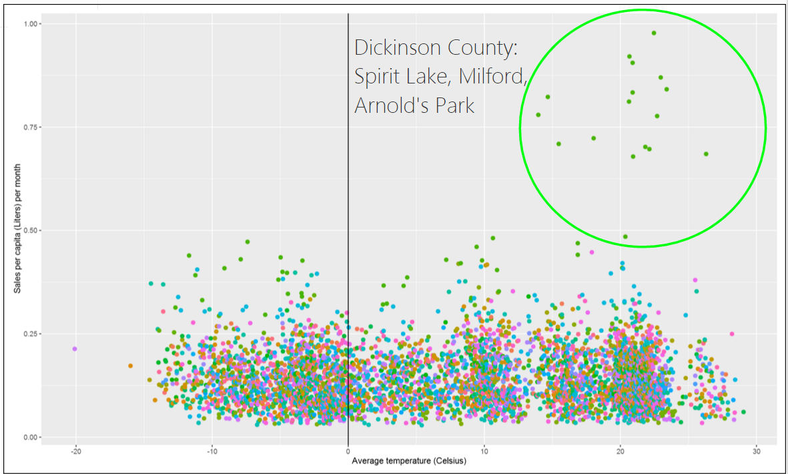
Are sales correlated with the weather?
Monthly weather summaries for each county in Iowa pulled from the Global Historical Climatology Network (GHCN) dataset.

Slide 13
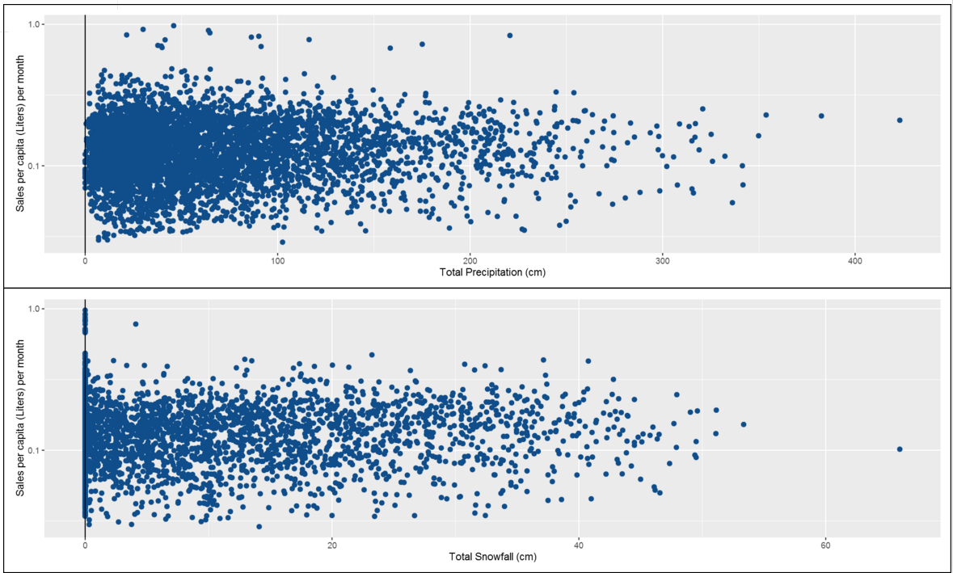
Are sales correlated with precipitation?
Monthly averages not correlated with purchases from stores.

Slide 14
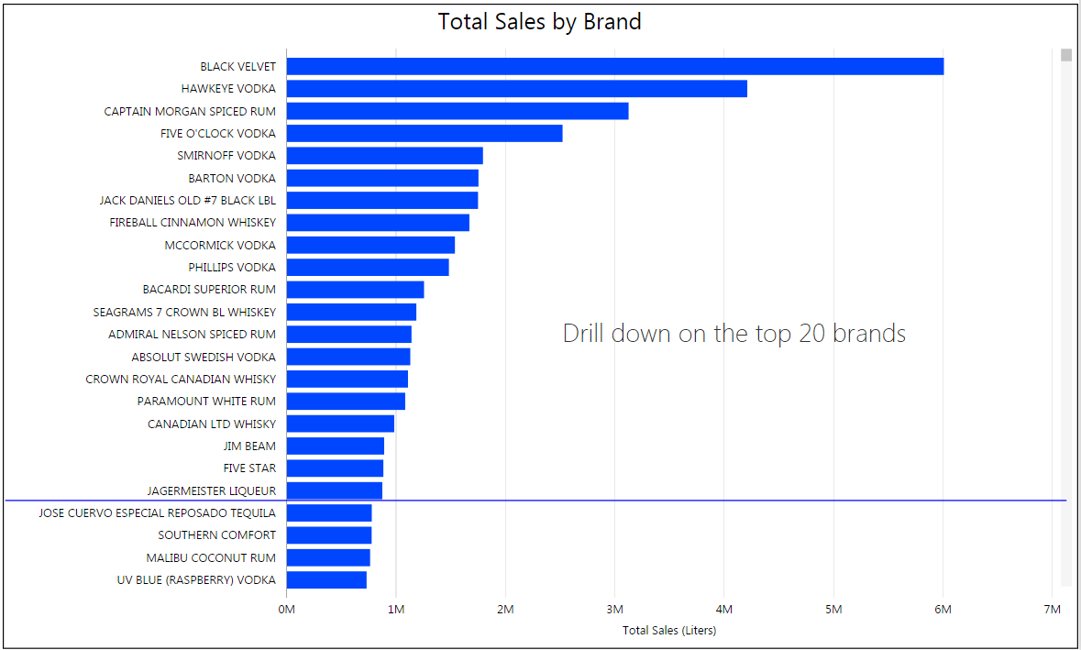
What are the top-selling liquor brands?

Slide 15
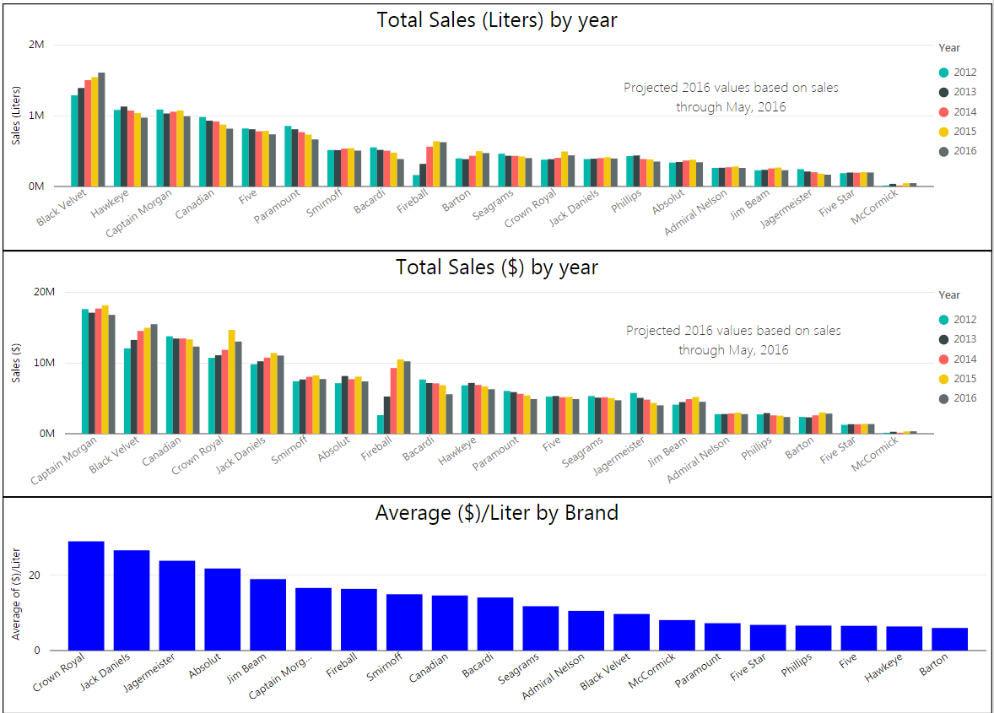
What are the trends in the top-selling brands?
How do sales ($) compare to sales (Liters) for these brands?

Slide 16

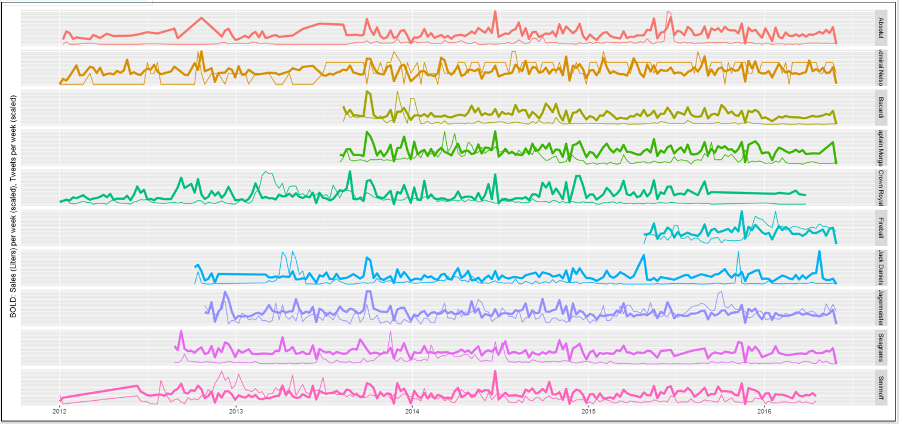
How do social media posts affect sales volume?

Slide 18
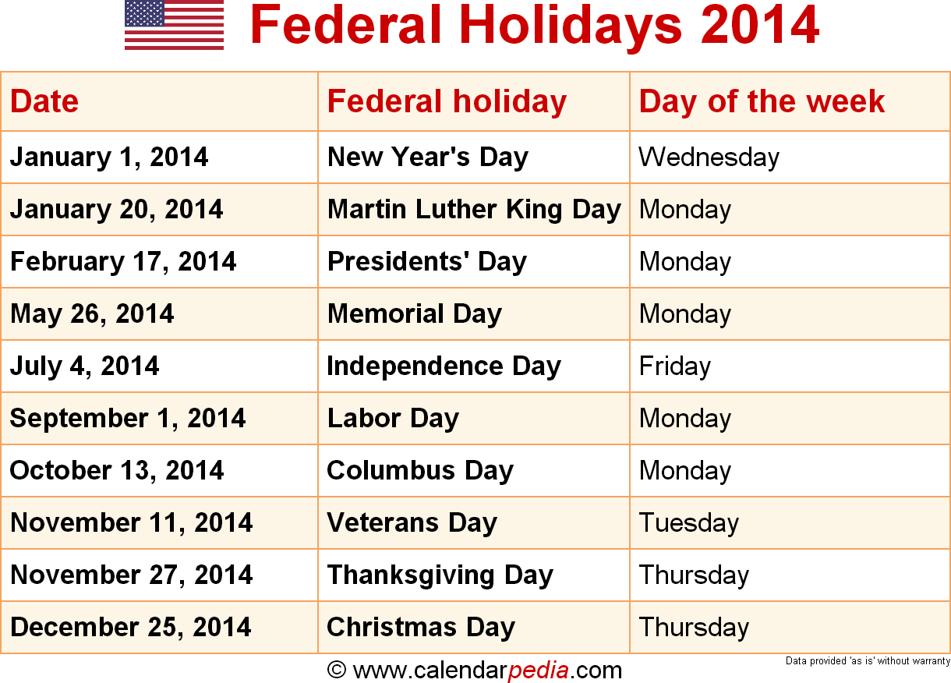
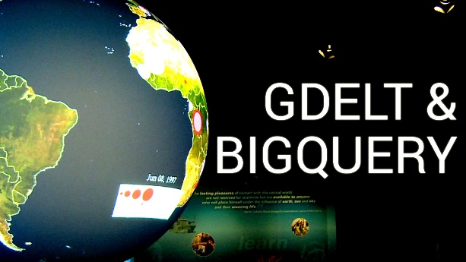

Slide 19
Thank You!
Questions, comments, or further conversation:
Martin John Madsen
https://www.linkedin.com/in/martinjohnmadsen
Notes:
[Josh’s Slide]

