Slide 1

Using IoT to Enrich Enterprise Data
Beyond point-of-sale analytics
Martin Madsen
Ph.D. in Experimental Physics
16 years’ experience working with sensors, data collection, data analysis, and predictive model building

Slide 2



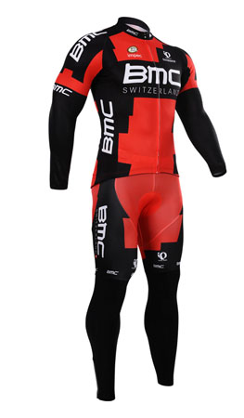
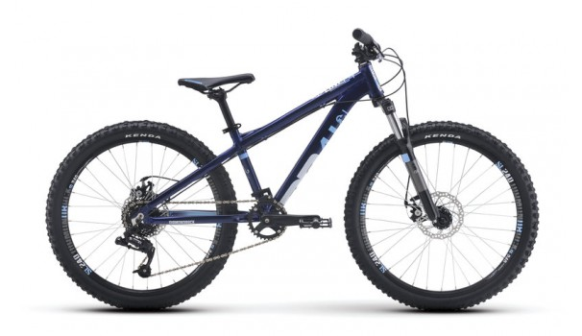
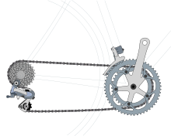

Bikes
Components
Clothes
Accessories

Slide 3
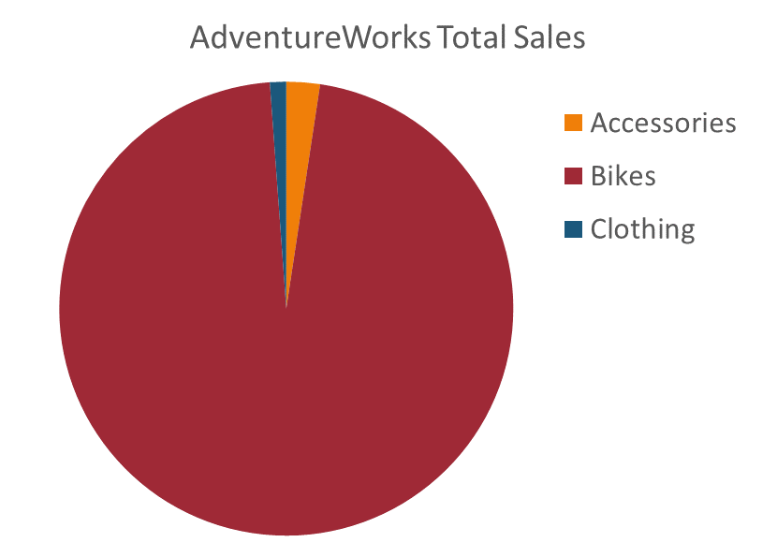
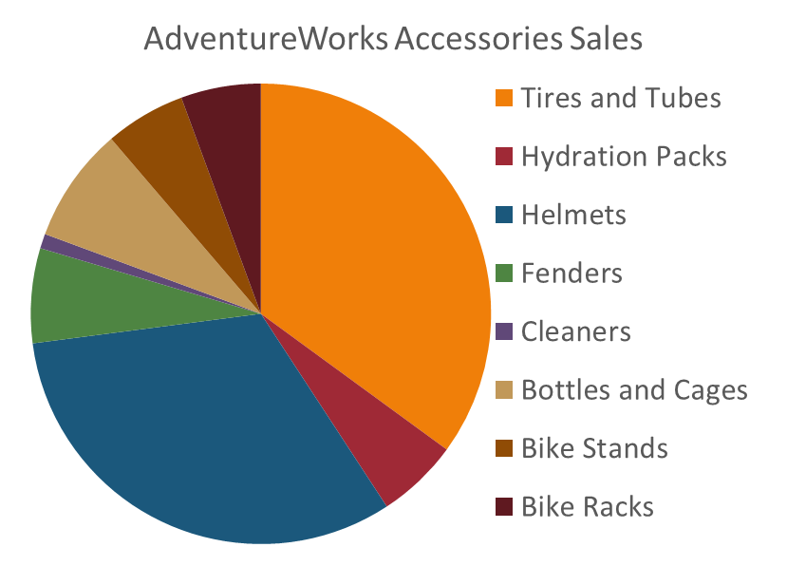
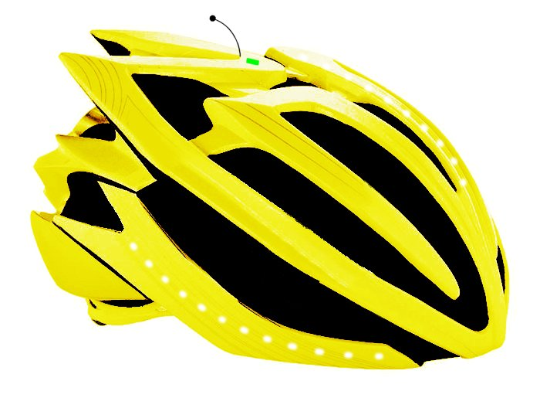
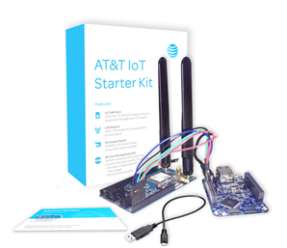
AdventureWorks IoT Project
GPS Receiver
Latitude/Longitude
Time
Accelerometer
Impact/Crash
Mobile Transmitter

Slide 4
Internet of Things
Things
Connectivity
Data
Analytics
Action
Hot
Data Stream: Real-time alerts
Cold
Data Stream: Patterns and trends
Microsoft IoT Webinar 2016

Slide 5
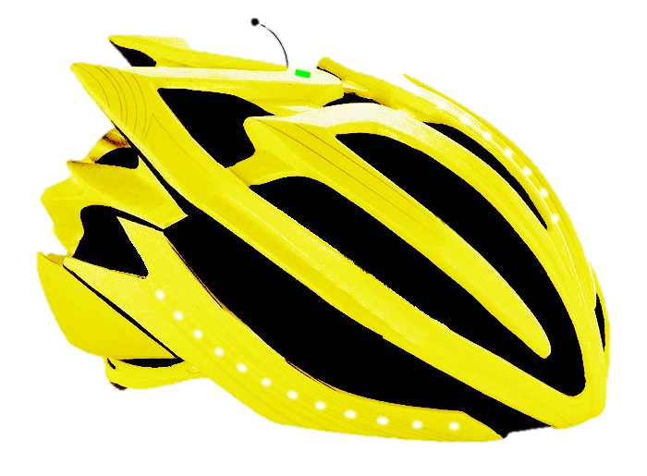




Hot
Data Stream:
Real-time alerts
IoT Data Source
Azure IoT Hub
Azure Stream Analytics

Slide 6
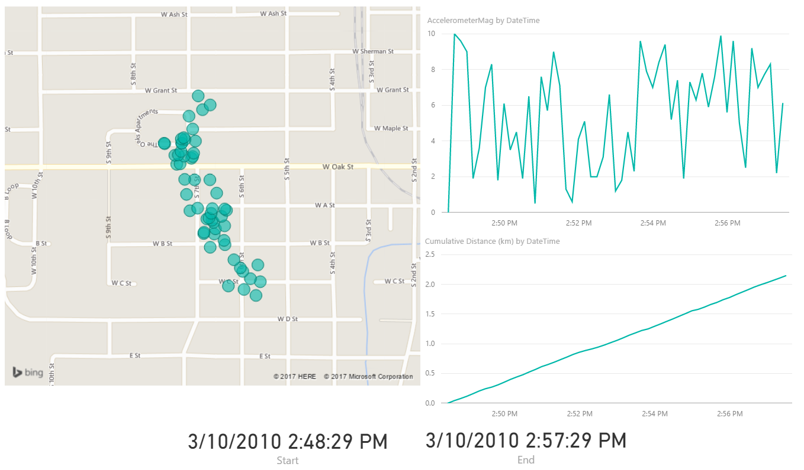
Hot Data Stream Dashboard

Slide 7

Azure Blob Storage
IoT Data Source
Azure IoT Hub
Azure Stream Analytics

Slide 8
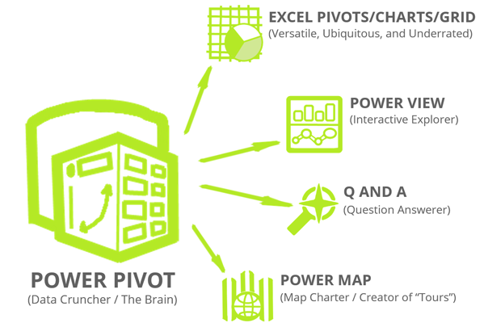



Cold
Data Stream:
Patterns and trends
Azure Blob Storage
Enterprise
Data
Hadoop
Processing
Data Analysis

Slide 9


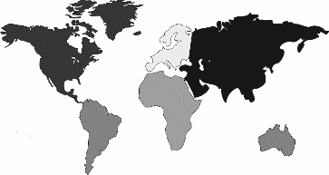
Accident Data
Time Tracking Data
Geotag Data
Notes:
IoT Question
How often and for how long do our customers use the product?
How often does the product have problems?
Where are our customers using the product?
Enterprise Question
How does our product lifecycle keep our customers engaged?
What would the ROI be if we supplied the product as a service (PaaS)?
In what markets could we most readily expand?

Slide 10
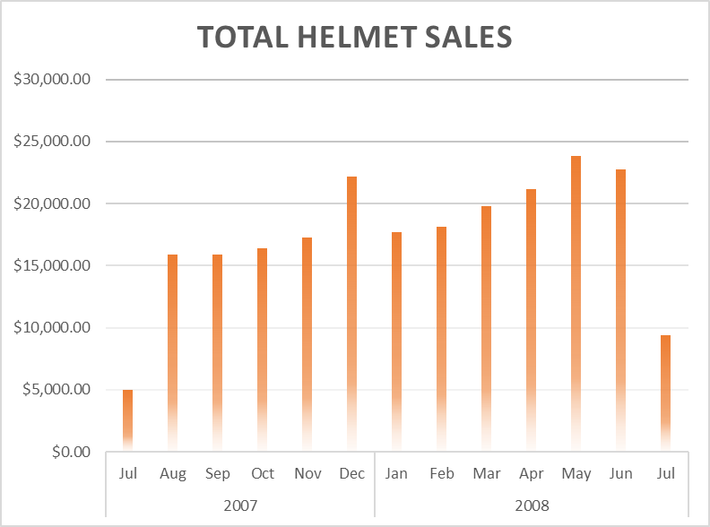
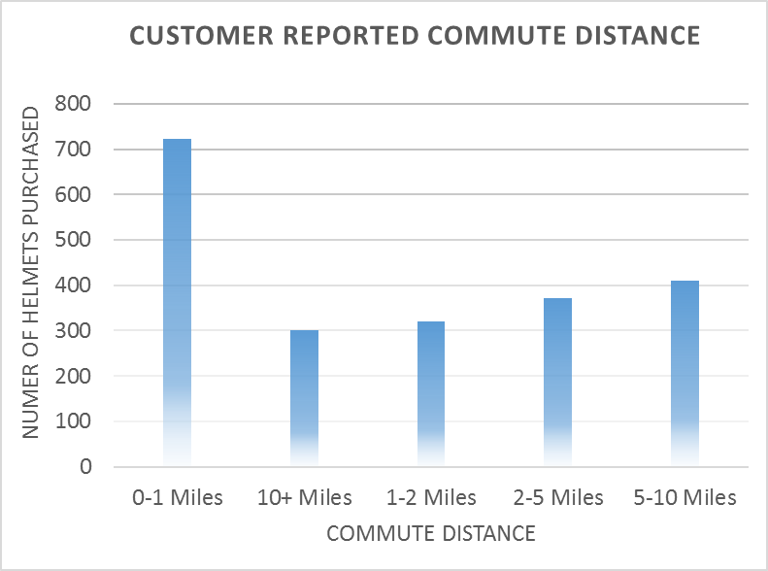
Traditional Enterprise Data

Slide 11
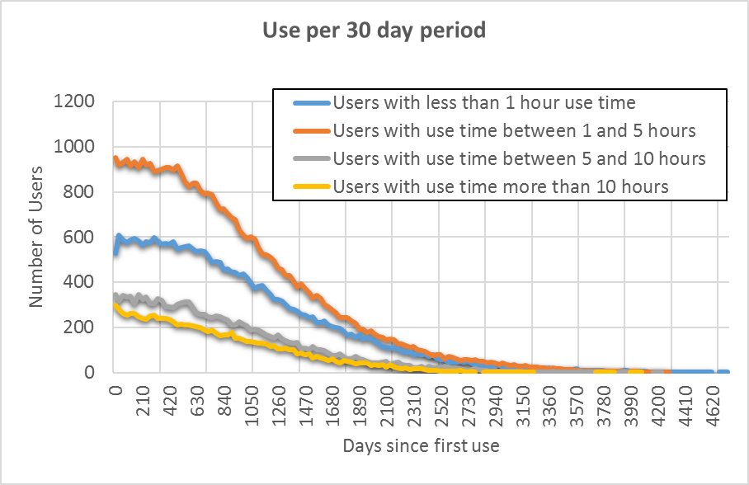
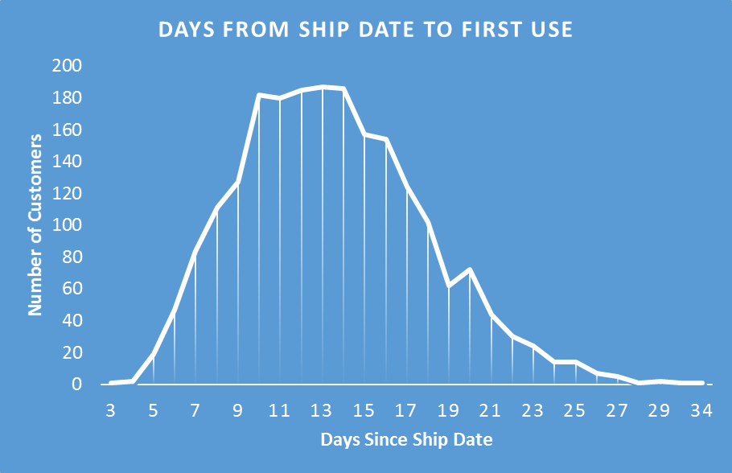
IoT Enriched Data

Slide 12
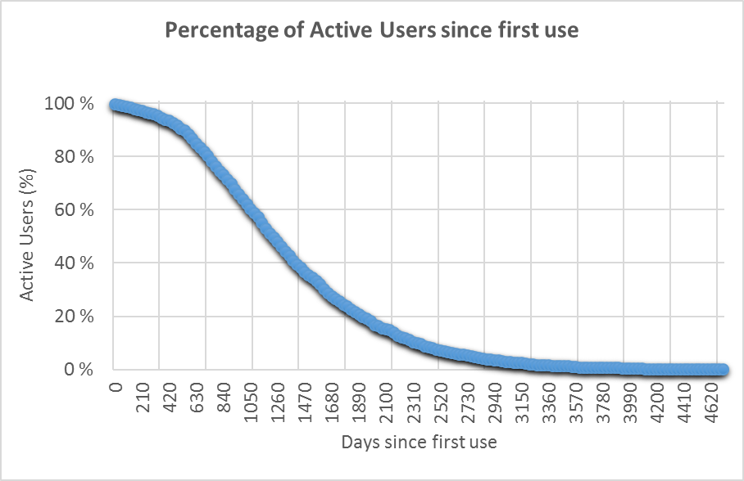
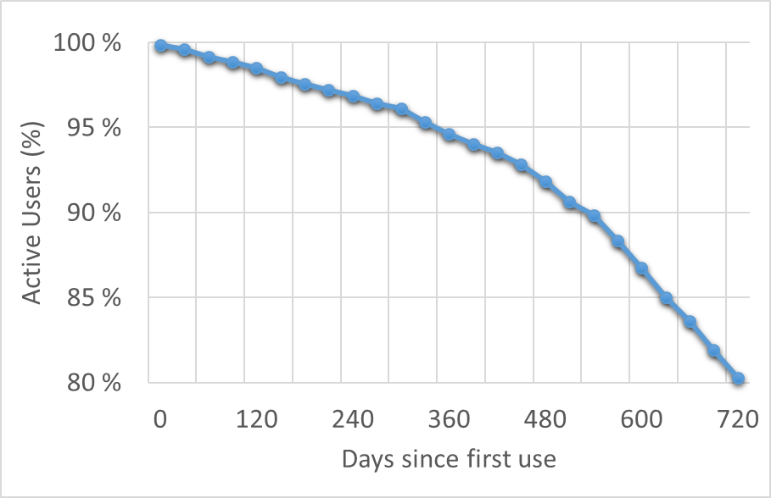
IoT Enriched Data
New Product Releases

Slide 13
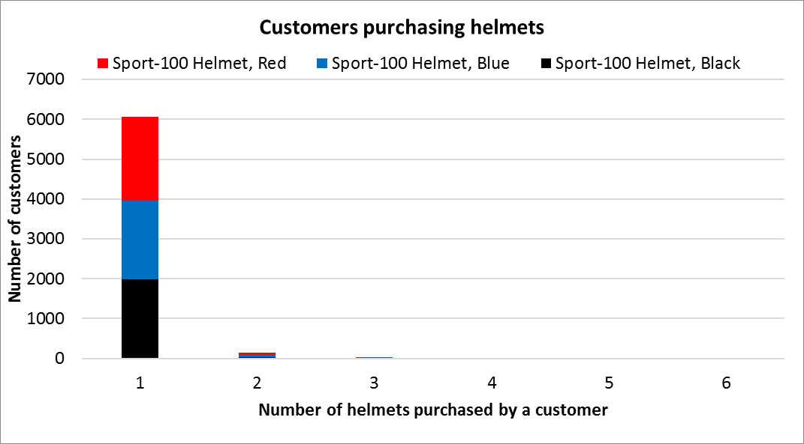
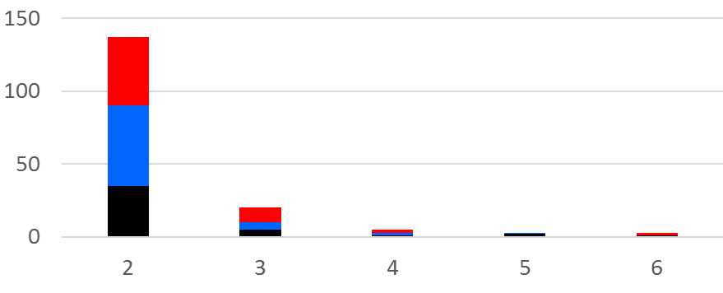
Traditional Enterprise Data

Slide 14
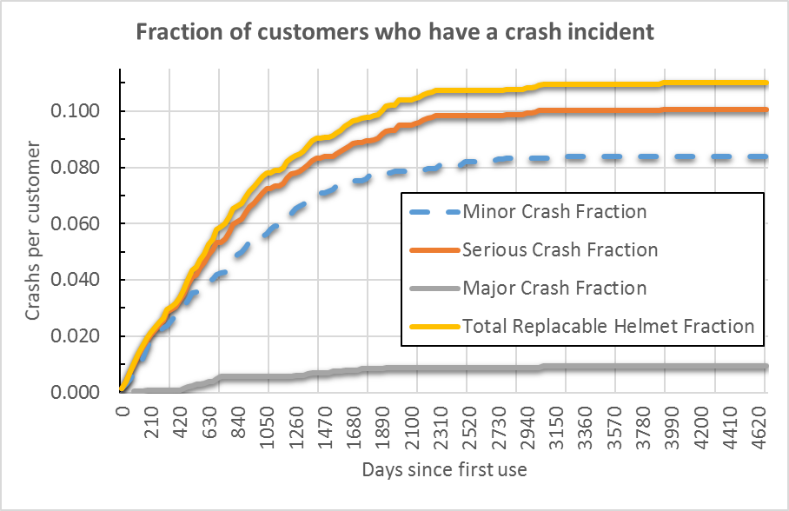
IoT Enriched Data
Warranty cost
Production cost
> (0.11)

Slide 15

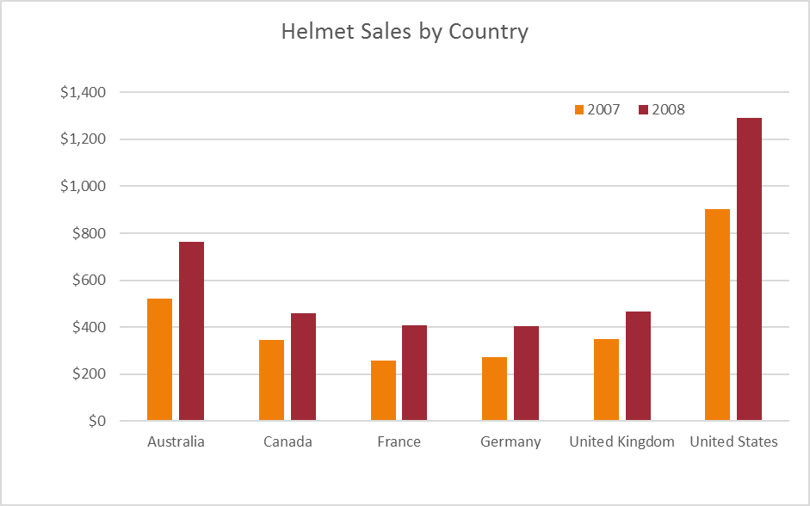
Traditional Enterprise Data

Slide 16
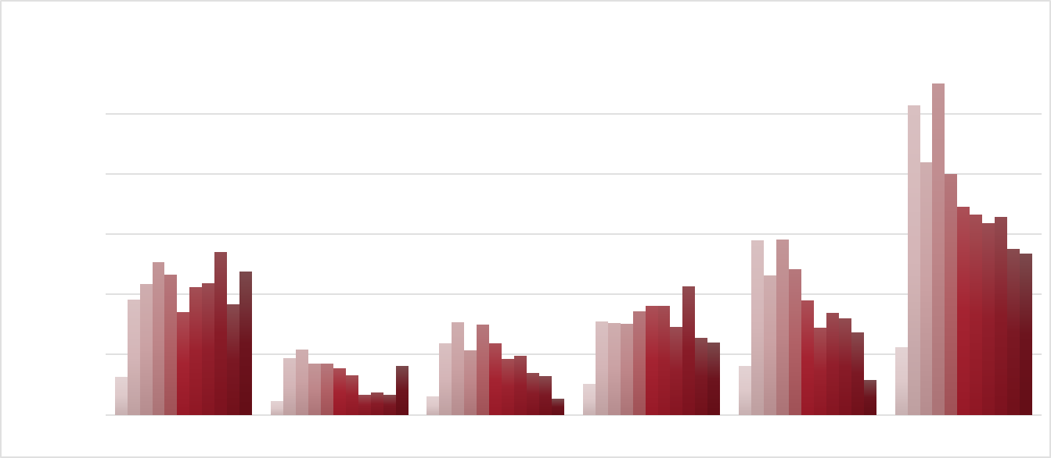
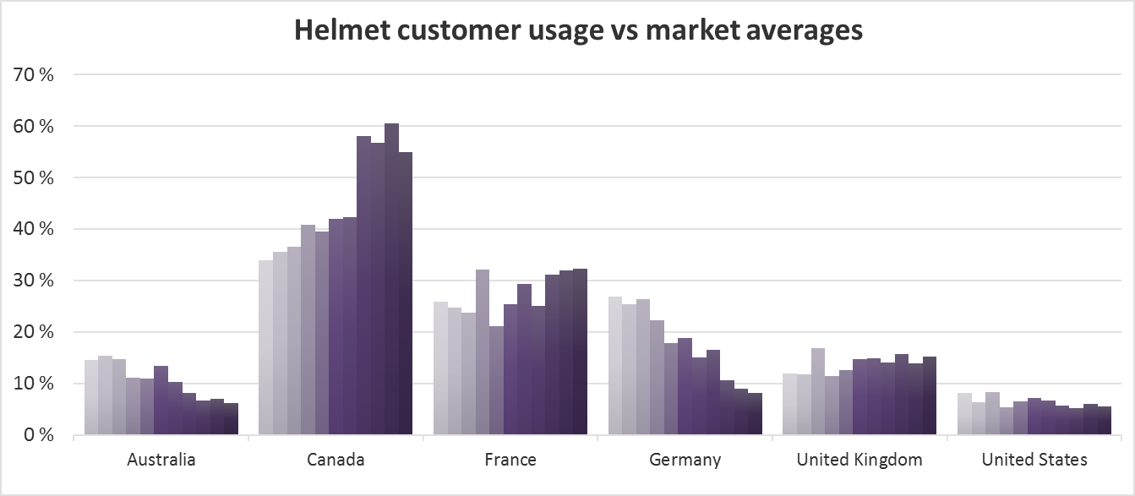
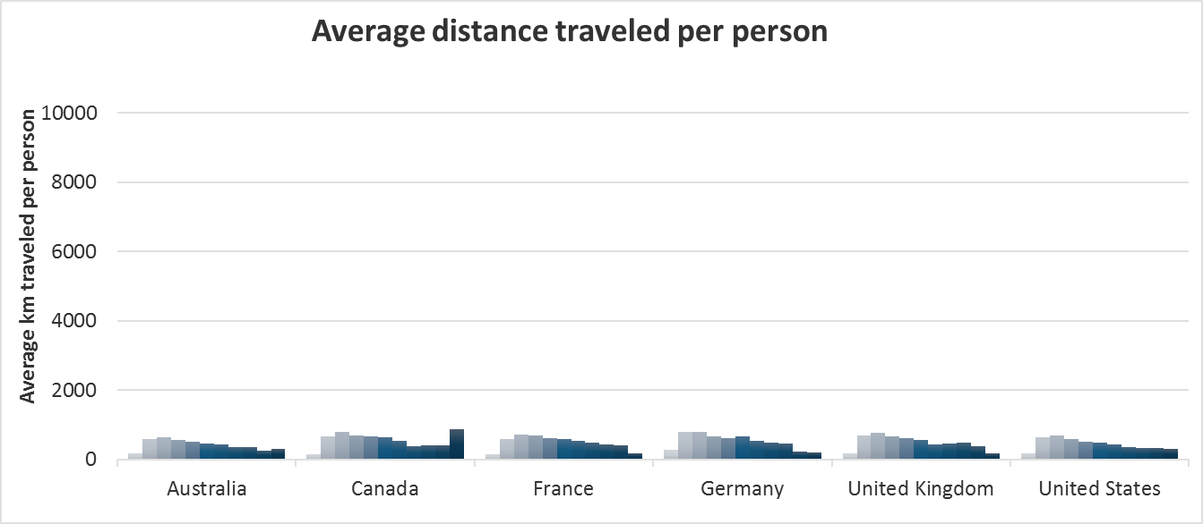
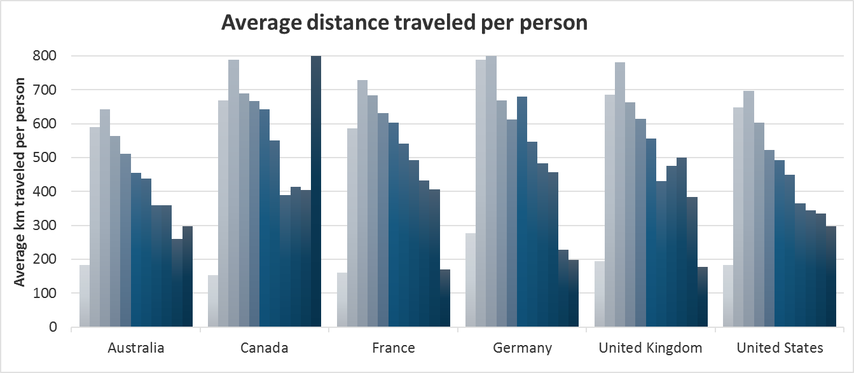
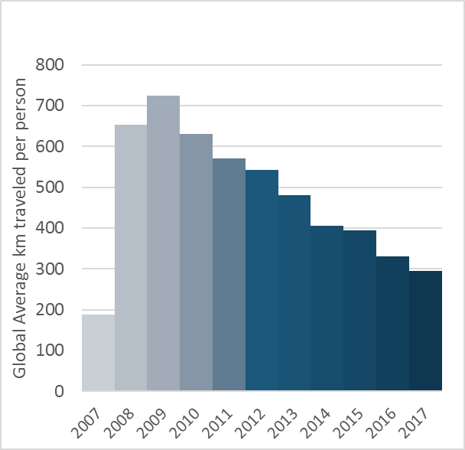
IoT Enriched Data
Market average distance per person

Slide 17
Things
Connectivity
Data
Analytics
Action
Cold
Data Stream: Patterns and trends

Slide 18
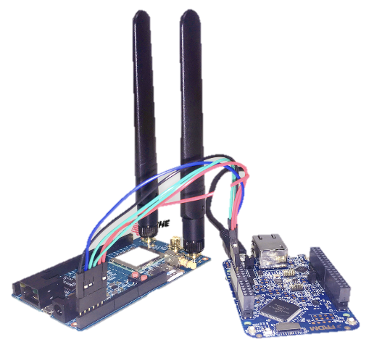

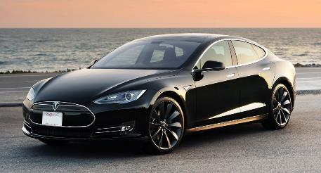

Rolls Royce Aircraft Engines
IoT Data Source
Tesla Model S
Thyssenkrupp Elevator Monitoring

Slide 19
Thank You!
Questions, comments, or further conversation:
Martin John Madsen
https://www.linkedin.com/in/martinjohnmadsen
Notes:
[Josh’s Slide]

