Slide 1
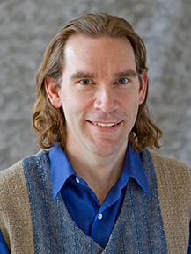
An Internet of Things (IoT) Use Case Demo
Optimizing Resource Usage
Martin Madsen
Ph.D. in Experimental Physics
16 years’ experience working with sensors, data collection, data analysis, and predictive model building

Slide 2
Internet of Things
Things
Connectivity
Data
Analytics
Action
Microsoft IoT Webinar 2016

Slide 3







Enterprise IoT Projects
Optimizing fleet and asset utilization
Reducing facility operating costs
Improving safety and security
Automating supply-chain processes
Building connected products and services
Improving cities and public spaces
Vodafone IoT Barometer 2016

Slide 4
Enterprise IoT Projects
Optimizing fleet and asset utilization
Reducing facility operating costs
Improving safety and security
Automating supply-chain processes
Building connected products and services
Improving cities and public spaces
Vodafone IoT Barometer 2016

Slide 5
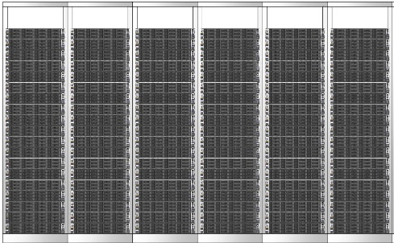
IoT Scenario
Aircraft
Medical devices
Oil distribution
Power plant
Vending machines
Buildings
IoT Hub
Postboxes
Engines
Things

Slide 6
Device has resources to utilize
Aircraft
Medical devices
Oil distribution
Power plant
Vending machines
Buildings
IoT Hub
Postboxes
Engines
Things

Slide 7
Device has resources to utilize
?
Which option is best?
Medical devices
Aircraft
Oil distribution
Power plant
Vending machines
Buildings
IoT Hub
Postboxes
Engines
Things
Notes:
Options on resource utilization

Slide 8
Device has resources to utilize
Send options to IoT hub for evaluation
?
Aircraft
Medical devices
Oil distribution
Power plant
Vending machines
Buildings
IoT Hub
Postboxes
Engines
Things

Slide 9
Device has resources to utilize
Hub evaluates choices using machine learning
?
Aircraft
Medical devices
Oil distribution
Power plant
Vending machines
Buildings
IoT Hub
Postboxes
Engines
Things

Slide 10
Device has resources to utilize
?
Aircraft
Medical devices
Oil distribution
Power plant
Vending machines
Buildings
Hub returns best choice to device
IoT Hub
Postboxes
Engines
Things

Slide 11
Device uses resource
Aircraft
Medical devices
Oil distribution
Power plant
Vending machines
Buildings
IoT Hub
Postboxes
Engines
Things

Slide 12
Return outcome to hub for analysis and adaptive learning
Aircraft
Medical devices
Oil distribution
Power plant
Vending machines
Buildings
IoT Hub
Postboxes
Engines
Things

Slide 13


IoT Hub
“Thing” = Movie Studio

Slide 14

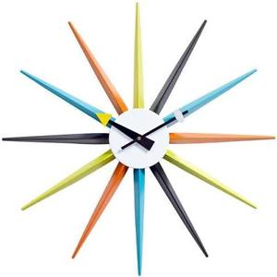

Director
Year
Genre
“Thing” = Movie Studio

Slide 15
Result = Viewer Rating
Year
Director
Genre
“Thing” = Movie Studio

Slide 16
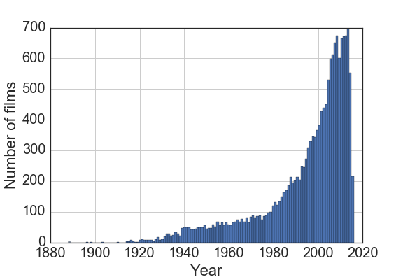

Historical Data
16,470 films
www.omdbapi.com

Slide 17
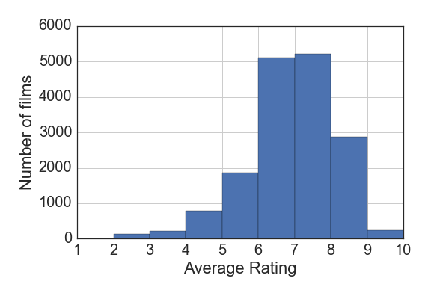
Historical Data
www.omdbapi.com

Slide 18
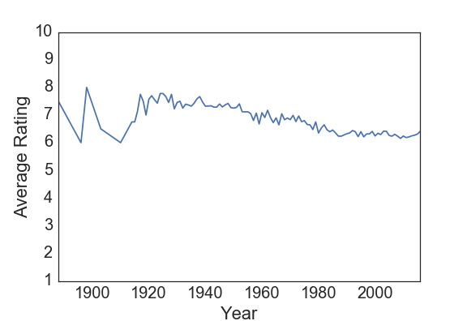
Historical Data
www.omdbapi.com

Slide 19
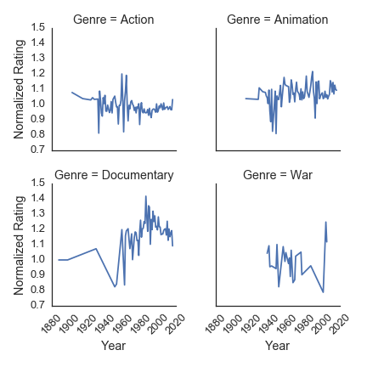
Historical Data
www.omdbapi.com

Slide 20
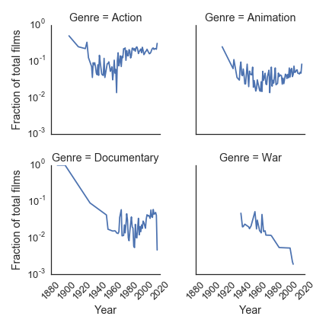
Historical Data
www.omdbapi.com

Slide 21
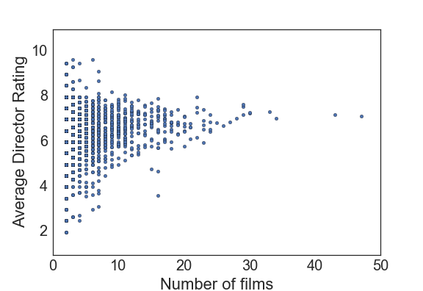
Historical Data
www.omdbapi.com

Slide 22
Historical Data
www.omdbapi.com

Slide 23
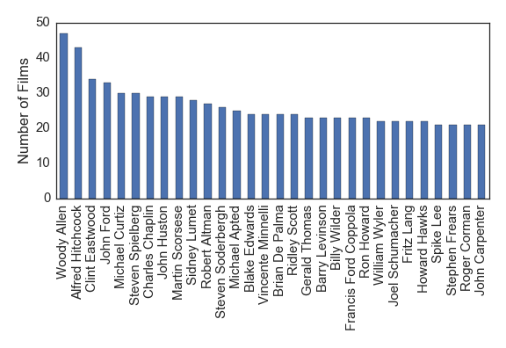
Historical Data
www.omdbapi.com

Slide 24
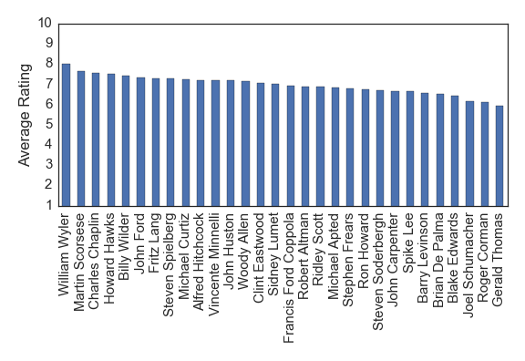
Historical Data
www.omdbapi.com

Slide 25


Train Model
www.omdbapi.com
AWS Machine Learning
AWS S3

Slide 26
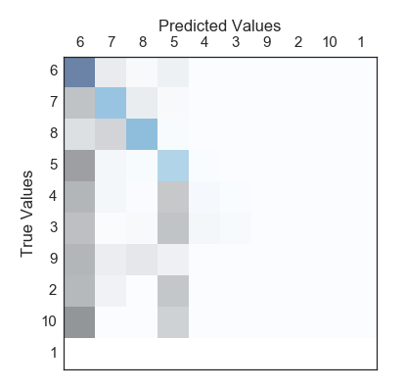
Train Model
www.omdbapi.com
AWS Machine Learning
AWS S3

Slide 27
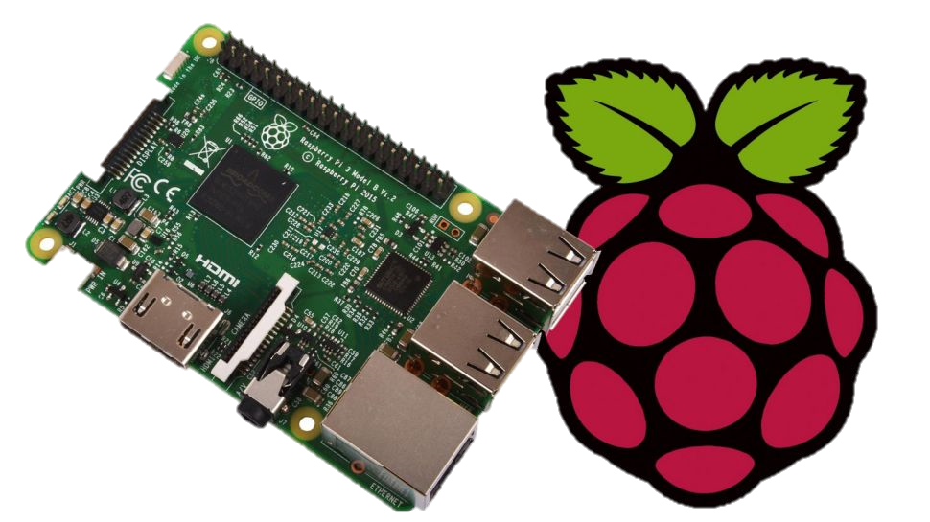
Start with Choices
Director:

Slide 28
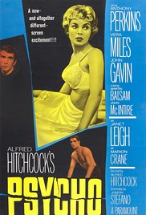
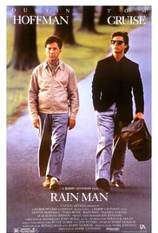

Alfred Hitchcock
(1960)
Barry Levinson
(1988)
Start with Choices
Start with Choices
Director:
Spike Lee
(1992)

Slide 29
Directors
Genres
Years
Alfred Hitchcock
Comedy/Drama/Action
1914
Barry Levinson
Comedy/Short
1981
Start with Choices
Spike Lee
Drama
1997
War/Comedy

Slide 30

Request Prediction
via MQTT
AWS Python
SDK
AWS IoT

Slide 31

Event Triggers
Lambda script
AWS IoT
AWS Lambda

Slide 32
Script retrieves
prediction
AWS IoT
AWS Lambda
AWS Machine Learning

Slide 33
Return Prediction
AWS IoT
AWS Lambda
AWS Machine Learning

Slide 34
Send message
back to device
AWS IoT
AWS Lambda
AWS Machine Learning

Slide 35
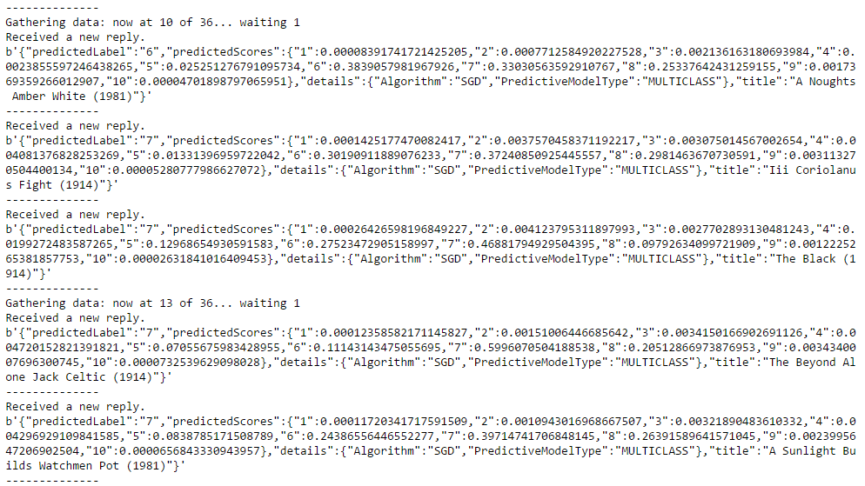

Slide 36
Device makes
decision,
Gets outcome
AWS IoT
AWS Lambda
AWS Machine Learning

Slide 37
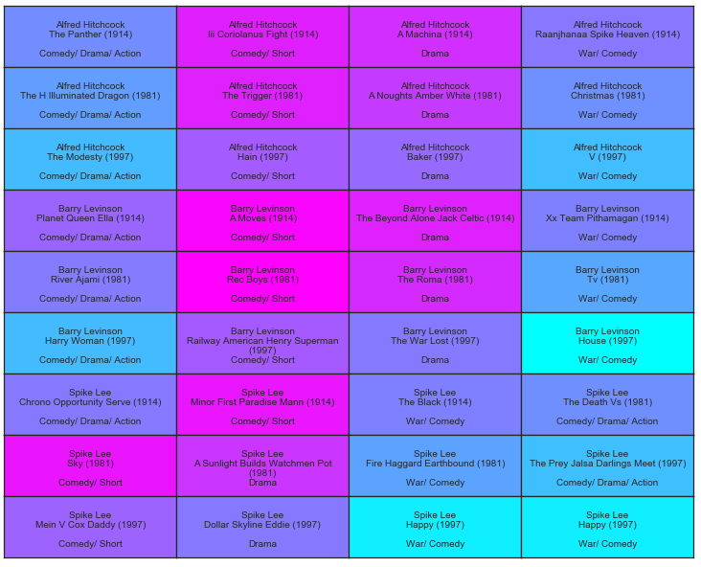
Highest Predicted Score
Lowest Predicted Score

Slide 38
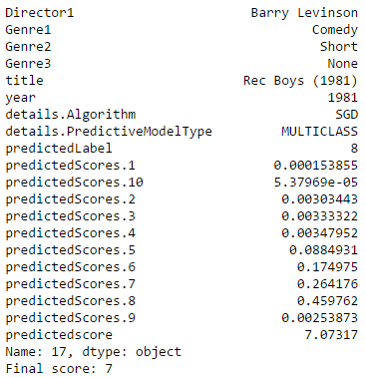
Final Score: 7/10 stars

Slide 39
Send outcome
via MQTT
AWS IoT

Slide 40
Outcome triggers
storage script
AWS IoT
AWS Lambda

Slide 41

Store outcome
for future learning
AWS DynamoDB
AWS IoT
AWS Lambda
AWS S3

Slide 42
Improve model
using new data points
AWS S3
AWS Lambda
AWS Machine Learning

Slide 43

Monitor Performance
AWS DynamoDB

Slide 44
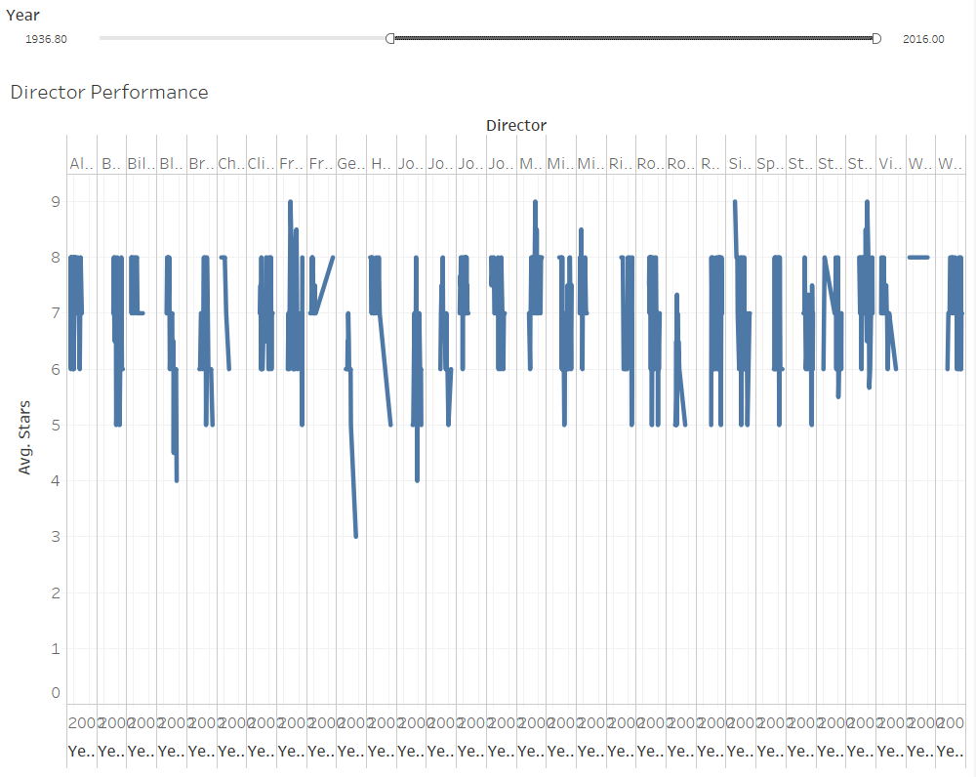

Slide 45

Summary
Monitor
outcomes
Request for
prediction
Aircraft
Medical devices
Data Flow
Oil distribution
Power plant
Vending machines
Buildings
IoT Hub
Results to
improve model
Postboxes
Engines
Things

Slide 46
Thank You!
Questions, comments, or further conversation:
Martin John Madsen
https://www.linkedin.com/in/martinjohnmadsen
Notes:
[Josh’s Slide]

