Slide 1
Reaching Predictive Analytics
IoT and Machine Learning Demo

Slide 2

Martin John Madsen, Ph.D.
Senior Data Analytics Consultant
15+ years’ experience working with data gathering, analysis, and predictive analytics

Slide 3





Data Analytics Maturity Model
Process & Data Mapping
Predictive Analytics
Prescriptive Analytics
Descriptive Analytics
HIGH
FORESIGHT
AGILITY
ACCESS
INSIGHT
Prescriptive Analytics
BUSINESS VALUE
Predictive Analytics
Descriptive Analytics
LOW
BASIC
SKILLS
ADVANCED

Slide 4
Business Use Case

Slide 5



















Business Use Case
CLIENTS
RESOURCES
OUTCOMES

Slide 6





HEALTH CARE DEMO
Clients
Resources
OUTCOMES
KPI: Average Outcome Movement
+1
0
-1

Slide 7
Demo Scenario
Clients
Resources
?
Optimize
Outcome

Slide 8
Data Analytics Maturity Model
Predictive Analytics
Prescriptive Analytics
Descriptive Analytics
HIGH
What were past outcomes?
What might future outcomes be?
How do we get the best outcome possible?
Prescriptive Analytics
BUSINESS VALUE
Predictive Analytics
Descriptive Analytics
LOW
BASIC
SKILLS
ADVANCED

Slide 9
Descriptive Analytics
Clients
Resources
OUTCOMES
+1
0
-1

Slide 10
Data Analytics Maturity Model
Descriptive Analytics
HIGH
What were past outcomes?
Prescriptive Analytics
BUSINESS VALUE
Predictive Analytics
Descriptive Analytics
LOW
BASIC
SKILLS
ADVANCED

Slide 11
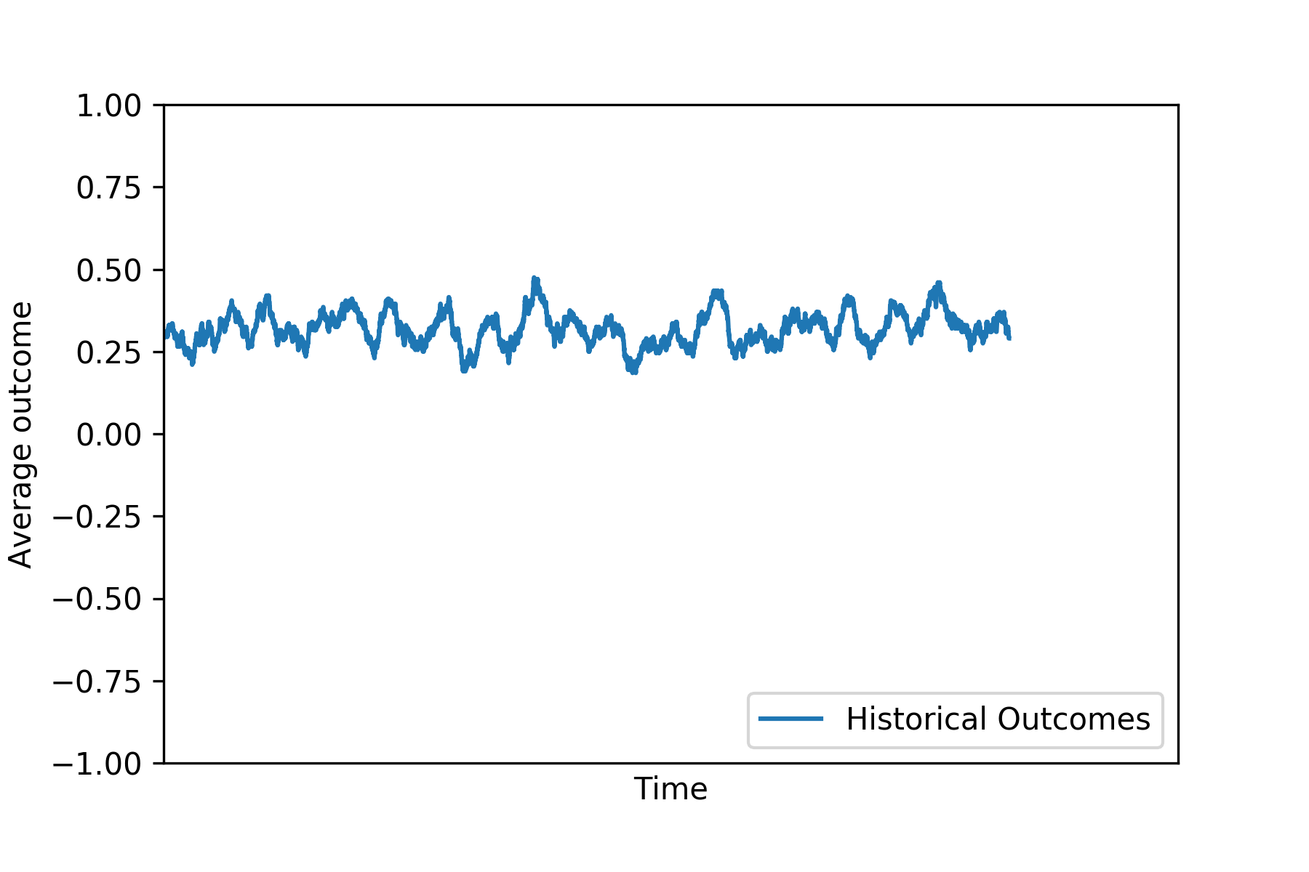
Descriptive Analytics
Clients
Resources
OUTCOMES
KPI: Average Outcome Movement
+1
0
-1

Slide 12








Past Interactions
Clients
Resources
Past
Interactions
Skills
Conditions

Slide 13



Recommender System
Clients
Resources
Rating
Conditions

Slide 14
Data Analytics Maturity Model
Predictive Analytics
HIGH
What might future outcomes be?
Prescriptive Analytics
BUSINESS VALUE
Predictive Analytics
Descriptive Analytics
LOW
BASIC
SKILLS
ADVANCED

Slide 15
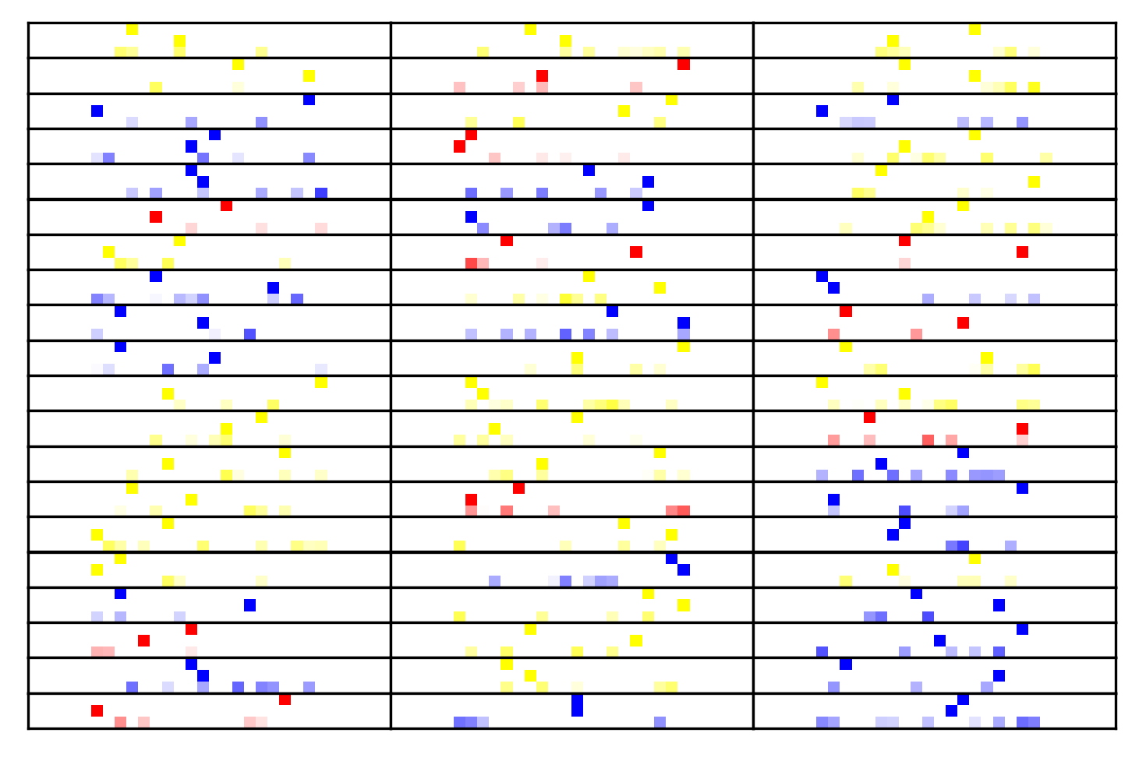

Neural Network Recommender
Rated Past Interactions
Multiclass
Neural Network
Code for
Client
Resource
Condition
https://www.extremetech.com/extreme/215170-artificial-neural-networks-are-changing-the-world-what-are-they

Slide 16

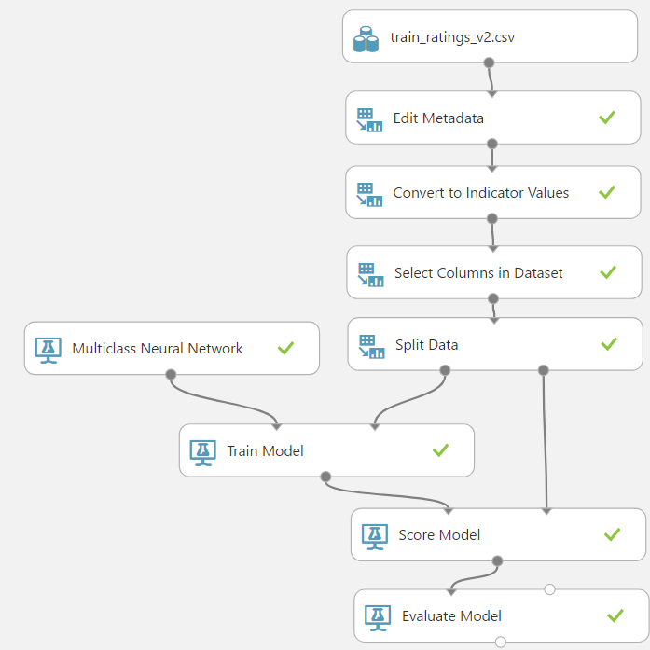
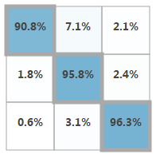
Azure Machine Learning Studio
Predictions
-1
0
+1
-1
Actuals
0
+1
>95% Accuracy

Slide 17
Data Analytics Maturity Model
Prescriptive Analytics
HIGH
How do we get the best outcome possible?
Prescriptive Analytics
BUSINESS VALUE
Predictive Analytics
Descriptive Analytics
LOW
BASIC
SKILLS
ADVANCED

Slide 18
Predicted KPI Improvement
Available Resources
Predicted Ratings
Actual Rating
Test Scenario
Deploy Resource

Slide 19
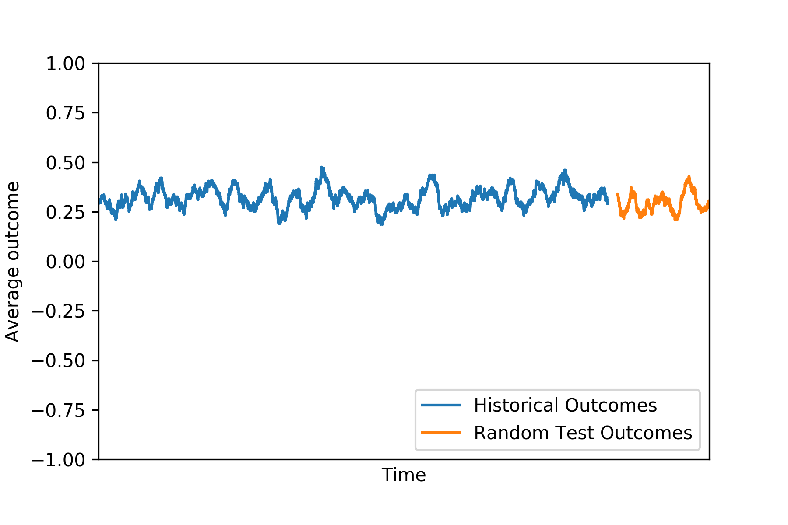
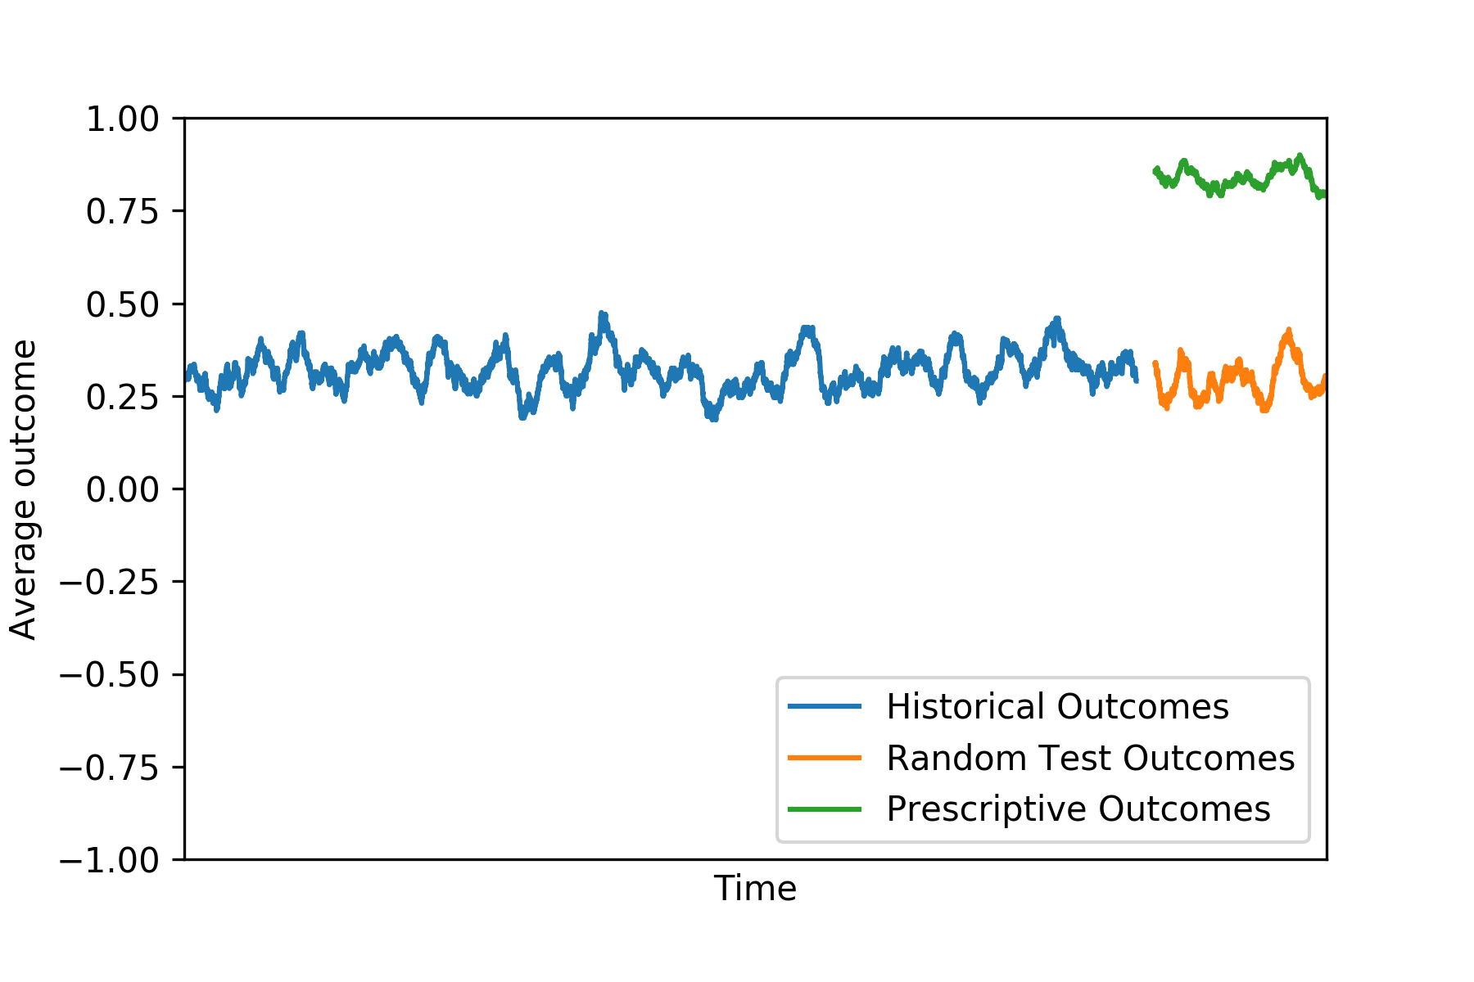
KPI Improvement
KPI: Average Outcome Movement
ML Improvement
Business as usual
Past Average Rating

Slide 20
IoT Deployment

Slide 21


IoT Deployment
Client
Conditions
Resource
Azure IoT Hub
Azure Web App
Availability

Slide 22
IoT Deployment
Alert Message
Alert Message
Client
ALERT
Conditions
Azure IoT Hub
Azure Web App

Slide 23
IoT Deployment
Resource
Resource
Resource
Availability
Deployed
Client
Availability
Conditions
Resource
Resource
Availability
Availability

Slide 24






Work Flow Demo
Azure Blob Storage
Azure ML Studio
Azure IoT Hub
Azure Stream Analytics
Power BI
Dashboard

Slide 25






QUESTIONS
THINKING AHEAD
Expanded Capabilities
Presentation
Envision
Session
Customer
Immersion
Experience
Strategy
Session

Slide 26
HOW CAN
WE HELP YOU?

