Slide 1

Supervised Contrastive Vision Transformer for Breast Histopathological Image Classification
By -
Mohammad Shiri
Monalika Padma Reddy
CS 895 – Computer Vision
Spring 2023

Slide 2
Outlines
Introduction
Dataset
System
Evaluation
Future Work

Slide 3
Introduction
Breast cancer - Second leading cause of cancer-related deaths among women
Invasive Ductal Carcinoma (IDC) -
Most common types of breast cancer , accounting to 80% of the known cases
Time consuming and challenging task - Involves a pathologist scanning large swathes of benign regions to ultimately identify the areas of malignancy
Lack of abundant labelled training data is a challenge in deep learning application for accurate medical diagnosis
Transfer-learning based models have been applied in IDC detection
Aim -
Improve the accuracy and generalization performance of IDC prediction
Leveraging the powerful representation learning capabilities of supervised contrastive loss along with fine-tuning a pretrained vision transformer
Notes:
The dataset used for this work consists of 162 whole mount slide images of Breast Cancer specimens that were scanned at 40x magnification. From this dataset, 277,524 patches of size 50 x 50 were extracted, where 198,738 patches were IDC negative and 78,786 patches were IDC positive.

Slide 4

Dataset
162 H&E-stained breast histopathology samples of Breast Cancer (BCa) specimens
Consists of 277,524 50x50 pixel RGB digital image patches
Patches labeled "1" - regions that are characteristic of invasive ductal carcinoma
198,738 negative samples (Malignant) and 78,786 positive samples (Benign)
Number of samples used for training – 262,016(95%)
Number of samples used for testing – 15,520(5%)
Notes:
Vision transformer is a type of neural network architecture that uses self-attention mechanisms to process images
Based on the Transformer, a neural network architecture originally developed for natural language processing
The input image is split into a fixed number of patches, which are linearly projected into a sequence of tokens
The tokens are processed using transformer blocks, consisting of multi-head self-attention and feedforward network sub-layers
The self-attention mechanism allows the model to capture global dependencies and relationships between different regions of the input image
After several transformer blocks, the output sequence is linearly projected back into a feature map, which is fed into a classification head
The model is trained using supervised learning, typically using a cross-entropy loss function
The vision transformer architecture can process images of arbitrary size and has shown impressive performance on various computer vision tasks

Slide 5
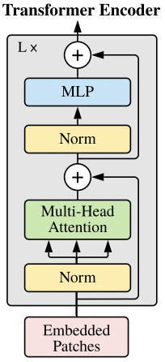
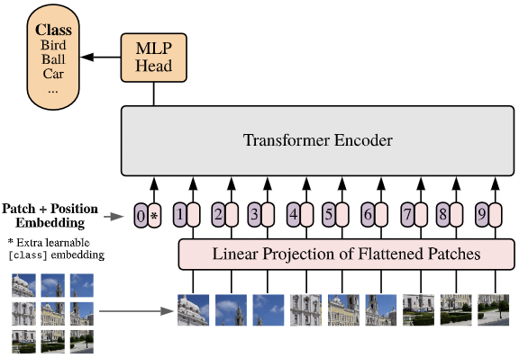
System
Vision Transformer (ViT)
ViT is a NN architecture based on Transformer that uses self-attention mechanisms to process images
The input image is split into a fixed number of patches, which are linearly projected into a sequence of tokens
The tokens are processed using transformer blocks, consisting of multi-head self-attention and feedforward network sub-layers
The self-attention mechanism allows the model to capture global dependencies and relationships between different regions of the input image
After several transformer blocks, the output sequence is linearly projected back into a feature map, which is fed into a classification head
The model is trained using supervised learning, typically using a cross-entropy loss function
ViT can process images of arbitrary size and has shown impressive performance on various computer vision tasks
Notes:
Vision transformer is a type of neural network architecture that uses self-attention mechanisms to process images
Based on the Transformer, a neural network architecture originally developed for natural language processing
The input image is split into a fixed number of patches, which are linearly projected into a sequence of tokens
The tokens are processed using transformer blocks, consisting of multi-head self-attention and feedforward network sub-layers
The self-attention mechanism allows the model to capture global dependencies and relationships between different regions of the input image
After several transformer blocks, the output sequence is linearly projected back into a feature map, which is fed into a classification head
The model is trained using supervised learning, typically using a cross-entropy loss function
The vision transformer architecture can process images of arbitrary size and has shown impressive performance on various computer vision tasks

Slide 6
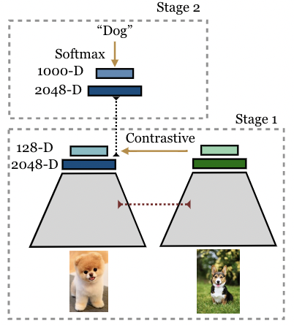
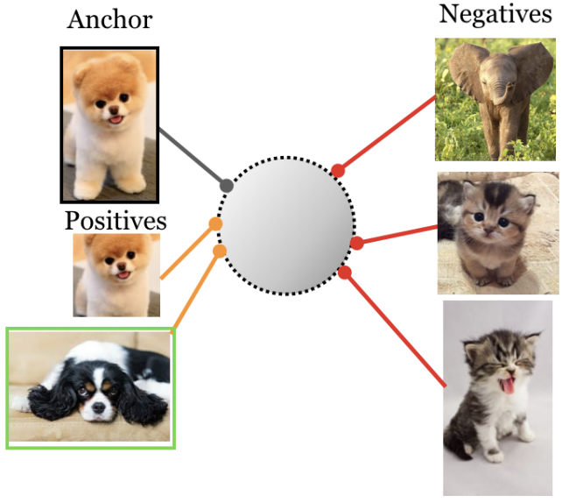

System Supervised Contrastive Learning
Contrastive learning was initially introduced for self-supervised representation learning.
Supervised contrastive learning aims to make a better separation in learned feature representations for different classes
To apply supervised contrastive learning -
Input batch of data is first augmented twice to obtain two copies or "views" of each sample.
Both copies are then forward propagated through an encoder network, and the resulting embedding is L2-normalized.
Representation is further propagated through an optional projection network to help identify meaningful features.
SupCon loss is computed on the normalized outputs of the projection network.
SupCon loss function encourages -
Embeddings from the same class to be pulled closer together
Embeddings from different classes are pushed apart
After learning is done, the frozen network is used to train classification head for making predictions
Notes:
Self-supervised representation learning using contrastive learning has significantly advanced in recent years, but determining the optimal method to generate positives is still an area of active research.
Supervised contrastive learning is a novel approach that bridges the gap between self-supervised learning and fully supervised learning, allowing contrastive learning to be applied in the supervised setting.
The proposed loss function, called SupCon, encourages normalized embeddings from the same class to be pulled closer together, while embeddings from different classes are pushed apart.
SupCon enables the use of labeled data to generate positives from existing same-class examples, providing more variability in pretraining than could typically be achieved by simply augmenting the anchor.
The approach allows for multiple positives per anchor, resulting in an improved selection of positive examples that are more varied, while still containing semantically relevant information.
SupCon is straightforward to implement and stable to train, provides consistent improvement to top-1 accuracy for a number of datasets and architectures (including Transformer architectures), and is robust to image corruptions and hyperparameter variations.
To apply supervised contrastive learning, the input batch of data is first augmented twice to obtain two copies or "views" of each sample. Both copies are then forward propagated through an encoder network, and the resulting embedding is L2-normalized.
The representation is further propagated through an optional projection network to help identify meaningful features. The supervised contrastive loss is computed on the normalized outputs of the projection network.
Positives for an anchor consist of the representations originating from the same batch instance as the anchor or from other instances with the same label as the anchor; the negatives are then all remaining instances.
To measure performance on downstream tasks, a linear classifier is trained on top of the frozen representations.
Allows for multiple positives per anchor, resulting in an improved selection of positive examples that are more varied, while still containing semantically relevant information.
Positives for an anchor consist of the representations originating from the same batch instance as the anchor or from other instances with the same label as the anchor; the negatives are then all remaining instances.

Slide 7
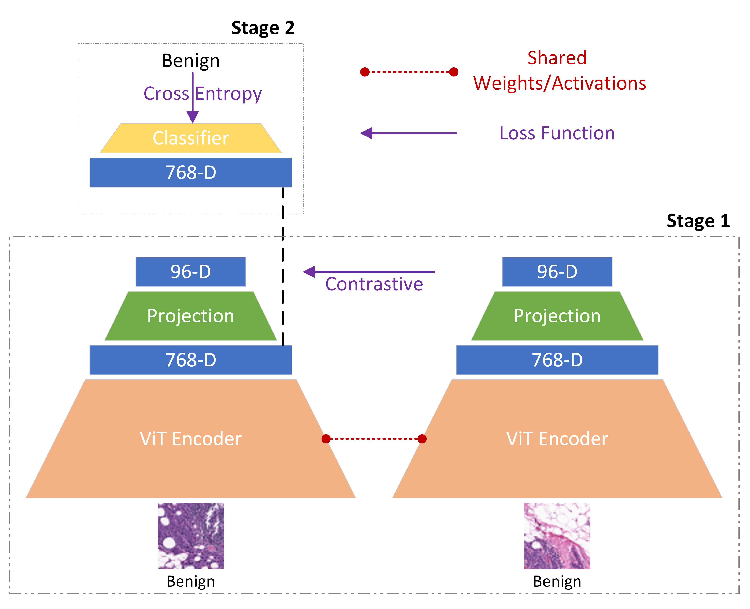
System SupConViT
Inputs:
Augmentation of the input data into 2 views
Represents a different view of the data, contains some subset of the information in the original sample
Augmentation: Normalization, Random Grey Scale Conversion, Random Resized Crop, Color Jitter, Random Horizontal Flip
Stage 1 -
Forward propagation through the ViT encoder (768-D)
Projection network -
Single linear layer that maps the representation of the encoder into a vector (96-D)
Normalization (L2) - Enables using an inner product to measure distances in the projection space
SupCon loss obtained from outputs of the projection network
Stage 2 -
Freeze the ViT encoder and projection network and train a classifier using Cross Entropy loss

Slide 8
Evaluation
 | F1 score | Balanced Accuracy
ViT (20 epoch) | 0.78 | 0.86
SupCon ViT (1 epoch) | 0.79 | 0.86
ResNet-50 (20 epochs) | 0.76 | 0.84
El Shawi et al. (NNI for architecture search) | 0.79 | 0.86
Curz et al. (CNN) | 0.72 | 0.84
Janowczuk et al (Alex Net) | 0.76 | 0.84

Slide 9
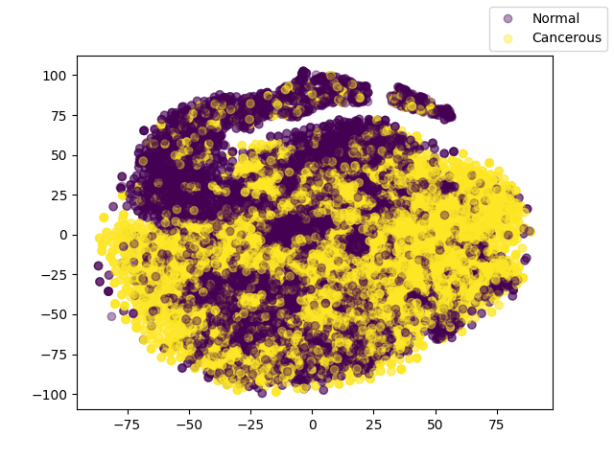
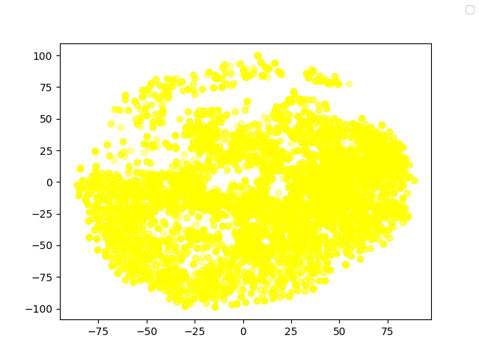
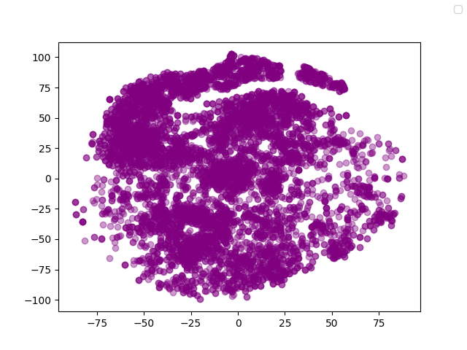
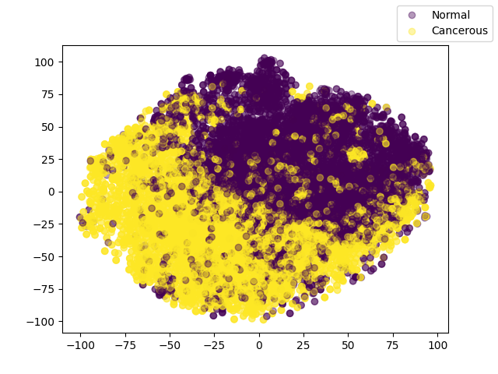
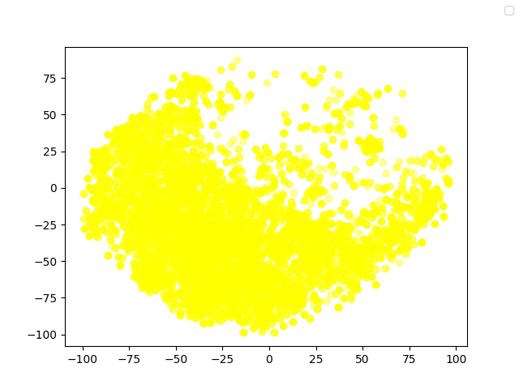
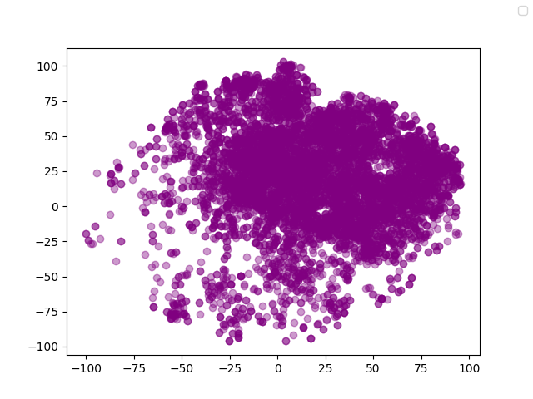
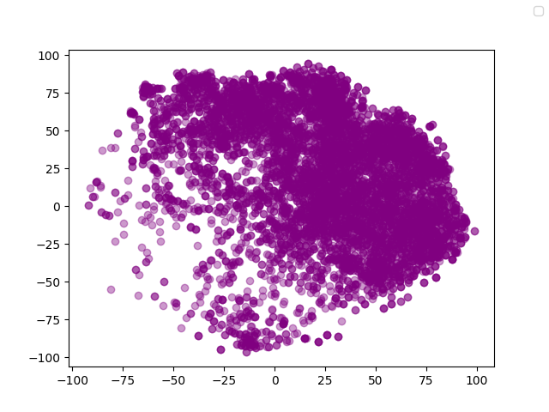
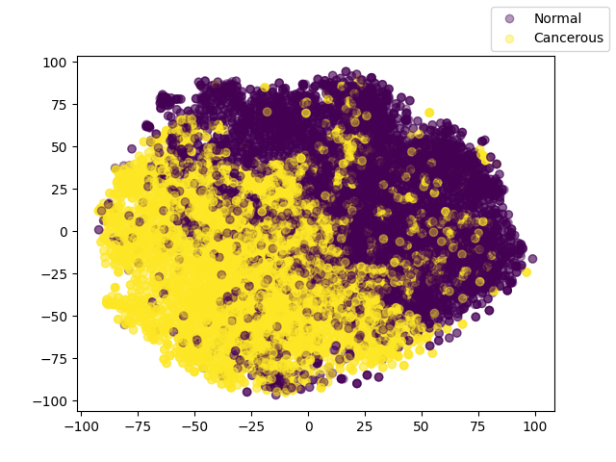
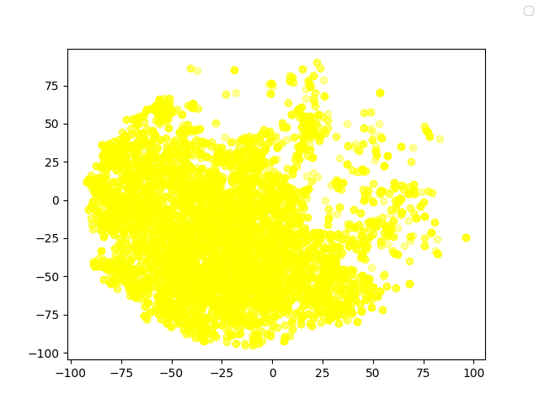
Evaluation
t-SNE visualization of embedding
ResNet-50 (20 epochs)
ViT
(20 epoch)
SupCon ViT
(1 epoch)

Slide 10
Future Work
Training SupCon ViT for more epochs (slower than ViT or ResNet)
Explore different augmentations of the data (Eg. GANs)
Extending the framework into a multi-modal approach by integrating it
Gene Expression (Single cell RNA seq, BRACA1, BRACA2)
Clinical Parameters - like ER-Range, KI-76, PR Intensity

Slide 11

Thank you for your attention!
Questions? Comments?

