Slide 1
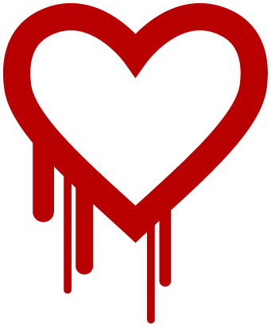

Slide 2
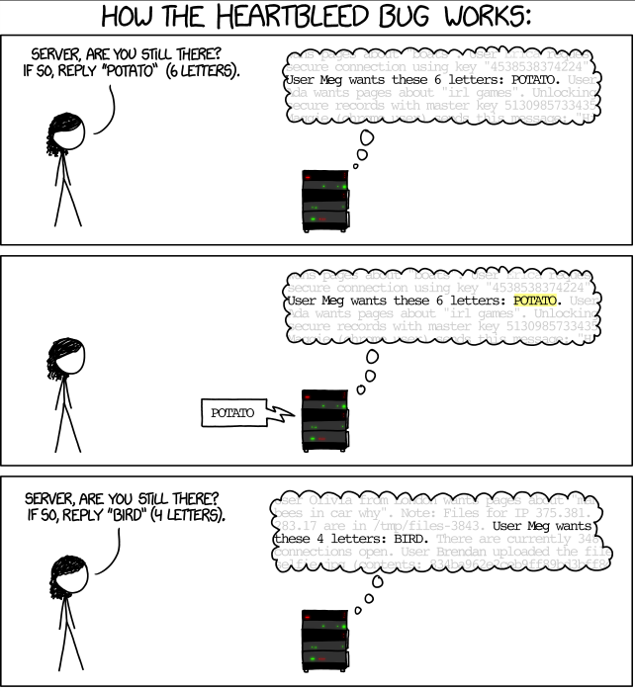

Slide 3
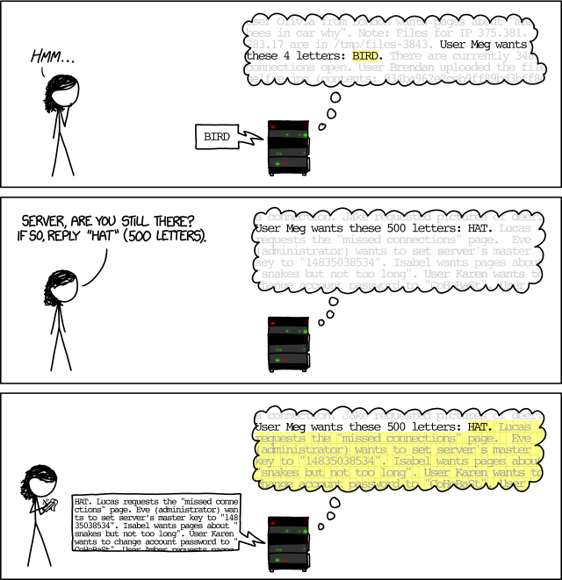

Slide 4
But what is heartbeat exactly?
Contains a payload(data) and the size of that payload
For keeping a TLS connection alive, if there is a communication-gap
“Heartbeat”-packets == a way of saying:”Are you there?” to the server
Is intended for use over UDP(or other connectionless protocol) == no guarantee that the packet won’t be lost
Arbitrarily-sized payload == too much flexibility for most users

Slide 5
The good news
Implementation error
Not an error by design

Slide 6
The bug
Programmer forgot to check the payload size
Returns up to 64kb of additional RAM-data
Etc. send payload of 1b, with size of 60.000b, rinse and repeat
That could be:
Database information
Server side code
Privat encryption keys
Basically anything in the RAM

Slide 7
Demonstration
$ python hb-test.py localhost

Slide 8
Affected versions
OpenSSL 1.0.1 through 1.0.1f (inclusive) are vulnerable
OpenSSL 1.0.1g is NOT vulnerable
OpenSSL 1.0.0 branch is NOT vulnerable
OpenSSL 0.9.8 branch is NOT vulnerable
Vulnerable for almost 2 years

Slide 9
The discovery
Discovered independently by:
Codenomicon(security team consisting of 3 people)
Neel Mehta(Google security)
Reported to OpenSSL
Analyzed and verified by “The National Cyber Security Centre Finland”

Slide 10
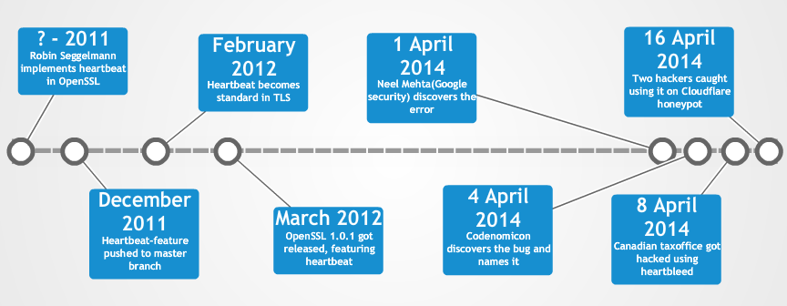
Timeline
Notes:
Transport Layer Security (TLS)
http://tools.ietf.org/html/rfc6520
Stephen N. Henson bug-tested ?-2011 and didn’t notice the error

Slide 11
Scale and Impact
Shutdown costs caused by Heartbleed are estimated to be 500 million US dollars
Many major websites, such as fx. GitHub, Pinterest, Reddit, SourceForge and Tumblr were affected
Android v 4.1.1 is still susceptible to Heartbleed. There is 50 million devices still using that version

Slide 12
How could it happen?
OpenSSL was operating solely on donations totalling $841
OpenSSL defied the standards of OpenBSD and programmed their own memory management
OpenSSL is maintained by a single full-time worker and a tiny number of volunteers
Because of lack of funding OpenSSL never had proper security audits. Nobody checked if Heartbleed was there

Slide 13
The Future
Experts predict more vulnerabilities like Heartbleed will be found
The Linux Foundation has started a multi-million dollar project to fund initiatives such as OpenSSL

