Slide 1
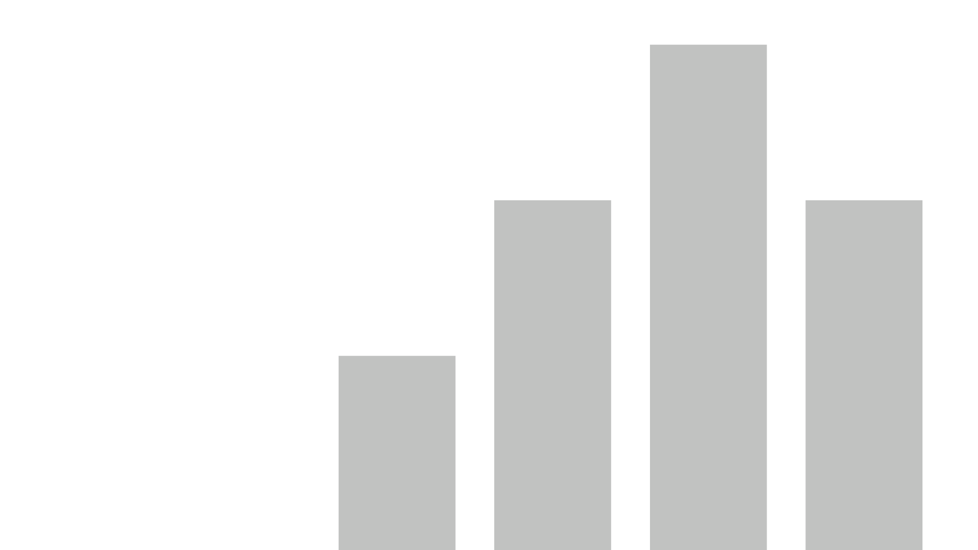


Dashboard-report
View in Power BI
Last data refresh:
3/2/2023 5:50:18 PM UTC
Downloaded at:
3/4/2023 6:01:37 AM UTC

Slide 2
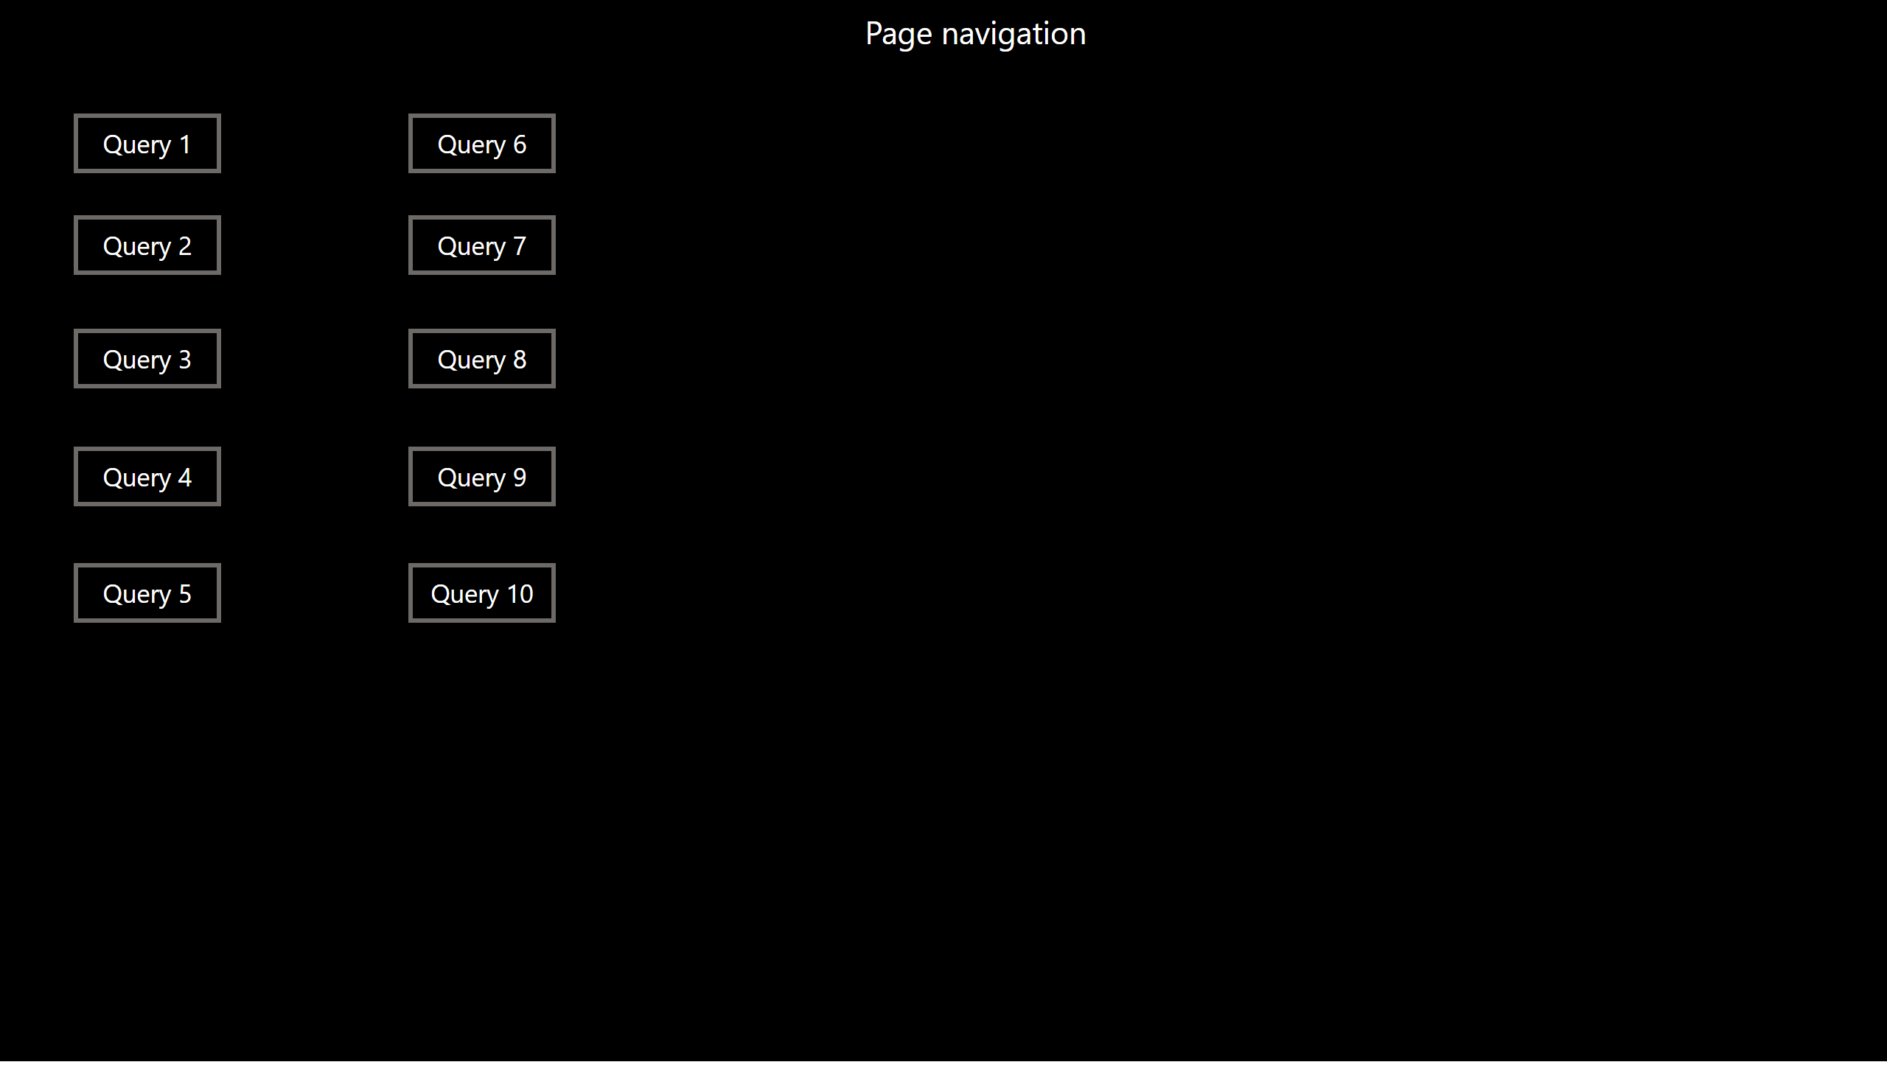
Page navigation
Notes:
Page 1
No alt text provided
Page 1
No alt text provided
Page 1
No alt text provided
Page 1
No alt text provided
Page 1
No alt text provided
Page 1
No alt text provided
Page 1
No alt text provided
Page 1
No alt text provided
Page 1
No alt text provided
Page 1
No alt text provided
textbox
No alt text provided

Slide 3
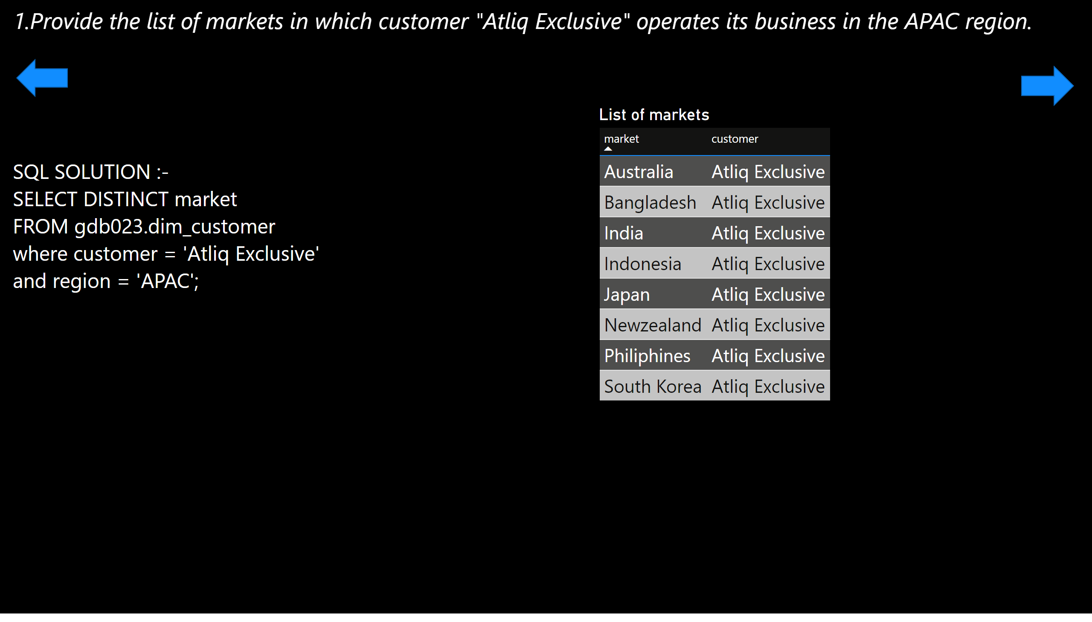
Query 1
Notes:
textbox
No alt text provided
textbox
No alt text provided
shape
No alt text provided
shape
No alt text provided
List of markets
No alt text provided

Slide 4
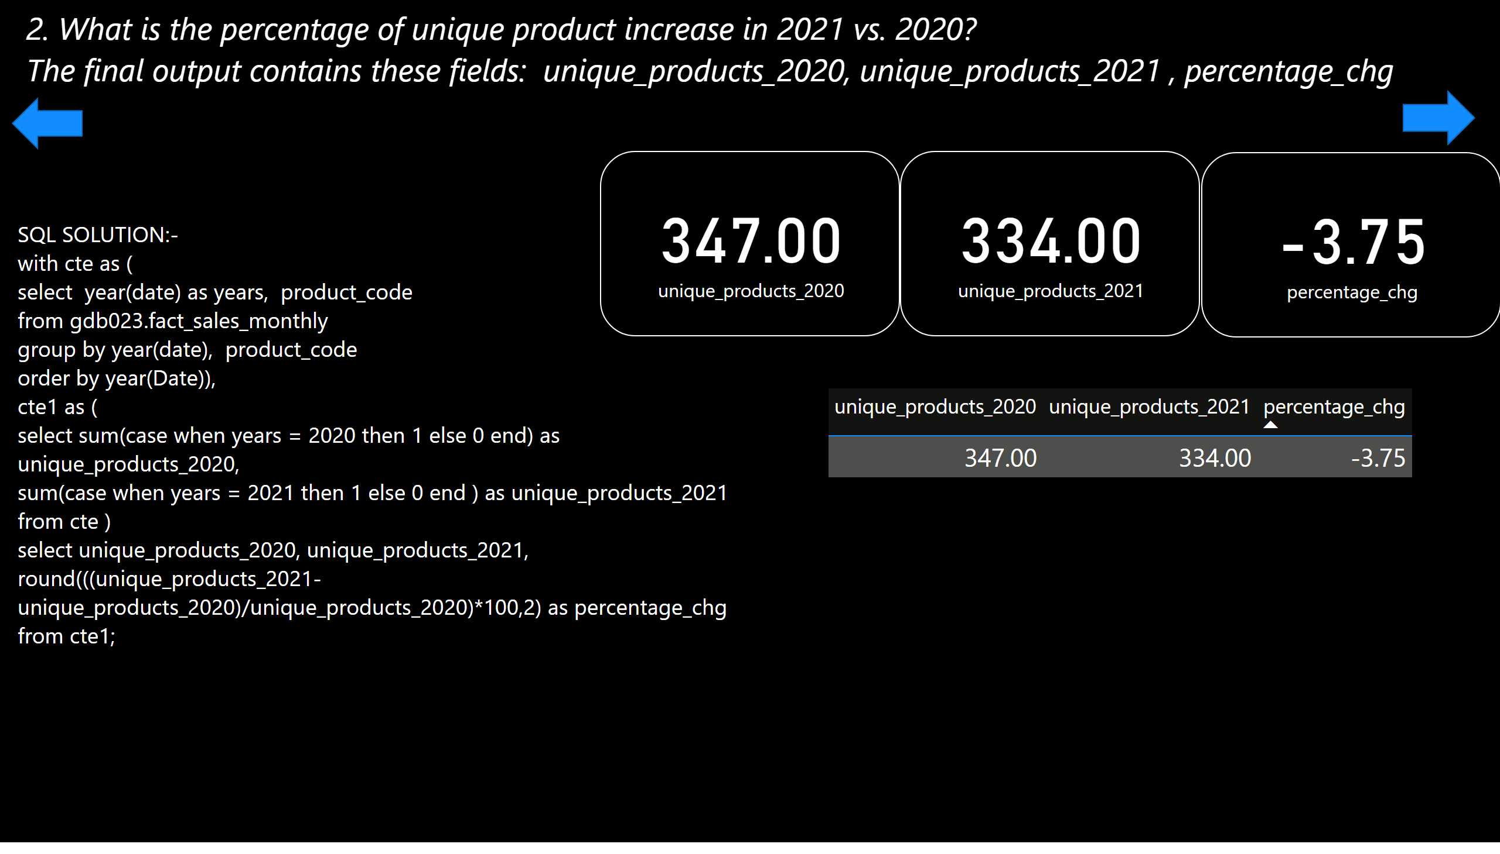
Query 2
Notes:
textbox
No alt text provided
textbox
No alt text provided
tableEx
No alt text provided
card
No alt text provided
card
No alt text provided
card
No alt text provided
shape
No alt text provided
shape
No alt text provided

Slide 5
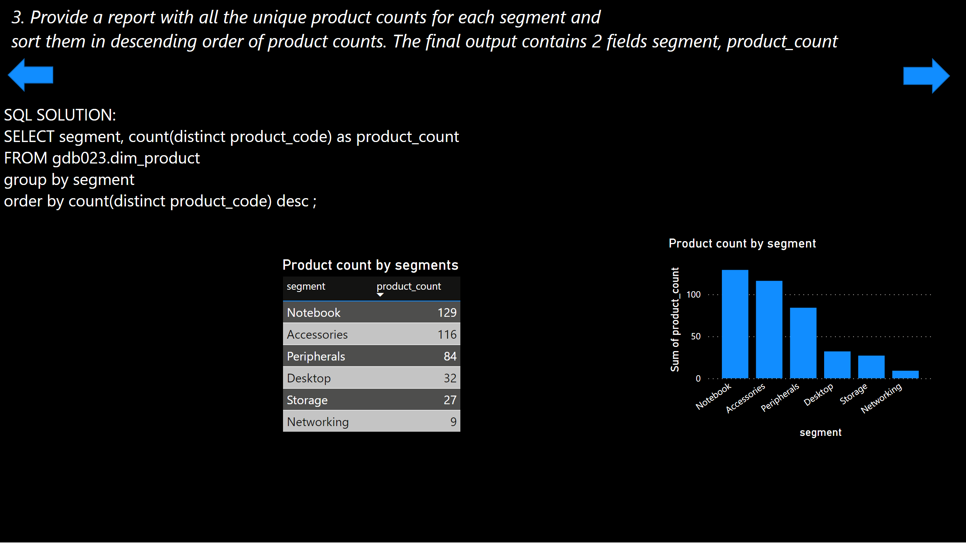
Query 3
Notes:
textbox
No alt text provided
textbox
No alt text provided
Product count by segments
No alt text provided
Product count by segment
No alt text provided
shape
No alt text provided
shape
No alt text provided

Slide 6
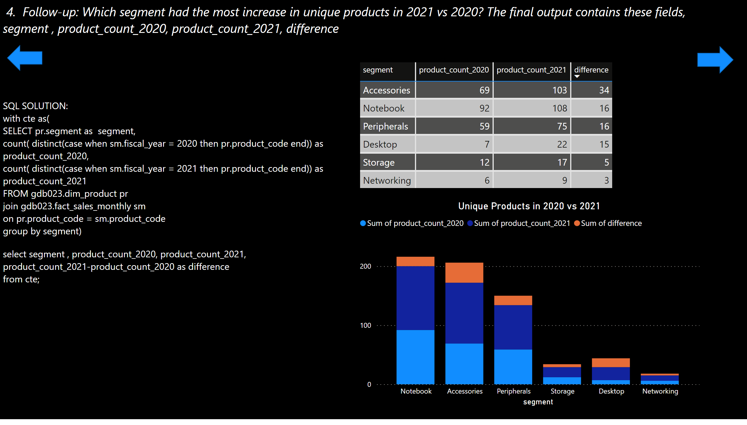
Query 4
Notes:
textbox
No alt text provided
textbox
No alt text provided
tableEx
No alt text provided
Unique Products in 2020 vs 2021
No alt text provided
shape
No alt text provided
shape
No alt text provided

Slide 7
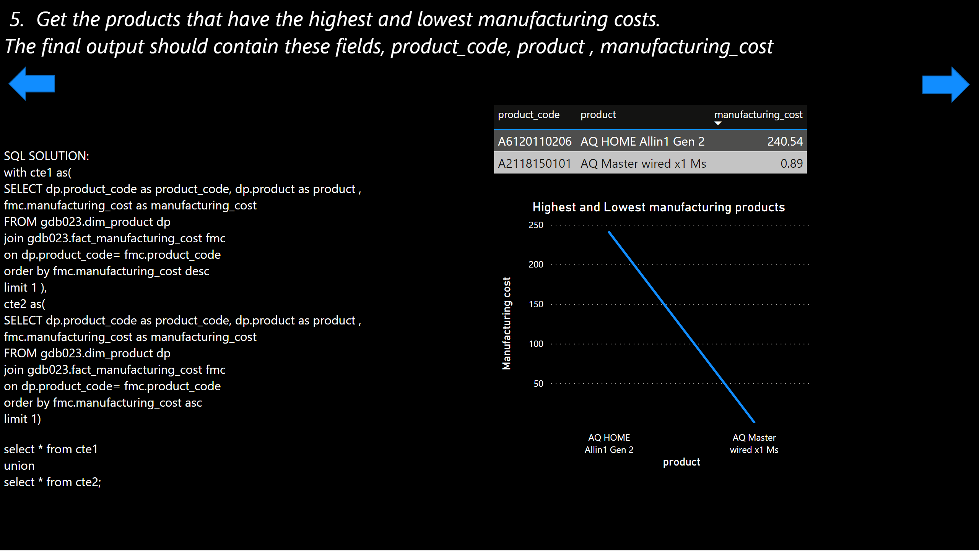
Query 5
Notes:
textbox
No alt text provided
textbox
No alt text provided
tableEx
No alt text provided
Highest and Lowest manufacturing products
No alt text provided
shape
No alt text provided
shape
No alt text provided

Slide 8
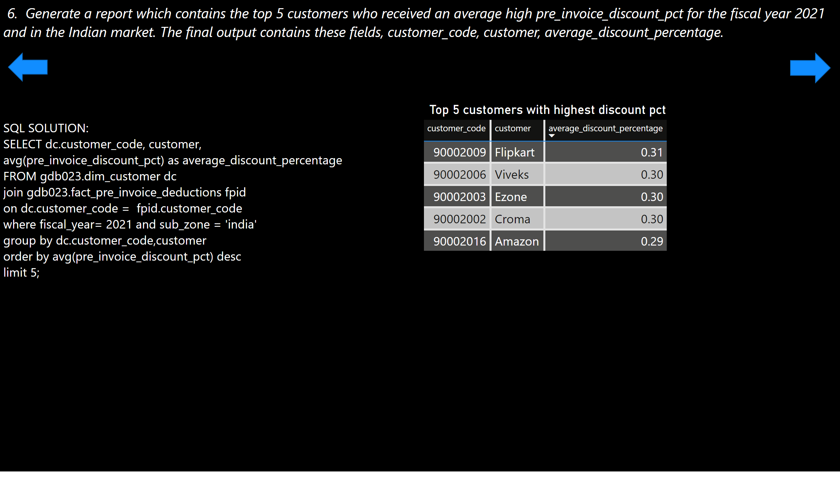
Query 6
Notes:
textbox
No alt text provided
textbox
No alt text provided
Top 5 customers with highest discount pct
No alt text provided
shape
No alt text provided
shape
No alt text provided

Slide 9
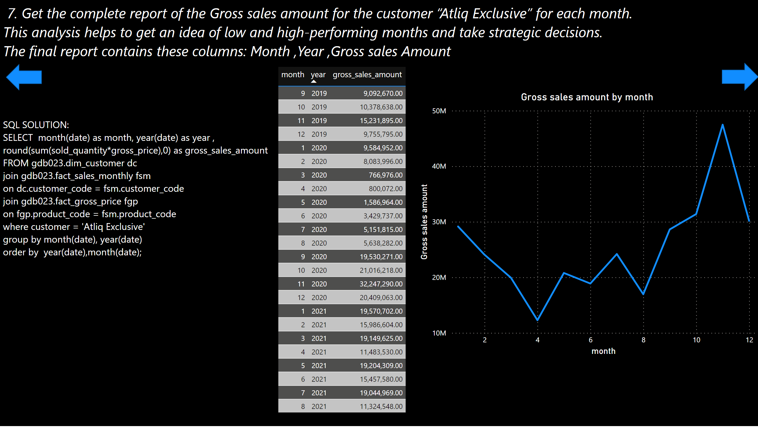
Query 7
Notes:
textbox
No alt text provided
textbox
No alt text provided
tableEx
No alt text provided
lineChart
No alt text provided
shape
No alt text provided
shape
No alt text provided

Slide 10
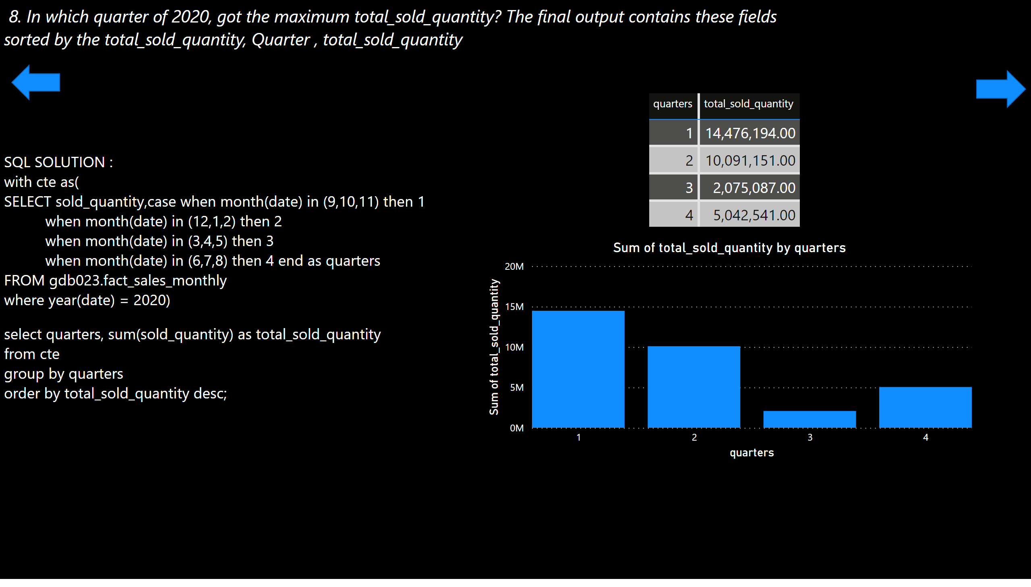
Query 8
Notes:
textbox
No alt text provided
textbox
No alt text provided
columnChart
No alt text provided
tableEx
No alt text provided
shape
No alt text provided
shape
No alt text provided

Slide 11
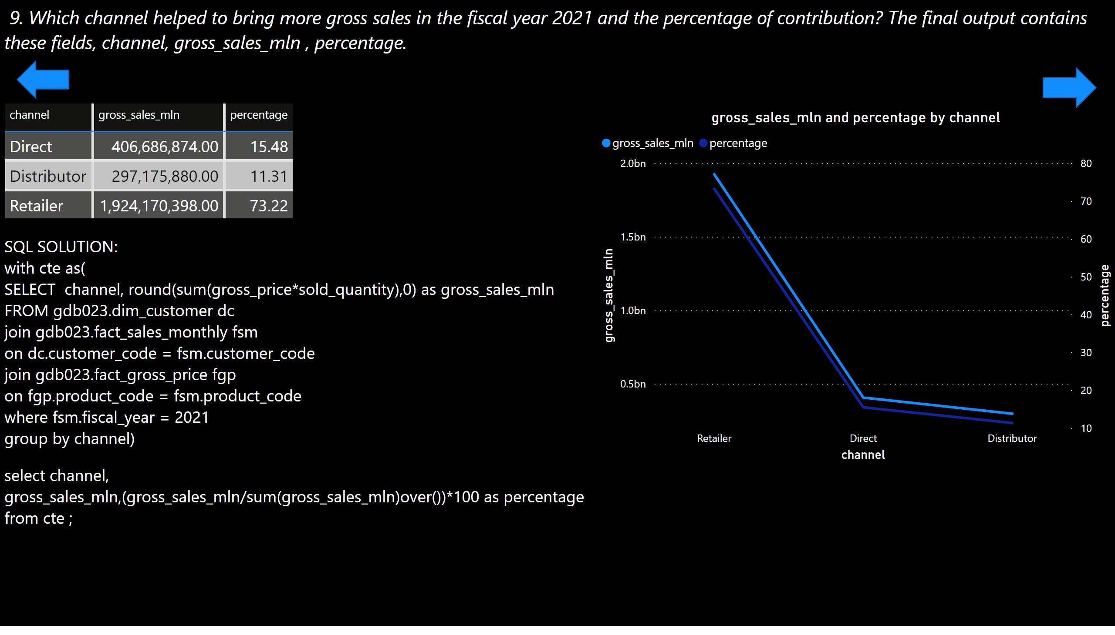
Query 9
Notes:
textbox
No alt text provided
textbox
No alt text provided
lineChart
No alt text provided
tableEx
No alt text provided
shape
No alt text provided
shape
No alt text provided

Slide 12
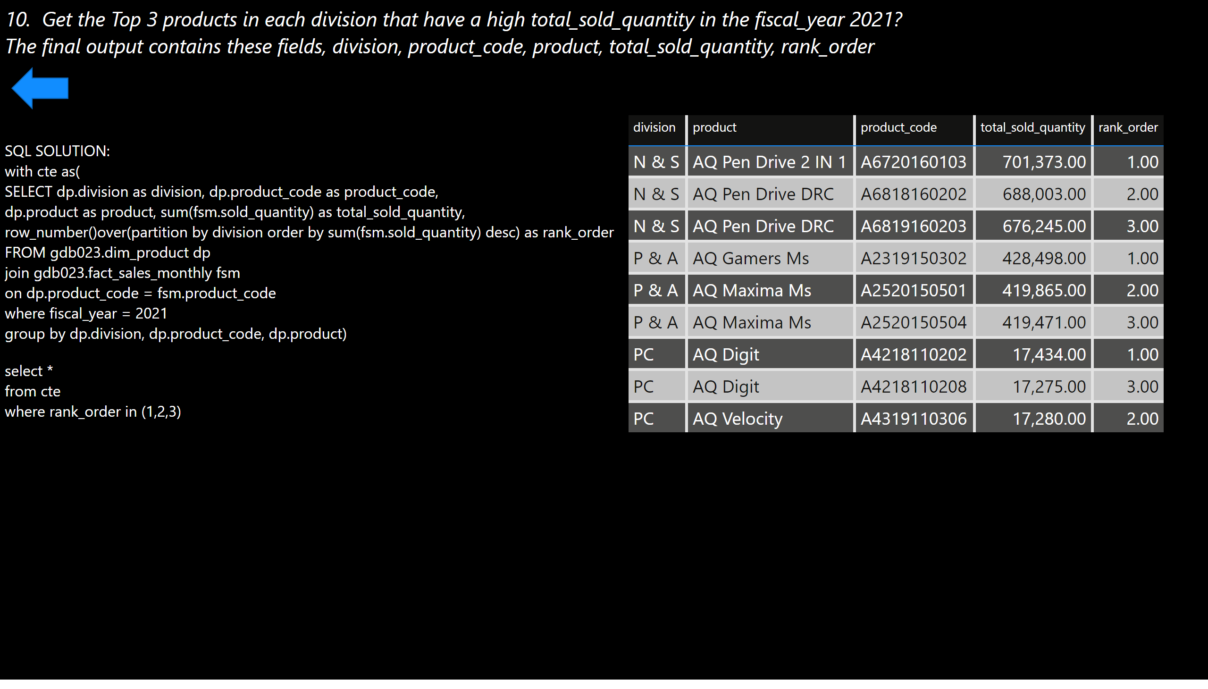
Query 10
Notes:
textbox
No alt text provided
textbox
No alt text provided
tableEx
No alt text provided
shape
No alt text provided

