Slide 1
Junior Cert Portfolio 2027
Exam Number:________________
QR Code:
Instructions for examiner:
Picture of Finished project/ Sketch.

Slide 2
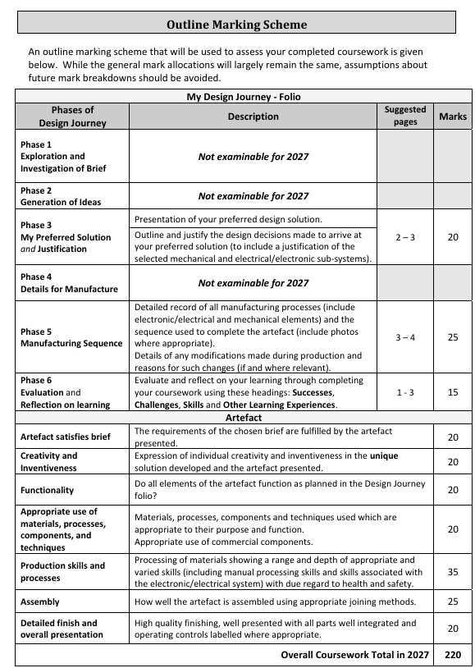
2027 Marking Scheme for Folio and Artefact

Slide 3
Analysis of brief
Chosen Brief :
Key words
Key Requirments:

Slide 4
Research
What have you done in order to research for this project?
Key words research:
Requirments research:
Previous examples:
Primary sources:
Mechanisms
Electronics
Questionaires etc?

Slide 5
Mindmap
JC Project

Slide 6
Mood Board
Fill the page with loads of colourful images that help your theme.

Slide 7
Design Idea 1 &2

Slide 8
Final Design and Justification
*make sure to include justification. Use the key words from the success cirteria (worth 20 marks*)

Slide 9
Final Design Mechanism and Electronics

Slide 10
Onshape and Tinkercad simulation

Slide 11
Working drawings and measurements

Slide 12
Manufactoring sequence

Slide 13
Electronics, Mechanisms, Troubleshooting and Improvements/Changes

Slide 14
Evaluation and Reflection
SSS
Successes x3
Challenges x3
Skills and other learning experiences x3

