Slide 1

Lamp Project
1st year Lamp project Template

Slide 2
Contents
Page 1- Introduction
Page 2 – Design Brief, problem and key requirements
Page 3-4- Types of research
Page 5 -Mind Map
Page 6 – Mood board
Page 7,8,9 Design ideas
Page 10,11 Final Design and justification
Page 13 Prototype
Page 14 Reflection and Evaluation
Page 12 Manufacturing Sequence

Slide 3
Introduction
Include some information about yourself, a picture with your final project, etc

Slide 4
Analyse the Brief
Include the brief, underline important parts
include section for key requirments
Include section for desired parts

Slide 5
Research
Google
Past examples
Pictures from a shop
Interview
Survey
Bar charts
Electronics
Mechanisms

Slide 6


Mindmap

Slide 7

Moodbaord

Slide 8
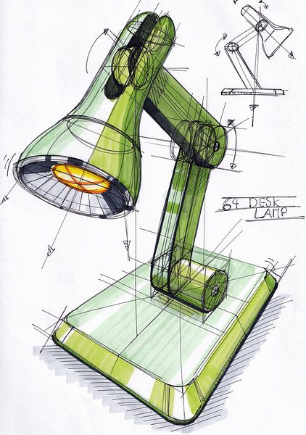
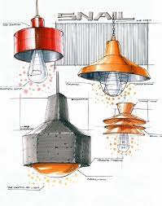
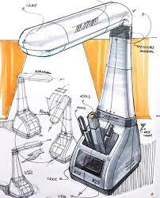
Design idea 1 and 2

Slide 9
Final design

Slide 10
Justification and detail

Slide 11
Manufacturing sequence pictures

Slide 12
Prototype

Slide 13
Evaluation and reflection

