Slide 1
Surferboys Hackathon
Kadaster

Slide 2
Regex-analyse
Addition of synonyms
Improvements??

Slide 3
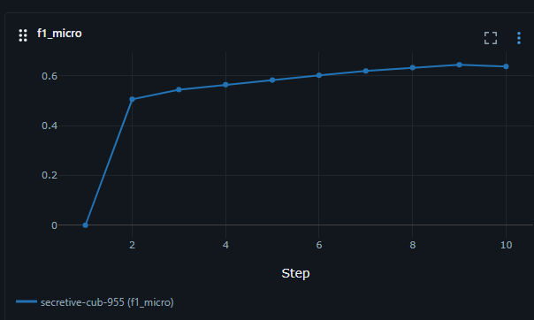
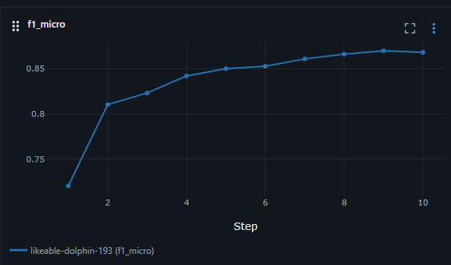
Textvectorizer
Started with tinybert
We used Nebius and parallel api calls to train bge multilingual gemma 2 model
NebiusTextVectorizer Cloud based embeddings via API (Nebius)
Concurrent API Calls with threadpool (4 workers)
After training this way we ended up with 86% micro f1 score

Slide 4
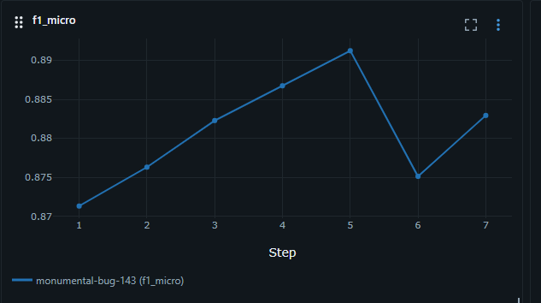
Hybridstep
We combined the regex and gbe model
After training this way we ended up with 89% f1 micro score
Extracts keywords with regex through regexgenerator
Regexvectorizer for feature vectors so the hybrid uses both signals / results

Slide 5
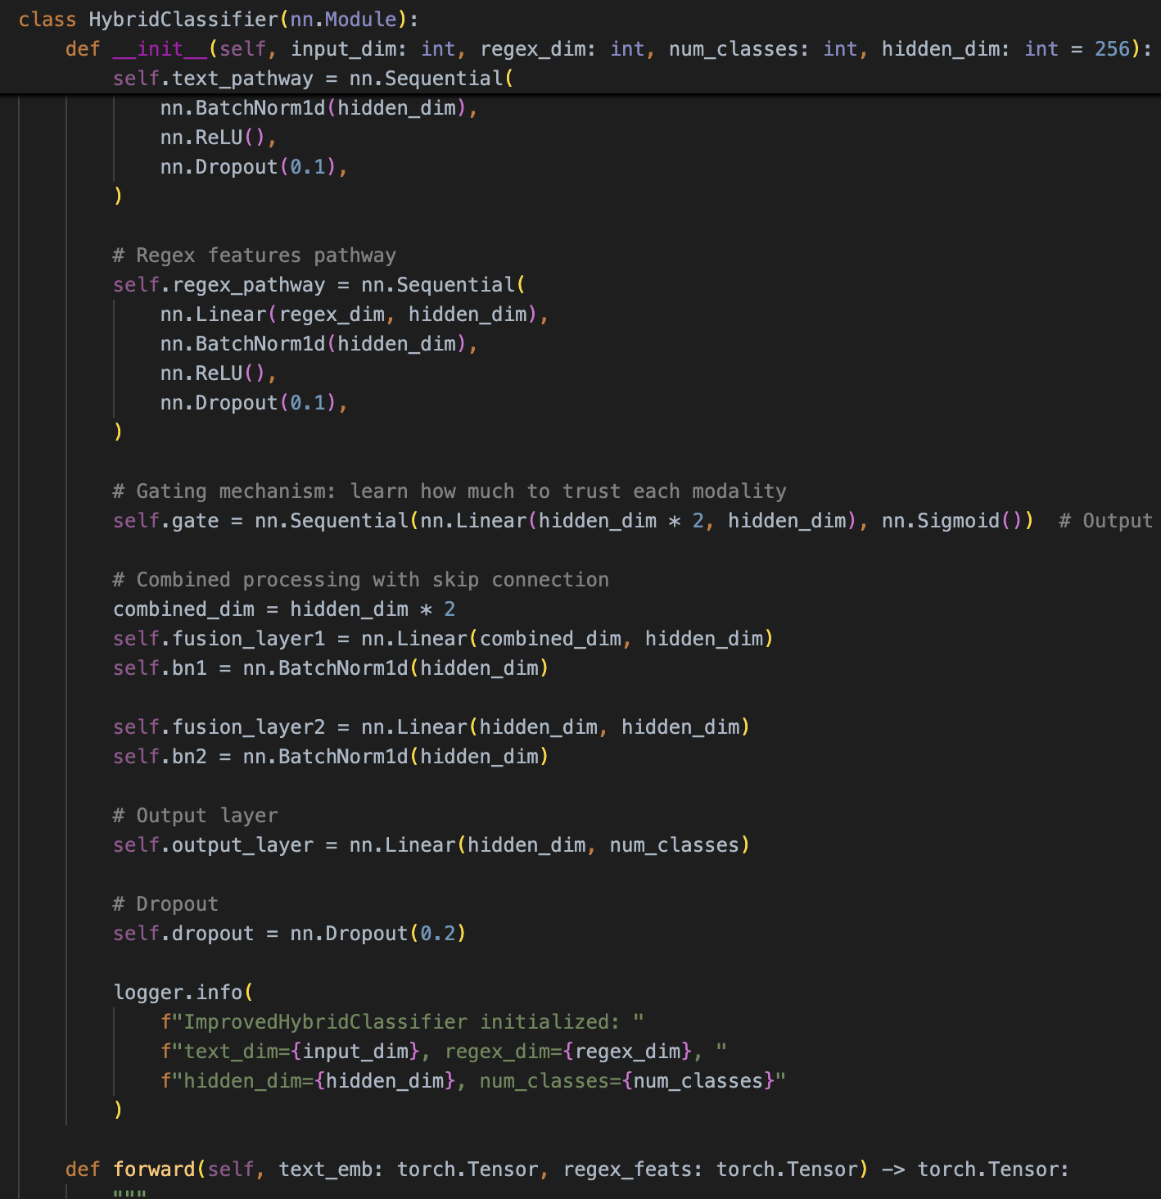
Neural model changes
NebiusTextVectorizer Cloud based embeddings via API (Nebius)
Concurrent API Calls with threadpool (4 workers)
We used Linear – BN – Relu – drop – Gate – fusion1-bn-relu-skip
(Tekst and regex processed indepently, gating learn to weight tekst, skip connections for gradients, batch normailzaiton, Fusion layers?

Slide 6
Large language model
Default model: Meta Llama 8B (F1- score)
  Start: 9%
  Focus on context: 21%
    Exclude misleading text (wihtin “”): 16%
    Reasoning: 19%
Large model: GPT OSS 120B
  No additions: 65%
  Including synonyms: 57% (eerste versie)

Slide 7
Final solution
We used a threshold for the classes of 99%
Fallback for the leftover words to LLM

Slide 8
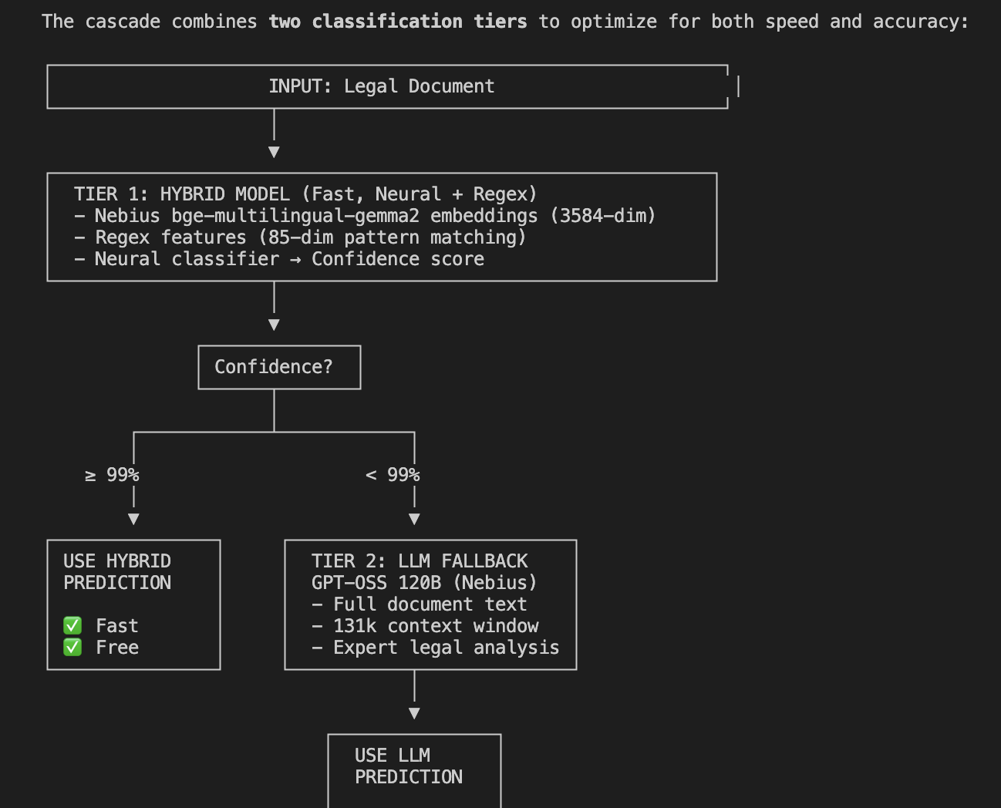
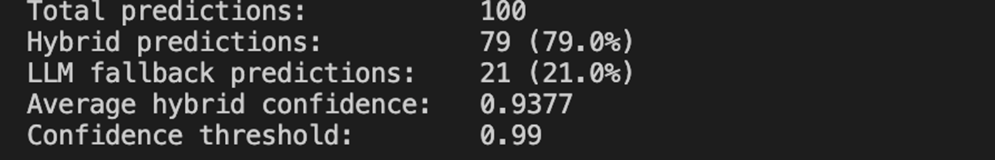

Slide 9
