Slide 1
Introduction
Workload: git-add of two files, followed by git-commit
Initial state of repository: contains two committed files
Configuration option called ‘core.fsyncobjectfiles’
switched off by default
Crash guarantees: Not well-defined
But, Git is used by a lot of people: we consider reasonable expectations
Mailing list talks about crash guarantees

Slide 2

Results

Slide 3
Checkers
Meta-information read
git status
git log
git show-ref
git show-ref –head
Git fsck
Meta-information write and data checks
git rm, git add
git commit
git checkout
Note: If locks are present during checks, they are removed

Slide 4
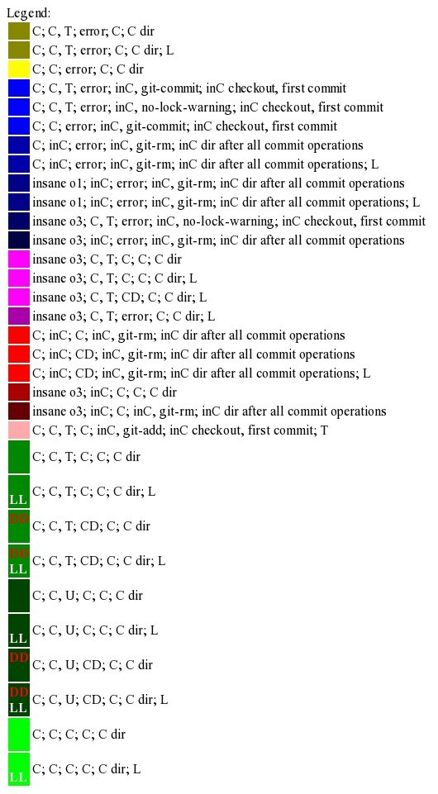
Checkers
Correct states

Slide 5
Checkers
Incorrect, but not detected by fsck

Slide 6
Checkers
Detected by only one tiny checker

Slide 7
Checkers
Incorrect, detected by fsck

Slide 8
Checkers
Errors detected only by fsck

Slide 9
Protocol
Git-add:
creat(index.lock)
Create an 'object file' corresponding to the first added file
mkdir('objects/XX')
creat(temporary file within 'objects/XX')
write to temporary file
fsync(temporary file)
link(temporary file -> permanent file, within 'objects/XX')
unlink(temporary file)
Create an object file corresponding to second added file
Similar to step 2, but uses a different directory instead of 'XX'
Write to index.lock
rename(index.lock -> index)

Slide 10
Protocol
Git-commit:
creat(index.lock), and then unlink(index.lock)
This is probably a check for whether some other process is holding the lock
Create an object file
Similar to step 2/3 of git-add, but the file created is very small.
This object file *does not* correspond to an added file, unlike steps 2 and 3 of git-add
Create an object file
Similar to step 2
creat(master.lock)
Write various meta-information files
Files: '.git/logs/refs/heads/master', '.git/logs/HEAD', and 'master.lock'
rename(master.lock -> master)

Slide 11

Until rename() of git-add: Correct
Dangling objects, locks might be present.
rename() corresponding to git-add

Slide 12
rename() corresponding to git-add: When both source and destination do not exist, incorrect

Slide 13


Slide 14
rename() corresponding to git-commit: When both source and destination do not exist, incorrect

Slide 15
Incorrect when crashing between
append(logs/HEAD), and
rename corresponding to git-commit

Slide 18

mkdir() for first object in git-add
link() for first object in git-add
mkdir() for second object in git-add

Slide 20

link() for second object in git-add

Slide 21
Append(index.lock)
index.lock: temporary file that is renamed at the end of git-add
Correctness is also violated by:
Converting entire append to garbage or zeros
Omitting the append entirely (keeping file size=0)

Slide 22
Rename() atomicity
Neither old link, new link, or temporary link exist
Rename() atomicity:
Old link exists, new link and temporary link don’t
i.e., the old version of the file exists

Slide 23
mkdir() and link() for first object file in git-commit

Slide 24
mkdir() and link() for second object file in git-commit
Note that the creat() operation does not play a role in correctness; links are the important part

Slide 25
Append(master.lock)
temporary file that is renamed at the end of git-commit
Correctness is also violated by omitting entire append, or converting it to garbage or zeros

Slide 26
Append(master.lock, ‘\n’)
Correctness is preserved if the entire append is omitted or filled with zero
Only filling with garbage is problematic

Slide 27
Append(logs/HEAD)
Not a temporary file, previously of non-zero size
Correctness is also violated by omitting entire append, or converting it to garbage or zeros
Incorrectness is only due to a tiny, specialized checker

Slide 28
Configuration option prevents these re-orderings. Without config:
Infinite loops
Non-determinism
Different behavior for
File size zero
File contains garbage/zeros
File size increased partially with valid data

Slide 29

Results: Miscellaneous
Checker bug
Unknown cause, seems to only affect these particular test cases
mkdir() for second object in git-add

Slide 30

Results: Miscellaneous
File unrelated to protocol

Slide 31
Results: Miscellaneous
File related to protocol, but no bugs found with current checker

Slide 32
Perceptions of FS behavior
Torvalds (2009): “there's a reason we don't enable fsync by default - it's generally not needed…
on non-journaling filesystems, fsync is obviously a good idea, but even then the state is often recoverable even in the face of a crash. Now, without fsync, you might have to work at it a bit and know what to do - like _manually_ resetting to the previous state and re-doing the last corrupt commit, throwing out any corrupt objects etc. ….
So enabling fsync can make things _much_ easier for recovery (to the point of making it possible at all for somebody who doesn't know the git object model), but is generally not a hard requirement.”

Slide 33
Perceptions of FS behavior
Jeff King - 2013 (Github’s git developer): “Our backend git systems are ext3 with journaling and data=ordered…. We do not fsync object files by default…. it shouldn't matter as long as your filesystem orders data and metadata writes …. So for our data=ordered filesystems, that's fine….
If the data and metadata writes are out of order, one could have problems (but again, not a problem with data=ordered).
So for ordered data and metadata writes, in my experience git is quite solid against power failures and crashes. For systems without that guarantee, you should turn on core.fsyncobjectfiles, but I suspect you could also see some ref corruption (and possibly index corruption, too, as it does not fsync either).”

Slide 34
Perceptions of FS behavior
Manpage for core.fsyncobjectfiles: “This is a total waste of time and effort on a filesystem that orders data writes properly, but can be useful for filesystems that do not use journalling (traditional UNIX filesystems) or that only journal metadata and not file contents (OS X’s HFS+, or Linux ext3 with "data=writeback").”

Slide 35
Crash Guarantees
Torvalds (2009): “there's a reason we don't enable fsync by default - it's generally not needed…
on non-journaling filesystems, fsync is obviously a good idea, but even then the state is often recoverable even in the face of a crash. Now, without fsync, you might have to work at it a bit and know what to do - like _manually_ resetting to the previous state and re-doing the last corrupt commit, throwing out any corrupt objects etc. ….
So enabling fsync can make things _much_ easier for recovery (to the point of making it possible at all for somebody who doesn't know the git object model), but is generally not a hard requirement.”

Slide 36
Crash Guarantees
Jeff King - 2013 (Github’s git developer): “Our backend git systems are ext3 with journaling and data=ordered…. We do not fsync object files by default…. it shouldn't matter as long as your filesystem orders data and metadata writes …. So for our data=ordered filesystems, that's fine….
If the data and metadata writes are out of order, one could have problems (but again, not a problem with data=ordered).
So for ordered data and metadata writes, in my experience git is quite solid against power failures and crashes. For systems without that guarantee, you should turn on core.fsyncobjectfiles, but I suspect you could also see some ref corruption (and possibly index corruption, too, as it does not fsync either).”

