Slide 1
Introduction
Tested version: 1.10.0 (May 2013)
Current version: 1.15.0 (Dec 2013)
Protocol keeps changing between versions, leveldb might be a good example of why our tool is needed
Workload:
Open database
Non-durable put()
Close database
Work in progress
Other workloads to test: Checkpointing
Crash guarantees: Well-defined
Atomicity, ordering, and optional durability
Mmap(), and threads
Threads not in current tested workload

Slide 2
Checker
Verification routine:
Open database
Read values from database
make sure atomicity and ordering is obeyed
make sure ancient data in the database is durable
Insert a value
Read again and check atomicity, ordering, durability
Close database, re-open
Read again and check atomicity, ordering, durability
Do verification routine four times:
Without checksum verification
With checksum verification
Recovery, then without checksum verification
Recovery, then with checksum verification

Slide 3
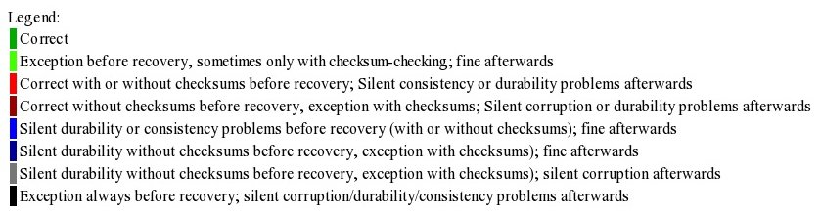
Checker

Slide 4
Protocol
(Terminal window)

Slide 5
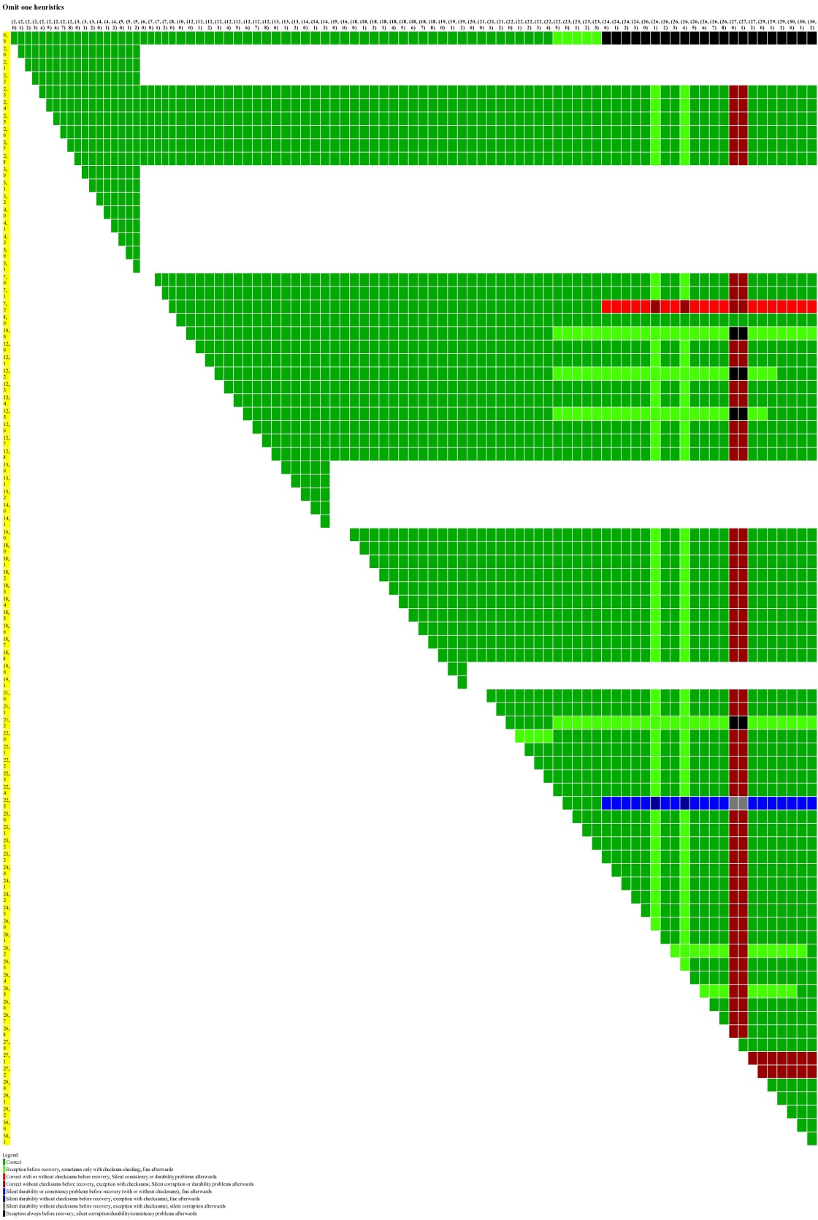
Start of put
End of put

Slide 6
Log file being extended with fallocate/ftruncate, but zero-filled log file not fsync()-ed. On presence of garbage before crash, bright-green state occurs.

Slide 7
During put(), if only part of the put() makes it to the log file.
i.e., atomicity of the log write corresponding to put()
The graph shows splitting the write into three diskops, but same effect was observed when split across 4096-page boundaries

Slide 8
creat(sst)

Slide 9
Truncating sst file after writing data to it. The sst file is sync-ed *before* the truncate. If truncate does not go to disk, incorrect.

Slide 10
creat(MANIFEST)

Slide 11
The MANIFEST file is first extended using ftruncate() or fallocate().
Since only msync() is done after writing data to it, the non-data filled portion might end up containing garbage. Bright-green if garbage is present.

Slide 12
Corresponds to temp-file that is subsequently renamed to CURRENT. File is msync()-ed, then truncated. Partial truncate of the file results in bright-green.
TODO: Finding red errors here will show problems of using msync()

Slide 13
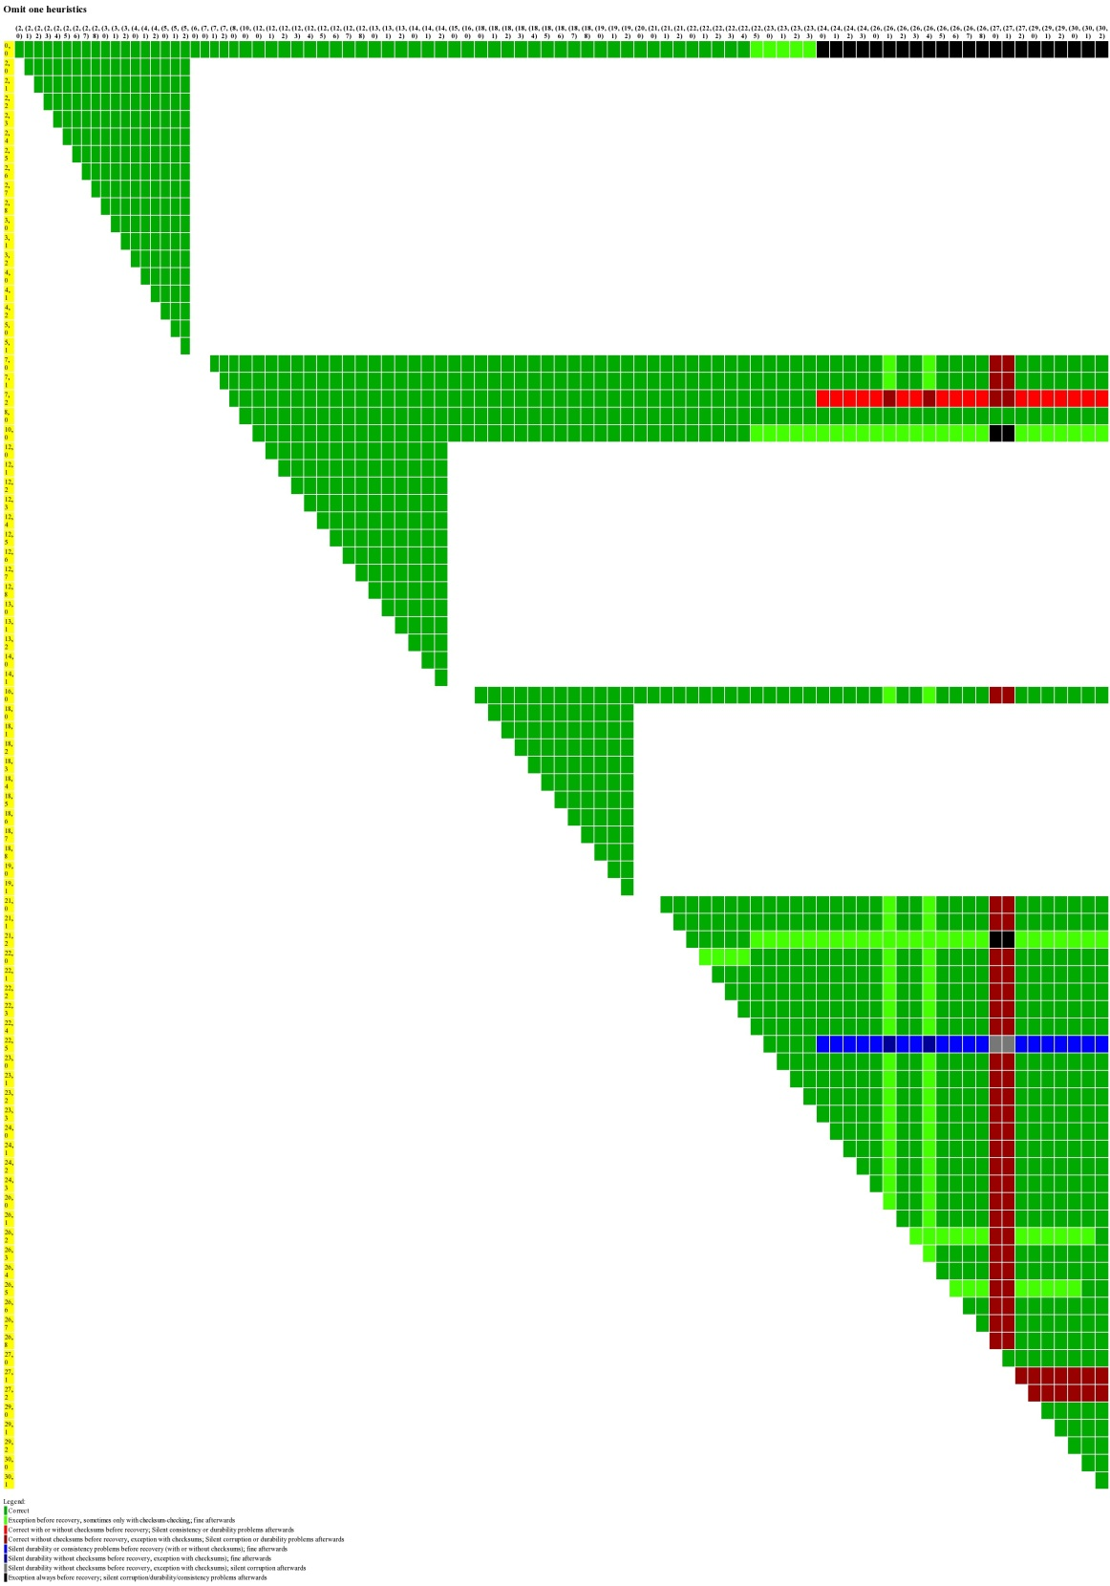
Using fsync() instead of msync()

Slide 14
Rename atomicity: when old link still exists, but is semi-truncated

Slide 15
When rename() is non-atomic, and neither the old link nor new link exist.

Slide 16
Issue not found with omit-one heuristic
If the rename(CURRENT) is entirely omitted:
Before recovery, leveldb throws an exception; after recovery, works fine.
If rename is omitted, unlink(MANIFEST) is omitted, and none of the log writes go to disk:
Silent durability violation before recovery (with or without checksum-checking); fine after recovery

Slide 17
Bug-Reporting Chronicles
When replying to bugs reported by me,
One of the lead developers of leveldb (dgrogan) forgot the ordering guarantee promised by leveldb
A developer (cbsm…, not sure if he is a lead developer) assumes journaling means ordered directory operations
When bitcoin moved to non-mmap()-ed version, they left off some directory fsync()-s
Later, bitcoin moved to upstream non-mmap() version

Slide 18
Miscellaneous stuff
Examined two other workloads
Creating a database
no bugs, though bright-green areas are present
I had wrongly reported one of the bright-green areas as a bug
Opening an existing database
protocol is subsumed by presented workload
To-examine:
Checkpoint workload
synchronous put workload
leveldb-1.15.0
Unexplored workloads:
Batch puts
Second-level checkpointing
Toggling compression
….

