Slide 1

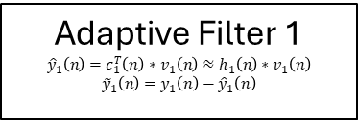
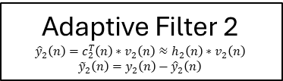








Input = $v_{1}\left(n\right)$
$$x\left(n\right)=y\left(n\right)+h_{1}\left(n\right)∗v_{1}\left(n\right)+h_{2}\left(n\right)∗v_{2}\left(n\right)+A\cos{(Ωn+φ)}$$
Adaptive Filter 1 $${\hat{y}}_{1}\left(n\right)=c_{1}^{T}\left(n\right)∗v_{1}\left(n\right)≈h_{1}\left(n\right)∗v_{1}\left(n\right)$$
$${\tilde{y}}_{1}\left(n\right)=y_{1}\left(n\right)−{\hat{y}}_{1}\left(n\right)$$
Notch Filter
$\hat{z}\left(n\right)= y\left(n\right)+h_{1}\left(n\right)∗v_{1}\left(n\right)+h_{2}\left(n\right)∗v_{2}\left(n\right)$ = $y_{1}\left(n\right)$
Desired Signal = $y_{1}\left(n\right)$
$${\hat{y}}_{1}\left(n\right)$$
$${\tilde{y}}_{1}\left(n\right)≈y\left(n\right)+h_{2}\left(n\right)∗v_{2}\left(n\right)$$
Input = $v_{2}\left(n\right)$
Adaptive Filter 2
$${\hat{y}}_{2}\left(n\right)=c_{2}^{T}\left(n\right)∗v_{2}\left(n\right)≈h_{2}\left(n\right)∗v_{2}\left(n\right)$$
$${\tilde{y}}_{2}\left(n\right)=y_{2}\left(n\right)−{\hat{y}}_{2}\left(n\right)$$
Desired Signal
$y_{2}\left(n\right)$ $≈y\left(n\right)+h_{2}\left(n\right)∗v_{2}\left(n\right)$
$${\hat{y}}_{2}\left(n\right)$$
${\tilde{y}}_{2}\left(n\right)$ $≈y\left(n\right)$
Final Estimate $\hat{y}\left(n\right)$

