Slide 1
Zomato Restaurant Analytics
Insights Generated Using Excel, SQL, Power BI & Tableau

Slide 2
📌 What is this project about?
This project is an end-to-end Zomato restaurant data analysis project.
The goal is to analyze restaurant performance, understand customer behavior and pricing trends, (online delivery & table booking) using Excel, SQL, Power BI, and Tableau.
The same dataset is used across all tools to ensure consistency and accuracy, and insights are presented through interactive dashboards to support business decision-making.

Slide 3
Challenges Faced During Data Cleaning
Missing and null values in ratings and votes
Country information available only as country codes
Inconsistent data types (text vs numbers)
Date fields not structured for time-based analysis
Multiple tools requiring clean and formatted data
Percentage KPIs not directly available in raw data

Slide 4
🧹 How the Data Was Cleaned and Handled

Slide 5
In Excel
Checked missing values and data consistency
Validated ratings, votes, and cost columns
Ensured proper column formats
Used Excel for initial understanding and validation
In SQL
Imported cleaned CSV into MySQL Workbench
Created structured tables
Used SQL queries to handle:
  Null values
  Aggregations (COUNT, AVG)
  Bucketing using CASE statements
Created reusable logic using views

Slide 6
In Power BI
Created a Date table using DAX
Built proper data model (fact & dimension tables)
Established relationships (Country, Date)
Handled blanks using filters and measures
In Tableau
Defined relationships between tables
Used calculated fields for:
  Price buckets
  Percentage KPIs
Filtered null values
Ensured clean visuals and accurate aggregation

Slide 7
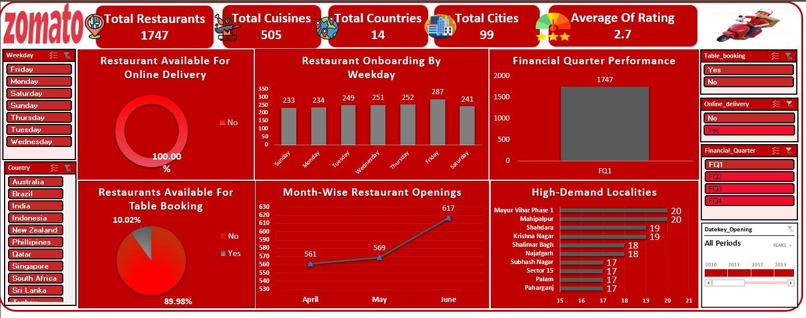
Excel Dashboard

Slide 8
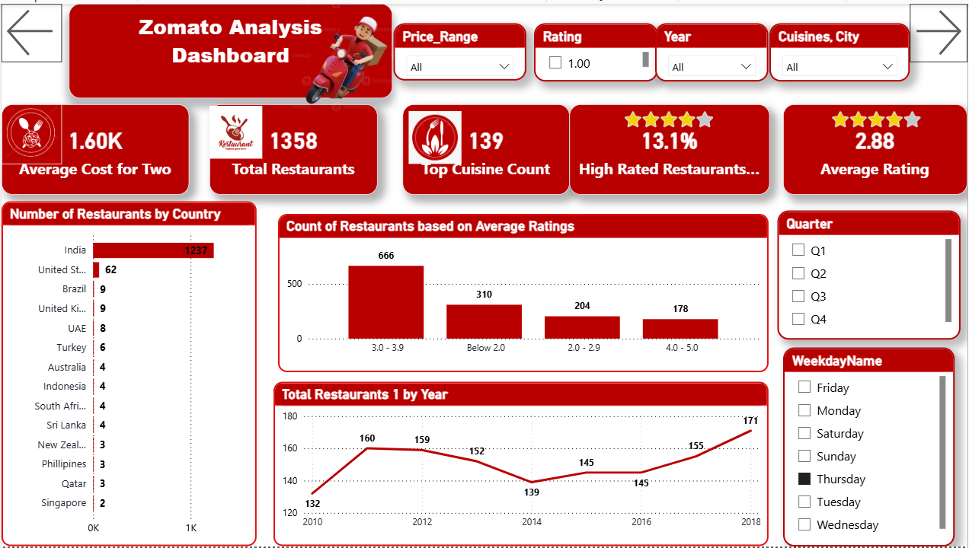
Power BI Dashboard

Slide 9
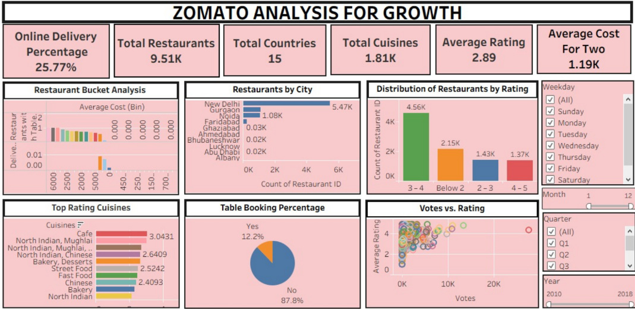
Tableau Dashboard

Slide 10
📊 Key Recommendations
Focus expansion on high-growth regions
Enhance customer experience to boost ratings
Strengthen online delivery & booking channels
Optimize pricing by regional demand
Leverage ratings & votes to improve visibility

Slide 11
Conclusion
Zomato’s growth is strong but concentrated. The next phase of growth lies in geographic expansion, quality consistency, and smarter data-driven personalization.
With optimized partner onboarding, tech-driven insights, and customer-focused strategies, Zomato can significantly improve customer retention, restaurant satisfaction, and revenue growth.

Slide 12
Thank You
Group 5 Members
M BHARGAVI
G ABHILASH
SURAJ VAIDHYA
Riya Mukund Talele
M.NARMATHA
Gavvala Sree Ramya

