Slide 1

My Farm
Notes:
Luis: Good afternoon everyone - my name is Luis Rengifo; I am the Scrum Master for team My Farm; welcome to Sprint 3 Review. I will be your MC, and time keeper.

Slide 2
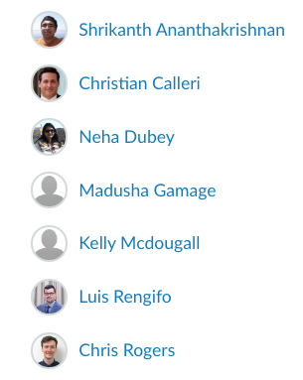
Team My Farm
Name: Role:
Product Owner
Scrum Master
Developer
Developer
Developer
Developer
UX Designer
Notes:
Luis: let me introduce the My Farm Team.

Slide 3
My Farm - Sprint 3 Review
Notes:
Luis: I will now turn it to our product owner, Shrikanth.
Shrikanth:
The purpose of the Sprint Review is to inspect the outcome of the Sprint and determine future adaptations.
I would like to welcome our stakeholders - I am very grateful for your participation, and I am eager to hear your feedback, once we show you the product increment.

Slide 4
Far Vision
We’re the platform where farmers and customers meet

Slide 5
Our Stakeholders

Slide 6
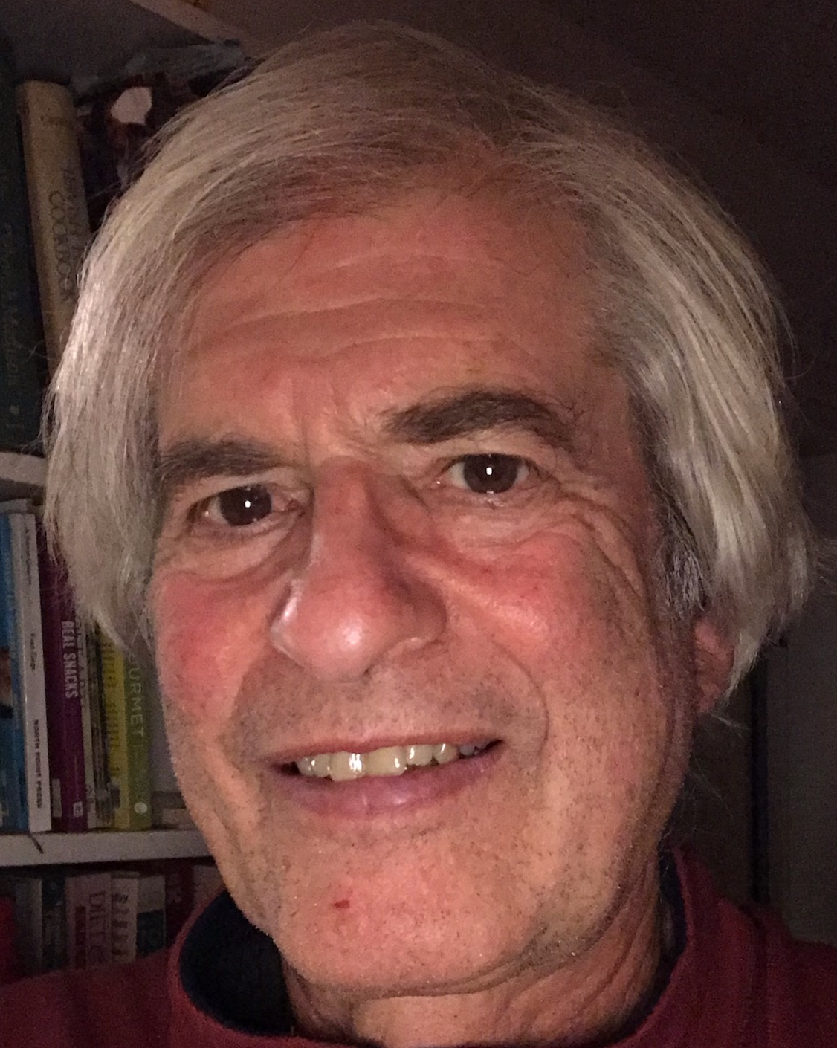
Ari Kurtz, Farmer, 70, Male
Owner: Lindentree Farm
Lincoln MA
As a farmer in Lincoln MA growing organic fruit and vegetables, Ari would like to sell his products in bulk, retail and pick your own. Here are some of his requirements:
Outreach: Ari currently advertises to an email list of existing customers and through the town’s newspaper. In the age of digital marketing, he would like to advertise his produce to a larger customer base.
Pricing: Ari finds it difficult to determine a fair price for his produce. He visits local grocery stores and other farm stores to come up with a price. He would like a suggested price for his produce that is competitive and profitable.
Notes:
Ari, whos a farmer in lindentree,

Slide 7
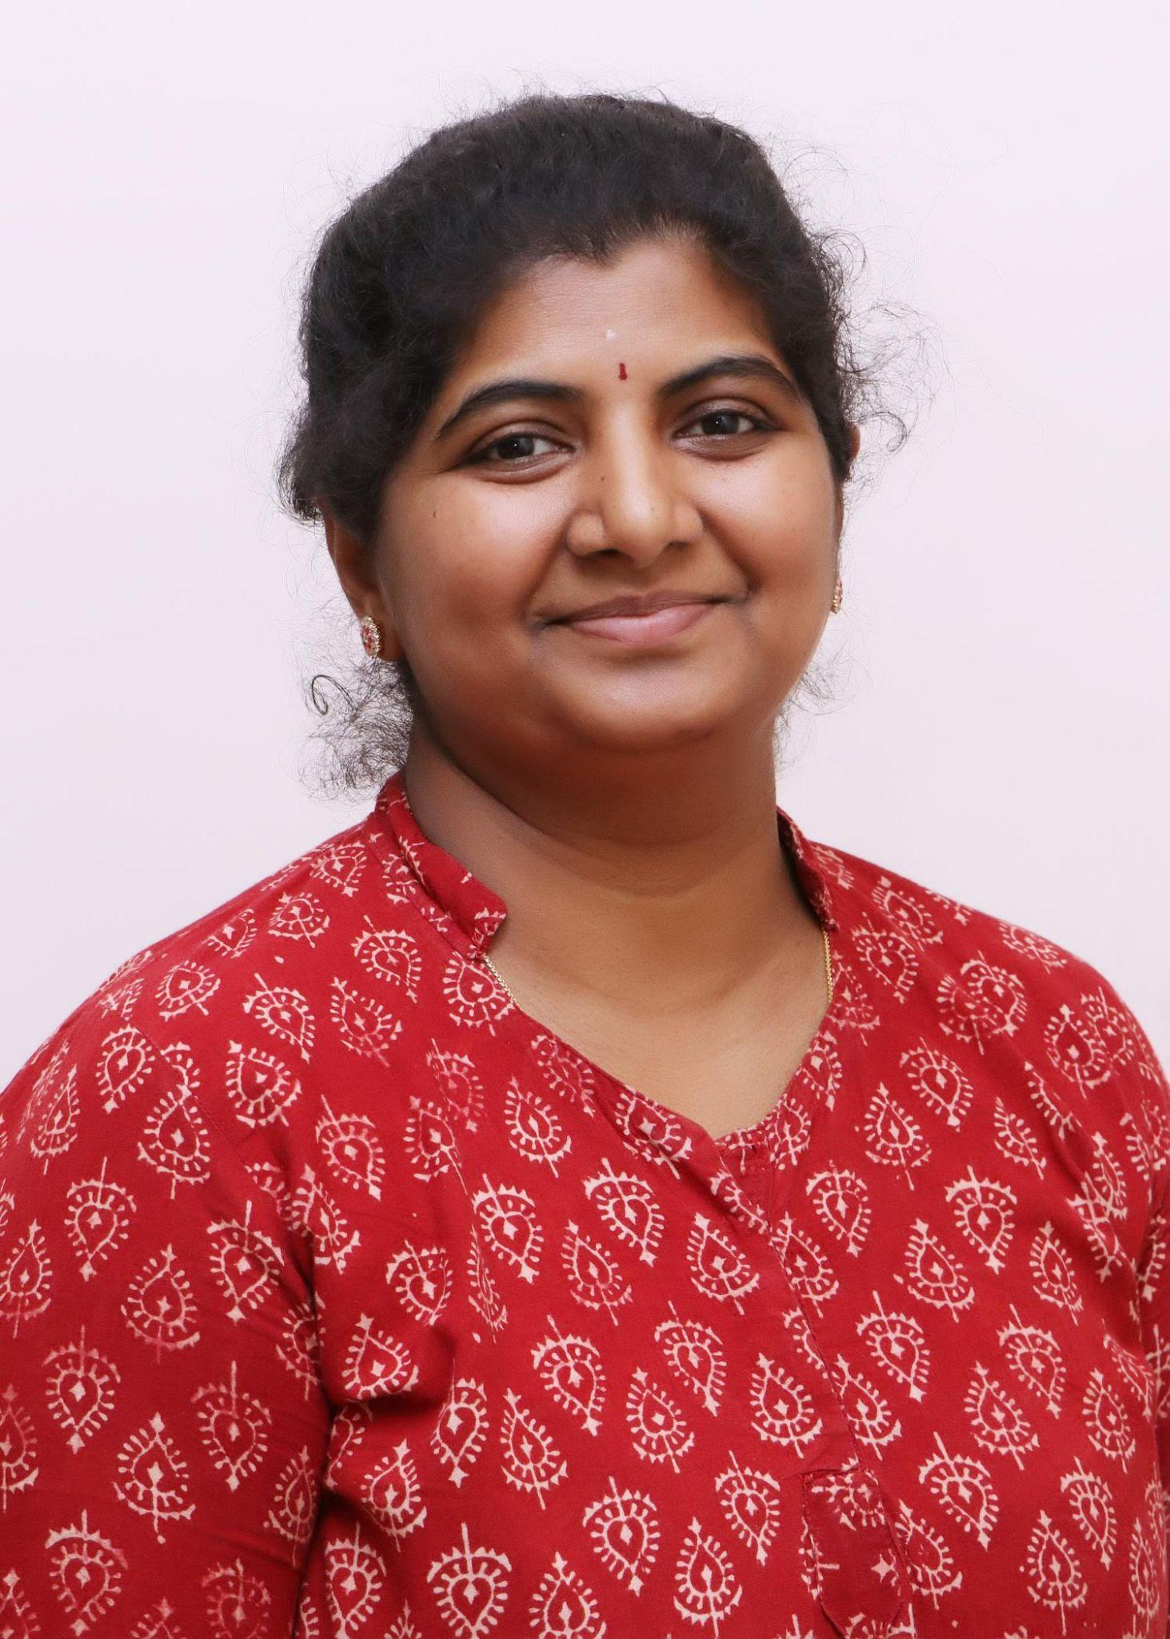
Vijaya Meduri,
Homemaker, 43, Female
Acton MA
Vijaya is primarily responsible for food for her family. She would like to source as much food locally as possible. She gets her information from:
A global mailing list that is shared between farmers and customers, google search and sites like pickyourown.org, massnrc.org, etc.
She then calls up individual farms to check for availability and pickup time
Her problem: She has to do a lot of research to find what is available right now, locally. She would like all of the above on one portal

Slide 8
Mary Hannan,
Farmer, 43, Female
Pittsfield, MA
Mary is a farmer in training grows vegetables and hopes to run a small CSA with a few members as an experiment. As a new entrant she needs the following:
a) A portal to host and market her virtual farm
b) Ability to sell CSA shares online and attract customers
If her venture works out she hopes make farming her full time profession
Notes:
Eliminate?

Slide 9
Near Vision
Allow a farmer to:
Create a virtual farm
List produce available to sell in the market
Indicate where a customer can buy the produce
Allow a customer to:
Search local produce near a given location
Send a message to the farmer with interest to buy the produce
See other produce available at the same location

Slide 10
My Farm - Product Demonstration
Notes:
Luis: we will now conduct a demonstration of the stories completed this Sprint.

Slide 11
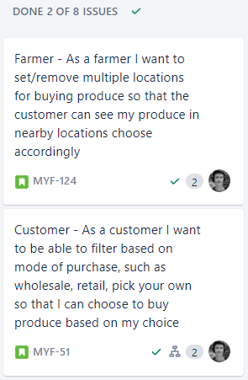
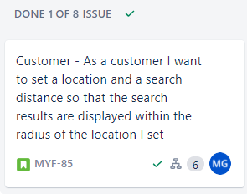
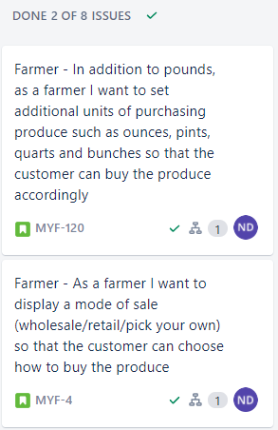
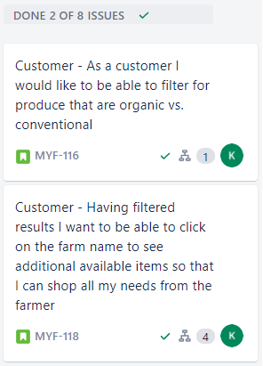
Sprint 3 goal: give the customer more options and tools to find what they want to buy.
Notes:
Luis:
The Sprint 3 Goal: give the customer more options and tools to find what they want to buy.
We completed 7 stories, worth 17 story points as you can see on our Sprint Board.

Slide 12
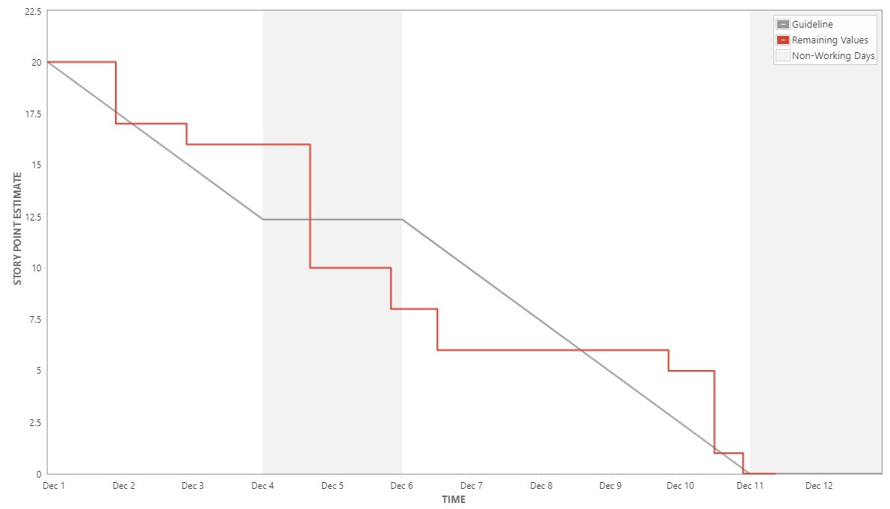
Burndown Chart
https://txmd-webops.atlassian.net/jira/dashboards/10001
Notes:
Luis:
our burndown chart shows that the team has become pretty accurate in its forecasting.
The developers will now demonstrate the product increment.

Slide 13
Stakeholder Feedback
Notes:
Luis: we will now have a very brief session for stakeholder feedback.
Shrikanth: I would like to solicit stakeholder feedback;
What would you like to see in the next sprint.

Slide 14
My Farm - Future Plans
Add functionality to make the farmer experience more flexible. E.g. do not show farm address for wholesale products and add farm days and hours of operation.
Develop Community Supported Agriculture (CSA) functionality.
Add features for suggested pricing
Continue to develop functionality to make the application more customer friendly, such as shopping carts, etc.
Notes:
Shrikanth:
The future plans for My Farm are:

Slide 15
Sprint 4 Forecast
Add functionality for the farmer, such as days and hours of operation, the option to show the farm’s address or not, customer contact preferences.
Develop the foundation for Community Supported Agriculture (CSA) functionality.
Notes:
Shrikanth:
In sprint 4 we will focus on developing the foundation of the Community Shared Agriculture (CSA) functionality, and on developing the customer shopping cart functionality.
To summarize this Sprint Review, we made great progress in making the product much more customer friendly by adding more advanced search functionality for products, and for farm locations.
I would like to sincerely thank our stakeholders for being here today for the sprint review and for their support, and to the scrum team for all their hard work.

Slide 16
My Farm

Slide 17
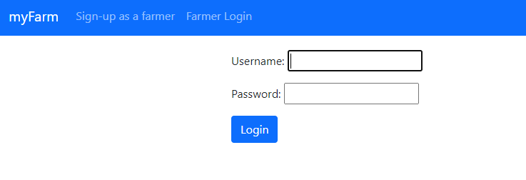
Screenshots
Appendix:
Step 1: Sign-up as a farmer
Credentials user name: Strawberry_Farmer
first name: Strawberry
last name: Farmer
email address: chriscalleri@gmail.com
pw: Agile-Class-1

Slide 18
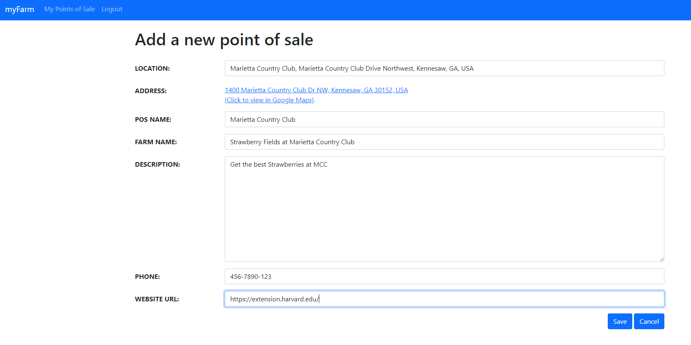
Screenshots
Appendix:
Step 2: Add a new point of sale

Slide 19
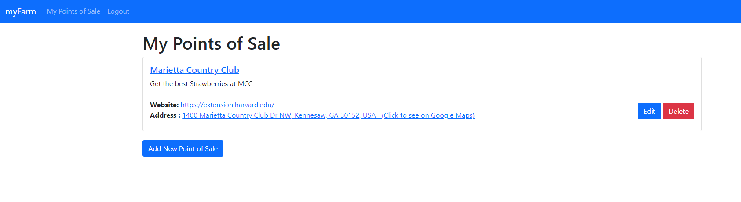
Screenshots
Appendix:
Step 3: My Point of Sale screen

Slide 20
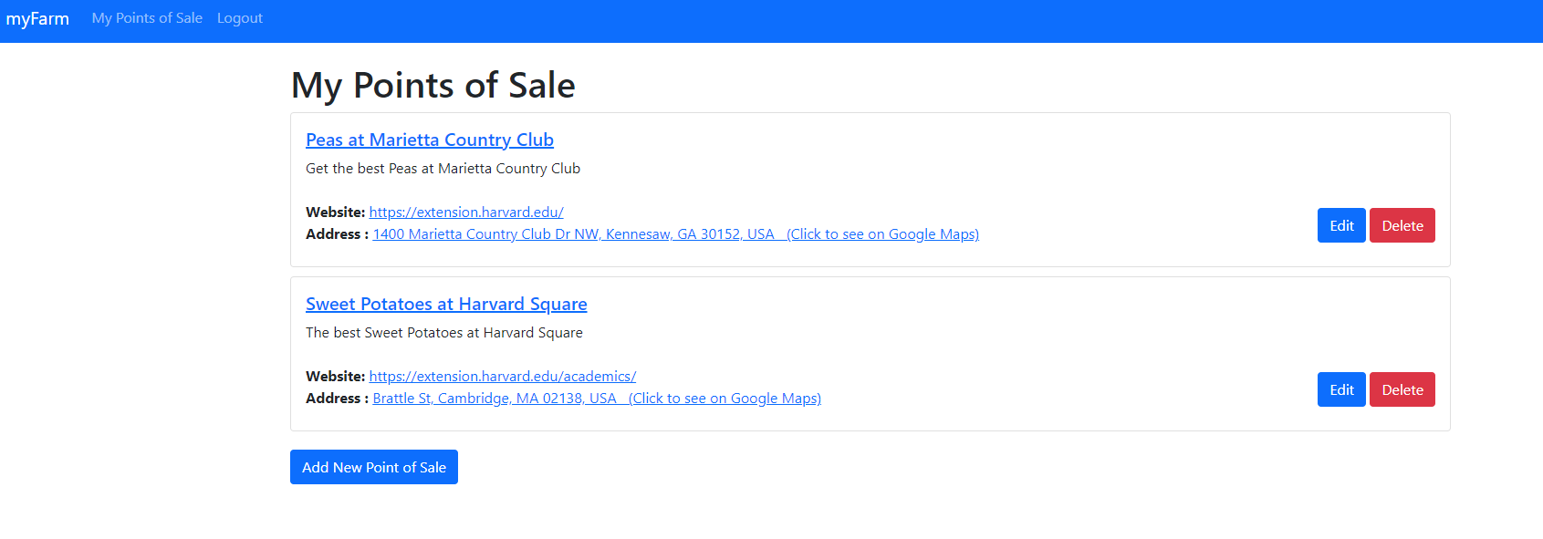
Screenshots
Appendix:
Step 4: My Points of Sale with Multiple Physical Locations, Physical Addresses, Names and Website URLs.

Slide 21
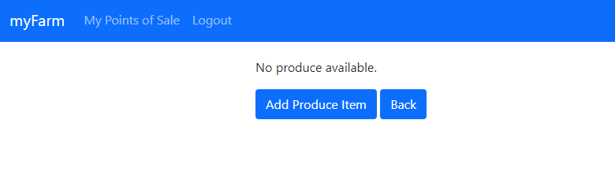
Screenshots
Appendix:
Step 5: Add Produce Item

Slide 22
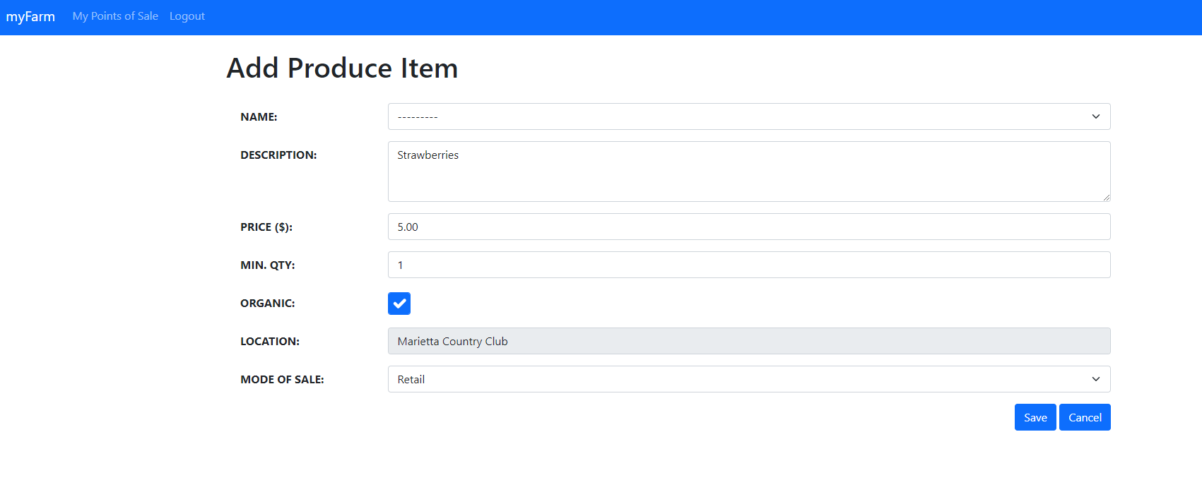
Screenshots
Appendix:
Step 6: Add Produce Item

Slide 23
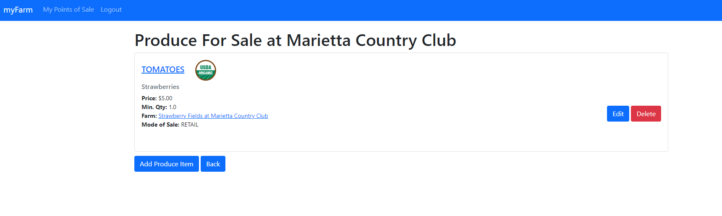
Screenshots
Appendix:
Step 7: Produce for Sale screen

Slide 24
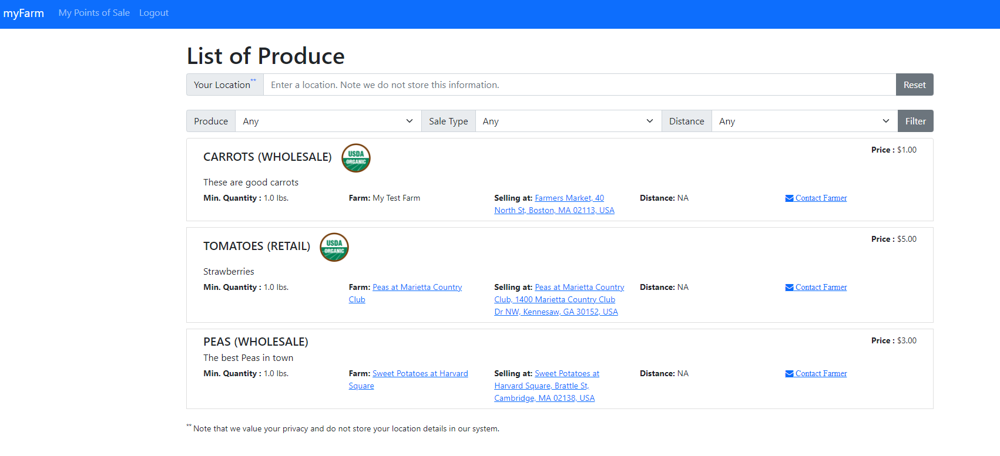
Screenshots
Appendix:
Step 8: List of Produce

