Slide 1
TRACK 2 · THE AGENT THAT CAN EXPLAIN WHY
TraceHarbor
One shipment.
Four conflicting stories.
An operations analyst needs a defensible explanation
for a disputed cold-chain temperature exception.
MANIFEST · TELEMETRY · INCIDENTS · CALIBRATION
TRACEHARBOR / OPEN AGENT HACKATHON 2026
1
Notes:
TraceHarbor is a focused prototype for an operations analyst investigating a disputed temperature alarm. The supplied records are synthetic. The problem and proposed value are a hypothesis; no customer study or measured savings is claimed.
Evidence and sources:
https://traceharbor.web.app
https://github.com/madvidd/GenAI.works_Hackathon/blob/main/data/README.md

Slide 2
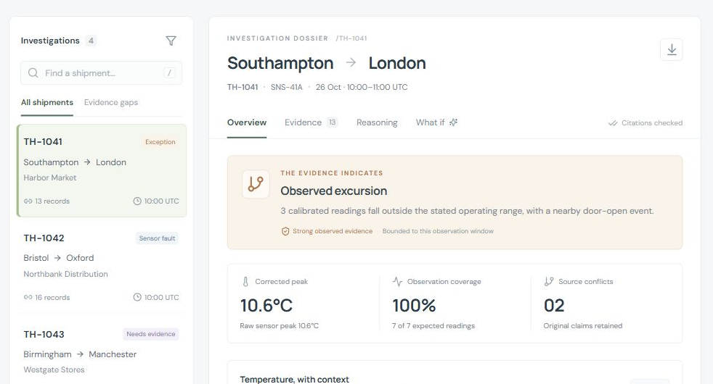
SOLUTION
A dossier the operator can inspect
Findings cite the records.
Conflicts stay visible.
Missing evidence stays missing.
The next action belongs
to the human operator.
TRACEHARBOR / OPEN AGENT HACKATHON 2026
2
Notes:
The screenshot is a real capture from the deployed website. The public site computes synthetic sample results locally. It is not evidence that local Zetaris or Nightshift services executed. The interface presents source-backed findings and preserves contradictory operational claims. It never approves cargo release.
Evidence and sources:
https://traceharbor.web.app
docs/images/traceharbor-desktop.png
core/investigator.mjs

Slide 3
AGENT WORKFLOW
The critic has a concrete job
01
Plan retrieval
Choose the evidence needed for the question.
02
Read and reconcile
Query governed sources; build World Model context.
03
Challenge the answer
Request missing evidence; withhold a key assumption.
04
Recompute and explain
Return supported findings, citations and next actions.
BOUNDED LIVE PATH: 3 MODEL CALLS · 4 UNIQUE SQL READS · 5 MINUTES
TRACEHARBOR / OPEN AGENT HACKATHON 2026
3
Notes:
This slide describes the implemented live path, not a successful sponsor-model run. Planner and critic choices are restricted to allowlisted evidence operations. The deterministic core owns temperature arithmetic and verdicts. The live orchestrator must stop on transport errors and never silently fall back to the sample dataset. Verify the current implementation and corresponding tests before presenting.
Evidence and sources:
server/agent.mjs
core/investigator.mjs
tests/runtime.test.mjs
docs/architecture.md

Slide 4
TECHNICAL STACK
Two ways to run the same evidence core
PUBLIC SAMPLE
LOCAL LIVE COMPANION
React + Vite
Firebase Hosting
Synthetic source records
Local deterministic computation
Node.js structured runner
Zetaris REST + semantic layer
Official Meterless World Model
Nightshift model requests
traceharbor.web.app
Private service credentials stay server-side.
TRACEHARBOR / OPEN AGENT HACKATHON 2026
4
Notes:
The website is deployed and independently verified with four feeds and the evidence-withholding interaction. The public frontend cannot access the builder’s loopback services. The local companion serves the built frontend and a bounded same-origin investigation API. No service tokens are embedded in the frontend bundle.
Evidence and sources:
https://traceharbor.web.app
server/http.mjs
server/agent.mjs
.env.example
firebase.json

Slide 5
SPONSOR TECHNOLOGY
Receipts determine what we claim
Technology | Role | Verified state
Meterless World Model | Evidence state and provenance | Local feature test + 8/8 conformance
Zetaris | Four feeds, USL, data quality | Implementation present; execution pending
Meterless Nightshift | Primary live model route | Runtime reachable; provider needed
NVIDIA Nemotron | Optional model through Nightshift | No verified model request
Codex assisted implementation. Cursor usage is not claimed.
TRACEHARBOR / OPEN AGENT HACKATHON 2026
5
Notes:
This status is deliberately evidence bounded. The official World Model is vendored at revision 1742dec56a66e58eef9dda2d2b865823758ca8cd with its Apache-2.0 license retained. Its upstream conformance runner passed eight of eight. At this build, Nightshift is installed and authenticated models discovery succeeds, but a real completion returns no_provider_configured. Update only after actual successful receipts exist. Network-mocked orchestration tests do not count as sponsor execution.
Evidence and sources:
metadata.json
core/vendor/meterless-world-model/UPSTREAM.md
docs/sponsor-technology.md
https://github.com/Meterless/Meterless

Slide 6
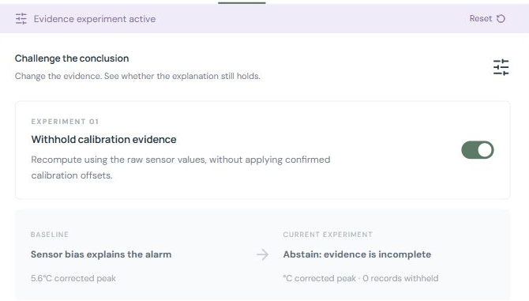
WHAT IS DISTINCTIVE
Remove the evidence. Recompute the answer.
TH-1042
Calibration available
Sensor bias explains
the alarm.
Calibration withheld
Abstain: evidence
is incomplete.
TRACEHARBOR / OPEN AGENT HACKATHON 2026
6
Notes:
The actual browser experiment was verified after deployment. This is evidence sensitivity, not proof of experimental causality. The original full source record remains available. In the synthetic dataset a valid +4.5 degree sensor offset and independently calibrated reference readings support the bias explanation. Removing calibration prevents that explanation from being accepted.
Evidence and sources:
https://traceharbor.web.app
docs/images/calibration-counterfactual.png
core/investigator.mjs
data/calibration.json
tests/investigator.test.mjs

Slide 7
PRODUCT AND EVALUATION
Different records produce different conclusions
Synthetic case | What the evidence tests | Computed result
TH-1041 | Calibrated peaks + conflicting claims | Observed excursion
TH-1042 | Valid offset + agreeing reference | Sensor bias
TH-1043 | Missing observations + uncertain calibration | Insufficient evidence
TH-1044 | Complete bounded observations | Within observed range
14 local tests passed
8 / 8 upstream engine checks passed
TRACEHARBOR / OPEN AGENT HACKATHON 2026
7
Notes:
These are synthetic functional scenarios, not a clinical or commercial benchmark. Tests cover changed inputs, invalid samples, expired or conflicting calibration, source provenance and abstention. Official World Model conformance covers identity, merge boundaries, provenance rejection, change detection, bitemporal relationships and audit behavior. Orchestration transports in automated tests are mocked. The public website and local sample runs were separately exercised.
Evidence and sources:
tests/investigator.test.mjs
tests/runtime.test.mjs
logs/runs
metadata.json

Slide 8
NEXT STEPS AND LIMITS
Make the explanation useful in real operations
01 Finish live integration receipts
02 Validate with an operations analyst
03 Time a fair manual-versus-assisted study
Synthetic evidence today. No measured savings,
causal proof, release approval or safety certification.
traceharbor.web.app
github.com/madvidd/GenAI.works_Hackathon
TRACEHARBOR / OPEN AGENT HACKATHON 2026
8
Notes:
The next validation is a repeatable comparison on the same case files, with identical questions and scoring, separating one-time setup from investigation time and reporting errors as well as time. Any savings estimates elsewhere in the submission are explicitly unmeasured assumptions. A human remains responsible for operational decisions. No claim of guaranteed competition success is made.
Evidence and sources:
https://traceharbor.web.app
https://github.com/madvidd/GenAI.works_Hackathon
docs/zetaris-reflections.md
docs/requirements-matrix.md

