Slide 1
A
PRESENTATION ON
BOOT CAMP ASSIGNMENT
“PROXY CMD”
BY
YUGESH BHOSALE
(GS-1013)
MENTOR - MAHENDRAKUMAR PATEL

Slide 2

AGENDA
Introduction
Problem Statement
Technical Design
Implementation
Overall Flow
Demo
References
Q & A

Slide 3
INTRODUCTION
Three Components:
1. Hive Manager
2. Hive Agent
3. Switch

Slide 4
INTRODUCTION
Hive Manager
HiveManager (HM) is Aerohive’s centralized network management system.
HM is deployed on the public cloud.
Access points on the enterprise side are connected to the Switches and Switches are connected to the router.
Communication between public network and private network is through router.
HiveManager can not initiate the communication.

Slide 5
INTRODUCTION
Hive Agent
Hive Agent (HA) is deployed on one of the access point which is connected to the Switch.
This Hive Agent is helping HiveManager to communicate with the Switch to which HA is connected.
On HiveAgent ProxyCmd (?) is running and actually this is responsible for the comminication between the HiveManager and Switch.

Slide 6
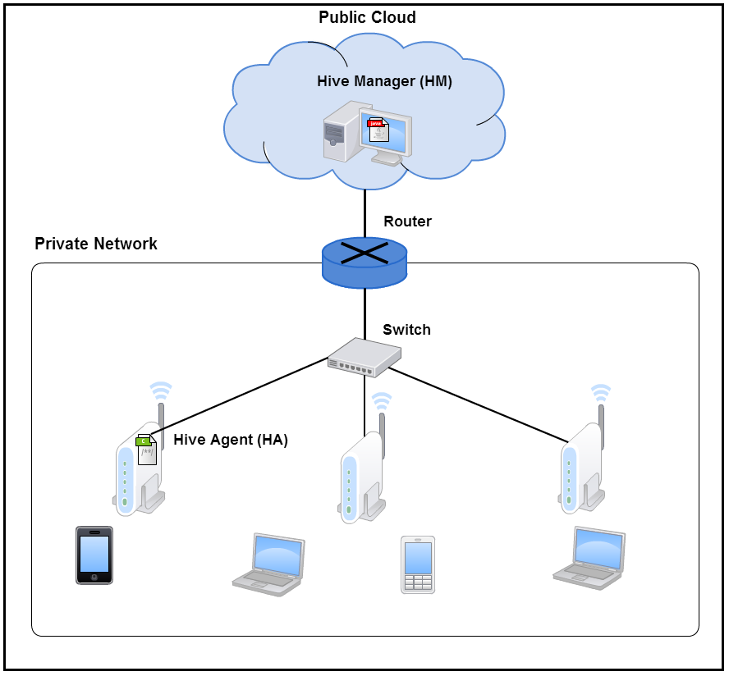
INTRODUCTION

Slide 7
PROBLEM STATEMENT
HiveManager wants to access the Command Line Interface (CLI) of the Switch.
HiveManager is on public cloud and can not initiate comunication with Switch which is in the private network at enterprise side.
Hive Manger can request the HiveAgent for command line interface (CLI) of switch, which is reside on enterprise side.
HiveAgent only access the switch terminal as it is in same network but directly Hive Manger will not.
In current requirement only single terminal session is allowed to access the console.

Slide 8
TECHNICAL DESIGN
ProxyCmd
ProxyCmd is a program (in C) running on the HiveAgent and responsible to create the tunnels between HA-HM and HA-Switch.
It uses Secure SHell (SSH) for the communication which is initiated by the HiveManager.
By using Local port forwarding and Remote port forwarding a secure tunnel is created to access the CLI of the Switch.
HiveManager can initiate the request by passing credentials of the HM and HA to the ProxyCmd and then ProxyCmd creates the tunnel between HM and HA by using remote port forwarding and a tunnel between HA and Switch by using local port forwarding.

Slide 9
TECHNICAL DESIGN
Forwarding Connections
“Port forwarding comes in SSH protocol in two different flavours: direct and reverse port forwarding. Direct port forwarding is also named local port forwarding, and reverse port forwarding is also called remote port forwarding”

Slide 10
TECHNICAL DESIGN
I. Direct Port Forwarding
“Direct port forwarding is from client to server. The client opens a tunnel, and forwards whatever data to the server. Then, the server connects to an end point. The end point can reside on another machine or on the SSH server itself.”

Slide 11
TECHNICAL DESIGN
II. Reverse Port Forwarding
“The reverse forwarding is slightly different. It goes from server to client, even though the client has the initiative of establishing the tunnel. Once the tunnel is established, the server will listen on a port. Whenever a connection to this port is made, the server forwards the data to the client.”

Slide 12
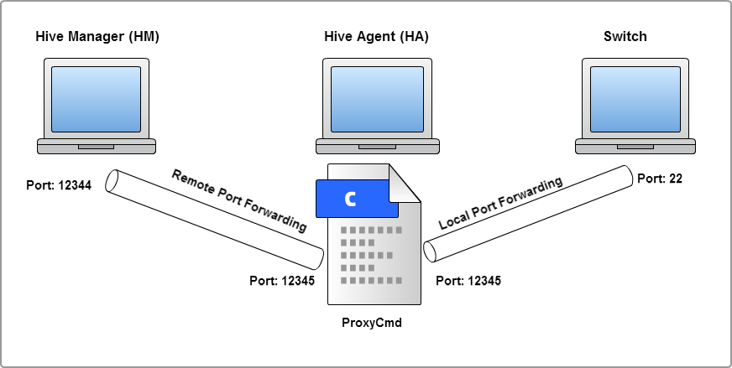
TECHNICAL DESIGN

Slide 13
IMPLEMENTATION
ProxyCmd: is implemented in C using libssh2-1.6.0 and pthread libraries.
In ProxyCmd.c file two threads are created first thread is RemotePortForwarding and another one is LocalPortForwarding.
Flask: is a micro lightweight web application framework written in Python.
Flask app is running on the HA receives the credentials (POST method) from the HM and call's the ProxyCmd by passing these credentials and then ProxyCmd creats the tunnels.
By sending GET request to Falsk app HM can download log file.
Once the tunnels creates successfully HM can access the CLI of switch on browser using Shell in a box server.

Slide 14
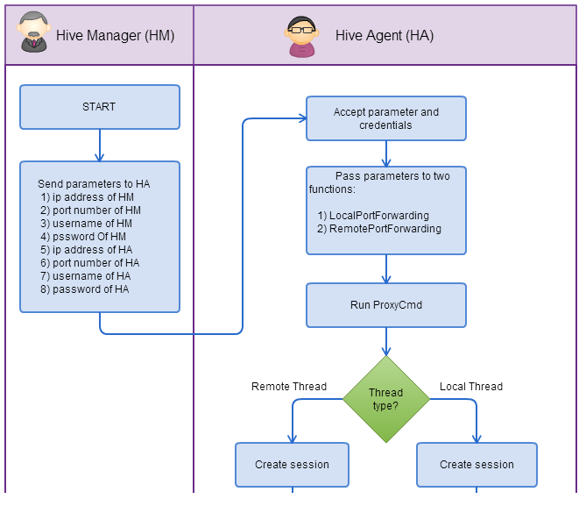
OVERALL FLOW

Slide 15
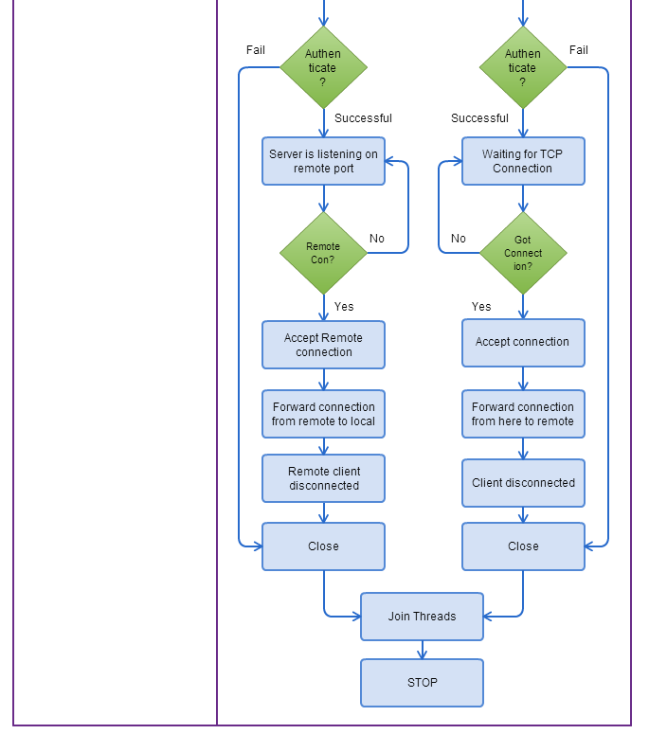
OVERALL FLOW

Slide 16

DEMO
DEMO

Slide 17
REFERENCES

Slide 18
ANY QUESTIONS
?
“ THANK YOU ”
FOR YOUR TIME
&
KIND ATTENTION

