Slide 1
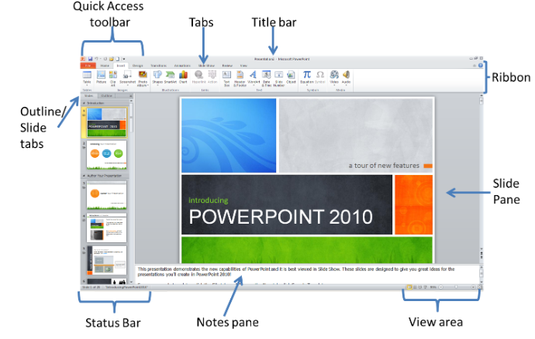
MS PowerPoint Elements
SUFFICIENT SLEEP
Omar Shah

Slide 2
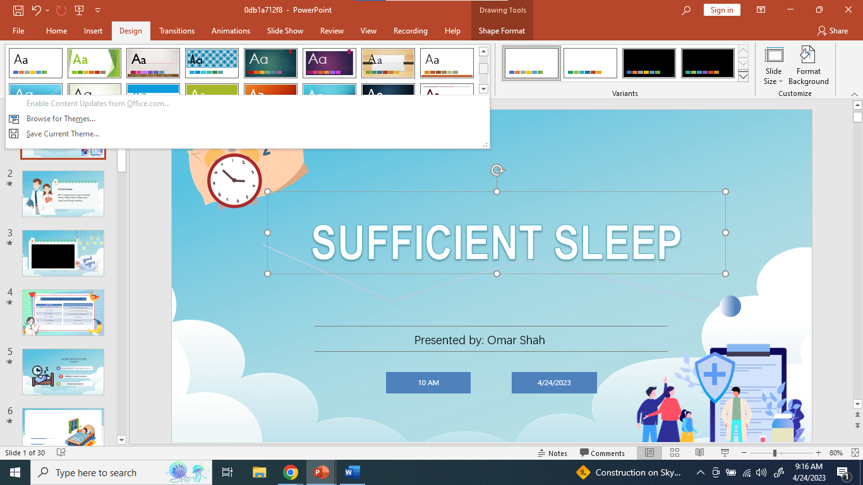
ADDING TEMPLATES TO POWERPOINT
Click “Design”
Choose “browse your themes”
Attach your downloaded themes/templates

Slide 3
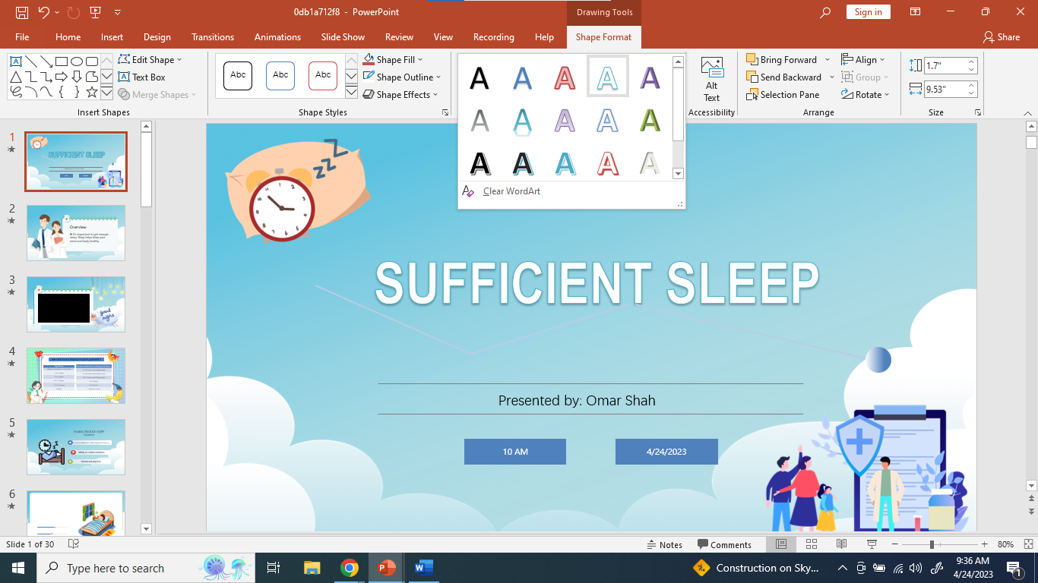
ADDING WORDART STYLES
Click the text you want to edit.
Go to “Shape Format” tab
Choose the style you want

Slide 4

ADDING TEXT SHADOW AND BOLD TO TEXT
Again, click the text you want to edit.
Go to “Home” tab and
Press the Text Shadow (S) icon.
Press the Bold (B) icon.

Slide 5
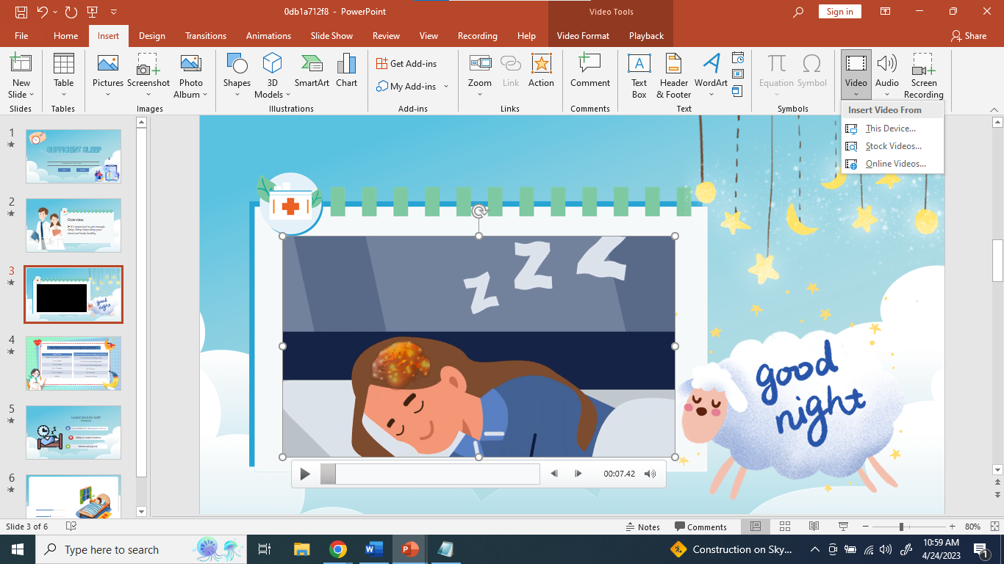
ADDING VIDEO TO POWERPOINT
Click the “Insert” tab
Press the “Video” icon
Select where the video will be coming from

Slide 6
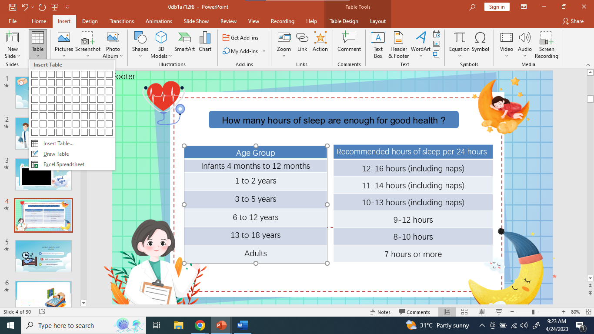
ADDING TABLE TO POWERPOINT
Click the “Insert” tab
Click the “Table” icon
Choose the desired table size (E.g. 1x7)

Slide 7
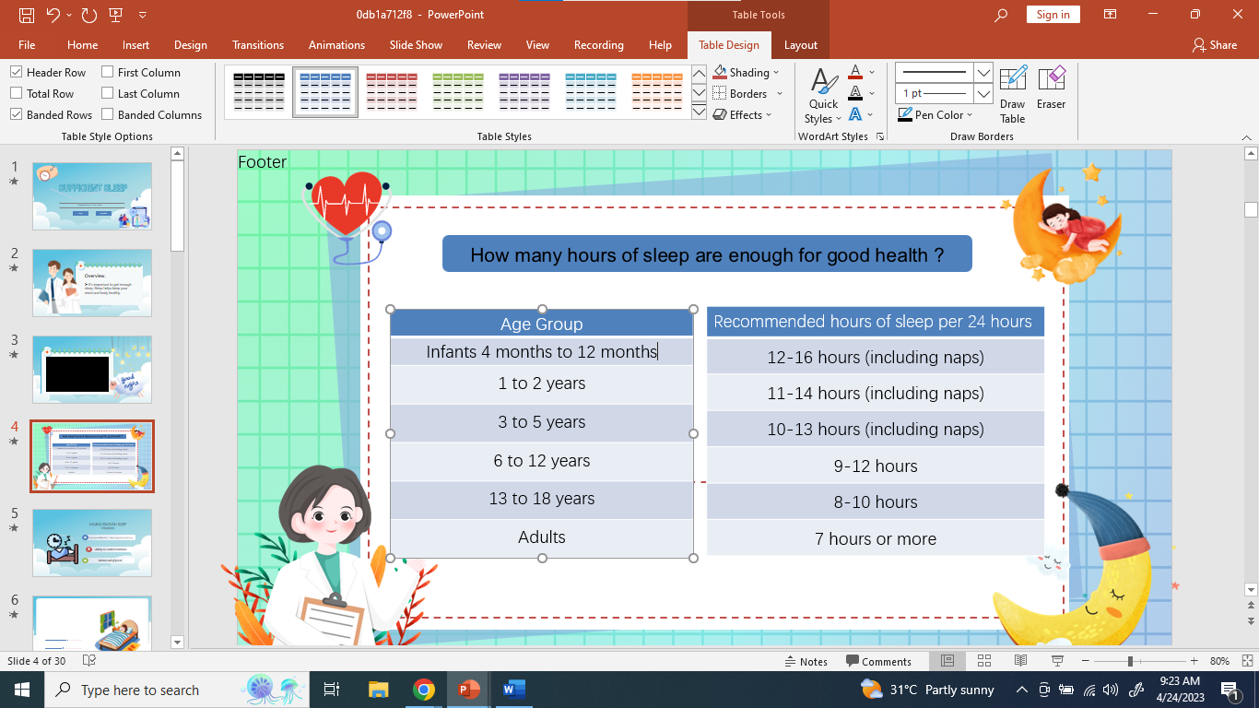
ADDING DESIGN TO THE TABLE
Click the table you want to edit
Select “table design”
Choose the preferred table style

Slide 8
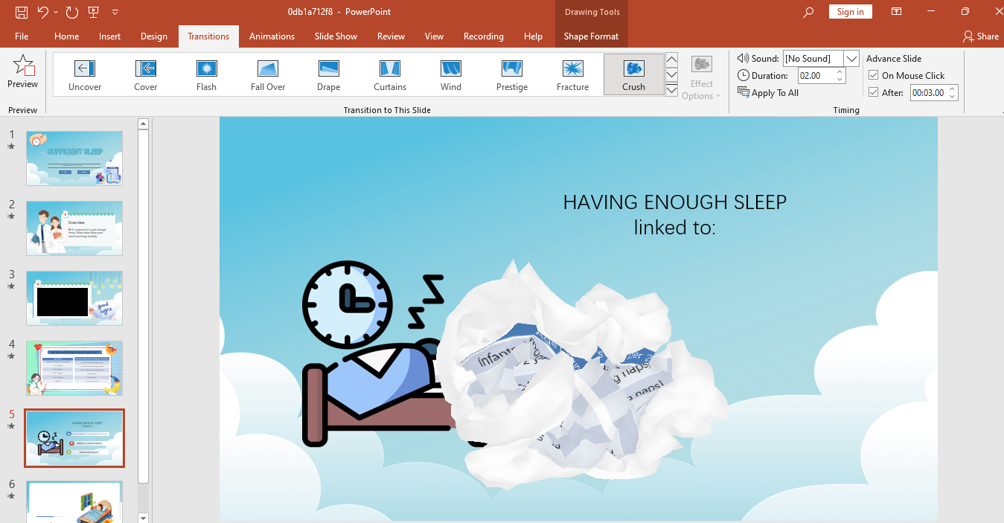
ADDING PAGE TRANSITION
Click the page you want to animate
Select “Transition”
Choose the preferred transition style

Slide 9
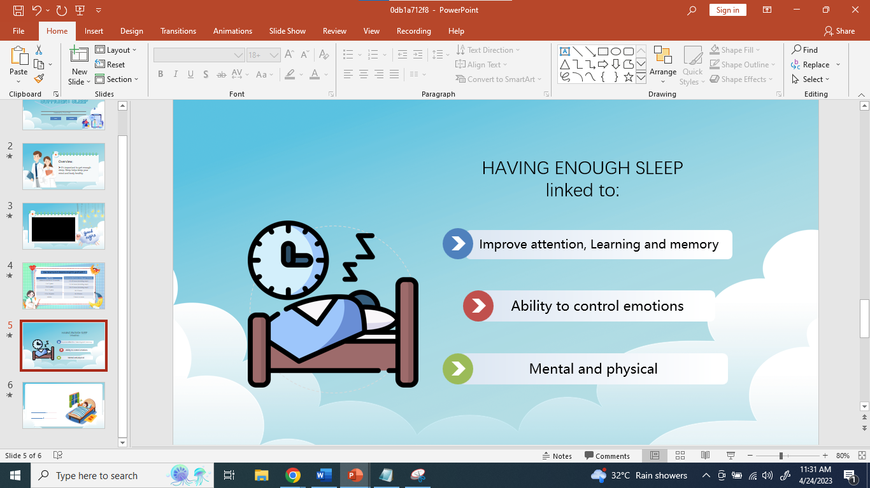
TRANSITION OUTPUT

