Slide 1
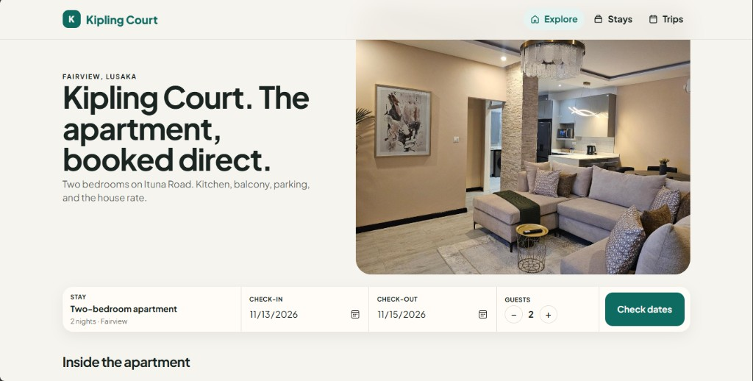
PITCH · GUEST JOURNEY
Kipling Court.
Booked direct.
A house-rate booking site for one Fairview apartment — without Booking.com commission.
Direct booking · Fairview, Lusaka
01 / 11

Slide 2
K
KIPLING COURT
The problem
1
2
3
Marketplace fees
OTAs take a large cut on every stay. That tax sits on a small Lusaka apartment.
Someone else’s brand
Guests land on Booking.com, not on Kipling Court.
No control of the journey
Photos, rates, and checkout live on a platform you do not own.
Direct booking · Fairview, Lusaka
02 / 11

Slide 3
K
KIPLING COURT
The product
One apartment. One brand. Direct pay.
WHAT
Kipling Court 1, Apartment 3, Ituna Road, Fairview, Lusaka
STAY
Two bedrooms · sleeps 4 · kitchen, balcony, parking, Wi-Fi, hot tub
GUEST PATH
Dates → apartment → reserve → dummy checkout → booked
LIVE DEMO
hotelz-bay.vercel.app
Direct booking · Fairview, Lusaka
03 / 11

Slide 4
K
KIPLING COURT
Five steps to a booking
01
02
03
04
05
Explore
Stays
Apartment
Pay
Booked
Headline, photos,
dates and guests
Availability, collage,
map on Ituna Road
Rooms, amenities,
Reserve
Visa, Mastercard,
Airtel, MTN MoMo
Trip saved on
this device
Direct booking · Fairview, Lusaka
04 / 11

Slide 5
K
KIPLING COURT
01 Explore
The home page is only this apartment. Guests pick dates and guests, then check availability.
Direct booking · Fairview, Lusaka
05 / 11

Slide 6
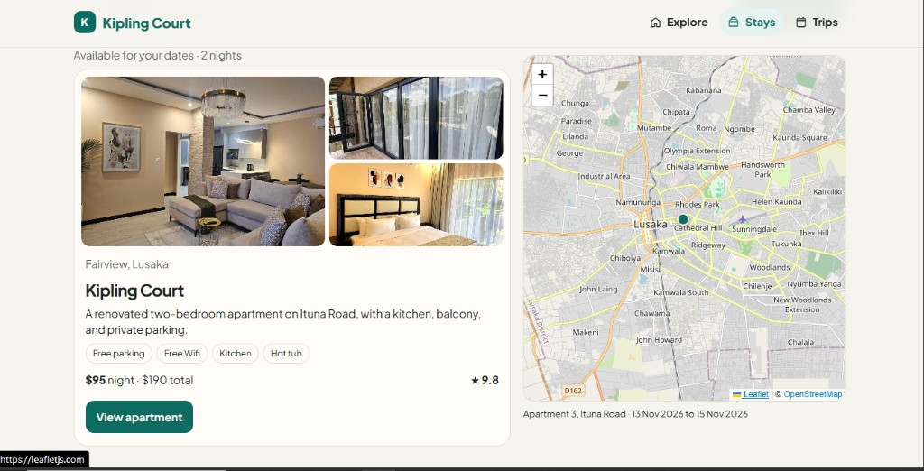
K
KIPLING COURT
02 Stays
Availability, photos, amenities, nightly rate, and the map pin on Ituna Road.
Direct booking · Fairview, Lusaka
06 / 11

Slide 7
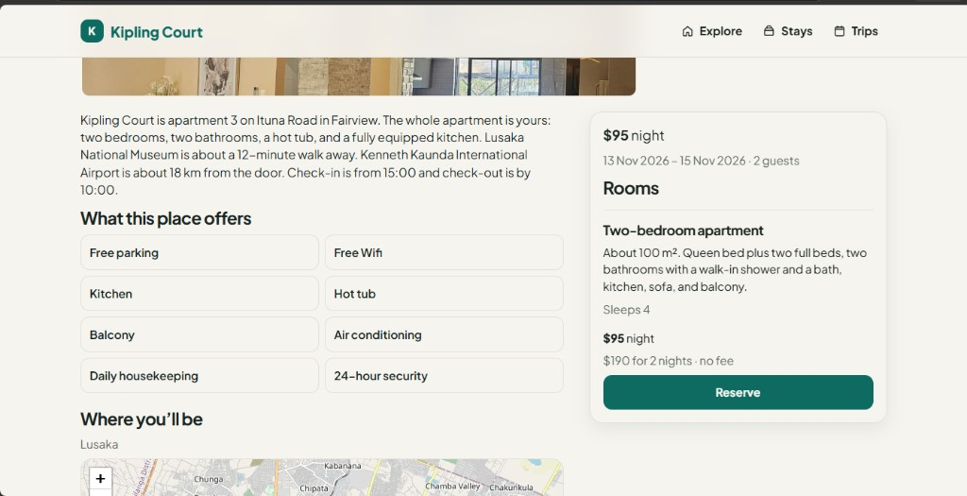
K
KIPLING COURT
03 The apartment
Full description, what is included, and a reserve card with the stay total.
Direct booking · Fairview, Lusaka
07 / 11

Slide 8
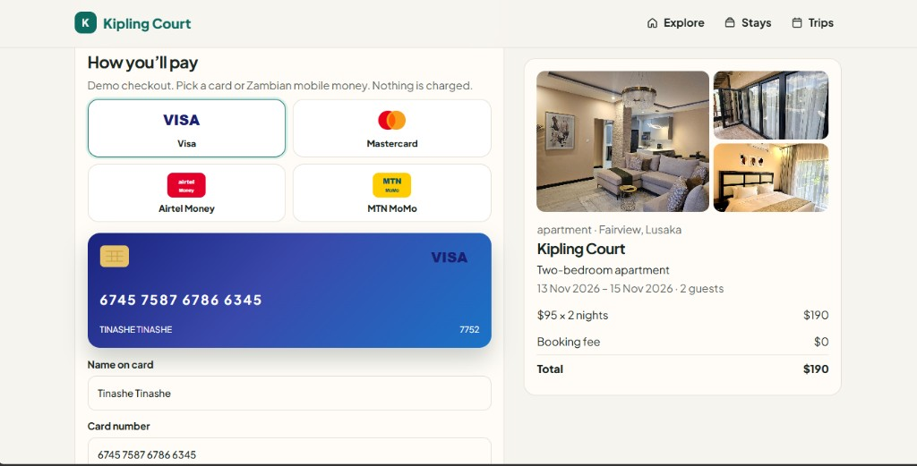
K
KIPLING COURT
04 Checkout
Guest details plus a dummy pay step. Nothing is charged. The method name is saved.
Direct booking · Fairview, Lusaka
08 / 11

Slide 9
K
KIPLING COURT
How Zambia guests pay
Demo checkout only. Looks real. Does not take money.
Visa
Card
Mastercard
Card
Airtel Money
Mobile money
MTN MoMo
Mobile money
Direct booking · Fairview, Lusaka
09 / 11

Slide 10
K
KIPLING COURT
Talking points
1
This is the company’s own site, not a listing rented from Booking.com.
2
The guest never leaves Kipling Court. Photos, map, and pay stay in one place.
3
Checkout is a demo: Visa, Mastercard, Airtel Money, MTN MoMo — no charge.
4
Next: real rates, WhatsApp confirmations, and a live payment provider.
Direct booking · Fairview, Lusaka
10 / 11

Slide 11
Open the site. Walk the stay.
Show the dummy pay.
https://hotelz-bay.vercel.app
Slideshow in the app · /present

