Slide 1
Grade 8 Geometry
Mary Grace P. Esteban Angel Mae C. Pajarillo

Slide 2
TOPIC: THE MATHEMATICAL SYSTEM OF GEOMETRY

Slide 3
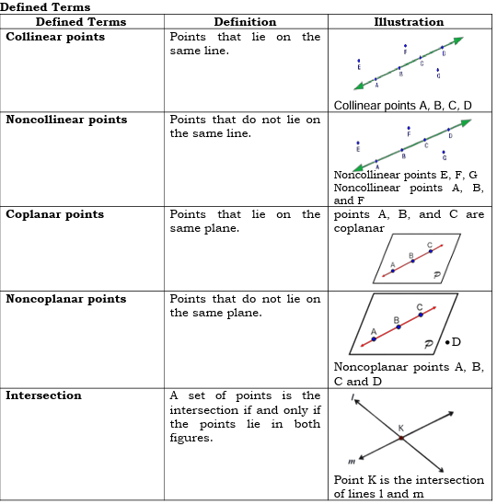
LESSON 2: DEFINED TERMS, UNDEFINED TERMS, POSTULATES AND THEOREMS
Lesson Objectives:
At the end of the lesson, the students should be able to:
illustrates defined terms, undefined terms, postulates and theorems; and
identify the postulates or theorems being referred in the given statement.
What’s in!
Recall: Point, Line, and Plane
Directions: Determine whether each of the following suggests a point, a line or a plane.
straight wire
pinhole
sheet of paper
period
stick
What’s New Directions: Write something about the following terms using your previous learning in geometry.
Point
Line
Plane
What is It
Points, lines, and planes are the building blocks of geometry. They are the undefined terms in geometry because they can be described without using other figures.
The undefined terms are used to define other geometric concepts. Here are some of the defined terms formed from the undefined terms.

Slide 4
POSTULATE | ILLUSTRATIONS
1.A line and a plane contain an infinite number of points.
2. Line Postulate Two points determine exactly one line.
3. Plane Postulate Three noncolinear points determine a plane.
4. If two points are on a plane, then the line containing them is at the same plane.
5. If two planes intersect, then their intersection is a line.
Postulates and Theorems
Postulates also known as axioms are statements accepted as true without proof.

Slide 5
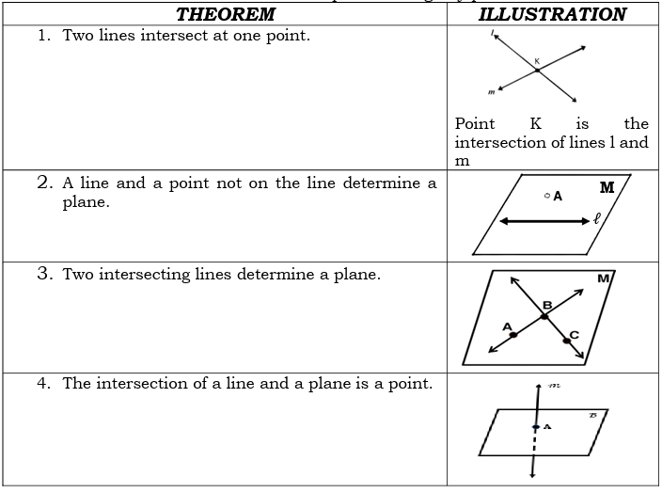
Theorems are statements that need to be proven using any postulate or theorem.

Slide 6
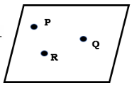
What’s More
Now it’s your turn!
Answer the activity below to solidify your understanding and skills of the topic.
Activity 1.2
I. Directions: Illustrate and label the following.
Line CD
Point C on plane D
Three non-collinear points A, B and C on plane K.
Lines l and m intersect at point X.
Planes P and R intersect at $\overline{AB}$.
Directions: State the postulate or theorem that makes each of statement true. Refer to the postulates and theorems stated above.
Given: three non-colinear points P, Q and R.

Slide 7
Points P and Q lie in line segment 𝑃𝑄.
Points P, Q and R are contained in plane PQR.
line segment 𝑃𝑄 lies on plane PQR.
line segment 𝑃𝑄 and point R lie on plane PQR.
line segment 𝑃𝑄 and line segment𝑄𝑅intersect only at point Q.

