Slide 1
Cryptography
Maeda Hanafi

Slide 2
Preview
Cryptography I: AES algorithm implementation
Cryptography II:
Message Tampering
Replay Attacks

Slide 3
Chat Server
Assumptions: Pre-shared keys
Weaknesses: can’t easily change the keys. But even with RSA, one can’t necessarily prevent impersonation

Slide 4
AES implementation
http://csrc.nist.gov/publications/fips/fips197/fips-197.pdf

Slide 5
Preview
Cryptography I: AES algorithm implementation
Cryptography II:
Message Tampering
Replay Attacks

Slide 6
Goals
Prevent Message Tampering
Prevent Replay Attacks
Verifying authenticity of message
HMAC-SHA1 + timestamps

Slide 7
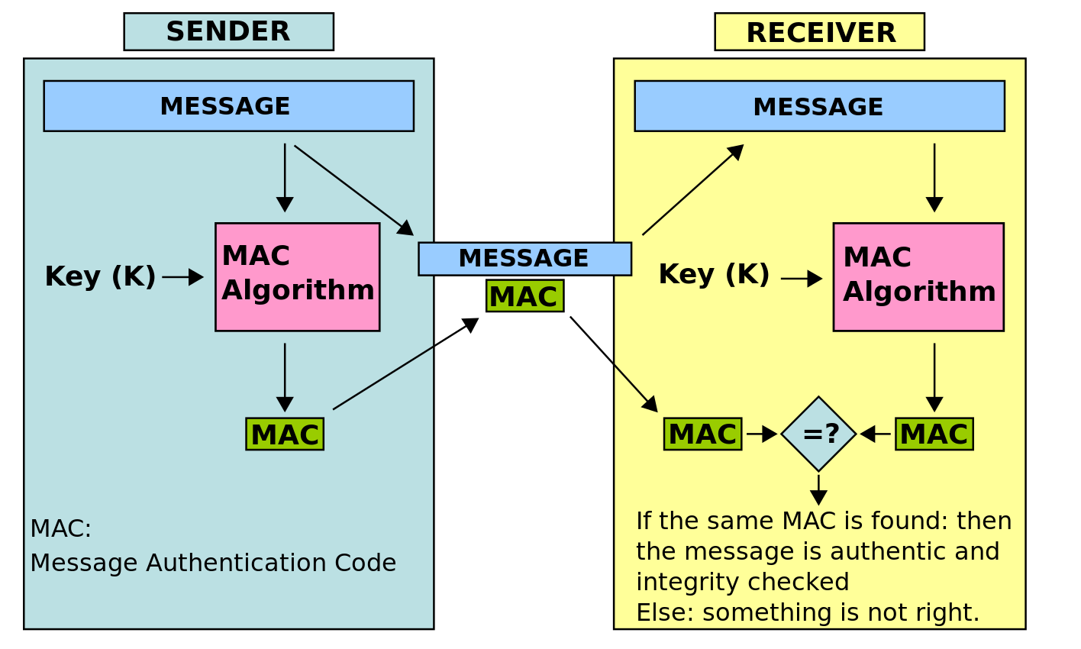
MAC: Verifying Messages

Slide 8
Weaknesses
HMAC for message authenticity
Not protected against non-repudiation.
Works well with symmetric encryption schemes IF the secret key remains secret

Slide 9
Prevent Replay Attack: Improvement to HMAC
Check messages against timestamp, making each message uniquely sent at a given
Receiver
Latest Message: T55
AES CBC Encryption + HMAC
[T44]: Meet up now!

Slide 10
Weaknesses in the whole system
Pre shared key required, and if it is compromised the whole system is too, keys cannot easily be restarted
RSA, keys can be restarted; message integrity done by digital signatures + provide non repudiation

Slide 11
HMAC vs RSA
Difference in assumptions about the system
Augment HMAC with session key, shared via RSA
Attacker can’t decrypt messages from that session even with the key

