Slide 1
Neural Networks in Java
Maeda Hanafi

Slide 2
What is a Neural Network?
Simulate brains
Ability to learn and make decisions
Variety of structures, such as SOM, feed forward, Hopfield
Applications
Recognizing patterns
Classifying
Data mining
Series prediction
Notes:
A neural network simulate brains. They have the ability to learn and make decisions. They come in a variety of structures. The one im using in my project is the feedforward one. Applications include recognizing patterns, such as Facebook’s face recognition program. Theres also classifying, data mining, and series prediction. Handwritten recognition would be under classifying

Slide 3
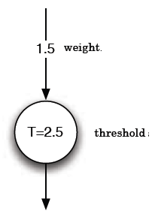
A Single Neuron
Weight amplifies input
If the amplified input is greater than the threshold, then the neuron fires a 1.
Notes:
The basic thing in artificial intelligence is a single neuron. A neuron simply makes decisions. It consists of a weight and threshold. In this example, the weight is 1.5 and the threshold is 2.5. The weight amplifies an input and it is compared against the threshold.

Slide 4
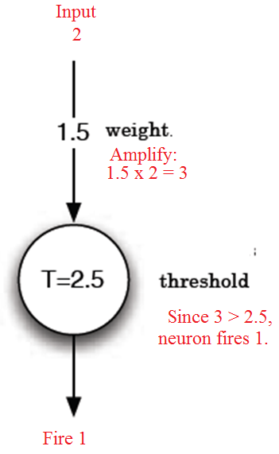
A Single Neuron
Notes:
For example, if the input to this neuron is 2, then 2 times the weight is 3. 3 is then compared against the threshold. Since 3 is greater than 2.5, the neuron outputs a 1. If the amplified weight was less than the threshold, it would fire a 0.

Slide 5
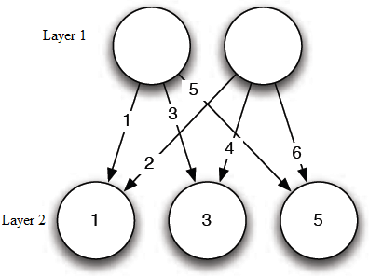
A Feed forward Neural Network
A feed forward network of neurons with 2 layers.
Notes:
This is an example of a network of neurons, which is simply a bunch of neurons. This network has 2 layers and is feed forward because the neurons are connected to the next layer only.

Slide 6
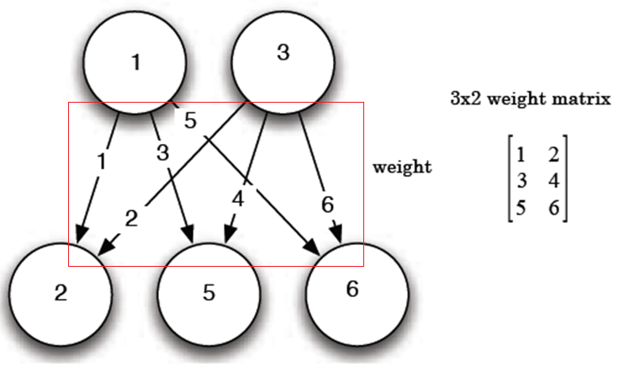
Representing a Network: Matrices
A weight matrix holds the weights between two layers.
Notes:
Matrices are used to represent a network. Weight matrix holds the weights of a layer. In this network, since there are 2 neurons in the first layer and 3 in the 2nd layer, we are going to have a 3 by 2 matrix. So, the weights going to the first neuron belongs in the first row, and so on. In java, this weight matrix would be a 2d array of doubles.

Slide 7
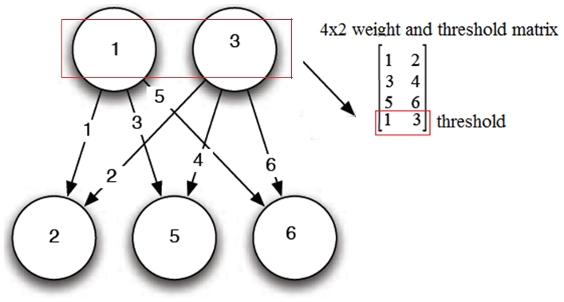
Representing a Network: Matrices
The thresholds are combined with the weight matrix.
Notes:
In addition to the weights, it is also required to store the thresholds. It is a lot easier when the thresholds are combined with the weight matrix. So, a whole network can be represented with multiple weight and threshold matrices, one for each layer excluding the output layer.

Slide 8
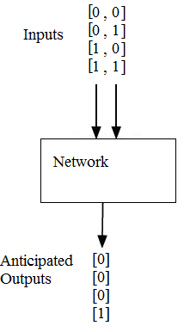
Training: Back propagation
Supervised Training
Given a set of inputs and anticipated outputs
Notes:
Before anything else is done to the network, it is trained. Training means that the network weights are adjusted. In my project, I am using backpropagation learning, which requires a set of inputs and anticipated outputs. Back propagation aims to adjust the weights to get the network to output what is expected. In this iimage for example, for an input of 0, 0, 0, 1, and 1, 0, we expect the network to output 0. and for inputs 1, 1, a 1 is expected

Slide 9
Training: Back propagation
To train:
Compute outputs
Calculate the error of the output layer and then the error of the previous layers.
Adjust weights based on errors.
Repeat until error is low enough.
Notes:
Before the errors are calculated, the outputs of the network are calculated. Then errors are calculated from the output layer to the input layer. The weights are then adjusted based on the errors. The process is then repreated until the error is low enough

Slide 10
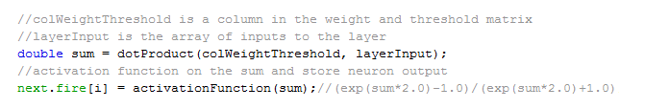
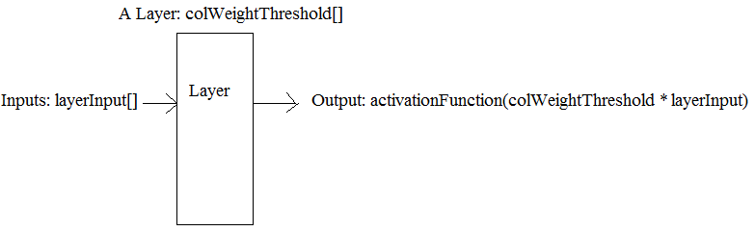
Computing Outputs
Notes:
To compute the outputs of a layer, the sum is calculated by taking the dot product of a column from the weight and threshold matrix and inputs to the layer. The sum is then put into an activation function. An activation function determines the range of values that will cause the neuron to fire. In this project I use the hyperbolic tangent activation function. The advantage is that it can fire negative values.

Slide 11


Calculating Error: Output Layer
First, calculate error of output layer:
Notes:
Once the network’s outputs are computed, the error of the output layers are computed. The error is calculated by subtracting the ideal output with the actual output. In java, youd use a loop to calculate for each element in the error array.

Slide 12
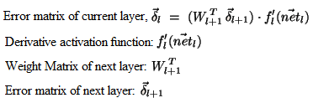
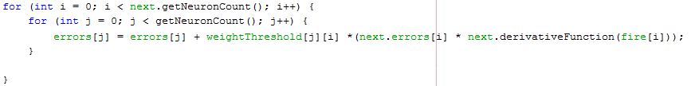
Calculate Error
Then, calculate error of the other layers:
Notes:
The rest of the layer’s error are calculated by multiplying the transposed weight matrix of the next layer with the error matrix of the next layer. This matrix is then multiplied with the derivative activation function. Notice that in the nested loop shown, the weight matrix is transposed. It also needs the errors and derivative function of the next layer.

Slide 13

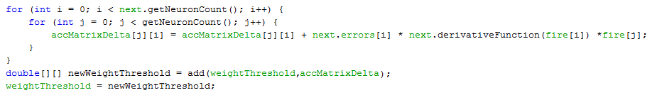
Change Weights
Once the errors are calculated, update weights:
When the weights are changed, the network has gone through an iteration of training.
Notes:
Once the errors are calculated, the change in weight is calculated by multiplying the error matrix with the output of the previous layer. In the nested for-loop shown, change in weight is calculated. After the nested loop, the threshold weight matrix is recalculated.

Slide 14
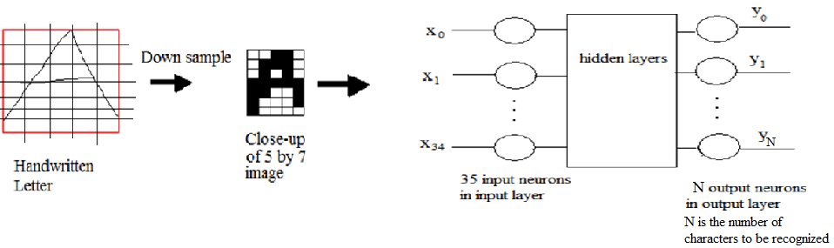
Handwritten Recognition Using Neural Networks
Notes:
In my project, I process an image by downsampling and that downsampled image is converted into a matrix. That matrix is then inputed into my network. Each input neuron takes in a pixel of the image. The network then outputs a 0.5 on the neuron that represent the letter it recognizes. Since I have finished the downsampling, I was thinking of doing some more image processing. I started to look into fourier descriptors.

Slide 15
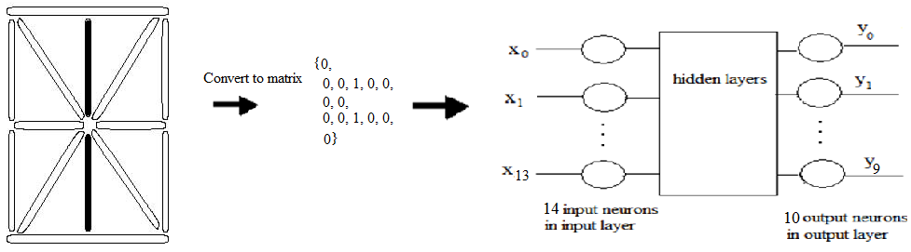
LED Display Recognition
Notes:
In podnar’s AI class, his led diplay recognition assignment is quite similar to what im doing. Given an led display, we had to use a feedforward network with backpropagation learning to recognize the number it displayed. this is a little different from what im doing in my project since I have to do image processing on the image. But for this AI assignment I don’t have to do any image processing. The led display can be easily converted into a matrix. Each of the elements in the matrix represents an LED segment, a 1 for on and 0 for off.

Slide 16
Reference
Heaton, Jeff. “Introduction to Neural Networks Using Java” 2nd Ed. 2002
Gorr. “Error Back propagation” <http://www.willamette.edu/~gorr/classes/cs449/backprop.html>
Pap and Singh. “Handwritten English Character Recognition using Neural Networks” 2010. < http://csjournals.com/IJCSC/PDF1-2/30..pdf>

Slide 17
Handwritten Recognizer: User Manual
Maeda Hanafi

Slide 18
How it works
Two phases
Specify data used to train feed forward neural network
Train the network (using back propagation)
Unfiltered
Filtered
After training, the network can be used to recognize handwritten letters

Slide 19
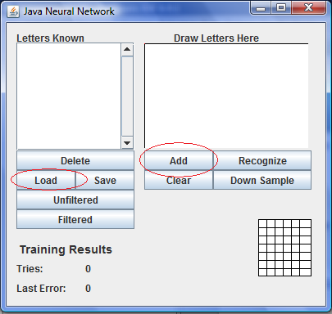
Specifying Training Data
Two ways
Add
Load

Slide 20
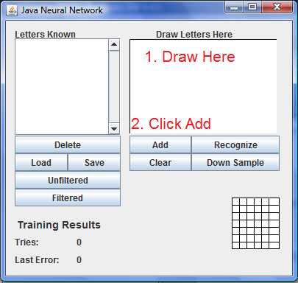
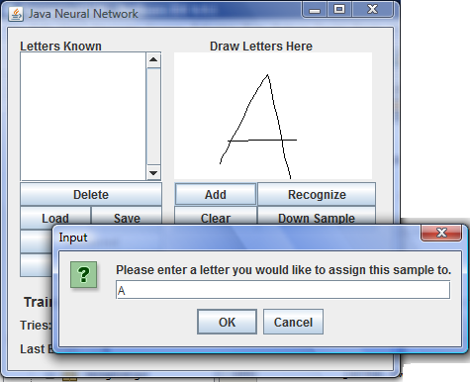
Specify Training Data: Add
Notes:
Draw here, click add, and specify what the letter is, then the letter is automatically added to letters known list

Slide 21
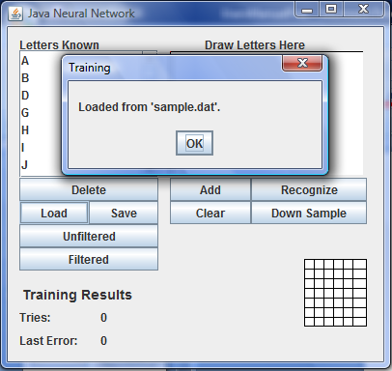
Specify Training Data: Load
Loads down sampled data of the letters
Loads from the file sample.dat
The save button stores training data into sample.dat
Notes:
Hwne you use the load button the program reads the file sample.dat that contains the downsampled data of the leters into the letters known list

Slide 22
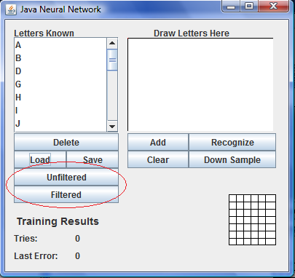
Training
Unfiltered uses all the data
Filtered trains using portion of the data
Error and Training Tries information updated in the Training Results section

Slide 23
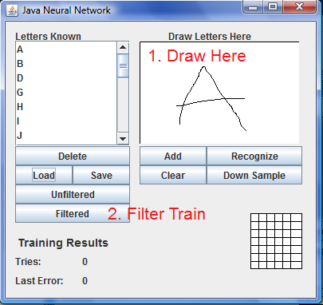
Filtered Training
Draw the letter first!

Slide 24
Finally
Click the “Recognize” button

