Slide 1


Seer: Automatically Learning Information Extraction Rules from User Examples
Maeda Hanafi, Azza Abouzied, Laura Chiticariu, Yunyao Li

Slide 2
Outline
Motivation
Iterative Process
Learning
Demo
Conclusion

Slide 3
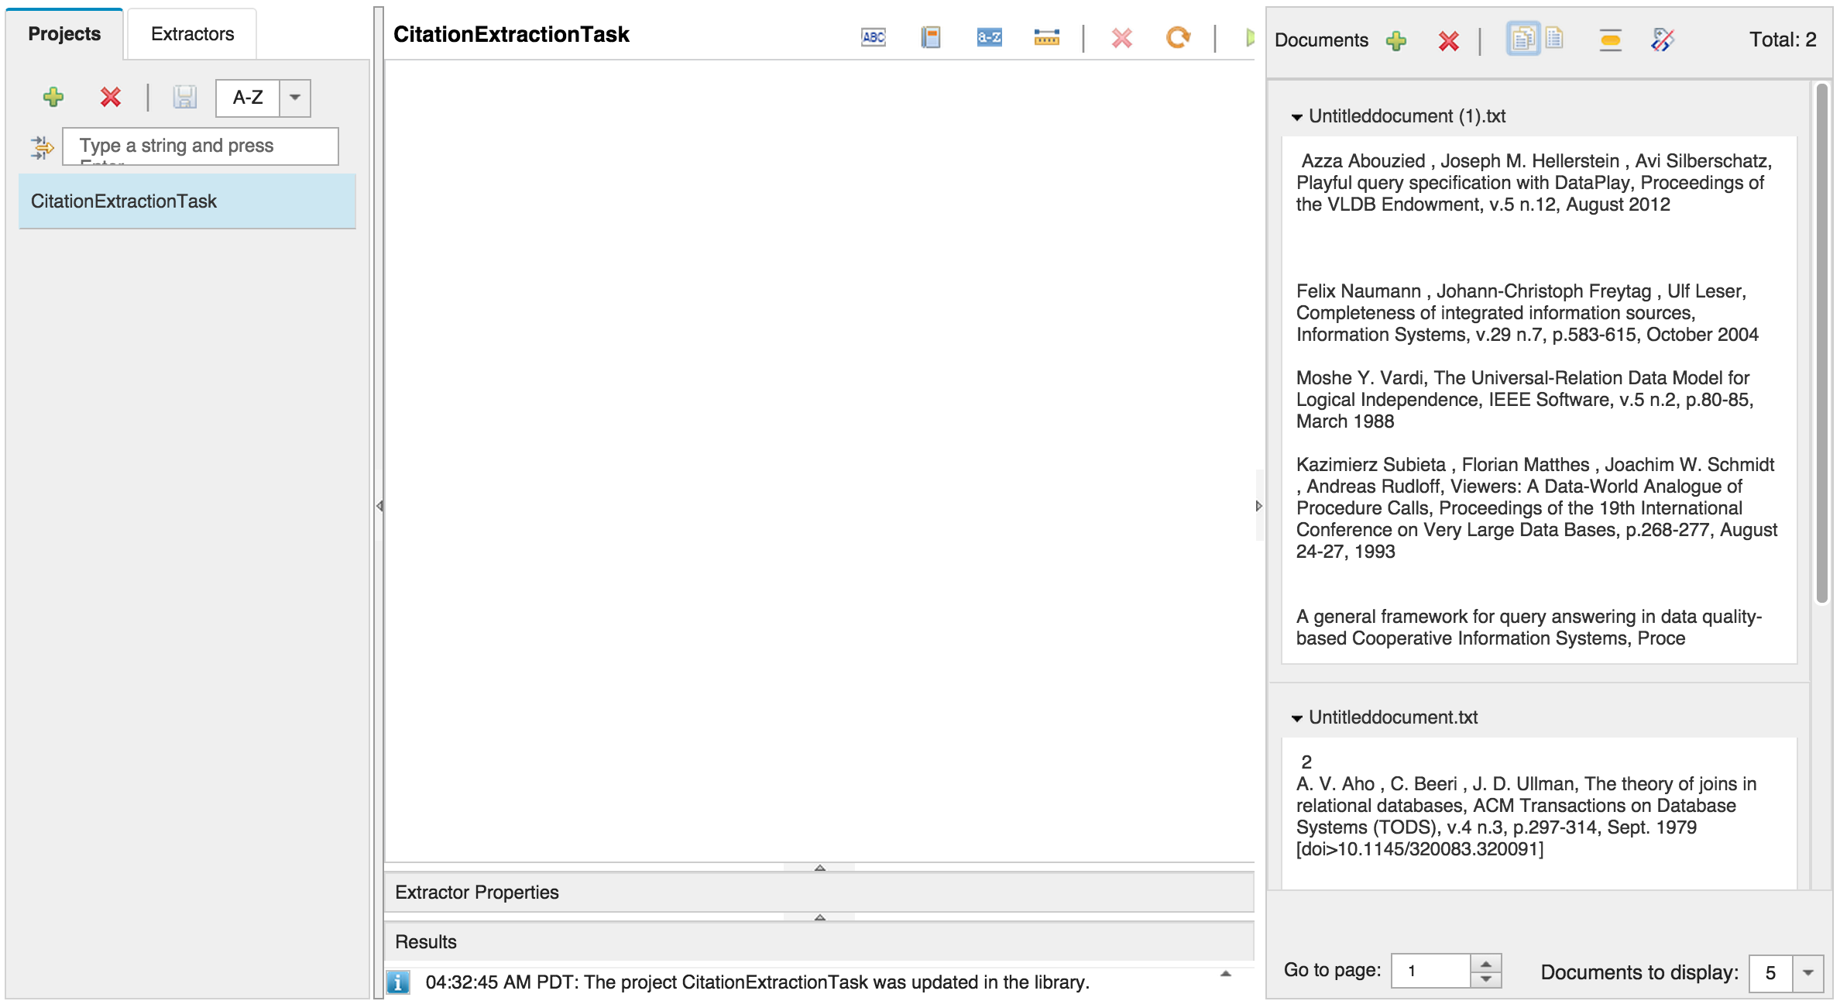
Empty Canvas Problem

Slide 4
Regex:[A-Za-z]+
Prebuilt: Number
Regex:[A-Za-z]+
Prebuilt:IntegerNumber
Regex:[A-Za-z]+
Regex:[0-9]+
Azza Abouzied , Joseph M. Hellerstein , Avi Silberschatz, Playful query specification with DataPlay, Proceedings of the VLDB Endowment, v.5 n.12, August 2012

Slide 5
Seer
Problem:
Creating extraction rules is time-consuming
Hard-to-understand rules/models
Web Tooling: Empty canvas problem; Manual effort in constructing rules
Solution:
Learn, suggest, refine easy-to-understand rules based off user examples

Slide 6
Seer
Language: Visual AQL in SystemT Web Tooling
Extraction Rules:
Component Types
Prebuilt e.g. Country, City, Capital Word, etc
Regular expressions
Literal (Exact String)
Dictionaries
Token gaps
Regex:[a-z]+
0-1
Tokens
Regex:[a-z]+
Prebuilt: Number

Slide 7
Related Works
Machine learning techniques for IE
Weakness: large labeled datasets and obscure mathematical models, unexplainable results
Strengths: quick to generate results
Rule-based, programming language approaches
Weakness: Manual creation of rules
Strength: explainable, transparent, customizable
Seer:
Generates easy-to-understand rules quickly based off small number of examples

Slide 8
Motivation
Tissot, Hegler, et al. "UFPRSheffield: Contrasting Rule-based and Support Vector Machine Approaches to Time Expression Identification in Clinical TempEval."
IE task: temporal expressions
Rule-based approach; 6 months developing extractors
Machine learning approach, SVM, 6 hours

Slide 9
Iterative Process
1. User provides examples
2. Seer Suggests Rules
3. User Confirms a Rule
Learn Rules
Set of examples
Set of Suggested Rules
Set of Accepted Rules
4. Extract from Data Collection
Run rules
Set of extraction results
End point: User edits a rule

Slide 10
Learning
Goal:
Suggest diverse, representative rules
Cover all positive examples and not capture negative examples
Operations
Intersection
Merge
Cluster
Ranking

Slide 11
Learning Overview
Merge: Merge near duplicate rules
Cluster: Group each rule with similar rules
Diverse, representative rules that conform to all examples
Intersection: Filter out rules applicable to all positive and not negative examples
Rank: Rank and pick representative rules
Positive and negative examples
Generate all possible rules for each example

Slide 12
Intersection: Overview
Goal: Rules capture all positive examples and no negative examples
Main idea:
Intersect positive examples → Set of rules capturing all positive examples.
Filter out rules that capture negative examples.
Left with rules that apply to all positive examples and not in the negative examples
Notes:
Goal: Rules applicable to all positive and not negative examples
Intersect positive examples → Set of rules capturing all positive examples. Call this the positive intersected rules
Filter out rules that appear in the negative set of rules.
Left with rules that apply to all positive examples and not in the negative set

Slide 13
Ruleset: Rules per example
Generate all possible rules for each example, positive and negative.
Rule set for
fourth-year 2005
fourth
-
year
2005
Regex:[a-z]+
0-1
Tokens
0-1
Tokens
Prebuilt: Number
Regex:[a-z]+
0-1
Tokens
Regex:[a-z]+
Prebuilt: Number
Regex:[a-z]+
0-1
Tokens
Regex:[a-z]+
Regex:[0-9]+
Regex:[a-z]+
Exact String: -
0-1
Tokens
Prebuilt: IntegerNumber
Exact String: fourth
Exact String: -
Exact String: year
Exact String: 2005
…
Notes:
- A rule set is a set of all possible rules for a given example. Regex of four digits followed by regexes of lowercases followed by currency amount is an element in the ruleset for the example “2005 income of $3.5 billion”

Slide 14
Intersected Positive Ruleset
Intersected Positive Ruleset:
Rules that are applicable to all the positive examples
U
Rule set for
Rule set for
fourth-year 2005
fifth-year 2006
➔
Regex:[a-z]+
0-1
Tokens
0-1
Tokens
Prebuilt: Number
Regex:[a-z]+
0-1
Tokens
Regex:[a-z]+
Prebuilt: Number
Regex:[a-z]+
0-1
Tokens
Regex:[a-z]+
Prebuilt: IntegerNumber
Regex:[a-z]+
0-1
Tokens
Regex:[a-z]+
Regex:[0-9]+
Regex:[a-z]+
Exact String: -
0-1
Tokens
Prebuilt: Number
…
Notes:
A component of <Exact String 2005> will not appear in the intersected positive ruleset.

Slide 15
Negative Examples
Filter out rules that appear in the rulesets of negative examples.
Negative example:
up 7
Regex:[a-z]+
Prebuilt: Number
Positive example:
fifth-year 2006
fourth-year 2005
Regex:[a-z]+
0-1
Tokens
0-1
Tokens
Prebuilt: Number

Slide 16
Learning Overview
Merge: Merge near duplicate rules
Cluster: Group each rule with similar rules
Diverse, representative rules that conform to all examples
Intersection: Filter out rules applicable to all positive and not negative examples
Rank: Rank and pick representative rules
Positive and negative examples
Generate all possible rules for each example

Slide 17
Merge
Near duplicate rules, where Exact String values differ
Exact String: fourth
0-1
Tokens
Exact String: year
Exact String: 2005
Exact String: fifth
0-1
Tokens
Exact String: year
Exact String: 2006
Merge: Create dictionary rules from near duplicate rules
Near duplicates:
Sequences have the same number of components, the components have the same type, and appear in the same order
At least two exact string components can be merged into a dictionary
Dictionary: {fourth, fifth}
0-1
Tokens
Exact String: year
Dictionary: {2005, 2006}

Slide 18
Learned Rules After Intersect and Merge…
Positive example:
Negative example:
fourth-year 2005
fifth-year 2006
up 7
Regex:[a-z]+
0-1
Tokens
Regex:[a-z]+
Prebuilt: Number
Regex:[a-z]+
0-1
Tokens
Regex:[a-z]+
Prebuilt: IntegerNumber
Regex:[a-z]+
0-1
Tokens
Regex:[a-z]+
Regex:[0-9]+
Regex:[a-z]+
0-1
Tokens
Exact String: year
Prebuilt: Number
Regex:[a-z]+
0-1
Tokens
Exact String: year
Prebuilt: IntegerNumber
Regex:[a-z]+
0-1
Tokens
Exact String: year
Regex:[0-9]+
Dictionary: {fourth, fifth}
0-1
Tokens
Exact String: year
Dictionary: {2005, 2006}
Dictionary: {fourth, fifth}
0-1
Tokens
Exact String: year
Prebuilt: Number
Dictionary: {fourth, fifth}
0-1
Tokens
Exact String: year
Prebuilt: IntegerNumber
…
Which rules should be suggested?

Slide 19
Learning Overview
Merge: Merge near duplicate rules
Cluster: Group each rule with similar rules
Diverse, representative rules that conform to all examples
Intersection: Filter out rules applicable to all positive and not negative examples
Rank: Rank and pick representative rules
Positive and negative examples
Generate all possible rules for each example

Slide 20
Cluster and Ranking
After Merging: many valid rules
Goal: Pick a subset of rules that are
Diverse and
More likely for the user to choose
Cluster and ranking → Final list of rules to suggest
Cluster :
Ensures diversity in suggested rules
Group similar rules
Prevents from suggesting similar rules
Ranker:
Based on a partial order
Notes:
Goal:
- To not suggest similar rules, but diverse ones

Slide 21
Cluster: Similarity
Differences in rules lies in its components
Regex:[a-z]+
0-1
Tokens
Regex:[a-z]+
Prebuilt: Number
Regex:[a-z]+
0-1
Tokens
0-1
Tokens
Prebuilt: IntegerNumber
Group: Regex, token gap, prebuilt
Regex:[a-z]+
0-1
Tokens
0-1
Tokens
Regex:[0-9]+
Group: Regex, token gap
Rule A and Rule B are similar if
Components in Rule A are the same in Rule B

Slide 22
Learned Rules After Cluster…
Positive example:
Negative example:
fourth-year 2005
fifth-year 2006
up 7
Regex:[a-z]+
0-1
Tokens
Regex:[a-z]+
Prebuilt: Number
Regex:[a-z]+
0-1
Tokens
Regex:[a-z]+
Prebuilt: IntegerNumber
…
Group: Regex, token gap, prebuilt
Regex:[a-z]+
0-1
Tokens
Exact String: year
Prebuilt: Number
Regex:[a-z]+
0-1
Tokens
Exact String: year
Prebuilt: IntegerNumber
…
Group: Regex, token gap, prebuilt, exact string
Dictionary: {fourth, fifth}
0-1
Tokens
Exact String: year
Prebuilt: Number
Dictionary: {fourth, fifth}
0-1
Tokens
Exact String: year
Prebuilt: IntegerNumber
…
Group: Dictionary, token gap, prebuilt, exact string
…

Slide 23
Learning Overview
Merge: Merge near duplicate rules
Cluster: Group each rule with similar rules
Diverse, representative rules that conform to all examples
Intersection: Filter out rules applicable to all positive and not negative examples
Rank: Rank and pick representative rules
Positive and negative examples
Generate all possible rules for each example

Slide 24
Rank
Goal: Pick representative rules from each group
Token by token analysis: Prefer a rule based on what components describe which token
2005 can be described by
Regex:[0-9]+
,
Prebuilt: Number
,
Prebuilt: IntegerNumber
Ranking by partial order allows us to encode preferences per token
is preferred over
Prebuilt: IntegerNumber
Regex:[0-9]+

Slide 25
Ranking: Token by Token Analysis
1. For each cluster group and for each token:
Rank components by a partial order.
Form a representative set of components by picking the highest ranked component of each token
2. For each rule, add a point for every component that appears in the representative tokens.
Suggested rules: rules that have the highest score in their cluster group

Slide 26
Ranking: Partial Order
Given Partial Order:
1. Prebuilt
1.1 Organization, Person, IntegerNumber, DecimalNumber
1.2 CapitalWord, Number
2. Token Gap
3. Regex
4. Dictionary
5. Exact String
Ex. Token:
2005
Regex:[0-9]+
,
Prebuilt: Number
,
Prebuilt: IntegerNumber
Ranked components:
Prebuilt: IntegerNumber
,
Prebuilt: Number
,
Regex:[0-9]+

Slide 27
Ranking: Representative Rules
Ranked components per token:
fourth
Regex:[a-z]+
-
0-1
Tokens
,
Exact String: -
year
Regex:[a-z]+
,
Exact String: year
2005
Prebuilt: IntegerNumber
,
Prebuilt: Number
,
Regex:[0-9]+
Group: Regex, token gap, prebuilt, exact string
Representative components for that group:
Regex:[a-z]+
0-1
Tokens
Regex:[a-z]+
Prebuilt: IntegerNumber

Slide 28
Ranking: Scoring for Rules
Representative component for that group:
Regex:[a-z]+
0-1
Tokens
Regex:[a-z]+
Prebuilt: IntegerNumber
Score per rule in group:
1
1
0
1
Regex:[a-z]+
0-1
Tokens
Exact String: year
Prebuilt: IntegerNumber
=
3
1
0
0
0
=
1
Regex:[a-z]+
Exact String: -
0-1
Tokens
Prebuilt: Number
1
0
0
0
=
1
Regex:[a-z]+
Exact String: -
0-1
Tokens
Regex:[0-9]+
1
1
0
0
Regex:[a-z]+
0-1
Tokens
Exact String: year
Prebuilt: Number
=
2
…
Group: Regex, token gap, prebuilt, exact string

Slide 29
Learning Overview
Merge: Merge near duplicate rules
Cluster: Group each rule with similar rules
Diverse, representative rules that conform to all examples
Intersection: Filter out rules applicable to all positive and not negative examples
Rank: Rank and pick representative rules
Positive and negative examples
Generate all possible rules for each example

Slide 30
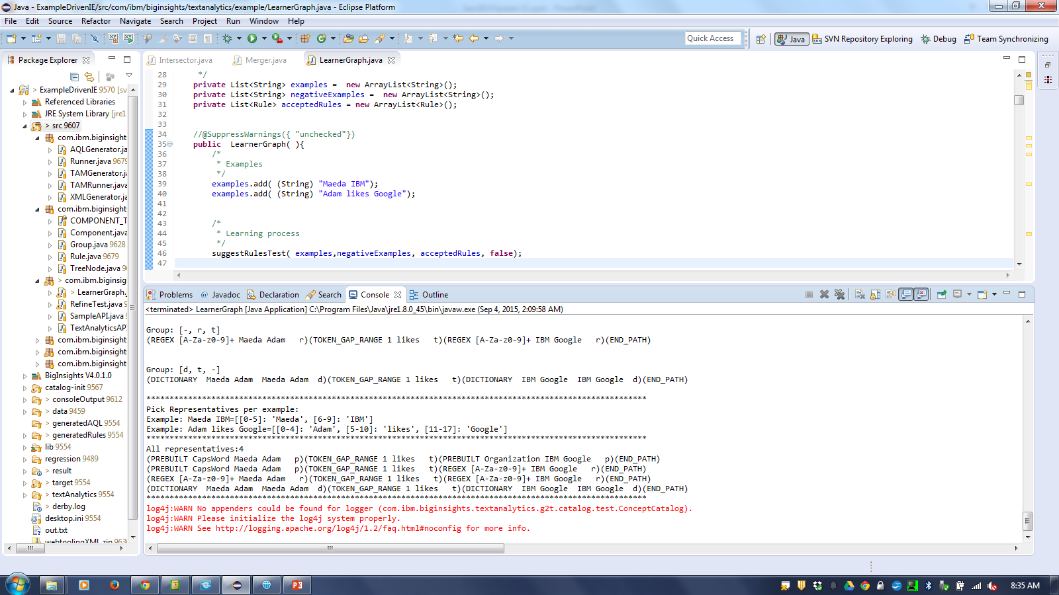
Demo

Slide 31
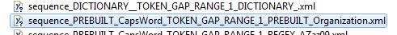
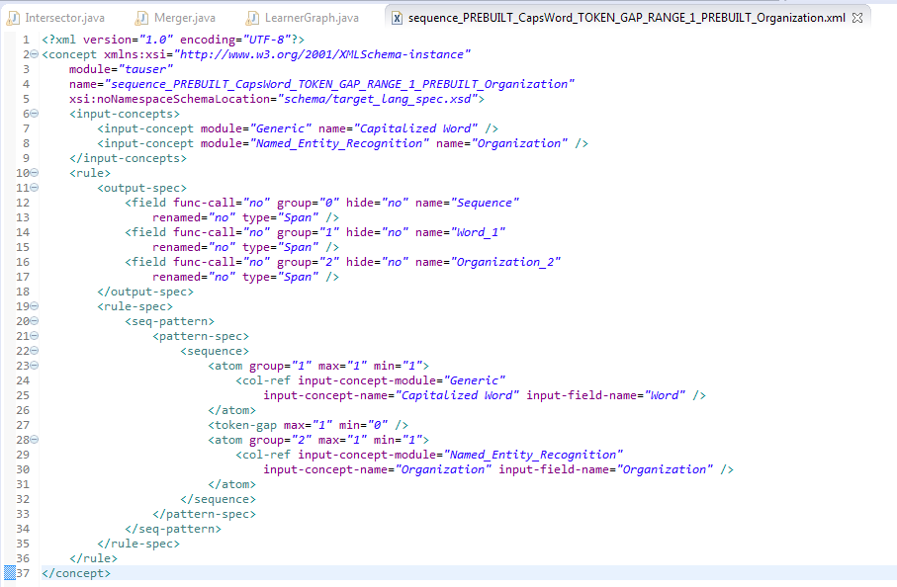
Internal Rules → XML

Slide 32
Conclusions
Seer combines the advantages of machine learning and rule-based approaches:
An iterative learning model for extraction rules based on a small number of examples from users.
Ongoing work
User studies and experiments
Integrating into Web Tooling interface

Slide 33
Thank you!

Slide 34
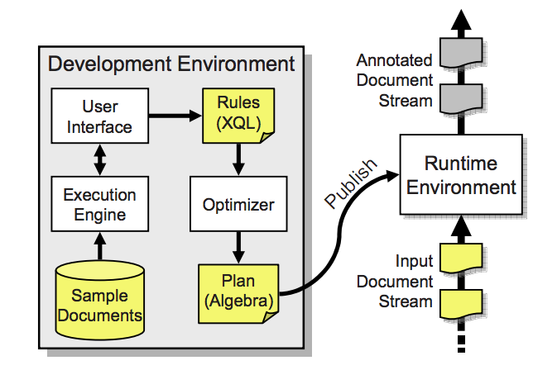
Appendix: SystemT
Focus on efficiency and scalability
Based off database concepts
Revolves around spanners

Slide 35
Appendix: SystemT
 | Texture | SystemT
Similarities | Semi structured documents Rule based approaches Gather observed facts on the data Use of dictionaries
Differences | User feedback – improvements PDFs Concept Dictionaries - bridge between user context and system | Targets Efficiency and Scalability Rule developers DB based operators
Notes:
Disambiguating rules: how to figure out which rules apply to which documents? SystemT: simply displays all of the results, overlapping or not, here we need to really pinpoint which rule is extracting the right thing. Two rules can describe Person’s name, but which one should be used on the document?

Slide 36
Appendix: FlashExtract
User highlights positive and cross out negative examples
Learns scripts that will extract the rest of the data
Scripts built up of operators:
Pair
Merge
Map
Filter

Slide 37
Appendix: FlashExtract
Merge
Disjunction
Map
Map
Common in prior work:
e.g. Spanners by SystemT
Pair
Filter
Starts/Ends with
Contains
Pred/Succ
REGEX
AbsPos/
REGEX
AbsPos/
REGEX
Intervals
Predicate
Core Extraction Operator
Selection Operator

Slide 38
Appendix: FlashExtract
Pair Limitations
Used even when not needed
DSL learning: template rules
Merge limitations –
Powersets of examples
Permutations – FE produces new rules
A rule per variation
Notes:
Template rule: if one such operator is used in a particular way, a set of other nested operators must also be used

Slide 39
Suggested Rules
Positive example:
Negative example:
fourth-year 2005
fifth-year 2006
up 7
Regex:[a-z]+
0-1
Tokens
Regex:[a-z]+
Prebuilt: Number
Regex:[a-z]+
0-1
Tokens
Regex:[a-z]+
Regex:[0-9]+
Regex:[a-z]+
Exact String: -
0-1
Tokens
Regex:[a-z]+
Exact String: -
0-1
Tokens
Prebuilt: IntegerNumber
Regex:[a-z]+
0-1
Tokens
Exact String: year
Prebuilt: Number
Exact String: year
Notes:
(REGEX [A-Za-z0-9]+ fourth fifth r)(TOKEN_GAP_RANGE 1 - - t)(REGEX [A-Za-z0-9]+ year quarter r)(PREBUILT Number 2005 2006 p)(END_PATH)
(REGEX [A-Za-z0-9]+ fourth fifth r)(TOKEN_GAP_RANGE 1 - - t)(REGEX [A-Za-z0-9]+ year quarter r)(REGEX [A-Za-z0-9]+ 2005 2006 r)(END_PATH)
(REGEX [A-Za-z0-9]+ fourth fifth r)(EXACT_STRING - - - e)(TOKEN_GAP_RANGE 1 year quarter t)(PREBUILT Number 2005 2006 p)(END_PATH)
(REGEX [A-Za-z0-9]+ fourth fifth r)(EXACT_STRING - - - e)(TOKEN_GAP_RANGE 1 year quarter t)(REGEX [A-Za-z0-9]+ 2005 2006 r)(END_PATH)
(REGEX [A-Za-z0-9]+ fourth fifth r)(EXACT_STRING - - - e)(REGEX [A-Za-z0-9]+ year quarter r)(PREBUILT Number 2005 2006 p)(END_PATH)
(REGEX [A-Za-z0-9]+ fourth fifth r)(EXACT_STRING - - - e)(REGEX [A-Za-z0-9]+ year quarter r)(REGEX [A-Za-z0-9]+ 2005 2006 r)(END_PATH)

