Slide 1

Chapter 4
Gates and Circuits

Slide 2
Computers and Electricity
Gate
A device that performs a basic operation on
electrical signals
Circuits
Gates combined to perform more
complicated tasks

Slide 3
Computers and Electricity
How do we describe the behavior of gates and circuits?
Boolean expressions
Uses Boolean algebra, a mathematical notation for expressing two-valued logic
Logic diagrams
A graphical representation of a circuit; each gate has its
own symbol
Truth tables
A table showing all possible input values and the associated
output values

Slide 4
Gates
Six types of gates
  NOT
  AND
  OR
  XOR
  NAND
  NOR
Typically, logic diagrams are black and white with gates distinguished only by their shape
We use color for clarity (and fun)

Slide 5
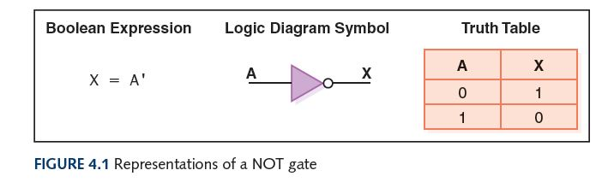
NOT Gate
A NOT gate accepts one input signal (0 or 1) and returns the complementary (opposite) signal as output

Slide 6
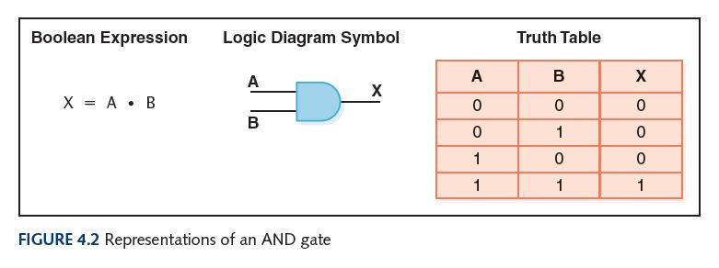
AND Gate
An AND gate accepts two input signals
If both are 1, the output is 1; otherwise,
the output is 0

Slide 7
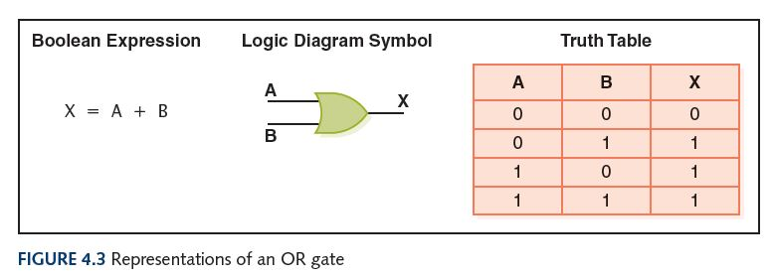
OR Gate
An OR gate accepts two input signals
If both are 0, the output is 0; otherwise,
the output is 1

Slide 8
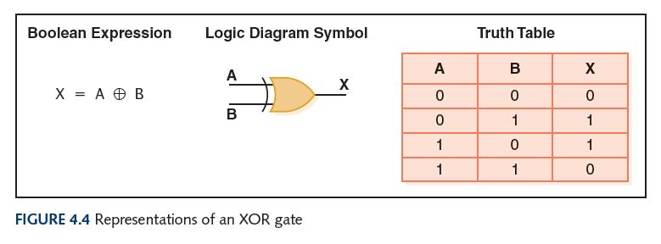
XOR Gate
An XOR gate accepts two input signals
If both are the same, the output is 0; otherwise,
the output is 1

Slide 9
XOR Gate
Note the difference between the XOR gate
and the OR gate; they differ only in one
input situation
When both input signals are 1, the OR gate produces a 1 and the XOR produces a 0
XOR is called the exclusive OR because its output is 1 if (and only if):
either one input or the other is 1,
excluding the case that they both are

Slide 10
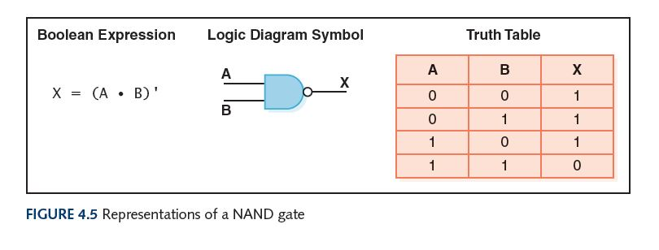
NAND Gate
The NAND (“NOT of AND”) gate accepts two input signals
If both are 1, the output is 0; otherwise,
the output is 1

Slide 11
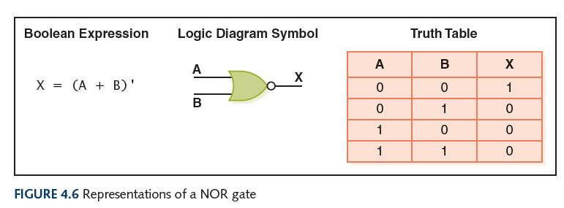
NOR Gate
The NOR (“NOT of OR”) gate accepts two inputs
If both are 0, the output is 1; otherwise,
the output is 0

Slide 12
Review of Gate Processing
A NOT gate inverts its single input
An AND gate produces 1 if both input values are 1
An OR gate produces 0 if both input values are 0
An XOR gate produces 0 if input values are the same

Slide 13
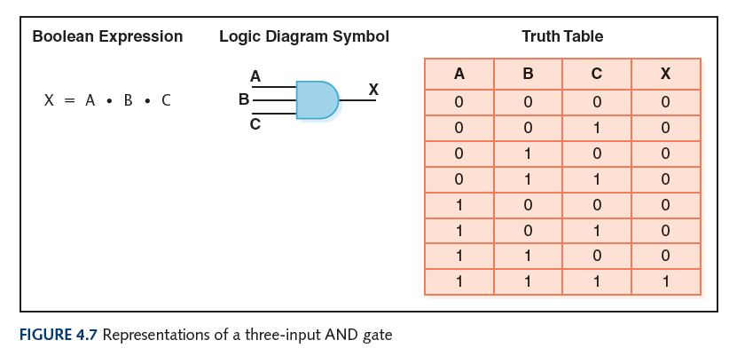
Gates with More Inputs
Some gates can be generalized to accept three or more input values
A three-input AND gate, for example, produces an output of 1 only if all input values are 1

Slide 14
Circuits
Combinational circuit
The input values explicitly determine the output
Sequential circuit
The output is a function of the input values and the existing state of the circuit
We describe the circuit operations using
  Boolean expressions
  Logic diagrams
  Truth tables
Are you surprised?

Slide 15
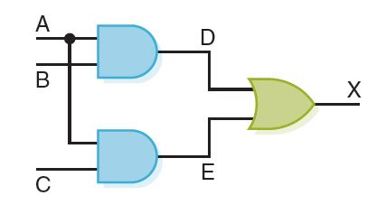
Combinational Circuits
Gates are combined into circuits by using the output of one gate as the input for another
This same circuit using a Boolean expression is AB + AC

Slide 16
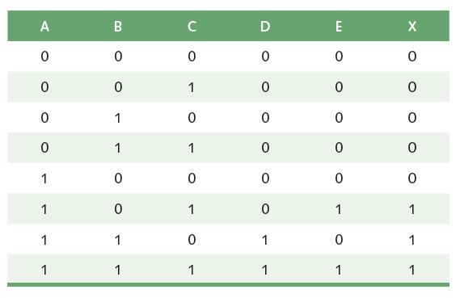
Combinational Circuits
Three inputs require eight rows to describe all possible input combinations

Slide 17
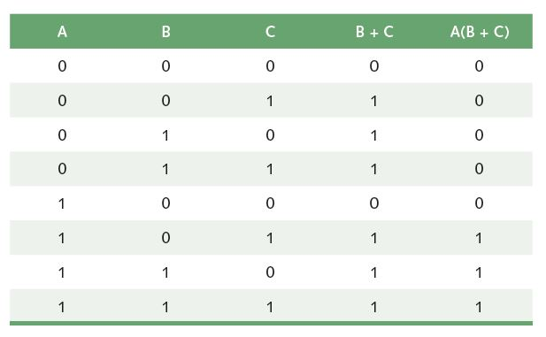
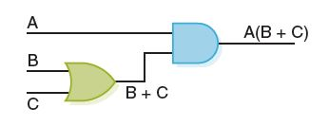
Combinational Circuits
Consider the following Boolean expression A(B + C)
Does this truth table look familiar?
Compare it with previous table

Slide 18
Combinational Circuits
Circuit equivalence
Two circuits that produce the same output for identical input
Boolean algebra
Allows us to apply provable mathematical principles to help design circuits
A(B + C) = AB + BC (distributive law) so circuits must be equivalent

Slide 19
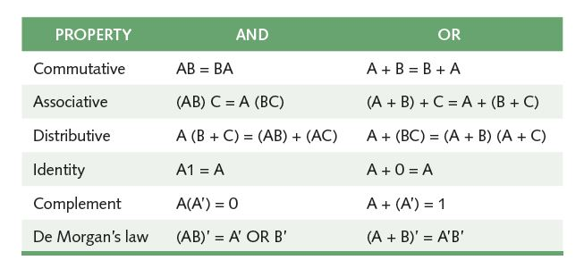
Properties of Boolean Algebra

Slide 20
Circuit Construction Algorithm
How do we create a circuit given a description of the circuit’s desired behavior?
4 steps:
Truth table construction
Subexpression construction (AND and NOT)
Subexpression construction (OR)
Circuit diagram production

