Slide 1
CSIS110 - Introduction to Computer Science
Dr. MaryAnne Egan

Slide 2
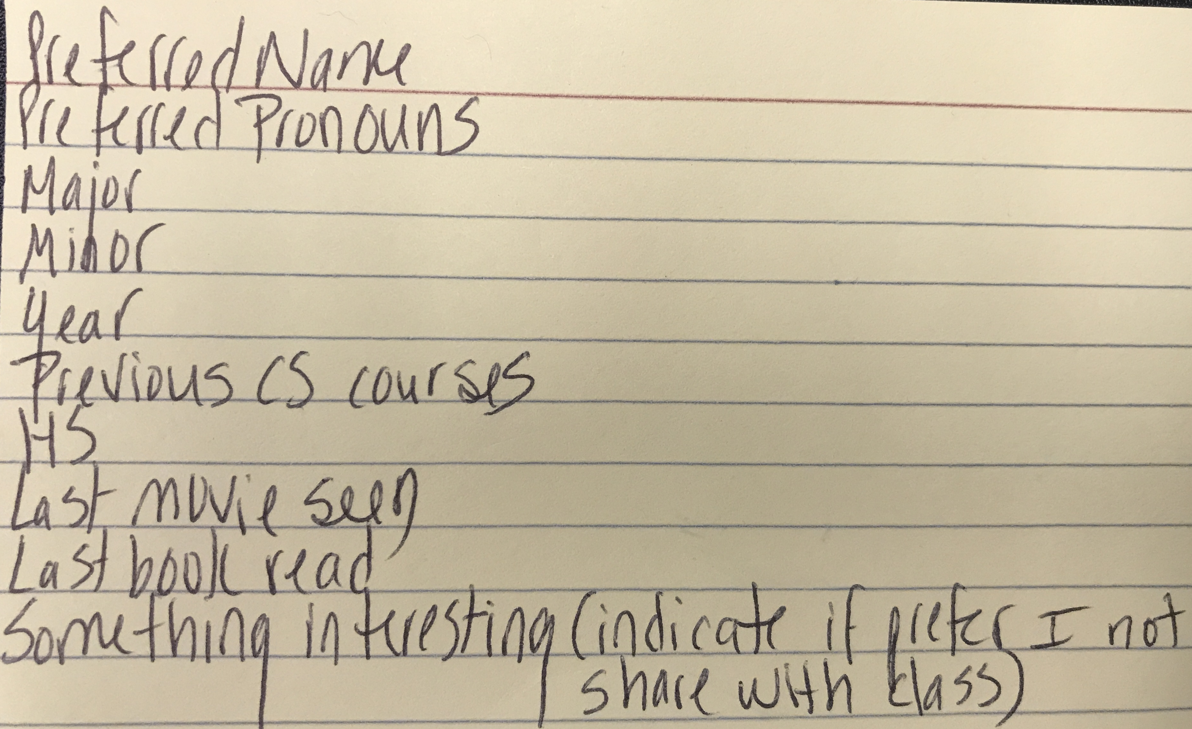
Agenda
Introduction
Cell phone box
Course website (http://egansienacs.com/courses/csis110-s18/)
Syllabus
other instructors
attendance policy
tests and quizzes (yes, there will be one next Monday)
schedule
Index cards (Preferred pronouns)
Disaster Recovery Activity
Notes:
cell phone policy… total number of check marks divide by 7 and will add to final exam.

Slide 3
First Day Activity
Consider a natural disaster…
Location: smallish city
Specifics:
Local uncovered soccer/football stadium is left intact and aid workers have directed all survivors to congregate at this single undamaged stadium
May assume it is sufficient in size to hold all survivors
Goal:
Devise a protocol for the aid workers to use to reunite the survivors of each nuclear family unit

Slide 4
Work in groups of 3 or 4 for the remainder of today’s class
Beginning of next class, each group will describe their algorithm to the class

