Slide 1
CSIS110 - Introduction to Computer Science
Dr. MaryAnne Egan

Slide 2
Agenda
Disaster recovery activity
Python intro
Layers of CS
Notes:
cell phone policy… total number of check marks divide by 7 and will add to final exam.

Slide 3
Python
Python is a popular programing language, which is designed to be easy to read.
Used by many companies.
Also used to make application software flexible and expendable.
For example, can be used to program GIMP or Blender

Slide 4
A word about Jython
Jython is Python
Python is a language implemented in C.
Jython is the same language implemented in Java.
Is the pizza different if a different company makes the flour? If so, not by much.

Slide 5
Python
The programming language we will be using is called Python
http://www.python.org
It’s used by companies like Google, Industrial Light & Magic, Pixar, Nextel, and others
The kind of Python we’re using is called Jython
It’s Java-based Python
http://www.jython.org
Notes:
URL to look at what companies use Python is in the book.

Slide 6
Much of programming is about naming
We name our data
Data: The “numbers” we manipulate
We call our names for data variables
A variable is a named location in main memory whose contents can vary
Naming conventions
Enough words to describe what you need to describe
Understandable
Python names must start with a letter
Case matters
Don’t use Python reserve words as names
Use camelCase if multiword variable name
Notes:
6

Slide 7
Python understands commands
We can name data with =
This is called _____________, and it puts a value into the variable (the memory location it names)
The following commands all have the same result:
A = 5
B = 10
A = B / 2
A = round (4.7)
Notes:
7

Slide 8
Do it again !!!
If we have some code that we think we want to use over and over again, we create a function
A function is a named algorithm (recipe)
Example: to average 3 numbers:
def avg (num1, num2, num3):
Now we can use that function over and over by simply invoking its name and giving it 3 numbers.

Slide 9
Colors
An image is a 2-dimensional grid of ________
A pixel is a single dot of a specific color
That color has 3 components:
Red (0..255)
Green (0..255)
Blue (0..255)
Examples:
R = 255, G = 0, B = 0
R = 128, G = 92, B = 192

Slide 10

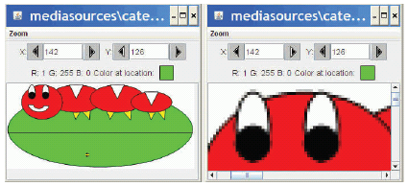
Pixels
Pixels are picture elements
Each pixel object knows its color
It also knows where it is in the picture
When we zoom the picture to 500%, we can see individual pixels.

Slide 11
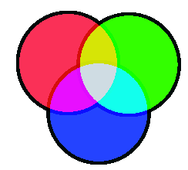
RGB
In RGB, each color has three component colors:
Amount of redness
Amount of greenness
Amount of blueness
Each does appear as a separate dot on most devices, but our eye blends them.
In most computer-based models of RGB, a single byte (8 bits) is used for each
So a complete RGB color is 24 bits, 8 bits of each

Slide 12
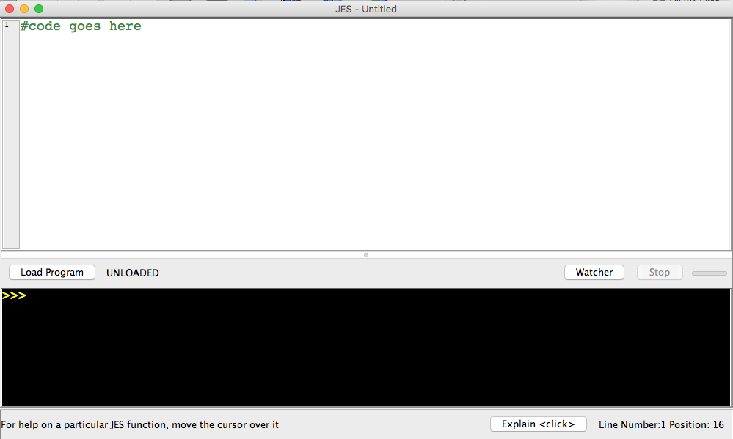
Demo JES

Slide 13
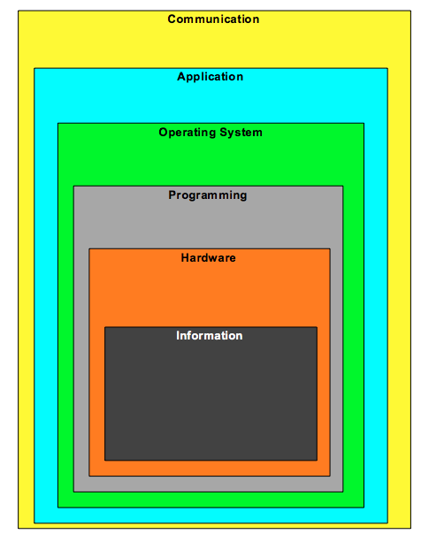
Layers of a Computing System

