Slide 1
Agenda – 1/31/18
Questions?
Group practice problems
Step through HW1 code
Python functions
For loops
Color change functions

Slide 2

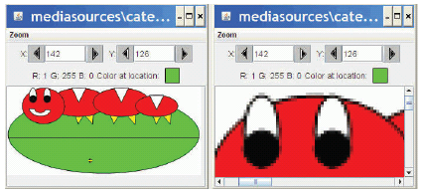
Pixels
Pixels are picture elements
Each pixel object knows its color
It also knows where it is in the picture
When we zoom the picture to 500%, we can see individual pixels.

Slide 3
for loop and our first picture recipe!
def decreaseRed(pict):
for p in getPixels(pict):
originalRed = getRed(p)
setRed(p, originalRed * 0.5)
The loop
- Note the indentation!

Slide 4
How for loops are written
def decreaseRed(pict):
for p in getPixels(pict):
originalRed = getRed(p)
setRed(p, originalRed * 0.5).
for is the name of the command
An index variable (p, in this example) is used to hold each of the different values of a sequence
The word in
A function that generates a sequence
The index variable will be the name for one value in the sequence, each time through the loop
A colon (“:”)
And a block (the indented lines of code)

Slide 5
What happens when a for loop is executed
The index variable is set to an item in the sequence
The block is executed
The variable is often used inside the block
Then execution loops to the for statement, where the index variable gets set to the next item in the sequence
Repeat until every value in the sequence was used.

Slide 6
getPixels returns a sequence of pixels
def decreaseRed(picture):
for p in getPixels(picture):
originalRed = getRed(p)
setRed(p, originalRed * 0.5)
Each pixel knows its color and place in the original picture
Change the pixel, you change the picture
So the loop here assigns the index variable p to each pixel in the picture picture, one at a time.

Slide 7
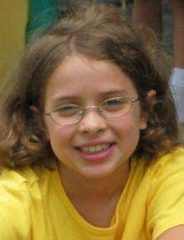
Let’s walk that through slowly…
Here we take a picture object in as a parameter to the function and call it picture
def decreaseRed(picture):
for p in getPixels(picture):
originalRed = getRed(p)
setRed(p, originalRed * 0.5)
picture

Slide 8
Now, get the pixels
def decreaseRed(picture):
for p in getPixels(picture):
originalRed = getRed(p)
setRed(p, originalRed * 0.5)
We get all the pixels from the picture, then make p be the name of each one one at a time
picture
getPixels()
Pixel, color r=135 g=131 b=105
Pixel, color r=133 g=114 b=46
Pixel, color r=134 g=114b=45
…
p

Slide 9
Get the red value from pixel
def decreaseRed(picture):
for p in getPixels(picture):
originalRed = getRed(p)
setRed(p, originalRed * 0.5)
We get the red value of pixel p and name it originalRed
picture
getPixels()
Pixel, color r=135 g=131 b=105
Pixel, color r=133
g=114 b=46
Pixel, color r=134 g=114b=45
…
…
p
originalRed = 135

Slide 10
Now change the pixel
def decreaseRed(picture):
for p in getPixels(picture):
originalRed = getRed(p)
setRed(p, originalRed * 0.5)
Set the red value of pixel p to 0.5 (50%) of originalRed
picture
getPixels()
Pixel, color r=67 g=131 b=105
Pixel, color r=133
g=114 b=46
Pixel, color r=134 g=114b=45
…
p
originalRed = 135

Slide 11
Then move on to the next pixel
def decreaseRed(picture):
for p in getPixels(picture):
originalRed = getRed(p)
setRed(p, originalRed * 0.5)
Move on to the next pixel and name it p
picture
getPixels()
Pixel, color r=67 g=131 b=105
Pixel, color r=133
g=114 b=46
Pixel, color r=134 g=114b=45
…
p
originalRed = 135

Slide 12
Get its red value
Set originalRed to the red value at the new p, then change the red at that new pixel.
def decreaseRed(picture):
for p in getPixels(picture):
originalRed = getRed(p)
setRed(p, originalRed * 0.5)
picture
getPixels()
Pixel, color r=67 g=131 b=105
Pixel, color r=133
g=114 b=46
Pixel, color r=134 g=114b=45
…
p
originalRed = 133
p
p

Slide 13
And change this red value
def decreaseRed(picture):
for p in getPixels(picture):
originalRed = getRed(p)
setRed(p, originalRed * 0.5)
Change the red value at pixel p to 50% of value
picture
getPixels()
Pixel, color r=67 g=131 b=105
Pixel, color r=66 g=114 b=46
Pixel, color r=134 g=114b=45
…
p
originalRed= 133
p
p

Slide 14
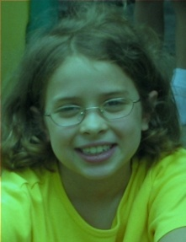
And eventually, we do all pixels
We go from this… to this!

Slide 15
“Tracing/Walking through” the program
What we just did is called tracing, stepping or walking through the program. You may hear them interchangeably. What does this mean?
You consider each step of the program, in the order that the computer would execute it
You consider what exactly would happen
You create a location for each variable
You write down what values each variable (name) has at each point.
It’s one of the most important debugging skills you can have.
And everyone has to do a lot of debugging, especially at first.

Slide 16
Command Area Editing Tips
Up/down arrows walk through command history
You can edit the line at the bottom
Just put the cursor at the end of the line before hitting Return/Enter.
If line “disappears” lengthen the bottom of the window
Anytime you hit “load”, it saves the program to your directory

Slide 17
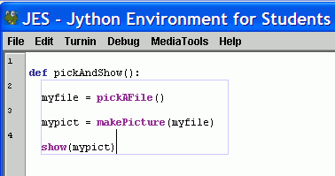
Blocking is important in JES
Statements that are indented the same, are in the same block.
Statements that are in the same block as where the line where the cursor is are enclosed in a blue box.

Slide 18
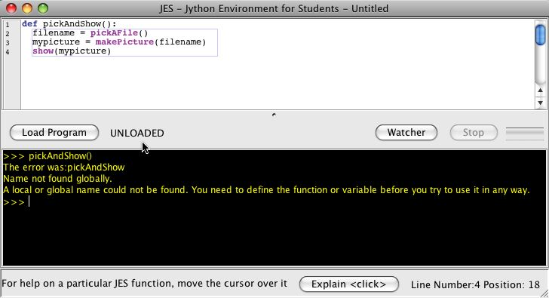
Forgetting to load
Your function does NOT exist for JES until you load it
Before you load it, the program is just a bunch of characters.
Loading encodes it as an executable function
Save and Save As
You must Save before Loading
You must Load before you can use your function
An “Unloaded” function doesn’t exist yet.

Slide 19
What went wrong?
Did you use the exact same names (case, spelling)?
All the lines in the block must be indented, and indented the same amount.
Variables in the command area don’t exist in your functions, and variables in your functions don’t exist in the command area.
The computer can’t read your mind.
It will only do exactly what you tell it to do.

Slide 20
Review of JES Functions
A bunch of functions are pre-defined in JES for sound and picture manipulations
pickAFile()
makePicture()
makeSound()
show()
play()
Some of these functions accept input values. Which ones?
Can you think of others?

Slide 21
What are steps to show a picture?
Don’t need the commands yet, just describe the steps
____________________________
____________________________
____________________________
____________________________
Notes:
1. Find a file with a picture.
2. Pick it.
3. Get the bytes from that file into memory and label it as a type: “picture”
4. Show the picture

Slide 22
What do these functions do?
>>> print pickAFile()
/Users/guzdial/mediasources/barbara.jpg
>>> print makePicture(pickAFile())
Picture, filename /Users/guzdial/mediasources/barbara.jpg height 294 width 222
>>> show(makePicture(pickAFile()))
>>> print show(makePicture(pickAFile()))
None
>>> print pickAFile()
/Users/guzdial/mediasources/hello.wav
>>> print makeSound(pickAFile())
Sound of length 54757
>>> print play(makeSound(pickAFile()))
None
pickAFile() returns a filename, which can be used as input to makePicture() to make a picture or makeSound() to make a sound.
Printing a picture just proves there’s a picture there.
show() and play() don’t return anything, so they print None.

Slide 23
Reminder: Typical sequence of commands to choose and show an image
>>> file=pickAFile()
>>> picture=makePicture(file)
>>> show(picture)

Slide 24
Manipulating pixels
getPixel(picture,x,y) gets a single pixel.
getPixels(picture) gets all of them in an array. (Square brackets is a standard array reference notation—which we'll generally not use.)
>>> pixel=getPixel(picture,1,1)
>>> print pixel
Pixel, color=color r=168 g=131 b=105
>>> pixels=getPixels(picture)
>>> print pixels[0]
Pixel, color=color r=168 g=131 b=105

Slide 25
What can we do with a pixel?
getRed, getGreen, and getBlue are functions that take a pixel as input and return a value between 0 and 255
setRed, setGreen, and setBlue are functions that take a pixel as input and a value between 0 and 255
getColor takes a pixel as input and returns a Color object with the color at that pixel
setColor takes a pixel as input and a Color, then sets the pixel to that color
makeColor takes red, green, and blue values (in that order) between 0 and 255, and returns a Color object
pickAColor lets you use a color chooser and returns the chosen color
We also have functions that can makeLighter and makeDarker an input color

Slide 26
Demonstrating: Manipulating Colors
>>> print getRed(pixel)
168
>>> setRed(pixel,255)
>>> print getRed(pixel)
255
>>> color=getColor(pixel)
>>> print color
color r=255 g=131 b=105
>>> setColor(pixel,color)
>>> newColor=makeColor(0,100,0
)
>>> print newColor
color r=0 g=100 b=0
>>> setColor(pixel,newColor)
>>> print getColor(pixel)
color r=0 g=100 b=0

Slide 27
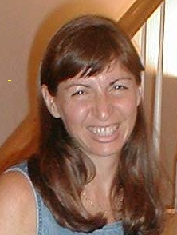
We can change pixels directly…
>>> file="/Users/guzdial/mediasources/barbara.jpg"
>>> pict=makePicture(file)
>>> show(pict)
>>> setColor(getPixel(pict,10,100),yellow)
>>> setColor(getPixel(pict,11,100),yellow)
>>> setColor(getPixel(pict,12,100),yellow)
>>> setColor(getPixel(pict,13,100),yellow)
>>> repaint(pict)
But that's really dull and boring to change each pixel at a time… Isn't there a better way?

Slide 28
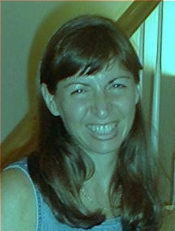
This is why we use a loop!
def decreaseRed(picture):
for p in getPixels(picture):
value=getRed(p)
setRed(p,value*0.5)
Used like this:
>>> file="/Users/guzdial/mediasources/barbara.jpg"
>>> picture=makePicture(file)
>>> show(picture)
>>> decreaseRed(picture)
>>> repaint(picture)
This works for any image.
What do we need to change to make it work for a new image?

Slide 29
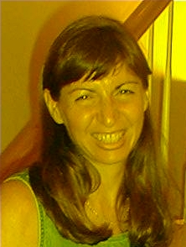
Clearing Blue
def clearBlue(picture):
for p in getPixels(picture):
setBlue(p,0)
Again, this will work for any picture.
Try stepping through this one yourself!

Slide 30
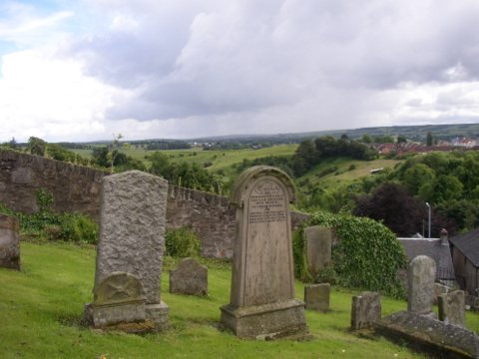
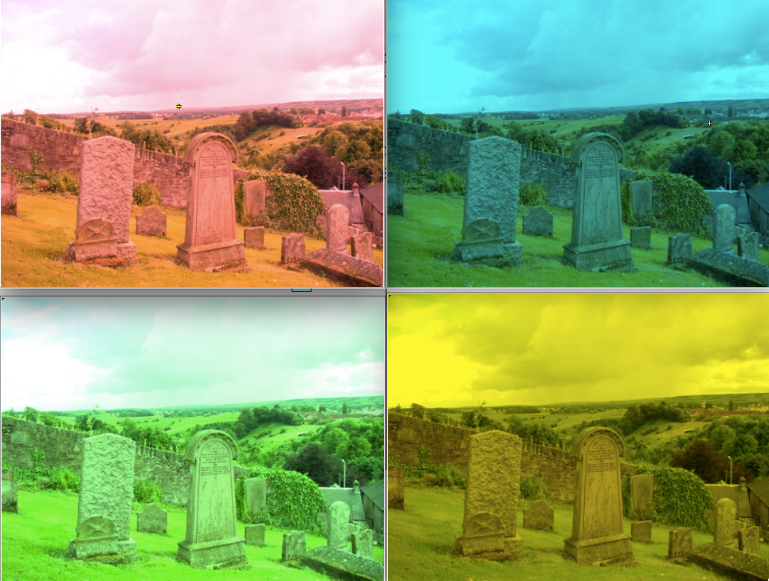




Which one of the below pictures was generated from this function:
def change2(picture):
for pixel in getPixels(picture):
setBlue(pixel,0)
Notes:
From upper left clockwise: 4, 3, 2, 1.
Answer here is #4.

Slide 31
Which one of the below pictures was generated from this function:
def change3(picture):
for pixel in getPixels(picture):
setGreen(pixel,2 * getGreen(pixel))
Notes:
From upper left clockwise: 4, 3, 2, 1.
Answer here is #3.

Slide 32

Can we combine these? Why not!
How do we turn this beach scene into a sunset?
What happens at sunset?
At first, I tried increasing the red, but that made things like red specks in the sand REALLY prominent.
That can't be how it really works
New Theory: As the sun sets, less blue and green is visible, which makes things look more red.

Slide 33

A Sunset-generation Function
def makeSunset(picture):
for p in getPixels(picture):
value=getBlue(p)
setBlue(p,value*0.7)
value=getGreen(p)
setGreen(p,value*0.7)

Slide 34
Contrast these two programs
def makeSunset(picture):
for p in getPixels(picture):
value=getBlue(p)
setBlue(p,value*0.7)
value=getGreen(p)
setGreen(p,value*0.7)
def makeSunset(picture):
reduceBlue(picture)
reduceGreen(picture)
def reduceBlue(picture):
for p in getPixels(picture):
value=getBlue(p)
setBlue(p,value*0.7)
def reduceGreen(picture):
for p in getPixels(picture):
value=getGreen(p)
setGreen(p,value*0.7)
Yes, they do the exact same thing!
makeSunset(somepict) works the same in both cases

Slide 35
Observations on the new makeSunset
def makeSunset(picture):
reduceBlue(picture)
reduceGreen(picture)
def reduceBlue(picture):
for p in getPixels(picture):
value=getBlue(p)
setBlue(p,value*0.7)
def reduceGreen(picture):
for p in getPixels(picture):
value=getGreen(p)
setGreen(p,value*0.7)
It's okay to have more than one function in the same Program Area (and file)
makeSunset in this one is somewhat easier to read.
It's clear what it does “reduceBlue” and “reduceGreen”
That's important!
Programs are written for people, not computers!

Slide 36
Does makeSunset do one and only one thing?
Yes, but it's a higher-level, more abstract thing.
It's built on lower-level one and only one thing
We call this hierarchical decomposition.
You have some thing that you want the computer to do?
Redefine that thing in terms of smaller things
Repeat until you know how to write the smaller things
Then write the larger things in terms of the smaller things.
Notes:
This argument really seems to work – I get lots of nods about “hierarchical decomposition” after this explanation.

Slide 37
I want to increase the blue of each pixel by 25%. I write this:
def increaseBlue(pic):
for pixel in getPixels(pic):
b = getBlue(pixel)
## What goes here?
setBlue(pixel, 0.25 * b)
setBlue(pixel, 1.25 * b)
setBlue(pixel, 0.75 * b)
setBlue(pixel, 1.75 * b)
Notes:
#2

Slide 38
I want to increase the red of each pixel by the same amount. I write this:
def increaseRed(pic):
for pixel in getPixels(pic):
r = getRed(pixel)
## What goes here?
setRed(pixel, r - 50)
setRed(pixel, r / 50)
setRed(pixel, r * 50)
setRed(pixel, r + 50)
Notes:
#4

Slide 39
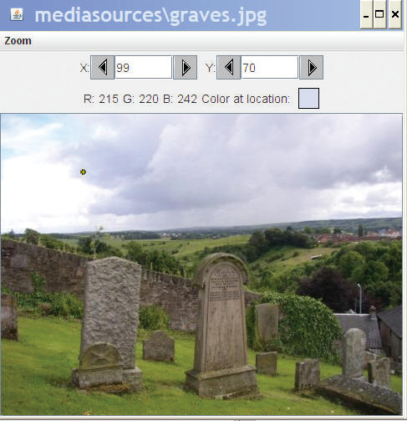
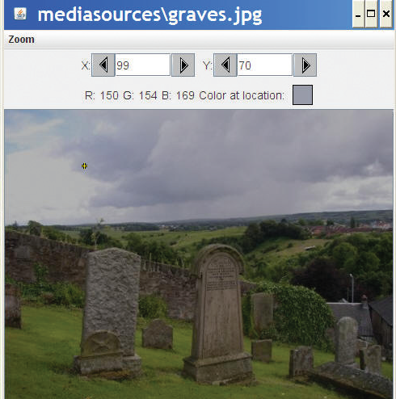
Lightening and darkening an image
def lighten(picture):
for px in getPixels(picture):
color = getColor(px)
color = makeLighter(color)
setColor(px ,color)
def darken(picture):
for px in getPixels(picture):
color = getColor(px)
color = makeDarker(color)
setColor(px ,color)

Slide 40
Consider these two functions
def decreaseRed(picture):
for p in getPixels(picture):
value=getRed(p)
setRed(p,value*0.5)
def decreaseRedNew(picture, amount):
for p in getPixels(picture):
value=getRed(p)
setRed(p,value*amount)
First, it's perfectly okay to have multiple inputs to a function.
The new function, decreaseRedNew, now takes an input of the multiplier for the red value.
decreaseRedNew(picture, 0.5) would do the same thing
decreaseRedNew(picture, 1.25) would increase red 25%

Slide 41
Functions
In natural language, the same word has different meanings depending on context.
I’m going to fly to Vegas.
Would you please swat that fly?
A function is its own context.
Input variables (placeholders) take on the value of the input values only for the life of the function, i.e. only while it’s executing
Variables defined within a function also only exist within the context of that function
The context of a function is also called its scope

Slide 42
Input variables are placeholders
Think of the input variable as a placeholder
It takes the place of the input object
During the time that the function is executing, the placeholder variable stands for the input object.
When we modify the placeholder by changing its pixels with setRed, we actually change the input object.

