Slide 1
Agenda – 2/12/18
Questions?
Readings: CSI 4, P 6.1-6.7
Finish Python notes from last class
Gates and Circuits

Slide 2
CSI Chapter 4
Gates and Circuits

Slide 3
Computers and Electricity
Gate
A device that performs a basic operation on
electrical signals
Circuits
Gates combined to perform more
complicated tasks

Slide 4
Computers and Electricity
How do we describe the behavior of gates and circuits?
Boolean expressions
Uses Boolean algebra, a mathematical notation for expressing two-valued logic
Logic diagrams
A graphical representation of a circuit; each gate has its
own symbol
Truth tables
A table showing all possible input values and the associated
output values

Slide 5
Gates
Six types of gates
NOT
AND
OR
XOR
NAND
NOR
Typically, logic diagrams are black and white with gates distinguished only by their shape
We use color for clarity (and fun)

Slide 6
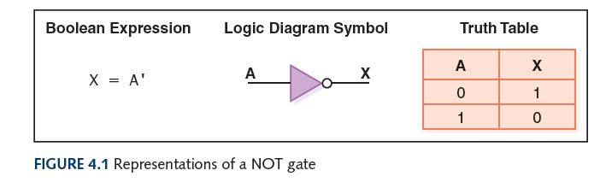
NOT Gate
A NOT gate accepts one input signal (0 or 1) and returns the complementary (opposite) signal as output

Slide 7
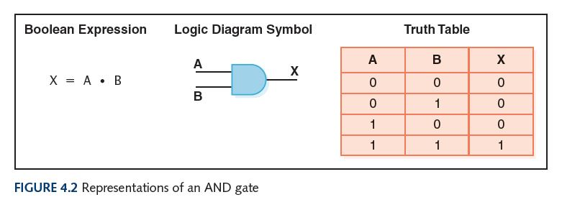
AND Gate
An AND gate accepts two input signals
If both are 1, the output is 1; otherwise,
the output is 0

Slide 8
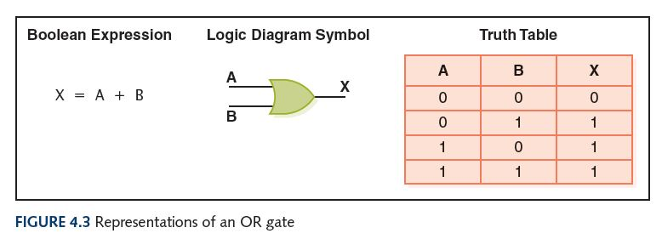
OR Gate
An OR gate accepts two input signals
If both are 0, the output is 0; otherwise,
the output is 1

Slide 9
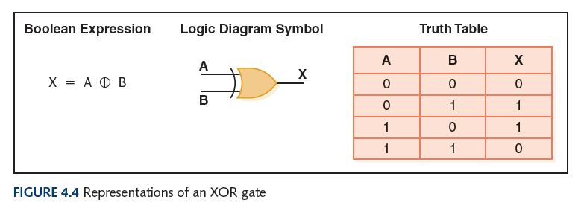
XOR Gate
An XOR gate accepts two input signals
If both are the same, the output is 0; otherwise,
the output is 1

Slide 10
XOR Gate
Note the difference between the XOR gate and the OR gate; they differ only in one input situation
When both input signals are 1, the OR gate produces a 1 and the XOR produces a 0
XOR is called the exclusive OR because its output is 1 if (and only if):
either one input or the other is 1,
excluding the case that they both are

Slide 11
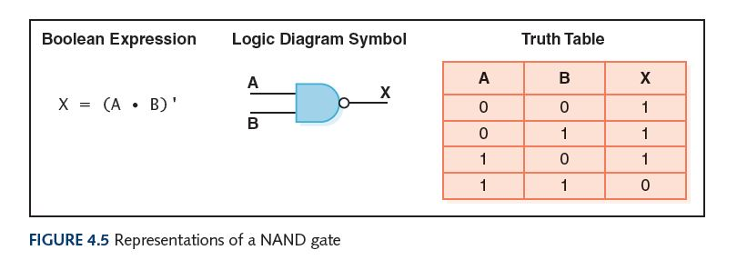
NAND Gate
The NAND (“NOT of AND”) gate accepts two input signals
If both are 1, the output is 0; otherwise,
the output is 1

Slide 12
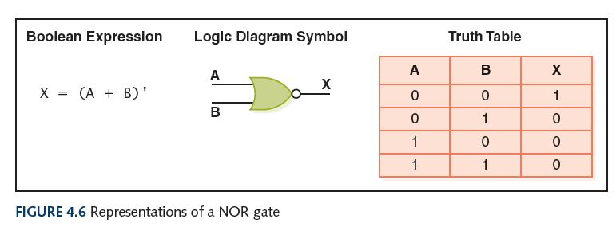
NOR Gate
The NOR (“NOT of OR”) gate accepts two inputs
If both are 0, the output is 1; otherwise,
the output is 0

Slide 13
Review of Gate Processing
A NOT gate inverts its single input
An AND gate produces 1 if both input values are 1
An OR gate produces 0 if both input values are 0
An XOR gate produces 0 if input values are the same

Slide 14
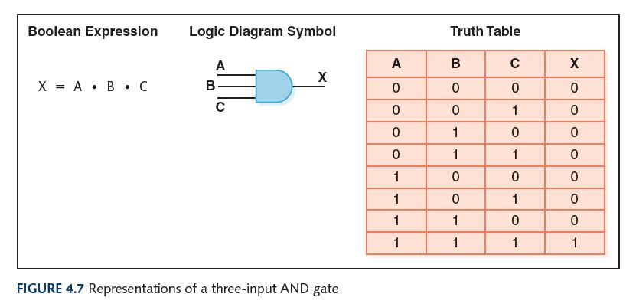
Gates with More Inputs
Some gates can be generalized to accept three or more input values
A three-input AND gate, for example, produces an output of 1 only if all input values are 1

Slide 15
Circuits
Combinational circuit
The input values explicitly determine the output
Sequential circuit
The output is a function of the input values and the existing state of the circuit
We describe the circuit operations using
Boolean expressions
Logic diagrams
Truth tables
Are you surprised?

Slide 16
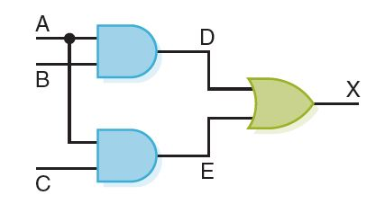
Combinational Circuits
Gates are combined into circuits by using the output of one gate as the input for another
This same circuit using a Boolean expression is AB + AC

Slide 17
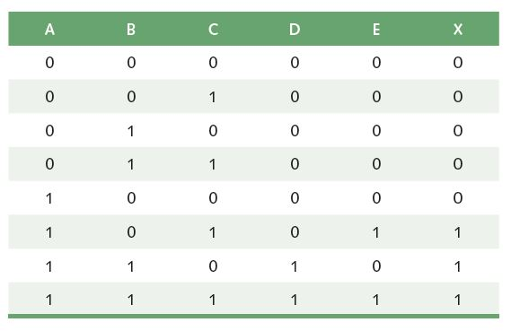
Combinational Circuits
Three inputs require eight rows to describe all possible input combinations

Slide 18
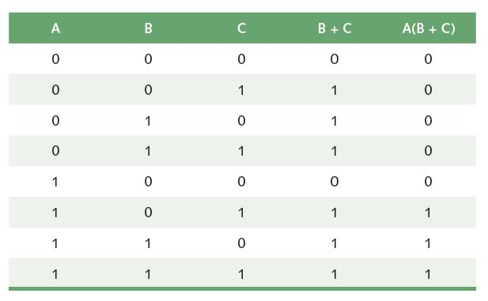
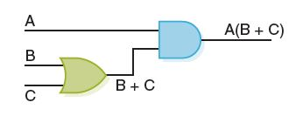
Combinational Circuits
Consider the following Boolean expression A(B + C)
Does this truth table look familiar?
Compare it with previous table

Slide 19
Combinational Circuits
Circuit equivalence
Two circuits that produce the same output for identical input
Boolean algebra
Allows us to apply provable mathematical principles to help design circuits
A(B + C) = AB + BC (distributive law) so circuits must be equivalent

Slide 20
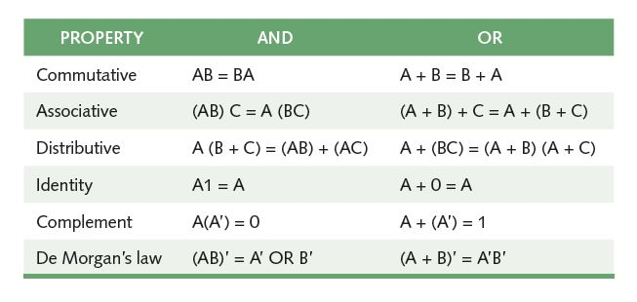
Properties of Boolean Algebra

Slide 21
Circuit Construction Algorithm (Sum-of-Products Algorithm)
How do we create a circuit given a description of the circuit’s desired behavior?
Step 1: Truth table construction
Create a column for each input and a column for the output
Fill in all combinations of inputs on a separate line of the table (there will be 2^{n}, where n is the number of inputs)
Fill in the output for each combination
Example: create an equality circuit
Test 2 unsigned binary numbers
Produce 1 if 2 numbers are equal, otherwise 0

Slide 22
Sum-of-Products Algorithm (cont’d)
Step 2: Sub-expression construction (AND and NOT)
Final all of the combinations in the table that have a true output
For each, write a sub-expression anding together each column; for inputs that must be false, use not.
A | B | Output
0 | 0 | 1
0 | 1 | 0
1 | 0 | 0
1 | 1 | 1
⬅
⬅

Slide 23
Sum-of-Products Algorithm (cont’d)
Step 3: Subexpression construction (OR)
All of the sub-expressions created in Step 2 are or’d together.

Slide 24
Sum-of-Products Algorithm (cont’d)
Step 4: Produce the circuit diagram.

Slide 25
Sum-of-Products Algorithm (cont’d)
Try this:
A | B | C | Output
0 | 0 | 0 | 0
0 | 0 | 1 | 0
0 | 1 | 0 | 1
0 | 1 | 1 | 0
1 | 0 | 0 | 0
1 | 0 | 1 | 0
1 | 1 | 0 | 1
1 | 1 | 1 | 0

Slide 26
Sum-of-Products Algorithm (cont’d)
Show the equivalent Boolean expression:
And circuit:

