Slide 1
Practice with loops!
What is the output of each function below?
def stars3( ):
result = ""
for s in range(4, 10):
result = result + "*"
print result
def stars4( ):
for r in range(1, 4):
result = ""
for c in range(1, 3):
result = result + "*"
print result
def stars5( ):
for r in range(1, 4):
result = ""
for c in range(1, r+1):
result = result + "*"
print result

Slide 2
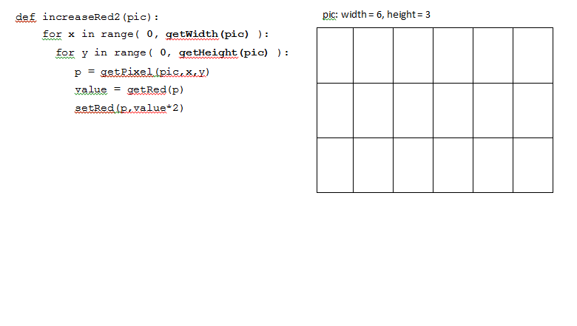
Practice with loops and images!
For each of the following functions, label the pixels of the input picture (shown on the right) in the order in which they are modified by the function.
x | y | Pixel whose red value is modified

Slide 3
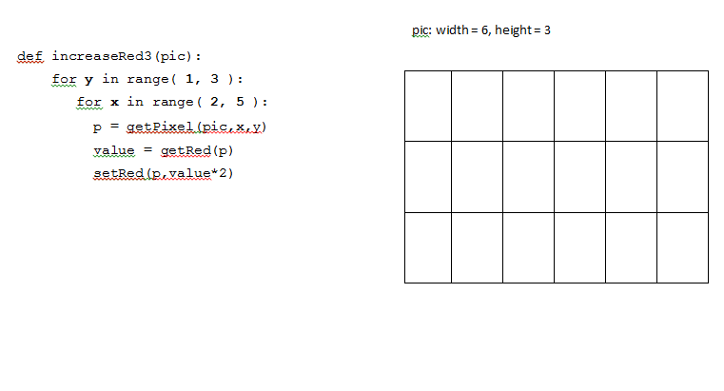

Slide 4
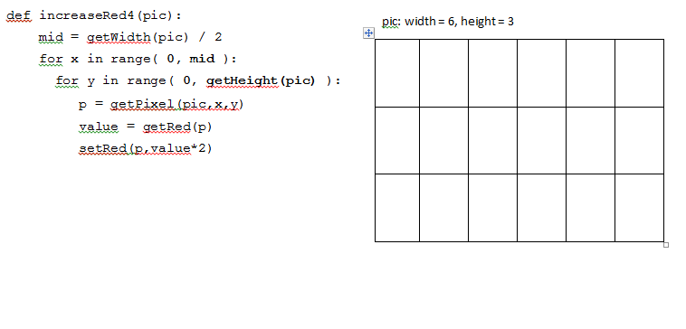

Slide 5
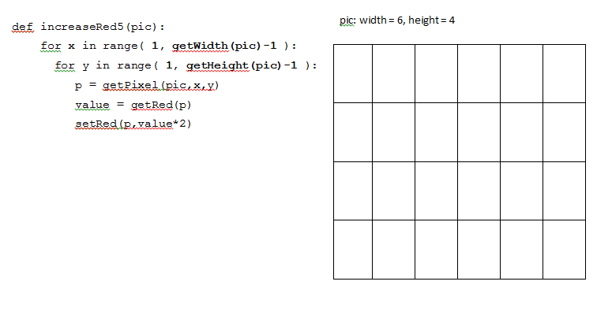

Slide 6
More Nested Loop Practice
The following function should put a 50x100 green rectangle in a picture starting at pixel (50, 50):
def greenRectangle (picture):
for x in range ( ):
for y in range ( ):
px = getPixel (picture,x,y)
setColor (px, green)
Question to ponder: what if the picture is too small?

Slide 7
Making Decisions in Python
Uses Boolean Logic (and, or, not)
Also uses statement: “if”
Basic format:
statements in the program before the if stmt
if CONDITION :
statements to execute if CONDITION is True
could have several statements inside the if
stmts indented to same level would be executed
more statements after the if stmt (always executed)

Slide 8
What if there are two options?
For example, we want to print “off” if a variable equals 0 and “on” otherwise.
statements in the program before the if stmt
if CONDITION :
statements to execute if CONDITION is True
could have several statements inside the if
else:
statements to execute if CONDITION is False
more statements after the if stmt (always executed)

Slide 9
What if there are more than two options?
For example, we want to print “off” if a variable equals 0, print “on” if the variable equals 1 and “no clue” otherwise.
statements in the program before the if stmt
if CONDITION :
statements to execute if CONDITION is True
could have several statements inside the if
elif 2ndCONDITION :
statements to execute if 2ndCONDITION is True
else:
stmts to execute if all previous tests are False
more statements after the if stmt (always executed)

Slide 10
Practice function writing
Complete the following function:
# return the number of pixels in a picture
def numPixels
return

Slide 11
Practice
Complete the following function:
# return true if the picture is "big" (has over 90,000 pixels)
def isBig
if
return
return

