Slide 1
Creating and Modifying Movies
Chapter 14
Notes:
Thanks to John Sanders of Suffolk University for contributions to these slides!

Slide 2
What is a movie?
We're going to refer generically to captured (recorded) motion as “movies.”
  This includes motion entirely generated by graphical drawings, which are normally called animations.
  This also includes motion generated by some kind of photographic process, normally called video.

Slide 3
Psychophysics of Movies:
Persistence of Vision
What makes movies work is yet another limitation of our visual system:
Persistence of vision
We do not see every change that happens in the world around us.
Instead, our eye retains an image (i.e., tells the brain “This is the latest! Yup, this is still the latest!”) for a brief period of time.
  If this were not the case, you would be aware of every time that your eye blinks because the world would “go away” for a moment.

Slide 4
16 frames and it's motion
If you see 16 separate pictures in one second, and these pictures are logically sequenced,
  That is, #2 could logically follow from the scene in #1.
  You will perceive the pictures as being in motion.
  16 pictures of completely different things doesn't work,
16 frames per second (fps), 16 pictures in a second, is the lower bound for the sensation of motion.

Slide 5
Beyond 16 fps
Early silent pictures were 16 fps – motion picture standards shifted to 24 fps to make sound smoother.
Videocameras (digital video) capture 30 fps
How high can we go?
  Air force experiments suggest that pilots can recognize a blurb of light in 1/200th of a second!
  Video game players say that they can discern a difference between 30 fps and 60 fps.
Bottomline:
  Generate at least 16 fps and you provide a sense of motion.
  If you want to process video, you're going to have 30 fps to process (unless it's been modified elsewhere for you.)

Slide 6
MPEG? QuickTime? AVI? JMV?
MPEG, QuickTime, and AVI are compressed movie formats:
  They don't record every frame.
  Record some key frames, and then store data about what parts of the screen change on intervening frames.
  MPEG is an international standard, from the same people who invented JPEG.
  AVI is a Microsoft standard.
  QuickTime is an Apple standard.
JMV is a file consisting of JPEG frames in an array.
  All frames represented

Slide 7
Why do we compress movies?
Do the math:
  One second of 640x480 pixels at 30 fps
  30 (frames) * 640 * 480 (pixels) = 9,216,000 pixels
  With 3 bytes of color per pixel, that's 27,648,000 bytes or 27 megabytes of information per second.
  For a 90 minute feature movie (short), that's 90 * 60 * 27,648,000 = 149,299,200,000 bytes (149 gigabytes)
A DVD stores 6.47 gigabytes of data.
  So even on a DVD, the movie is compressed.
Notes:
a 4k camera (very high end… #3000) I looked at was 30fps for 4k recording and 120 fps for 1080p recording.

Slide 8
MPEG movie
An MPEG movie is actually a series of MPEG frames composed with an MP3 soundtrack.
  It's literally two files stuck together in one.
We're not going to deal with sound movies for now.
  The real challenge in doing movie processing is generating and manipulating frames.

Slide 9
Processing movies
Our frames are going to be JPEG pictures.
  One JPEG file per frame.
So, if we're going to be processing movies, we're going to generating or processing sequences of JPEG files.

Slide 10
Get the frames in order
Many tools (including os.listdir()) can process frames in order if the order is specified.
We specify the order by encoding the number of the frame into the name.
  If you put in leading zeroes so that everything is the same length, the order is alphabetical as well as numerical.

Slide 11
Movies in JES
makeMovieFromInitialFile(firstFile) will create a movie object from the image sequence starting from that file.
playMovie(movie) opens a movie player on the movie object. You can write out QuickTime or AVI movies from there.

Slide 12
Simple Motion
def makeRectMovie (directory ):
for num in range (1, 30): #29 frames (1 to 29)
canvas = makeEmptyPicture (300, 200)
addRectFilled (canvas, num * 10, num * 5, 50, 50, red)
# convert the number to a string
numStr = str(num)
if num < 10:
writePictureTo (canvas, directory+"\\frame0"+numStr+".jpg")
if num >= 10:
writePictureTo (canvas, directory+"\\frame"+numStr+".jpg")
movie = makeMovieFromInitialFile (directory+"\\frame00.jpg");
return movie

Slide 13
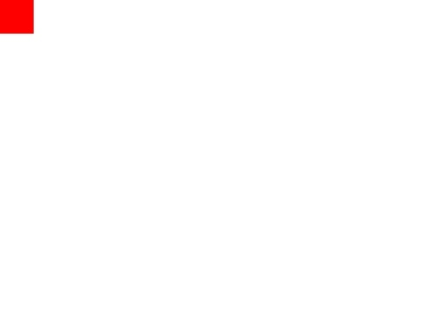
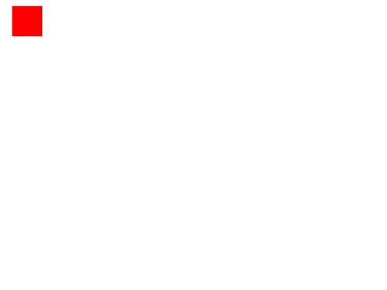
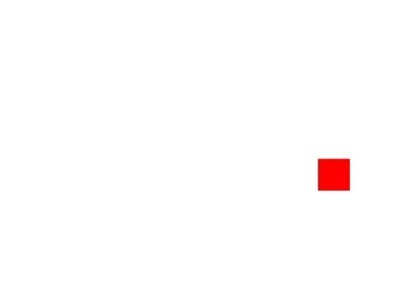
A Few Frames
frame00.jpg
frame02.jpg
frame50.jpg
>>> rectM = makeRectMovie("c:\\Temp\\rect")
>>> playMovie(rectM)
Windows
Mac OS
Notes:
Show the movie here

Slide 14
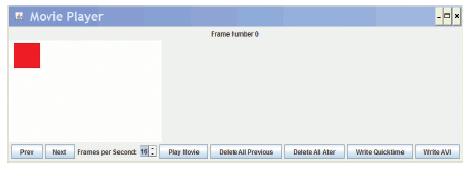
Making and Playing the Movie
>>> rectM = makeRectMovie("c:\\Temp\\ rect")
>>> playMovie(rectM)

Slide 15
Can draw past the end of the picture!
addText, addRect, and the rest of the drawing tools will work even if you go beyond the edge of the drawing.
  Drawings will clip what can't be seen in them, so you don't get an array out of bounds error.
  This is a big deal, because it means that you don't have to do complicated math to see when you're past the end of the drawing.
    But only for the drawing functions.
    If you set pixels, you're still on your own to stay in range.

Slide 16
Making a tickertape
def tickertape (directory, string):
for num in range (1, 100): #99 frames
canvas = makeEmptyPicture (300, 100)
#Start at right, and move left
addText (canvas, 300-(num*10), 50, string)
# Now, write out the frame
# Have to deal with single digit vs. double digit frame numbers differently
numStr = str(num)
if num < 10:
writePictureTo (canvas, directory+"//frame0"+numStr+".jpg")
if num >= 10:
writePictureTo (canvas, directory+"//frame"+numStr+".jpg")
movie = makeMovieFromInitialFile (directory+"/frame00.jpg")
return movie

Slide 17

Playing the tickertape movie

Slide 18
Can we move more than one thing?
def movingRectangle2 (directory ):
for num in range (1, 30): #29 frames
canvas = makeEmptyPicture (300, 250)
# add a filled rect moving linearly
addRectFilled(canvas, num*10, num*5, 50, 50, red)
# Let's have one just moving around
blueX = 100 + int (10 * sin(num))
blueY = 4*num + int (10* cos(num))
addRectFilled(canvas, blueX, blueY, 50, 50, blue)
# Now , write out the frame
# Have to deal with single digit vs. double digit
numStr=str(num)
if num < 10:
writePictureTo(canvas, directory +"// frame0"+ numStr +”.jpg")
if num >= 10:
writePictureTo(canvas, directory +"// frame"+ numStr +”.jpg")

Slide 19
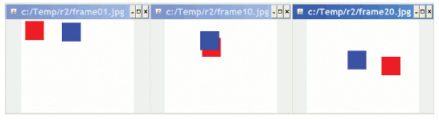
Moving two things at once

Slide 20
Moving a clip from a picture
def clip(picture, startX, startY, endX, endY ):
width = endX - startX + 1
height = endY - startY + 1
resPict = makeEmptyPicture(width, height)
resX = 0
for x in range(startX, endX):
resY =0 # reset result y index
for y in range (startY, endY):
origPixel = getPixel (picture, x, y)
resPixel = getPixel (resPict,resX,resY)
setColor(resPixel,(getColor(origPixel)))
resY=resY + 1
resX=resX + 1
return resPict
def moveHead(directory ):
markF=getMediaPath("blue-mark.jpg")
mark = makePicture(markF)
head = clip(mark, 275, 160, 385, 306)
for num in range (1, 30): #29 frames
printNow("Frame number: ” + str(num))
canvas = makeEmptyPicture (640, 480)
# Now, do the actual copying
copy(head, canvas, num*10, num*5)
# Now, write out the frame
# Have to deal with frame # digits
numStr = str(num)
if num < 10:
writePictureTo(canvas,directory+"//frame0"+numStr+".jpg")
if num >= 10:
writePictureTo(canvas,directory+"//frame"+numStr+".jpg")
Clip() function returns part of another picture.
Using general copy() function we defined earlier.

Slide 21
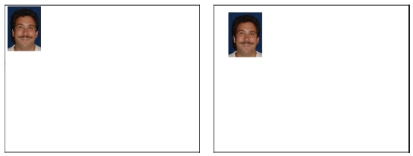
Moving around Mark's head

Slide 22
What if we have over 100 frames?
def writeFrame (num, directory, framepict):
# Have to deal with single digit vs. double digit frame numbers differently
framenum = str(num)
if num < 10:
writePictureTo(framepict,directory+"//frame00"+framenum+".jpg")
if num >= 10 and num<100:
writePictureTo(framepict,directory+"//frame0"+framenum+".jpg")
if num >= 100:
writePictureTo(framepict,directory+"//frame"+framenum+".jpg")
This will make all our movie-making easier — it's generally useful
Notes:
We keep doing the same if statement… let’s make a function!

Slide 23
Rewriting moving Mark's head
def moveHead2 (directory):
markF=getMediaPath ("blue -mark.jpg")
mark = makePicture (markF)
face = clip (mark, 275, 160, 385, 306)
for num in range (1, 30): #29 frames
printNow ("Frame number: "+str(num))
canvas = makeEmptyPicture (640, 480)
# Now, do the actual copying
copy (face, canvas, num*10, num*5)
# Now, write out the frame
writeFrame (num, directory, canvas)
This code is much easier to read and understand with the subfunctions.

Slide 24
Using real photographs
Of course, we can use any real photographs we want.
We can use any of the techniques we've learned previously for manipulating the photographs.
Even more, we can use the techniques in new ways to explore a range of effects.

Slide 25
Slowly making it (very) sunset
Remember this code?
What if we applied this to create frames of a movie, but slowly increased the sunset effect?
def makeSunset(picture):
for p in getPixels(picture):
value = getBlue(p)
setBlue(p, value*0.7)
value = getGreen(p)
setGreen(p, value*0.7)

Slide 26
SlowSunset
Just one canvas repeatedly being manipulated
def slowsunset (directory):
canvas = makePicture (getMediaPath ("beachSmaller.jpg")) #outside the loop!
for frame in range (0, 100): #99 frames
printNow ("Frame number: "+str(frame))
makeSunset (canvas)
# Now, write out the frame
writeFrame (frame, directory, canvas)
def makeSunset (picture):
for p in getPixels(picture):
value = getBlue(p)
setBlue(p, value*0.99) #Just 1% decrease!
value = getGreen(p)
setGreen(p, value*0.99)
Not showing you writeFrame() because you know how that works.
Notes:
Actually run this one in the background while we go on, to show the amount of time this takes.

Slide 27
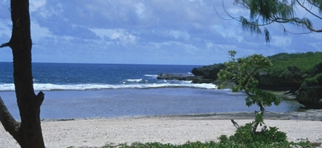
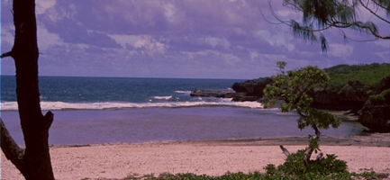
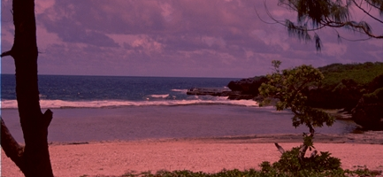
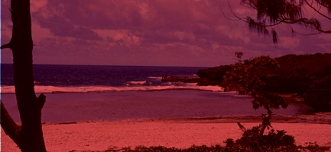
SlowSunset frames

Slide 28
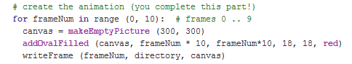
Simple Motion
frameNum | startX frameNum * 10 | startY frameNum * 10
0 | 0 | 0
1 | 10 | 10
2 | 20 | 20
3 | 30 | 30
4 | 40 | 40
… | … | …
Creates this file

Slide 29
Motion Practice 1
(assume frame image is 300x300 pixels)
If the following statement is in the program, draw (using an arrow) the initial position and direction of the red circle:
addOvalFilled (canvas, frameNum*10, 20, 18, 18, red)

Slide 30
Motion Practice 2
(assume frame image is 300x300 pixels)
If the following statement is in the program, draw (using an arrow) the initial position and direction of the red circle:
addOvalFilled (canvas, frameNum*10 + 100, frameNum*10, 18, 18, red)

Slide 31
Motion Practice 3
(assume frame image is 300x300 pixels)
If the red circle moves as shown in the diagram below, what line of code was used to create it?
x = 200

Slide 32
Motion Practice 4
(assume frame image is 300x300 pixels)
If the red circle moves as shown in the diagram below, what line of code was used to create it?

Slide 33
Demos
What have students done in the past?

Slide 34
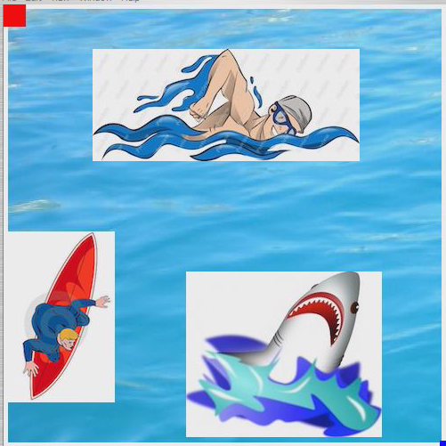
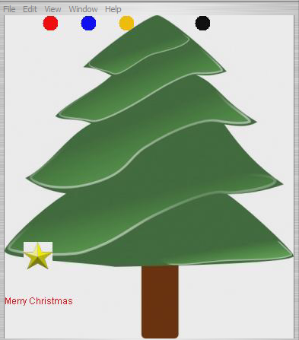
Demos

Slide 35
Tips
You may need to clear out the frames folder between test runs
Review frames to see what is going on and determine when you might want to move or change something
Probably won’t need to create any methods – just add code to the main for loop.
Use SMALL images for objects
Can use a larger image for background but you don’t want to copy onto canvas for each frame
  This will slow things down

Slide 36

HW5 - Now you do it!
Add a second object or text to the template code
Your Python textbook will be very helpful
  Particularly Chapter 14
Make sure you read the HW requirements so you don’t miss any additional required elements
Please note that creativity counts so have fun with it!

