Slide 1
Hardware
Computing Components

Slide 2
Chapter Goals
Read an ad for a computer and understand the jargon
List the components and their function in a von Neumann machine
Describe the fetch-decode-execute cycle of the von Neumann machine
Describe how computer memory is organized and accessed
Name and describe different auxiliary storage devices
Explain the concept of embedded systems and give examples from your own home

Slide 3
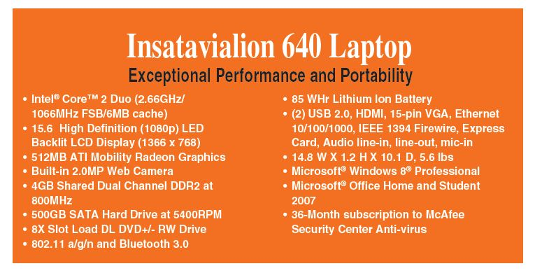
Computer Components
Consider the following ad:
Be patient! If you
don’t know now,
you should know
shortly

Slide 4
Sizes in Perspective
Admiral Grace Murray Hopper’s Illustration
A coil of wire nearly 1,000 feet long
Distance traveled by an electron along the wire in the space of a microsecond
A short piece of wire
In the space of a nanosecond
A bag containing grains of pepper
In the space of a picosecond

Slide 5
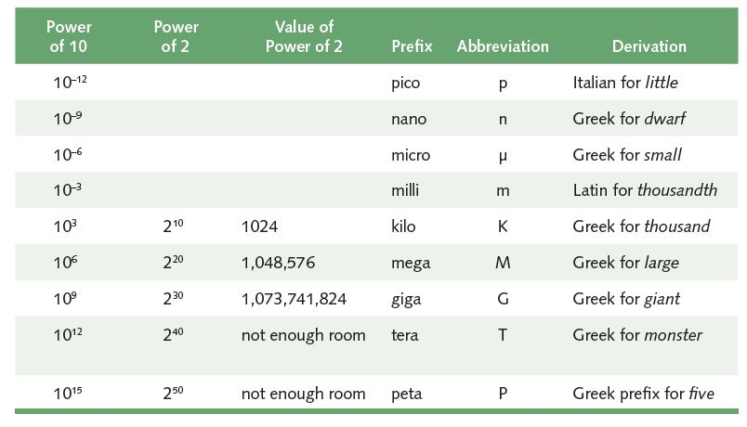
Sizes in Perspective
Powers of 10 for time, powers of 2 for storage
What is a Hertz?

Slide 6
Sizes in Perspective
Intel Processor
speed 2.66 GHz
SDRAM
size 4GB
speed 800 MHz
500GB SATA at 5400 RPM
Transfer rate 300MB per second
Flat screen dot pitch .28mm
To which do these
apply?
Bigger is better
Faster is better
Smaller is better

Slide 7
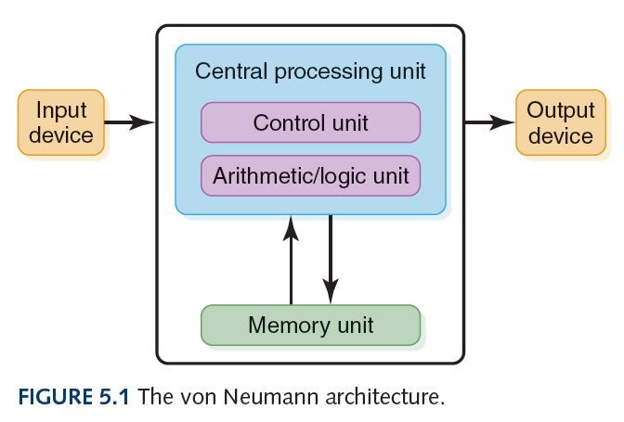
Stored-Program Concept
Instructions and data both stored in memory unit

Slide 8
Input/Output Units
Input Unit
A device through which data and programs from
the outside world enter the computer system;
Can you name three?
Output unit
A device through which results stored in the
computer memory are made available outside the computer system
Can you name two?

Slide 9
Touch Screens
Touch screen
A computer monitor that can respond to the user, touching the screen with a stylus or finger
There are four types
Resistive
Capacitive
Infrared
Surface acoustic wave (SAW)

Slide 10
Touch Screens
Resistive touch screen
A screen made up of two layers of electrically conductive material
One layer has vertical lines, the other has horizontal lines
When the top layer is pressed, it comes in contact with the second layer which allows electrical current to flow
The specific vertical and horizontal lines that make contact dictate the location on the screen that was touched

Slide 11
Touch Screens
Capacitive touch screen
A screen made up of a laminate applied over a glass screen
Laminate conducts electricity in all directions; a very small current is applied equally on the four corners
When the screen is touched, current flows to the finger or stylus
The location of the touch on the screen is determined by comparing how strong the flow of electricity is from each corner

Slide 12
Touch Screens
Infrared touch screen
A screen with crisscrossing horizontal and vertical beams of infrared light
Sensors on opposite sides of the screen detect the beams
When the user breaks the beams by touching the screen, the location of the break can be determined

Slide 13
Touch Screens
Surface acoustic wave (SAW)
A screen with crisscrossing high frequency sound waves across the horizontal and vertical axes
When a finger touches the surface, corresponding sensors detect the interruption and determine location of the touch

Slide 14
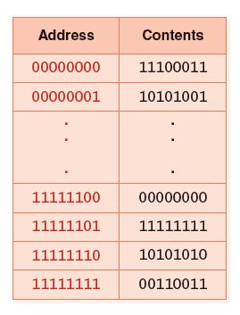
Memory
Memory
A collection of cells, each with a unique physical address
Most computers are byte-addressable
Cell at address 11111110 contains 10101010

Slide 15
Memory
Memory
What does 10101010 mean?
No way to answer that
Could be an instruction, a natural number, a signed integer, a character, part of an image, …

Slide 16
Memory (Primary), cont’d
Uses random access:
2 basic operations:
Fetch (addres)
Store (address, value)

Slide 17
RAM and ROM
Random Access Memory (RAM)
Memory in which each location can be accessed and changed
Read Only Memory (ROM)
Memory in which each location can be accessed but not changed
RAM is volatile, ROM is not
What does volatile mean?

Slide 18
Secondary Storage Devices
Why is it necessary to have secondary storage devices?
Can you name some of these devices?

Slide 19
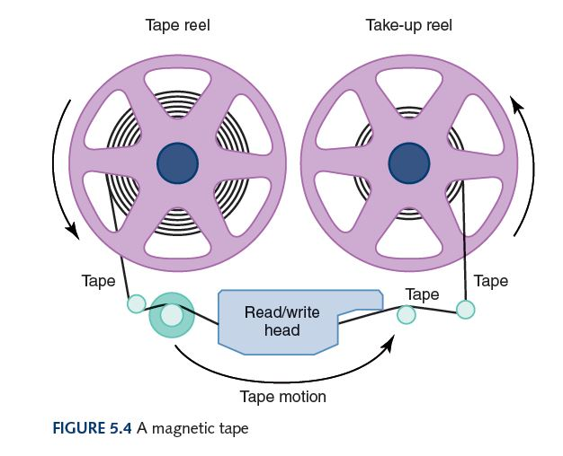
Magnetic Tape
The first truly mass auxiliary storage device was the magnetic tape drive
Tape drives have a
major problem; can
you describe it?

Slide 20
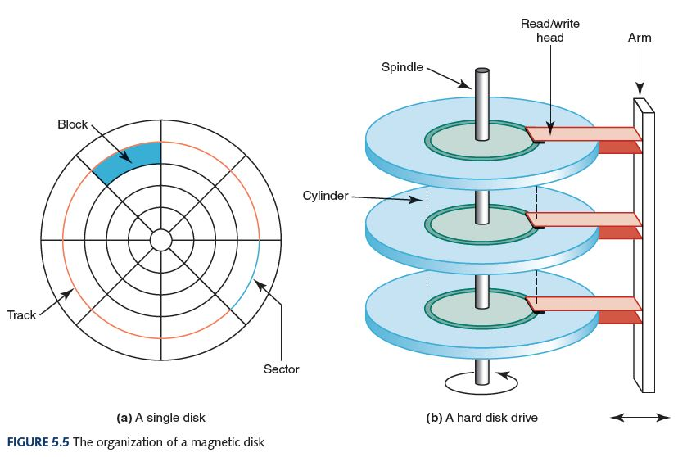
Magnetic Disks

Slide 21
Magnetic Disks
Seek time
Time for read/write head to be over right track
Latency
Time for sector to be in position
Access time
Can you define it?
Transfer rate
Rate at which data moves from the disk to memory

Slide 22
Magnetic Disks
3.5 floppy – epson SMD 1340 Specifications:
# sectors per track: 18 Rotation speed: 300 rpm
# tracks per surface: 80 Head motion: 3 msec to move 1 track
 | Seek time | Latency | Transfer time | Total
Best
Worst
Average

Slide 23
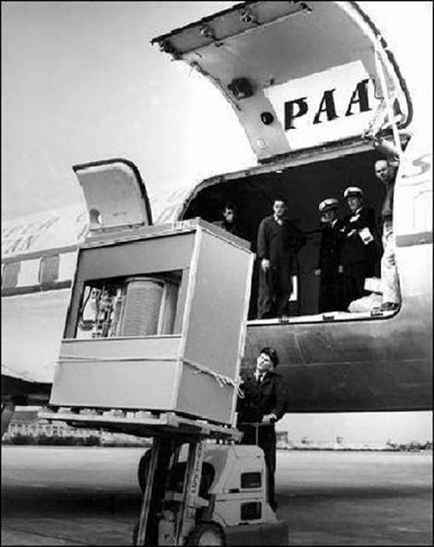
Magnetic Disks
Notes:
Hard disk drive… with 5mb of storage
In september 1956, ibm launched the 305 RAMAC, the first ‘super’ computer with a hard disk drive. The hard disk drive weighed over a ton and stored 5MB of data.

Slide 24
Optical Disks
CD
A compact disk that uses a laser to read information stored optically on a plastic-coated disk; data is evenly distributed around spiral track
CD-ROM read-only memory
CD-DA digital audio
CD-WORM write once, read many
RW or RAM both read from and written to
DVD
Digital Versatile Disk, used for storing audio and video
Blu-ray
Higher capacity DVD allowing higher resolution video, etc.

Slide 25
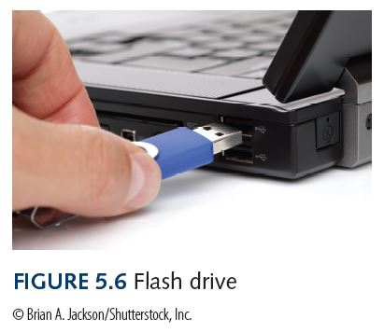
Flash Drives
Flash Memory
Nonvolatile
Can be erased and rewritten
Supports USB mass storage standard
Notes:
25

Slide 26
Memory (Primary/Secondary)
Cache memory
Principle of locality
When information is needed, it:
looks in cache
accesses desired info from RAM
copies data into cache

Slide 27
Memory (Primary/Secondary)
Summary:
Primary Memory | Secondary Memory

Slide 28
Arithmetic/Logic Unit
Performs basic arithmetic operations such as addition and subtraction
Performs logical operations such as AND, OR, and NOT
Most modern ALUs have a small amount of special storage units called registers that can be accessed faster than main memory

Slide 29
Control Unit
Control unit
The organizing force in the computer
Instruction register (IR)
Contains the instruction that is being executed
Program counter (PC)
Contains the address of the next instruction to be
executed
Central Processing Unit (CPU)
ALU and the control unit called the Central Processing Unit, or CPU

Slide 30
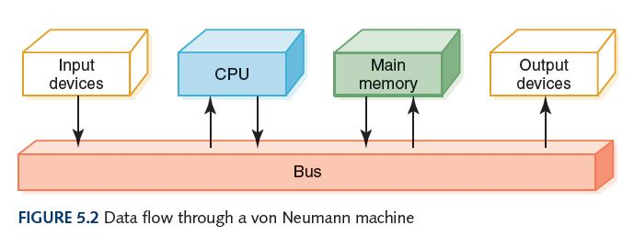
Flow of Information
Bus
In general: A communication system that transfers data between components inside a computer or between computers; the medium (wires, optical fiber, etc.) and the protocols (rules for sharing the medium nicely)
“The” bus: Connects the CPU, main memory, I/O devices, and possibly other components (e.g. hard disk drive)

Slide 31
What is an N-bit Processor?
It could mean any of these:
N-bit general registers
N-bit ALU
N-bit addresses
N-bit data bus

Slide 32
The Fetch-Execute Cycle
Fetch the next instruction
Decode the instruction
Get data if needed
Execute the instruction
Why is it called a cycle?

Slide 33
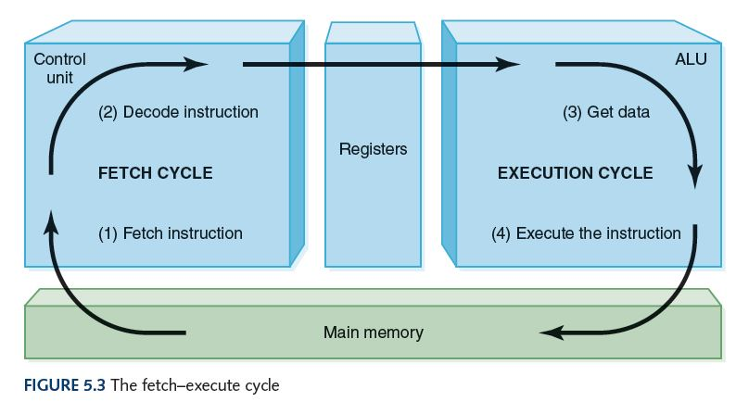
The Fetch-Execute Cycle

Slide 34
Embedded Systems
Embedded systems
Computers that are dedicated to perform
a narrow range of functions as part of a
larger system
Empty your pockets or backpacks.
How many embedded systems do you have?
34
Notes:
34

Slide 35
Instructions, cont’d
Typical format of machine language instruction
Ex: ADD X,Y
op code
address1
address2
…

Slide 36
Instruction Set
Numeric code | Meaning
0000 | load x | x → R
0001 | store x | R → x
0010 | clear x | 0 → x
0011 | add x | R + x → R
0100 | increment x | x + 1 → x
0101 | subtract x | R - x → R
0110 | decrement x | x – 1 → x
0111 | compare x | if x > R then 100 → CCR else if x < R then 001 → CCR else if x = R then 010 → CCR
1000 | jump x | goto x
1001 | jumpgt x | goto x if CCR=100
1010 | jumpeq x | goto x if CCR=010
1011 | jumplt x | goto x if CCR=001
1100 | jumpneq x | goto x if CCR<>010
1101 | in x | store input in x
1110 | out x | output x
1111 | halt

