Slide 1

Python – convert to Machine Language

Slide 2
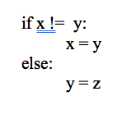
Python – convert to Machine Language

Slide 3
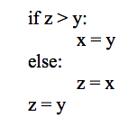
Python – convert to Machine Language

Slide 4
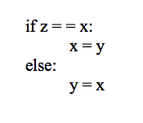
Python – convert to Machine Language

Slide 5
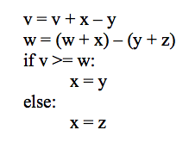
Python – convert to Machine Language

Slide 6
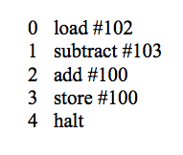
Machine Language – convert to Python

Slide 7
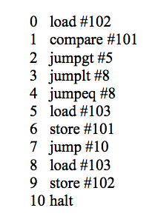
Machine Language – convert to Python

Slide 8
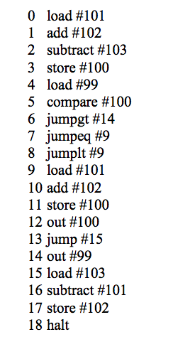
Machine Language – convert to Python

Slide 9
Sound Function Practice
Write a function called extreme that takes as input a sound and sets each positive sample value to 32767 (the largest amplitude). Leave the negative samples alone.
Write a function called theNixonGap that takes as input a sound and erases the middle portion of it by setting the amplitude of the middle half of the samples to zero.
Write a function called printMax that takes as input a sound. It should find and print the largest sample value in the sound.

