Slide 1
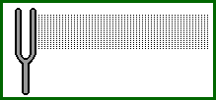
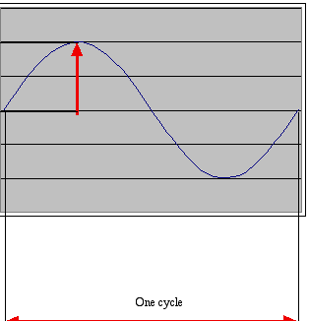
How sound works:
Acoustics, the physics of sound
Sounds are waves of air pressure
  Sound comes in cycles
  The ______________ of a wave is the number of cycles per second (cps), or Hertz
  The _________________ is the maximum height of the wave

Slide 2
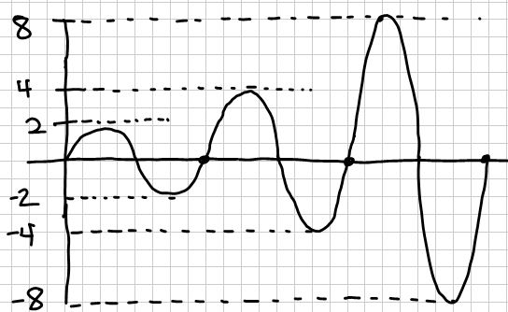
Volume and pitch: Psychoacoustics, the psychology of sound
Our perception of volume is related (logarithmically) to changes in amplitude
  If the amplitude doubles, it’s about a 6 decibel (dB) change
  Normal speech ~60dB. Shouted speech ~80dB

Slide 3
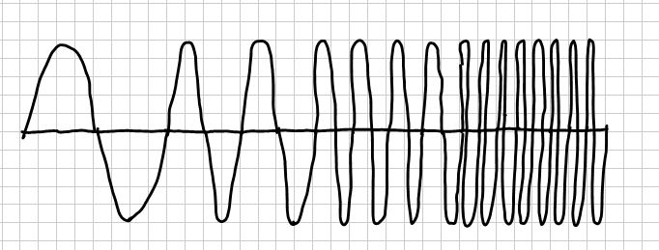
Volume and pitch: Psychoacoustics, the psychology of sound
Our perception of pitch is related (logarithmically) to changes in frequency
  Higher frequencies are perceived as higher pitches
  We can hear between 5 Hz and 20,000 Hz (20 kHz)
  A above middle C is 440 Hz
time (secs)
1 2 3 4

Slide 4
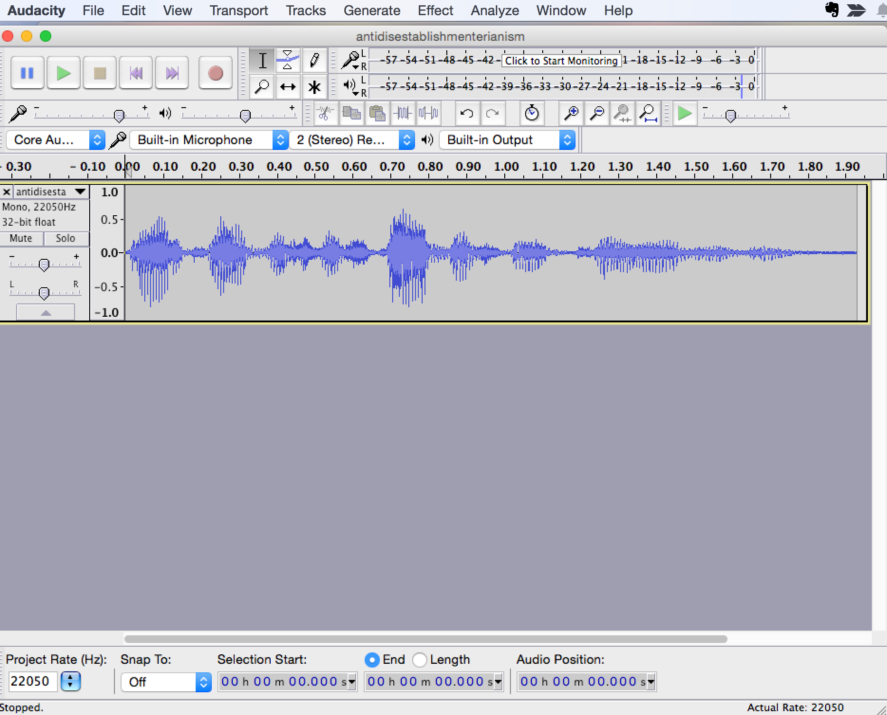
Demonstrating Audacity
Fourier transform (FFT)
Notes:
I usually bring in a couple musical instruments (harmonica, thumb piano, ukelele, flute) to show how they have different FFT “signature” (different spikes).

Slide 5
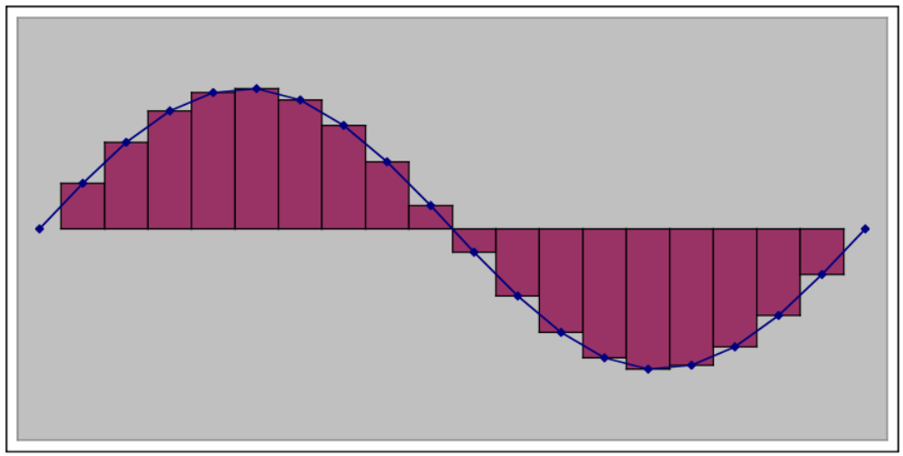
Digitizing Sound: How do we get that into numbers?
Analog-to-digital conversion (ADC) will give us the amplitude at an instant as a number: a sample

Slide 6
Digitizing Sounds: Arrays
A sound is just a long ordered list of numbers (samples), each of which is a measure of amplitude at regular intervals over time.
Samples are stored in memory in an array, a sequence of bytes right next to one another in memory.

Slide 7
Digitizing sound: Sample Size
Each sample stored as a number in two bytes
What’s the min and max amplitude we can represent with 2 bytes?
  2 bytes = _______ bits which can represent 2______ = _______________ values
  But we need both positive and negative amplitudes
  Use one bit to indicate positive (0) or negative (1)
  That leaves us with 15 bits
  15 bits, 2¹⁵ = 32,768
  Sample values are between -32768 and 32767

Slide 8
Nyquist Theorem
We need twice as many samples as the maximum frequency in order to represent (and recreate, later) the original sound.
The number of samples recorded per second is the sampling rate
  If we capture 8000 samples per second, the highest frequency we can capture is __________________ Hz
    That’s how phones work
  If we capture more than 44,000 samples per second, we capture everything that we can hear (max 22,000 Hz)
    CD quality is 44,100 samples per second

Slide 9


Recording Sounds Using Audacity and Using Sounds in Python
Demonstrate how to record and export sounds using Audacity
  Make sure sampling rate is 44100 (lower left)
  Save only left audio stream (middle left)
Manipulating sounds in Python
  >>> s = makeSound( pickAFile() )
  >>> play( s )
  >>> getSamplingRate( s )
  >>> getLength( s )
  >>> explore( s )
Notes:
NOTE TO TEACHERS! You must only save the left audio stream in Audacity for this reason: The sample functions in JES (like setSampleValueAt) only affect the left audio stream, not the right audio stream. So in the hands-on activities, if you save both streams and then try to erase (for example) the middle section of the sound by setting the amplitudes to 0s, it will zero out only the left audio stream but the right audio stream will remain in tack. So then when you play the resulting sound, what you get is both streams playing for the first ¼ of the sound, only the right stream playing for the middle, and then both streams playing for the last ¼ of the sound. It took me over an hour to figure out that this was why it wasn’t erasing! The wav files in the MediaSources folders only have a left stream (or at least this was true of the ones I checked), which is why they work fine. – Robin

Slide 10
Manipulating a Sample Value
getSampleValueAt(sound, index) → returns the value of the
sample at the index
setSampleValueAt(sound, index, value) → sets the value of the
sample at the index
>>> s = makeSound( pickAFile() )
>>> v = getSampleValueAt( s, 215 )
>>> print v
>>> setSampleValueAt( s, 215, 30000 )

Slide 11
Recipe to Increase the Volume
def increaseVolume(sound):
for index in range(0, getLength(sound)):
value = getSampleValueAt(sound, index)
setSampleValueAt(sound, index, value*2)
Using it:
>>> s = makeSound(pickAFile())
>>> increaseVolume(s)
>>> play(s)

Slide 12
How Did That Work?
def increaseVolume(sound):
for index in range(0, getLength(sound)):
value = getSampleValueAt(sound, index)
setSampleValueAt(sound, index, value*2)
index | value
3 | 8 | 10 | 7

Slide 13
Two useful functions: copy, clip
copy (sourceSound, targetSound, startPosition)
  copies the source sound into the target sound starting at the startPosition
  targetSound must be large enough to hold sourceSound
  sourceSound is unchanged
  targetSound is changed
  this function does NOT return a sound, it changes the targetSound!!
shortS = clip (sound, startPosition, endPosition)
  makes a new sound that is a clip of the sound from startPosition to endPosition
  sound is unchanged
  this function DOES return a sound – the shorter sound!

Slide 14
How clip works
  s:
  shortS = clip(s, 1, 7)
  shortS:
100 | 2000 | -4500 | 1500 | 100 | 30000 | -10500 | 5250 | -4004 | -20
0 | 1 | 2 | 3 | 4 | 5 | 6 | 7 | 8 | 9
0 | 1 | 2 | 3 | 4 | 5

Slide 15
How copy works
  s:
  s1:
  copy(s1, s, 2)
100 | 2000 | -4500 | 1500 | 100 | 30000 | -10500 | 5250 | -4004 | -20
0 | 1 | 2 | 3 | 4 | 5 | 6 | 7 | 8 | 9
500 | 500 | 500 | -500 | 1000
0 | 1 | 2 | 3 | 4

Slide 16
Copy and clip
Not going to trace them at this time
Need to understand the difference and how to use them
Last page is an excellent reference to remember how to use them

Slide 17
Making an empty sound
Reasons you may need this
  reverse a sound
  join two sounds together
  put part of one sound in another sound
  others…
How do you do this?
  newS = makeEmptySound(lengthOfNewSound, sampleRate)

Slide 18
Splicing two sounds
Use copy (sourceSound, targetSound, startPosition)
Example: to splice two sounds s1 and s2 into one:
  newS = makeEmptySound( )
  copy (s1, , )
  copy ( , , )
  explore (newS) # to see what it did!

Slide 19
Do you need to make empty sound to reverse a sound??
Why can’t you do this?
def reverse (sound):
revIndex = getLength(sound) - 1
for index in range (0, getLength(target)):
revValue = getSampleValueAt (sound, revIndex)
setSampleValueAt (sound, index, revValue)
revIndex = revIndex - 1
1500 | 200 | -500 | 3400 | 2500 | 1000 | -400 | 52 | 64 | -20
0 | 1 | 2 | 3 | 4 | 5 | 6 | 7 | 8 | 9

Slide 20
How we need to do reverse
def reverse (source):
target = makeEmptySound (getLength(source),44100)
sourceIndex = getLength(source) - 1
for targetIndex in range (0, getLength(target)):
sourceValue = getSampleValueAt (source, sourceIndex)
setSampleValueAt (target, targetIndex, sourceValue)
sourceIndex = sourceIndex - 1
return (target)
1500 | 200 | -500 | 3400 | 2500 | 1000 | -400 | 52 | 64 | -20
1500 | 200 | -500 | 3400 | 2500 | 1000 | -400 | 52 | 64 | -20
0 | 1 | 2 | 3 | 4 | 5 | 6 | 7 | 8 | 9

