Slide 1
Chapter 21: Images

Slide 2
Image Sources
3 options:
Create your own images
Find images
Hire someone to make images

Slide 3
Image Sources, cont’d
Create your own:
camera
electronic illustration
Adobe Photoshop – crazy expensive
Adobe Fireworks
Adobe Illustrator
Corel Paint Shop Pro – lowest price
GIMP – only one that is free
scanning

Slide 4
Image Sources, cont’d
Stock photography
do not use copyrighted materials
artwork falls under rights-managed, royalty-free or released under a Creative Commons license
if you are using images for a commercial site, be sure of your images
Some sources:
Flickr Creative Commons – best source for free, but quality varies
StockPhoto – reasonable price for images…. about $3 each
Getty Images – largest stock image house with variety of price ranges
Veer – a little more edgy than other sites
Notes:
rights managed – copyright holder controls who may reproduce the image… you must obtain a license and only use for a particular period of time
royalty-free – available for a one-time fee for unlimited use of image
creative commons license – some artists make their work free, but may ask for credit or limit the image to non-commercial purposes

Slide 5
Image Sources, cont’d
Clip art and icons
royalty-free illustrations, animations, buttons and other things that you can copy and paste into a range of uses
some sites offer free access, but have many pop-ups
others charge a monthly/yearly rate for unlimited access
Some sources:
Clipart.com – membership fee, but well organized and high quality
#1 Free Clip Art – no frills clip art site
Good sources for icons:
The Noun Project
Icon Finder

Slide 6
Formats
Windows: BMP graphics
Print designer: TIFF and EPS
Web: GIF, JPEG, PNG, SVG*
GIF: appropriate for images with flat colors, hard edges, or when transparency or animation is required
JPEG: best for photographs of images with smooth color blends
PNG: either one, but especially efficient for storing images with flat colors. Also, only format that allows multiple levels of transparency
Be sure to use correct file extension when saving your file!! Browsers look at the extension to see how to open the image.

Slide 7
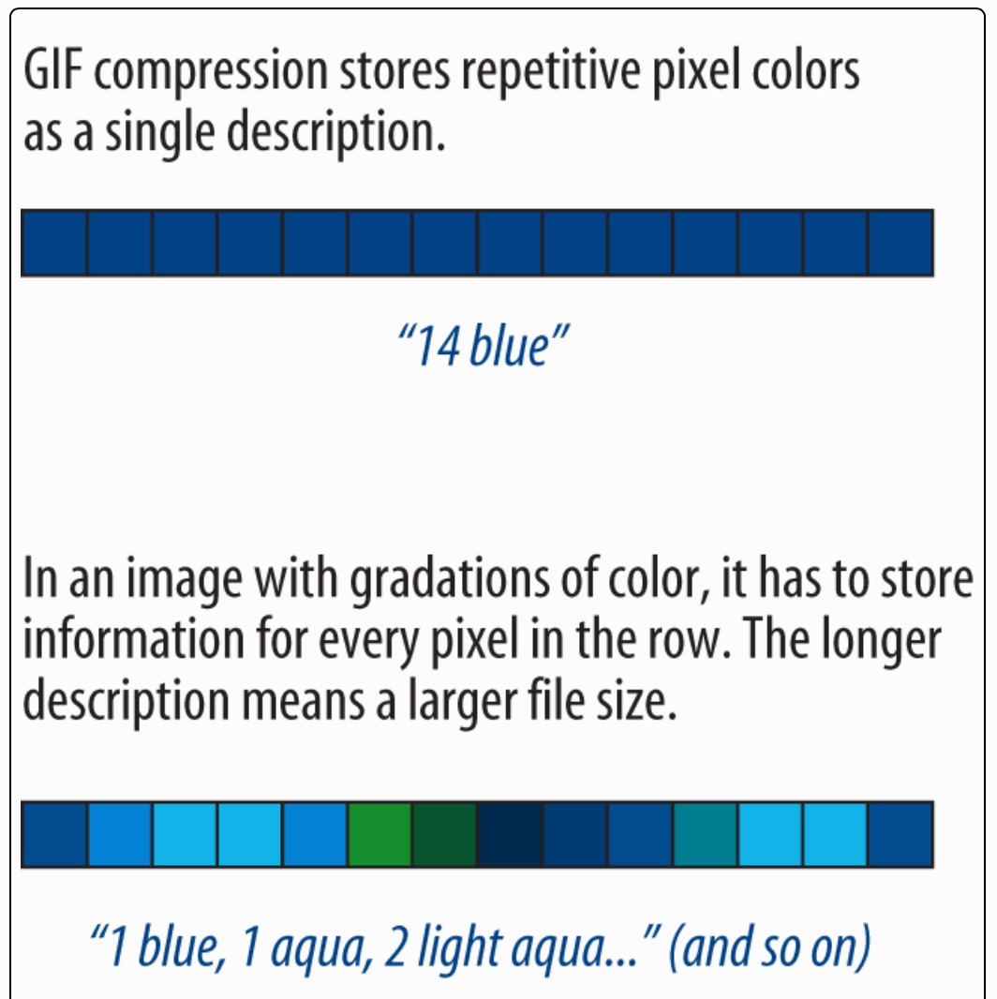
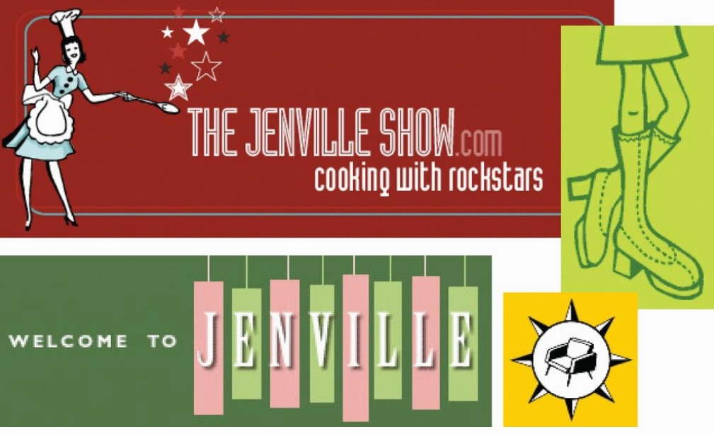
GIF
1st image format supported by web browsers
adopted for its versatility, small file sizes and cross-platform compatibility
still one of the most widely used web graphics formats
best for logos, line art, icons

Slide 8
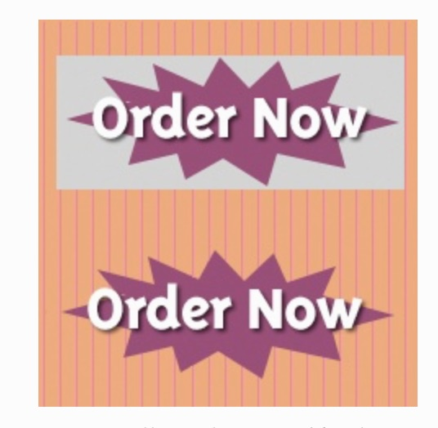
Transparency
You can make parts of images transparent so that the background image or color shows through
All graphics are rectangular… with transparency, you create the illusion that you image has a different shape.
Need more expensive graphics software to create transparency... a bit buggy in GIMP

Slide 9
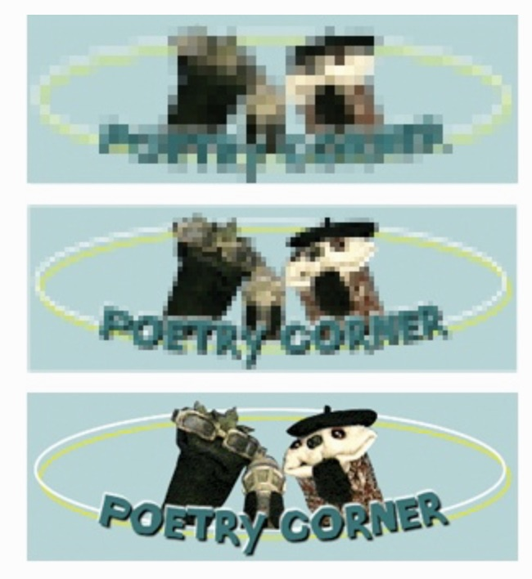
Interlacing GIFs
Display an image in a series of passes
Each pass is clearer than the pass before, until the image is fully rendered
Without interlacing, browsers may wait until entire image is downloaded before displaying
With fast connections, can’t notice it…

Slide 10

Animation
GIF file contains a number of frames, which are separate images.
Viewed together, they look like an animation.

Slide 11
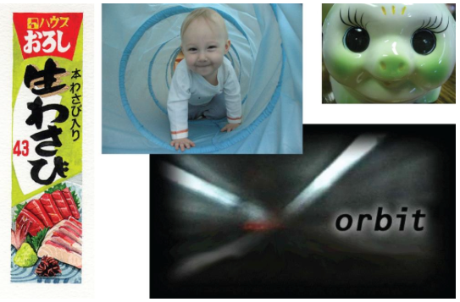
JPEG
Used for photographs
Compression scheme loves gradient and blended colors, but doesn’t work well on flat colors or hard edges.

Slide 12
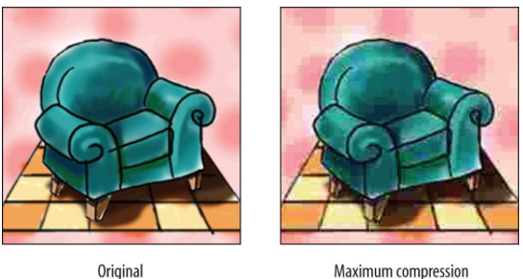
JPEG, cont’d
24 bit colors (millions of colors)
Compression is lossy
You can control how aggressively you want to compress the image – usually a slider when saved
If you compress too much, lose image quality
BUT, less compression = larger file sizes

Slide 13
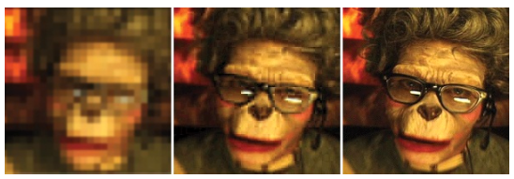
Progressive JPEGs
Similar idea to interlaced GIFs
Image is displayed in series of passes
Sometimes can specify the number of passes to fill in image (3, 4, or 5)

Slide 14
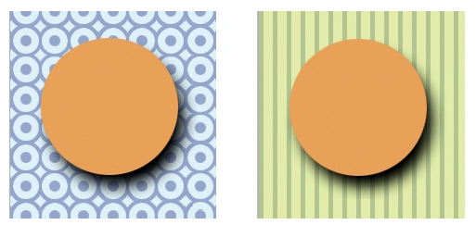
PNG
Latest bitmapped format
Slow start, but now supported by all browsers and becoming developers’ first choice in web graphics
Why?
may contain 8-bit indexed, 24-bit RGB, 16-bit grayscale and even 48-bit color images
lossless compression scheme
transparency of images (multiple levels!)
progressive display
gamma (brightness) adjustment
embedded text for attaching info about author, copyright, etc.
Notes:
16-bit grayscale – allows 65,536 shades of gray, enabling black and white photos and illustrations to be stored with amazing detail… though not appropriate for web, but good for print
multiple levels of transparency can be seen in the gradual shading of the circle shadow

Slide 15
Which one??
If your image… | use… | because…
is graphical, with flat colors | GIF or 8-bit PNG | GIF and PNG excel at compressing flat color
is a photograph or contains graduated color | JPEG | JPEG compression works best on images with blended color. Because it is lossy, it generally results in smaller file sizes than 24-bit PNG
is a combination of flat and photographic imagery | GIF or 8-bit PNG | Indexed color formats are best are preserving and compressing flat color areas. The dithering that appears in the photographic areas as a result of reducing to a palette is usually not problematic.
requires transparency | GIF or PNG | Both GIF and PNG allow transparency
requires multiple levels of transparency | PNG | PNG is the only format that supports multiple levels of transparency
requires animation | GIF | GIF is the only format that can contain animation frames

Slide 16
Saving an image
Almost all graphics programs allow you to save in GIF, JPEG and PNG formats
Start with image of highest quality available
After adjusting image (cropping, color correction, etc.), save image at full size so you have a good original
THEN, resize image so it is appropriate size for web page

Slide 17
Resizing images
Source images generally are not appropriate for Web, so a large portion of time with graphics is image resizing
How to do it?
Free versions:
Preview on Mac
Paint on PC
Notes:
demo these

