Slide 1
Lists, nesting, span/div

Slide 2
Lists
Unordered (Bulleted lists) <ul> <li>First</li> <li>Second</li> <li>Third</li> </ul>
Ordered (Numbered) <ol> <li>First</li> <li>Second</li> <li>Third</li> </ol>
First
Second
Third
First
Second
Third

Slide 3
Lists
<ul> and <ol> have 36px of left padding
For each <li>, the bullet is positioned at -16px
Seeing an example is worth a 1000-word explanation
(list_example.html)

Slide 4
Nesting in HTML
Lists are a great example of how HTML elements can be nested inside each other to create a hierarchy <ol>
<li></li>
<li>
<ul>
<li></li>
<li></li>
<li></li>
</ul>
</li>
</ol>

Slide 5
Blockquotes
<blockquote>The quote goes here</blockquote>
Often misused to create indents
Indicates a long quotation
It is not considered part of the document outline

Slide 6
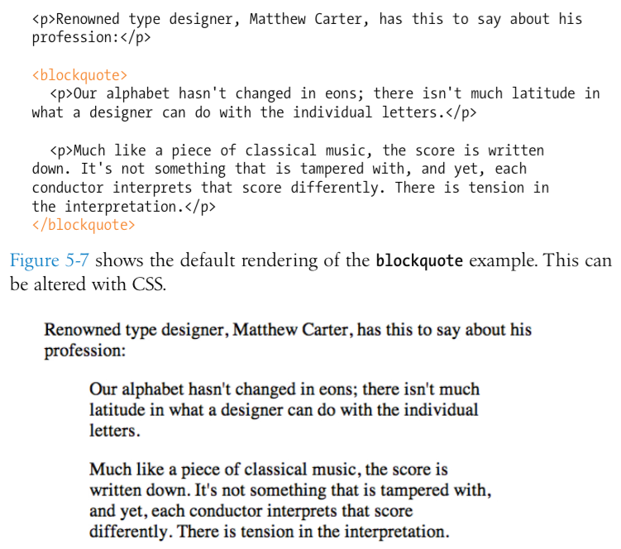

Slide 7
Pre-formatted text
Web browsers ignore extra “white space.”
Only one “space” is displayed between words and elements
Extra spaces, tabs, and line breaks are not displayed at all.
The <pre> tag allows extra spaces, tabs, and line breaks to be displayed.
Why do web browsers ignore extra “white space?”

Slide 8
Figures
<figure>
<img src=“piechart.jpg” alt=“This will pop up”>
<figcaption>This will display on screen</figcaption>
</figure>

Slide 9
Organizing with new HTML5 tags
<header>
<footer>
<section>
<article>
<aside>
<nav>
Notes:
explain why aside and not sidebary

Slide 10
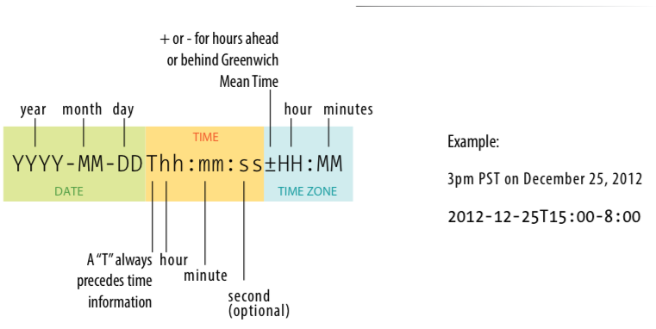
Time and dates
Written by Jennifer Robbins (<time datetime="2012-09-01T 20:00-05:00” pubdate>September 1, 2012, 8pm EST</time>)
Notes:
allows us to markup dates and times in a way that is comfortable for a human to read, but also encoded in a standardized way that computers can use.
content of element for people; datetime attribute for computer

Slide 11
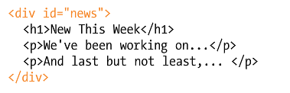
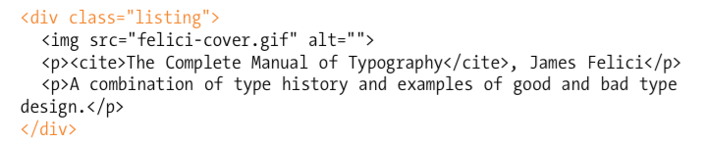
Span and Div

Slide 12
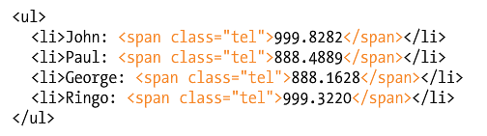
Span and Div

Slide 13
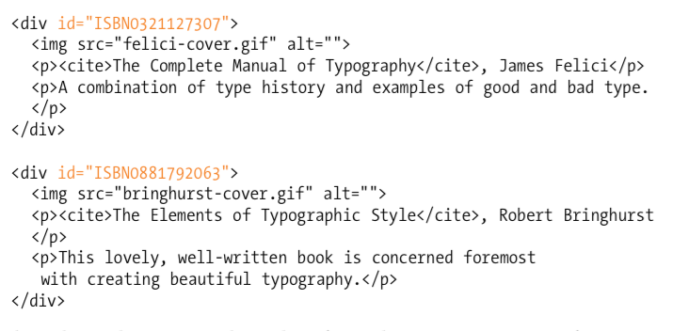
Class vs. id

Slide 14
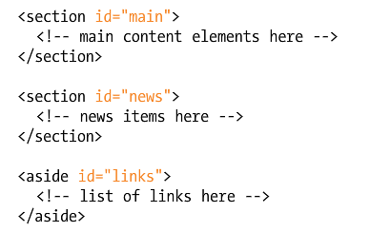
Class vs. id

Slide 15
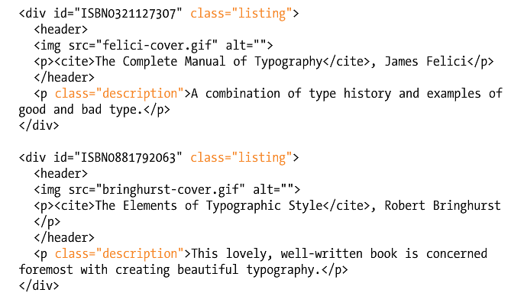
Class vs. id

