Slide 1
Chapter 17
CSS transformations

Slide 2
What is a transition?
instead of going from state to state instantly, it gradually changes
moves from state to state by filling in the frames in between – tweening
if used subtly and with reserve – can add sophistication and polish to your site

Slide 3
Transition decisions
transition-property
what you want to change
transition-duration
how long it should take
transition-timing-function
how transition accelerates
transition-delay
if it should pause before starting

Slide 4
Need trigger for the transition
Usually a state change such as
:hover
:focus
:active
Put the transition properties in the a tag
Put the final state, say color, in the trigger tag

Slide 5
Gradual color change
a {
display: block;
text-decoration: none;
text-align: center;
padding: 1em 2em;
width: 10em;
border-radius: 1.5em;
color: #fff;
background-color: mediumblue;
transition-property: background-color;
transition-duration: 0.5s;
}
a:hover, a:focus {
background-color: red;
}

Slide 6
Lots of things can change
width
color
opacity
text size
anything you can set with CSS can be changed

Slide 7
Multiple transitions
a {
...
transition-property: background-color, color, letter-spacing;
transition-duration: 0.3s, 2s, 0.3s;
transition-timing-function: ease-out, ease-in, ease-out;
}
a: hover, a:focus {
background-color: red;
letter-spacing: 3px;
color: black;
}

Slide 8
2D Transforms
4 types:
rotate - turn
translate - move
scale - resize
skew – slant
When an element transforms, its element box keeps its original position and influences the layout around it (similar to relative positioning)

Slide 9
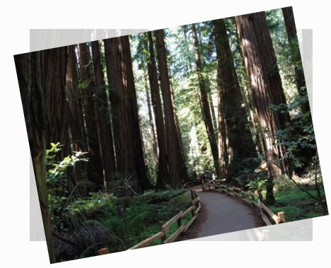
Rotate example
img {
width: 400px;
height: 300px;
transform: rotate(-10deg);
}
defaults to rotate around
origin

Slide 10
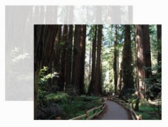
Translate example
img {
width: 400px;
height: 300px;
transform: translate(90px, 60px);
}

Slide 11

Scale example
img {
width: 400px;
height: 300px;
transform: scaleX(.75);
}
>1 increases size
<1 decreases size

Slide 12
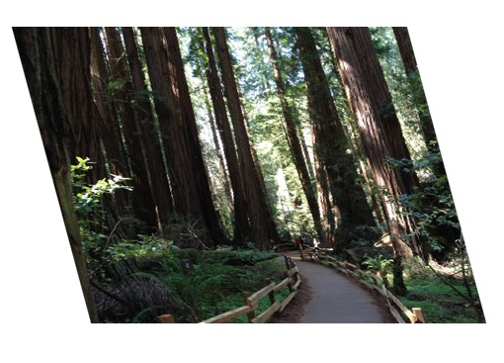
Skew example
img {
width: 400px;
height: 300px;
transform: skewX(15deg);
}

Slide 13
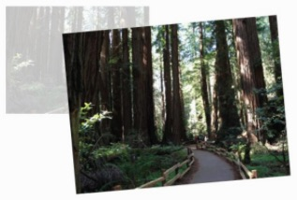
Multiple transforms
img:hover, img:focus {
transform: scale(1.5) rotate(-5deg) translate(50px,30px);
}
transforms applied in
order listed!

Slide 14
Multiple transform warning
If you apply additional transform on a different state, you need to repeat all the transforms already applied to element.
a {
transform: rotate(45deg);
}
a:hover {
transform: scale(1.25); /* rotate on a element would be lost */
}
vs.
a:hover {
transform: rotate(45deg) scale(1.25); /* rotates and scales */
}

Slide 15
3D transitions
image carousels
flippable cards
spinning cubes
demos:
https://codepen.io/tjegan/pen/OXgaNy
http://species-in-pieces.com/

