Slide 1
JSON (JavaScript Object Notation)
Dr. Denise Case
Dr. Doug Hawley
Northwest Missouri State University
Maryville, MO

Slide 2
JSON is …
a format that allows you to store and exchange JavaScript objects
easy to read, after understanding the name : value pairs concept
stored in text files
easily converted into objects
pronounced like the name Jason (or Jay-SON)

Slide 3
JSON is not …
cumbersome
a programming language
only used by JavaScript

Slide 4
Structure
{
"park": "Grand Canyon National Park",
"address": {
"addr1": "PO Box 129",
"city": "Grand Canyon",
"state": "AZ",
"zip": "86203",
"coord": ["36.0122 N", "113.8108 W"],
},
"trails": [
{ "name": "Bright Angel Trail", "length": 19.8, "grade": .1 },
{ "name": "South Kaibab Trail", "length": 14, "grade": .18},
{ "name": "Hermit Trail", "length": 17.8, "grade": .15 },
],
}

Slide 5
manifest.json
Let’s look at our manifest.json file
Every extension using the WebExtensions API must have one
This file allows us to specify metadata (information about the extension) and functionality.

Slide 6
manifest.json
manifest_version - required for reading content
{
"manifest_version" : 2,
"name" : "Custom Web Launcher",
"short_name" : "Web Launcher",
"version" : "0.3",
"description" : "A Chrome new tab extension that can be customized each semester.",
"icons" : {
"128" : "images/128x128.png"
}, ..
}

Slide 7
manifest.json
Name, version, and description show up in the Chrome extension store. Short name is optional.
{
"manifest_version" : 2,
"name" : "Custom Web Launcher",
"short_name" : "Web Launcher",
"version" : "0.3",
"description" : "A Chrome new tab extension that can be customized each semester.",
"icons" : {
"128" : "images/128x128.png"
}, ..
}

Slide 8
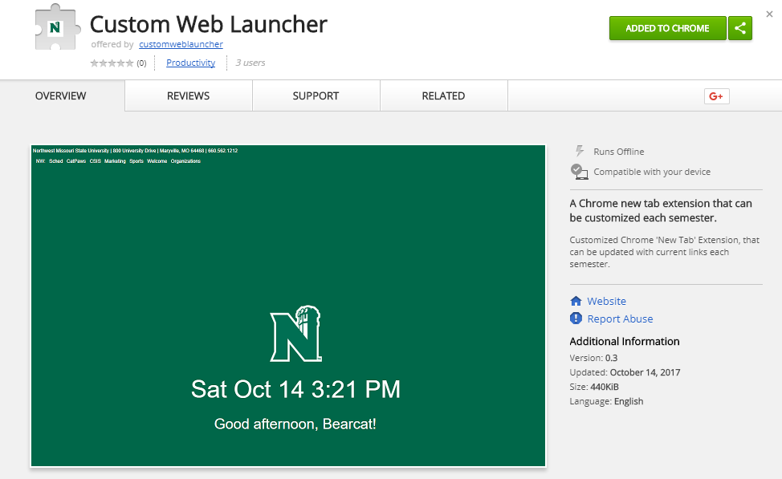
https://chrome.google.com/webstore/detail/custom-web-launcher/bjcnlknhmbnejpgmpblndpddpckjhomm

Slide 9
manifest.json
chrome_url_overrides is used to provide a custom replacement for the new tab document
"chrome_url_overrides" : {
"newtab" : "tab.html"
},

Slide 10
manifest.json
We will cover more when we talk about deploying our app.
For a complete reference list of manifest.json keys, see: https://developer.mozilla.org/en-US/Add-ons/WebExtensions/manifest.json

Slide 11
JSON

