Slide 1
History
Before designing web pages it is important to know how it all came about… History Channel – The Invention of the Internet
Notes:
Start at 17mins

Slide 2

URL
Uniform Resource Locator
The location part of the URI (Uniform Resource Identifier)

Slide 3
URLs/URIs can be complex
http://en.wikipedia.org/wiki/URI_scheme

Slide 4
Default Files
Depends on Web Server
https://www.facebook.com/ will load
https://www.facebook.com/home.php
In general
https://www.server.com/ will load
https://www.server.com/index.html

Slide 5
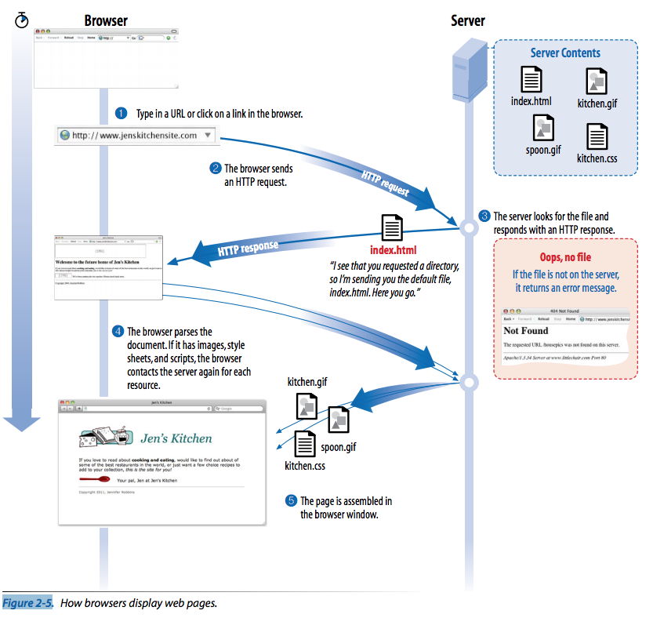

Slide 6
Never know how sites we create will be viewed
We don’t know:
which browser
desktop computer or portable
how large the browser window
what fonts are installed
whether JavaScript is enabled
speed of Internet connection
if pages being read by screen reader
Designers need to resist the urge to make assumptions about any of the above
Sites exist to test different browsers:
Browsershots.org

Slide 7
Mobile Browsers
Sometime soon (it may have already happened), most WWW views will be using a browser on a mobile device.
Screen size and low bandwidth change everything.
Optimizing graphics is important again.
Responsive web page layouts

Slide 8
How do we handle this diversity?
Standardize WWW
World Wide Web Consortium (W3C)
Sets the standards for HTML, CSS, and JavaScript
All browsers should(must) follow the standards
Web Hypertext Application Technology Working Group (WHATWG)
Lead by Apple, Google, and Mozilla Firefox
Established because the W3C is moving too slowly to adopt new technology

Slide 9
HTML5
The new standard adopted by almost all browsers
Will soon be adopted by W3C (slowly)
“Living Standard” / Progressive Enhancement
There may be no HTML6 ever
Supports web applications
HTML5 Canvas + JavaScript

Slide 10
Progressive Enhancement
No browser has implemented all the standards 100%
Idea is to start with baseline experience for basic browsers and layer on advanced features

Slide 11
Responsive Web Design
Strategy for providing custom layouts to devices based on size of browser window
Think of the “conditional light box” from lab… what happened when you changed the size of the window?

Slide 12
Accessibility
Need to consider:
Vision impairment
Mobility impairment
Auditory impairment
Cognitive impairment
All sites benefit from these considerations, but government sites require adherence (508 compliance)
Accessibility Guidelines
Notes:
cognitive impairment: users with memory, reading comprehension, problem solving and attention limitations benefit when sites are designed simply and clearly

Slide 13
Site Performance
Mainly speed
Optimize images so they are smallest size possible without sacrificing quality
Minimize HTML and CSS code
Keep JavaScript to a minimum
Other things that we will not cover in this class
Why is this important?
Google has now added site speed to its search algorithm

Slide 14
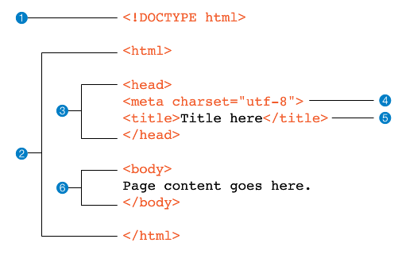
Basic HTML Document

