Slide 1
List Practice

Slide 2
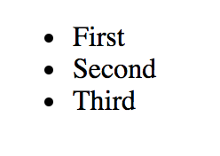
How do we make this?

Slide 3
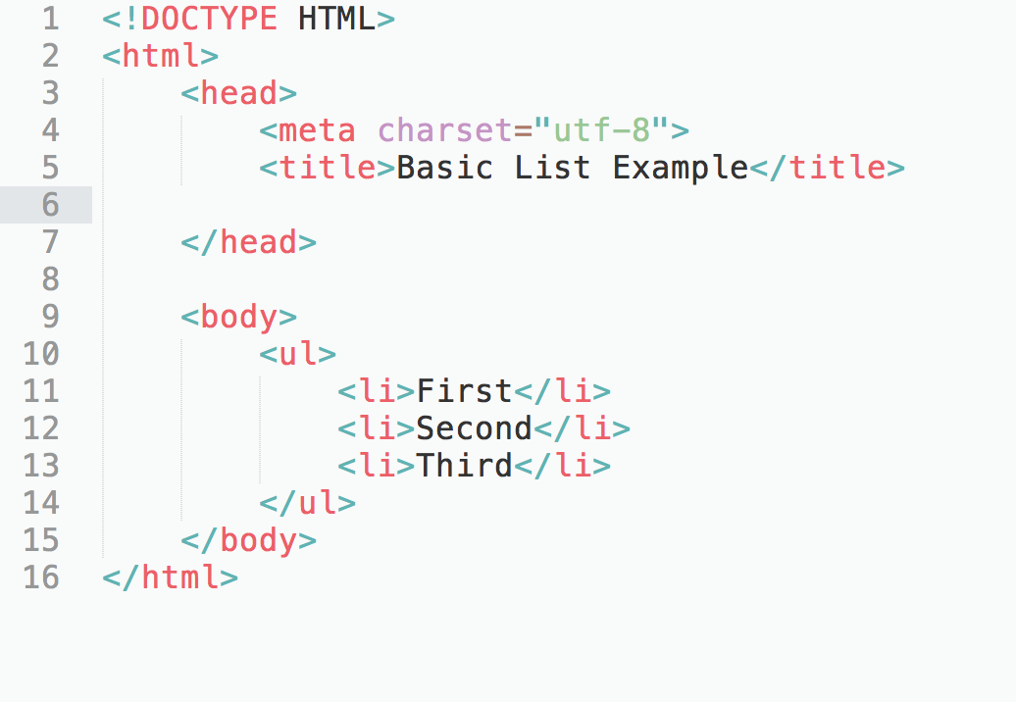
How do we make this?
Notes:
basicList.html… turn on borders to show details

Slide 4
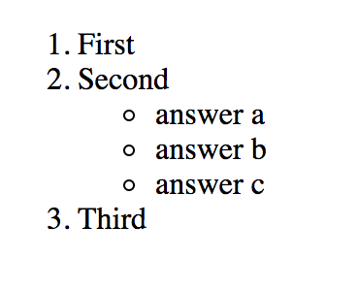
How do we make this?

Slide 5
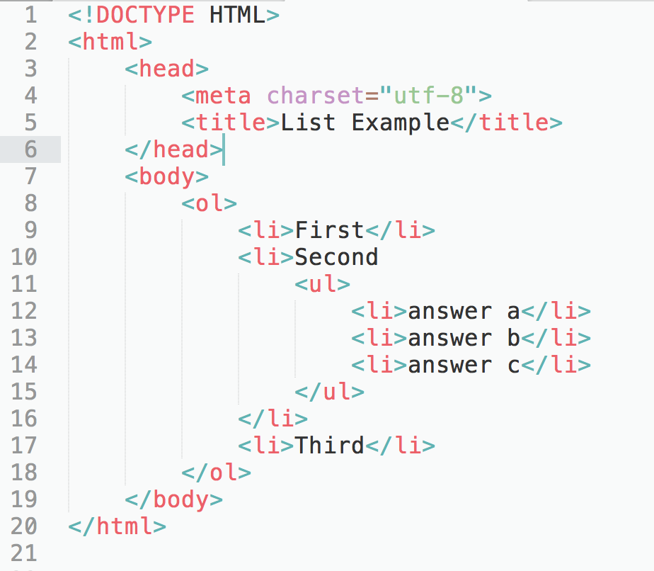
How do we make this?
Notes:
list_practiceA.html

Slide 6
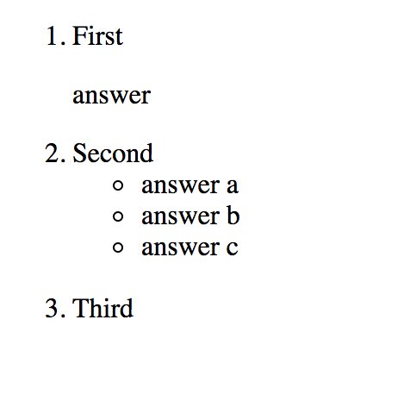
How do we make this?

Slide 7
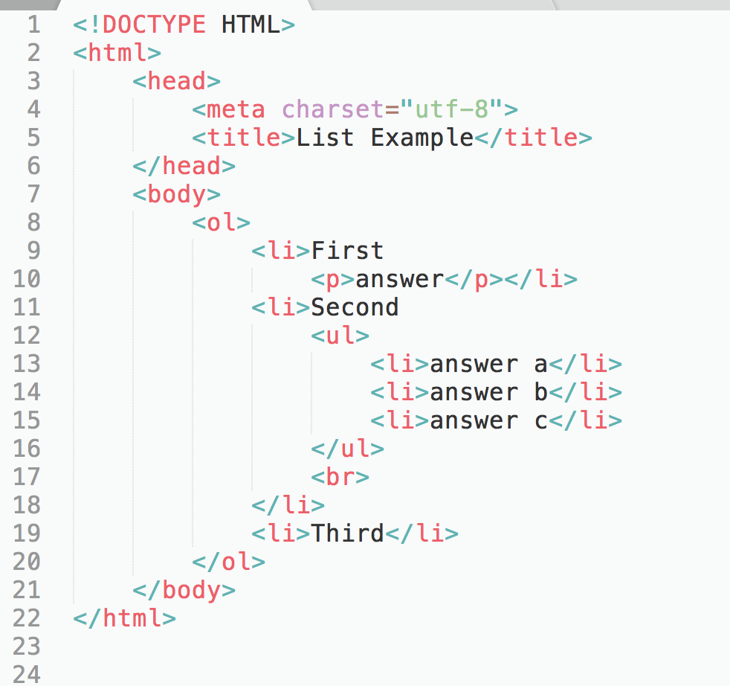
How do we make this?
Notes:
list_practiceB.html

Slide 8
List guidelines
<li> </li> goes around each item in the list for both unordered and ordered lists
Can not have anything between </li> and <li> of adjacent lists
When nesting lists, inner list must be completely inside one of the li tags of the outer list

Slide 9
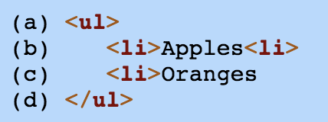
Fix the error(s)

Slide 10
Fix the error(s)
</li>
</li>

Slide 11
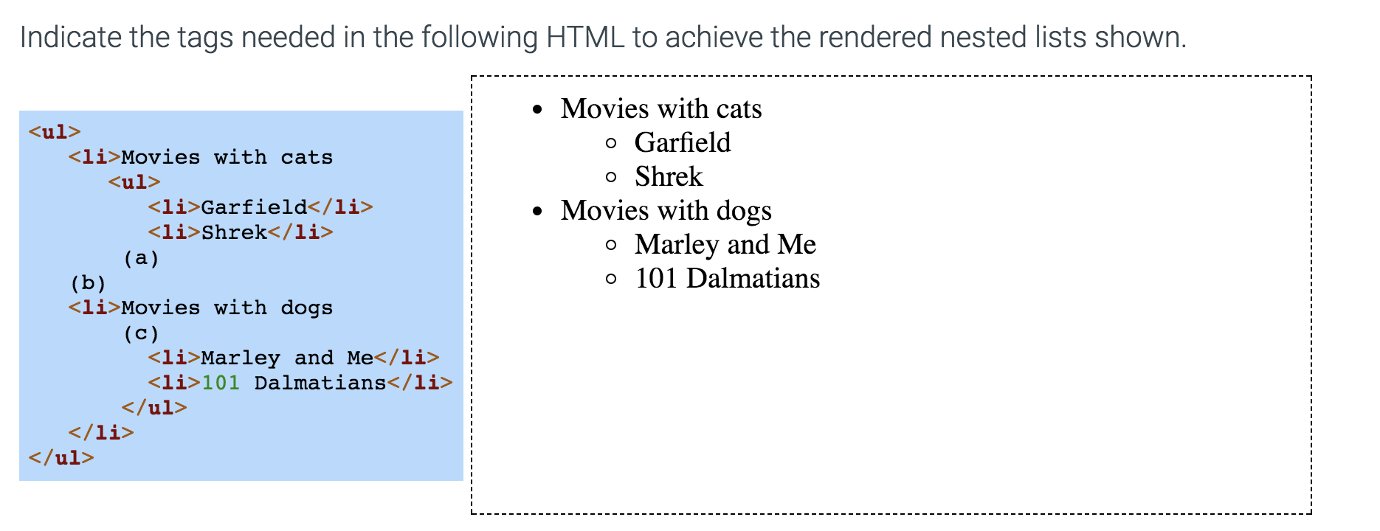

Slide 12
</ul>
</li>
<ul>

Slide 13

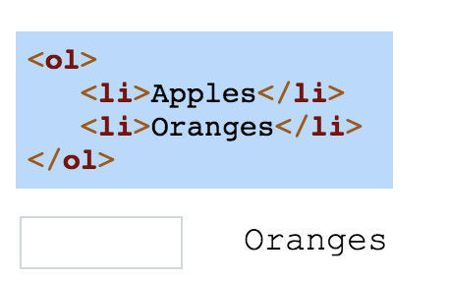

Slide 14
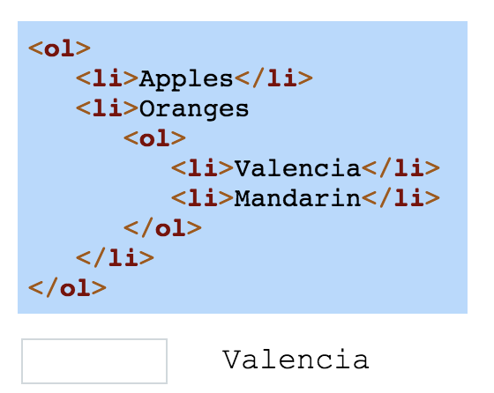

Slide 15
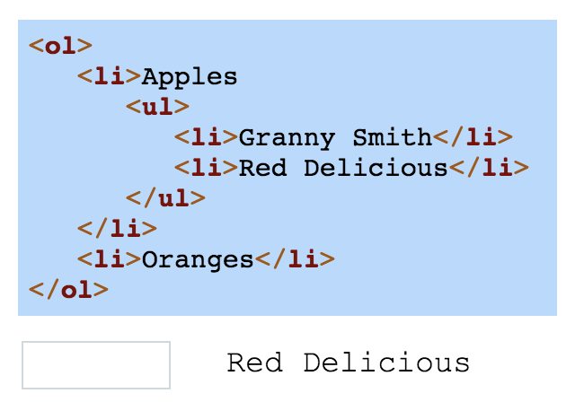

Slide 16
