Slide 1
List Practice

Slide 2
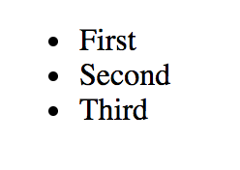
How do we make this?

Slide 3
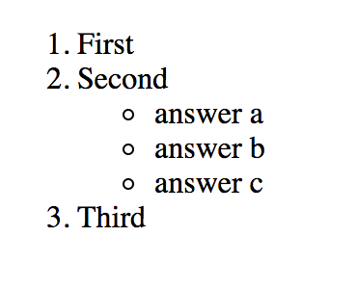
How do we make this?

Slide 4
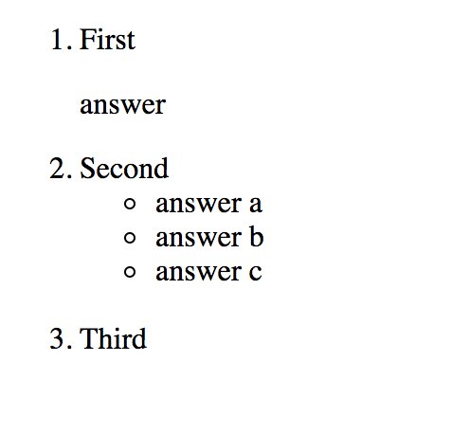
How do we make this?

Slide 5
List guidelines
<li> </li> goes around each item in the list for both unordered and ordered lists
Can not have anything between </li> and <li> of adjacent lists
When nesting lists, inner list must be completely inside one of the li tags of the outer list

Slide 6
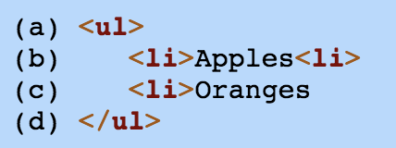
Fix the error(s)

Slide 7
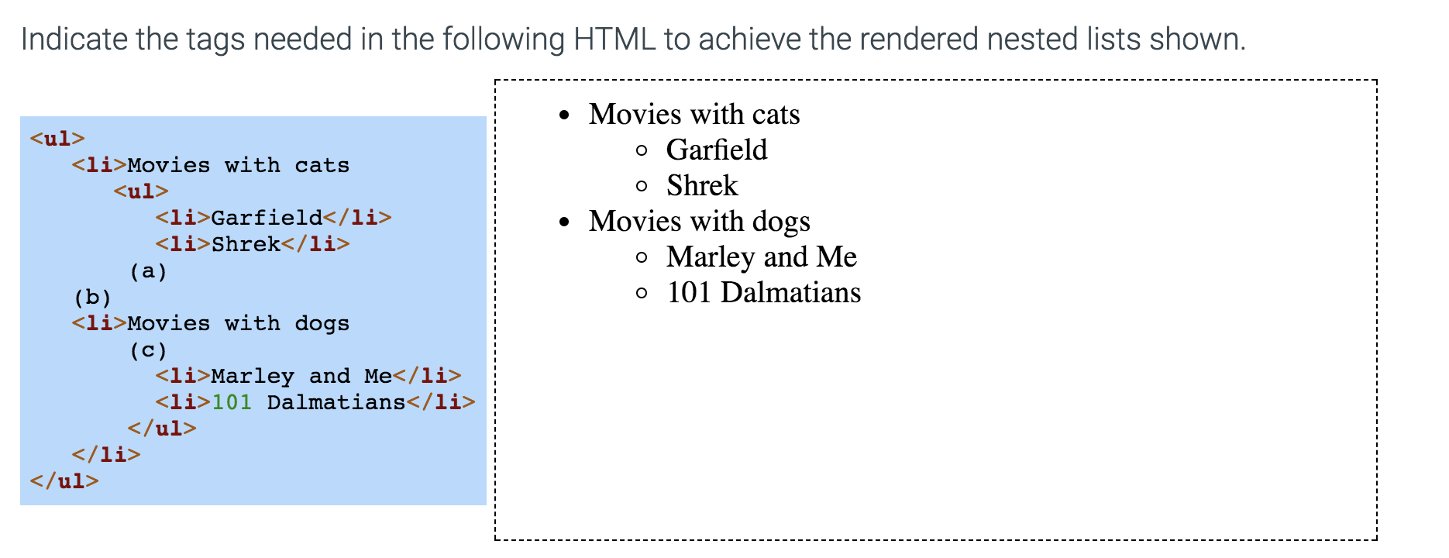

Slide 8
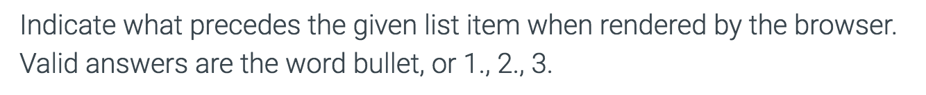
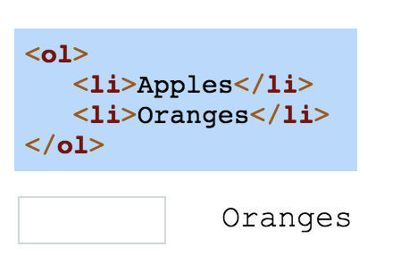

Slide 9
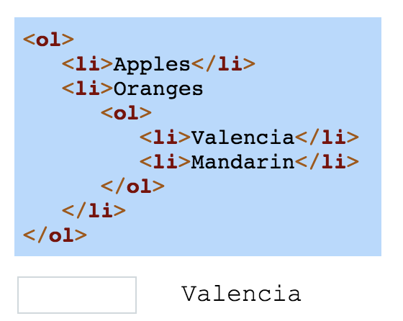

Slide 10
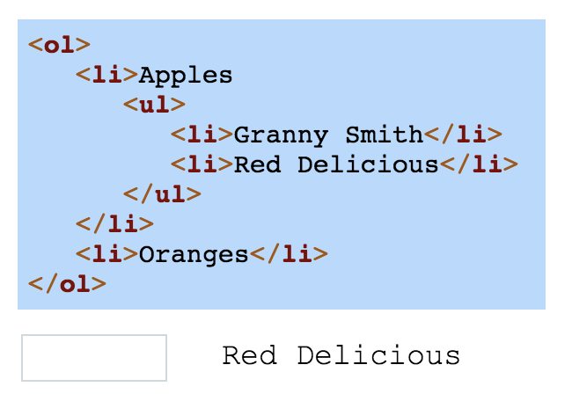

Slide 11
