Slide 1
Forms, cont’d

Slide 2
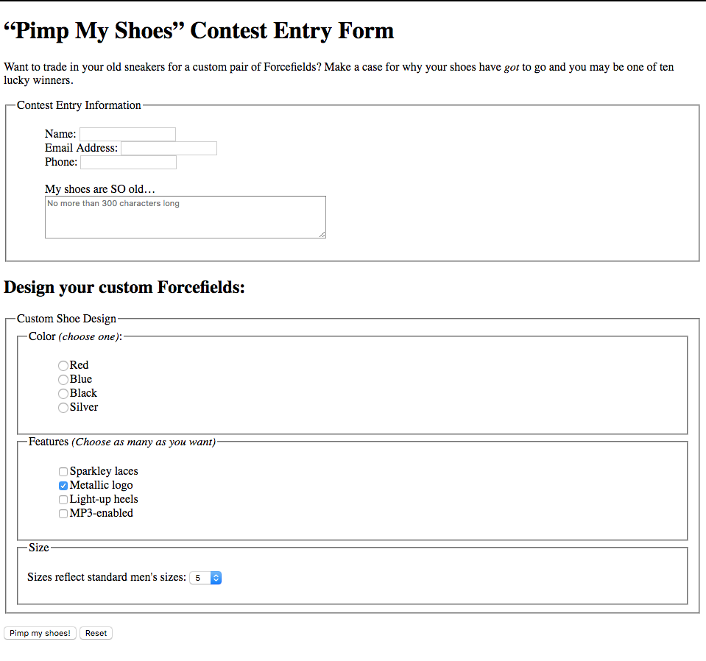

Slide 3
Identify tag locations for form
form
fieldset
legend
input
textarea
select/option

Slide 4
<form> tag
allows the web browser to send information from the user to the server
has two primary attributes:
action: indicates the URL where the form data should be sent
method: indicates the HTTP request type the browser will use to communicate with the server.
The method is either GET or POST.
GET is the default method and is used if no method is specified.

Slide 5
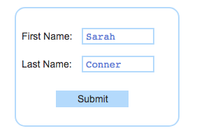
When user clicks submit
If method is GET:
Collect all data from the form fields into a query string.
The query string is a set of name=value pairs separated by the ampersand character (&).
Each name is specified as an attribute of the HTML field, and the value is the user-entered data. Ex: The last and first field names and values in the above text boxes become the string: last=Conner&first=Sarah
Create a URL with the server page and name=value pairs. The URL is composed of the action attribute specified in the form, the question mark character (?), and the query string. Ex: http://example.com/apply?last=Conner&first=Sarah
Use the newly created URL to contact the server using an HTTP GET request.
Display or update the web page using the response received from the server.

Slide 6
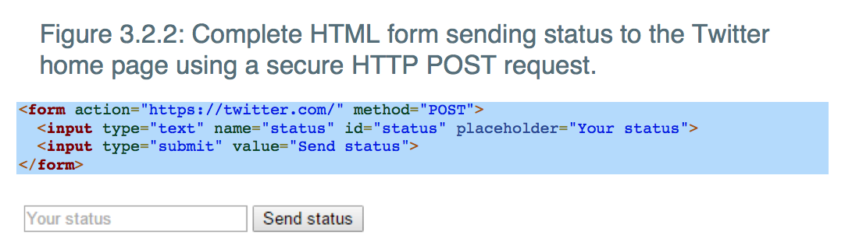
When user clicks submit
If method is POST:
browser creates the query string from the form data
It uses the URL from the form's action attribute to contact the server using an HTTP POST request
sends the query string in the HTTP request message body

Slide 7
Widgets
An interactive component (usually graphical) that the browser uses to interact with a user.
Buttons
Drop-down menus
Data entry fields
Radio boxes
Checkboxes
Sliders

Slide 8
Input tag
allows the user to enter information into a web page.
cannot enclose any additional page content, and thus does not have a closing tag.
The <input> tag has five primary attributes:
type
indicates what type of widget to display
default type is "text" if type is not specified
text box widget is an input element with the type attribute of "text" that allows users to enter a single line of text
A submit button widget is just an <input> tag with the type attribute of "submit", which sends the associated form's data to the server when clicked.
A submit button uses the value attribute to specify the button's text.
name
Allows server to identify which data came from which widget
id
Uniquely identifies the specific input tag for browser
placeholder
Provides a hint to user about info being requested
value
Allows widget to start with a default value

Slide 9
Looking at the attributes
Revisit this example:
Why no value attribute for the textbox?
Why no name or id attribute for the submit button?

Slide 10
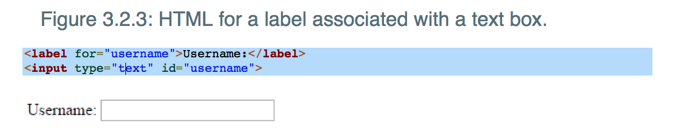
<label> tag
displays descriptive text associated with a specific widget
has a for attribute whose value should match the id attribute for the widget being labeled

Slide 11
Attribute format for tags
attributeName=“someValue”
appears angle brackets with tag
ex:
<input type=”text” name=“username”>
<h2 class=”favorites”> </h2>
<a href=“location of file”> </a>
<img src=“location of image”>

Slide 12
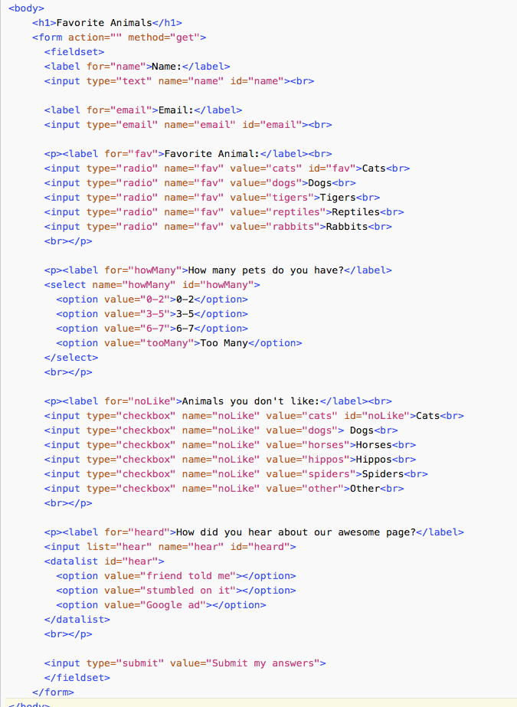
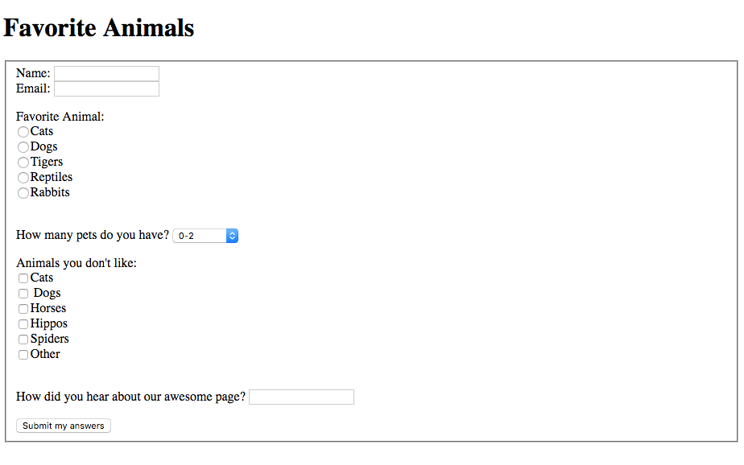
Form from last class

