Slide 1
Deployment (Chrome Extension)
Dr. Denise Case
Dr. Doug Hawley
Northwest Missouri State University
Maryville, MO

Slide 2
Deployment is …
Making your content available on the web
Chrome Extensions can be public or private/limited
Chrome Extensions can be free or paid
We deploy our new Chrome extension by “publishing” it
Our example is available in the Chrome Store here.

Slide 3
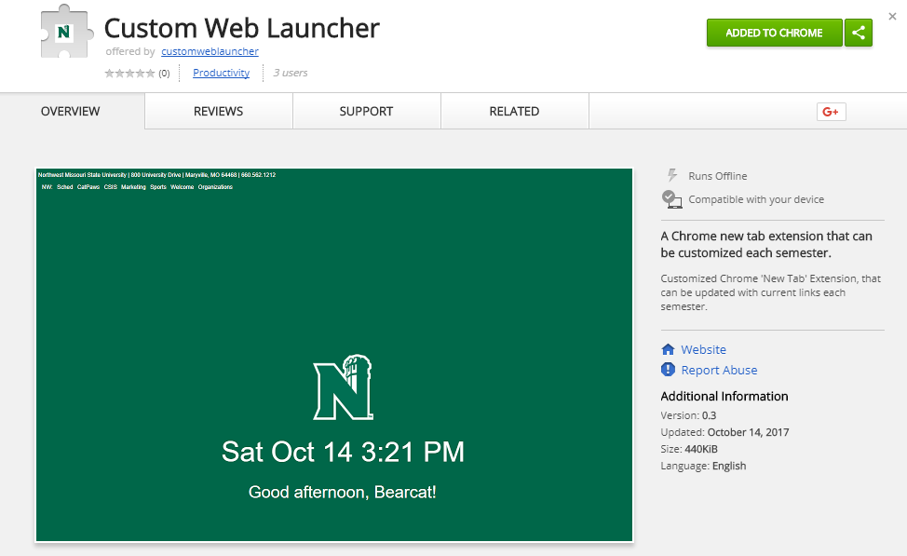

Slide 4
manifest.json
Information about your app is provided in a JSON file called “manifest.json”.
This file should be in the root folder (the main folder you commit to git).

Slide 5
Example
{
"manifest_version": 2,
"name": “Extension Name",
"description": “Put your description here.",
"version": “0.0.0.1",
"browser_action": {
"default_icon": "icon.png”
},
"author" : “Your Name",
"chrome_url_overrides" : {
"newtab" : "tab.html"
},
"optional_permissions" : [ "tabs" ],
"permissions": [
“tabs",
"storage"
]
}
Manifest version is required.
Icon shows up in the omibox at the top of the page

Slide 6
Example
{
"manifest_version" : 2,
"name" : "Custom Web Launcher",
"short_name" : "Web Launcher",
"version" : "0.3",
"description" : "A Chrome new tab extension that can be customized each semester.",
"icons" : {"128" : “images\128x128.png"},
"browser_action" : {
"default_icon" : {
"16" : “images\rsz_n60-2stack-w_small.png"
},
"default_title" : "Custom Web Launcher"
},
"author" : "Denise Case and Doug Hawley",
"chrome_url_overrides" : {
"newtab" : "tab.html"
},
"file_system_provider_capabilities" : {
"configurable" : true,
"multiple_mounts" : true,
"source" : "network"
},
"incognito" : "spanning",
"offline_enabled" : true,
"omnibox" : {
"keyword" : "aString"
},
"optional_permissions" : ["tabs"],
"permissions" : [
"storage",
"alarms",
"notifications",
"tabs",
"<all_urls>",
"http://www.bing.com/HPImageArchive.aspx?format=js&idx=0&n=1"]
}
Verify manifest.json is in the root folder.
Start with Version 0.1 or 0.0.0.1 (increment with each re-publish)

Slide 7
manifest.json
For a complete reference list of manifest.json keys, see: https://developer.mozilla.org/en-US/Add-ons/WebExtensions/manifest.json

Slide 8
Get Deployment Images
Create an icon to show in the Omnibox of the Chrome browser. Must be png, work on dark or light backgrounds, and follow size guidelines.
Create a screenshot to use in the listing. 1280 x 800 or 640 x 400 pixels. Follow guidelines.
Create a promotional image to show in a collection of options. A 440 x 280 px small image is required. Follow guidelines.

Slide 9
Try It
Open Chrome.
Go to chrome://extensions.
If Developer mode shows a +, click the +.
Click Load unpacked extension button.
Choose your working app folder.
Errors are likely due to the manifest file. Use a JSON validator.

Slide 10
Zip It
Zip the project folder.
In Windows: Right-click the folder and select Send to.. / Zipped (compressed) folder.
Or open a command window and run:
zip –r yourappname.zip yourappfoldername

Slide 11
Create Developer Account
First, use your Google Play (gmail) personal account. If you don’t have one, get a free one at gmail.com.
Sign in and go to: https://play.google.com/apps/publish/signup/

Slide 12
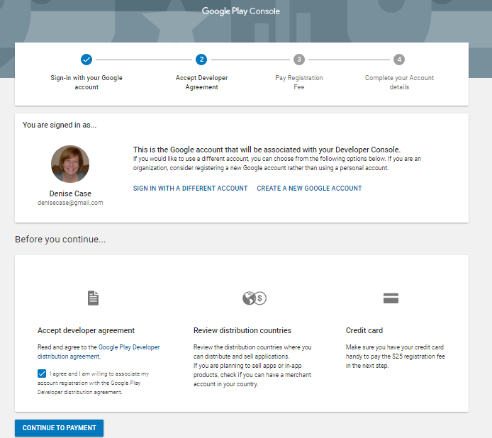
Click continue to payment.

Slide 13
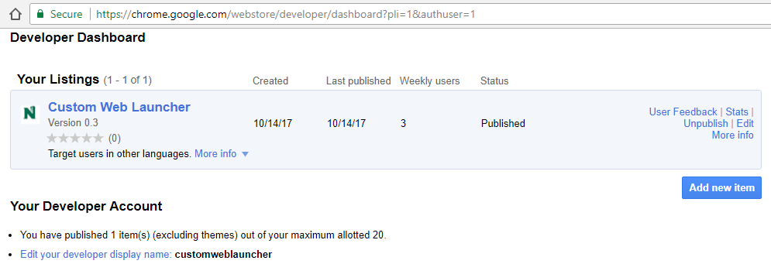
Go to the Chrome Developer Dashboard.
Sign in. Click Add new item.
Accept agreements as needed.
Choose your zipfile and upload.

Slide 14
Answer Questions & Provide Store Content
Add your information
Upload the screen shots and store content required
Make your app public or private or invite team members to review it

Slide 16
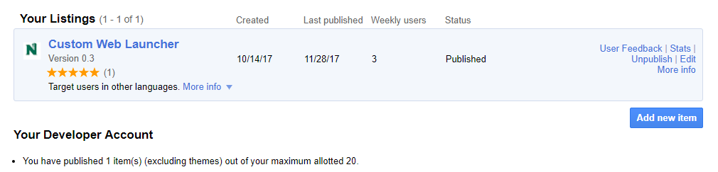
Updating your app
Make changes. Update your version in manifest.json.
Go to the Chrome Developer Dashboard.
Sign in.
Click edit.

Slide 17
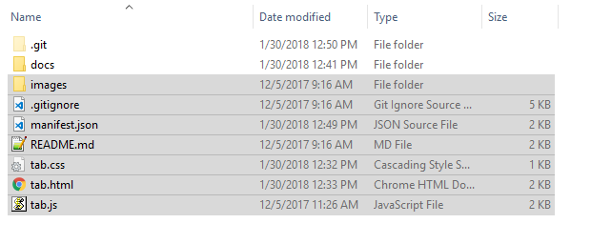
Select the following, right-click and select “Send to Zip”. Note the .git folder and docs folder are not selected.
Name it “update.zip”.

Slide 18
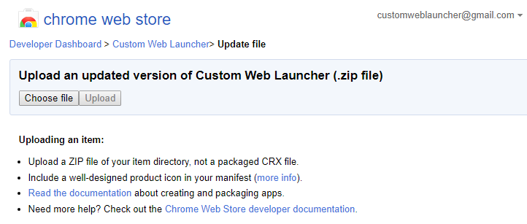
Updating your app
Click “Choose file”, find your zip file.
Click upload.

Slide 19
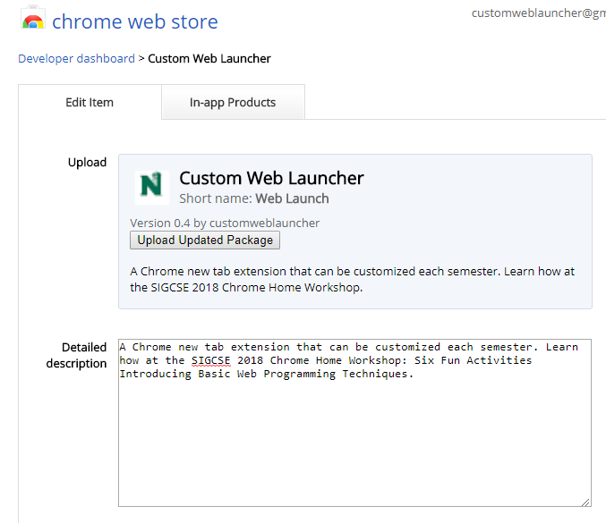
Update detailed description if desired.

Slide 20
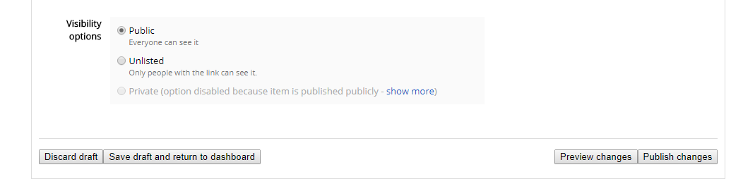
Verify other information. Scroll down.
Click Publish changes. Click OK

Slide 21
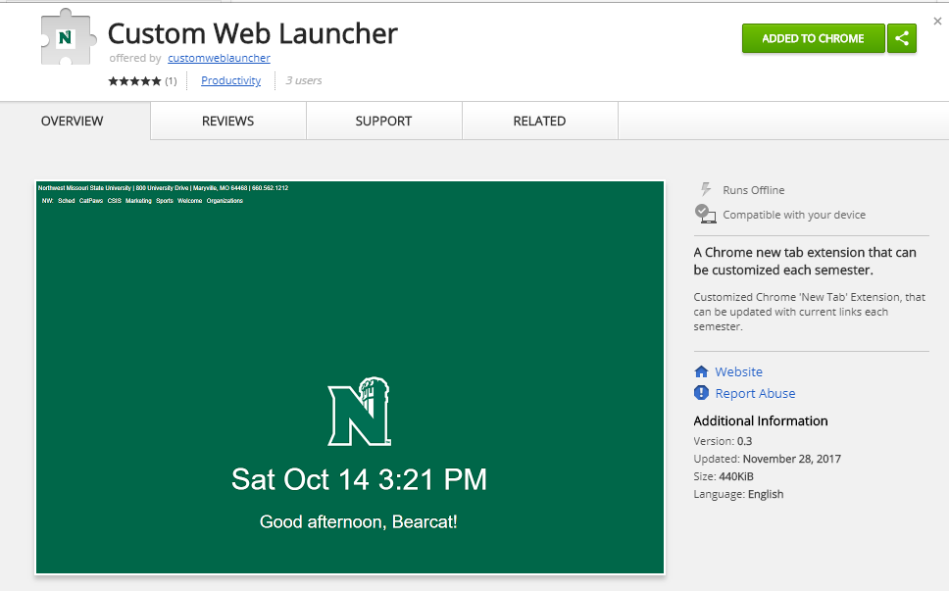
Before

Slide 22
After

Slide 23
Deployment

