Slide 1
Chapter 4 and 5

Slide 2
Objectives
Introduce markup: elements and attributes
How browsers interpret HTML documents
Basic structure of HTML document
What do style sheets do?

Slide 3
Where do we start?
Need content
Give the document structure
Identify the different text elements
Add some images
Specify page appearance with style sheet

Slide 4
Create a file
Use your favorite text editor
Notepad++ is on the computers in lab
I use either TextWrangler, Sublime, or Taco HTML Edit on Mac (first two are free)
Doesn’t matter which you use, but it must be a TEXT editor.
The ones mentioned above are helpful with context styling
Create a new file
Add the basic HTML elements
Save it in an appropriate directory with the extension .html
Notes:
Demo

Slide 5
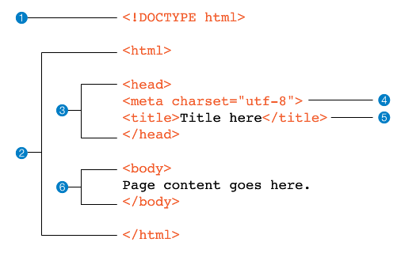
Basic file structure

Slide 6
HTML Elements
Format
<elementname> Content here </elementname>
Examples
<h1> This is a heading </h1>
<p> This is a paragraph. </p>
<p> So is this…
What happens if I separate my lines? </p>

Slide 7
What Browsers Ignore
Multiple “white” spaces
Line breaks (carriage returns)
Tabs
Unrecognized markup – ie. anything they don’t understand
Comments <!-- comment in here -->

Slide 8
Identifying Text Elements
Use HTML to add meaning and structure to the content, NOT how it should appear.
Choose elements based on what makes sense structurally
Each element has a default style
Use CSS to change how elements should appear

Slide 9
Block Elements
Examples:
Paragraphs <p>
Headings <h1>, <h2>, …, <h6>
Lists <ul>, <ol>, <li>
Treated as though they are rectangular boxes that are stacked up in the page.
Each one takes up the entire width of the web browser’s window
<p>, <h1>, <h2>, ..., <h6> have top and bottom margins
16px = 1em = height of 12pt line of text

Slide 10
Inline Elements
Examples:
<strong> or <b>
<em> or <i>
<a>
Creates an invisible box around the text being formatted
This is an <b>important</b> word
This is an important word
No border, padding or margin in or around the box

Slide 11
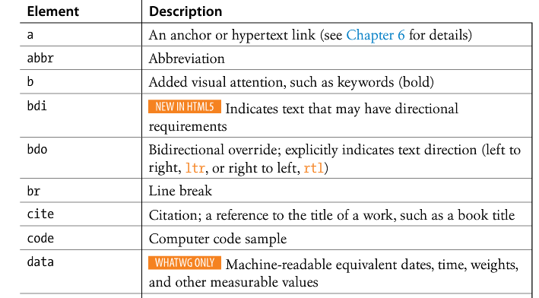
Inline elements

Slide 12
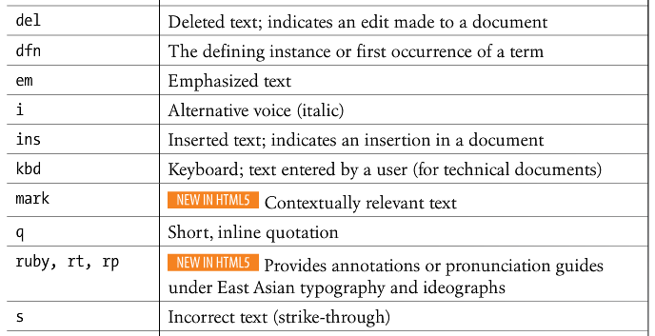
Inline elements

Slide 13
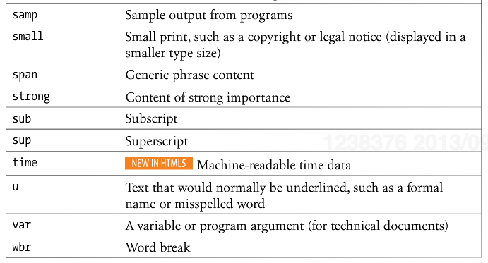
Inline elements

Slide 14
Empty Elements
Examples:
<br>
<img>
Elements do not have opening and closing tags and no content, they are just giving a directive.
Not very useful without more information.
Give information to these tags with attributes

Slide 15
HTML Elements & Attributes
Format
<tagname attribute=“value”> Content </tagname>
Or
<tagname attribute=“value”>
Examples
<a href=“www.siena.edu”> Siena College</a>
<img src=“cats.jpg” width=“200” alt=“Picture of cats”>

Slide 16
Power of Style Sheets
Most of the default styling of HTML elements are basic
To see power of style sheets:
CSS Zen Garden
All pages use exact same HTML file

Slide 17
Lists
Unordered (Bulleted lists) <ul> <li>First</li> <li>Second</li> <li>Third</li> </ul>
Ordered (Numbered) <ol> <li>First</li> <li>Second</li> <li>Third</li> </ol>
First
Second
Third
First
Second
Third

Slide 18
Lists
<ul> and <ol> have 36px of left padding
For each <li>, the bullet is positioned at -16px
Seeing an example is worth a 1000-word explanation
(list_example.html)

Slide 19
Nesting in HTML
Lists are a great example of how HTML elements can be nested inside each other to create a hierarchy <ol>
<li></li>
<li>
<ul>
<li></li>
<li></li>
<li></li>
</ul>
</li>
</ol>

Slide 20
Blockquotes
<blockquote>The quote goes here</blockquote>
Often misused to create indents
Indicates a long quotation
It is not considered part of the document outline

Slide 21
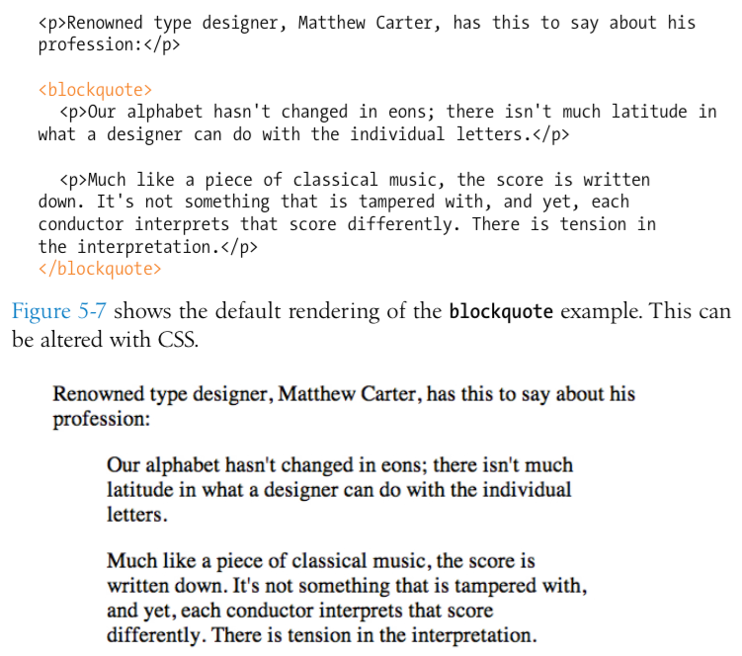

Slide 22
Pre-formatted text
Web browsers ignore extra “white space.”
Only one “space” is displayed between words and elements
Extra spaces, tabs, and line breaks are not displayed at all.
The <pre> tag allows extra spaces, tabs, and line breaks to be displayed.
Why do web browsers ignore extra “white space?”

Slide 23
Figures
<figure>
<img src=“piechart.jpg” alt=“This will pop up”>
<figcaption>This will display on screen</figcaption>
</figure>

Slide 24
Organizing with new HTML5 tags
<header>
<footer>
<section>
<article>
<aside>
<nav>
Notes:
explain why aside and not sidebary

Slide 25
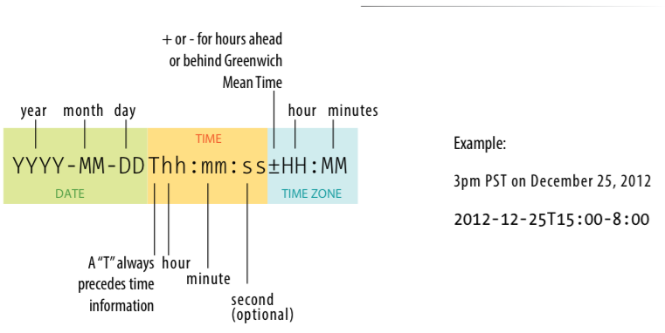
Time and dates
Written by Jennifer Robbins (<time datetime="2012-09-01T 20:00-05:00” pubdate>September 1, 2012, 8pm EST</time>)
Notes:
allows us to markup dates and times in a way that is comfortable for a human to read, but also encoded in a standardized way that computers can use.
content of element for people; datetime attribute for computer

Slide 26
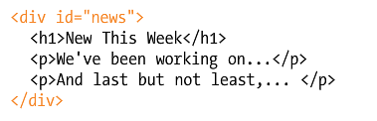
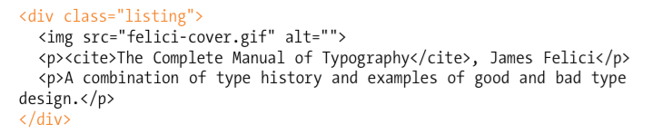
Span and Div

Slide 27
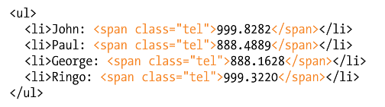
Span and Div

Slide 28
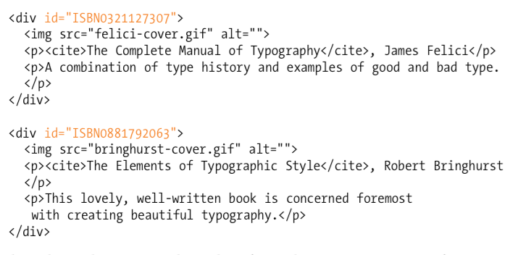
Class vs. id

Slide 29
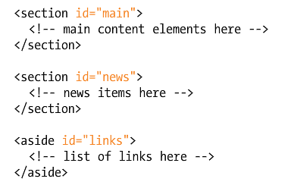
Class vs. id

Slide 30
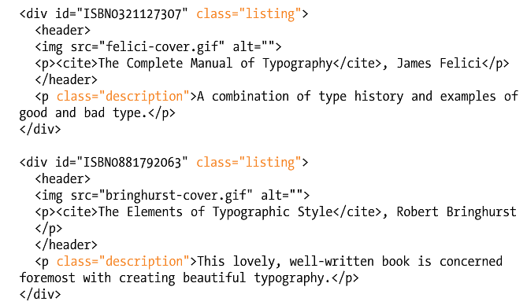
Class vs. id

