Slide 1
Chapter 6
pp 105-121

Slide 2
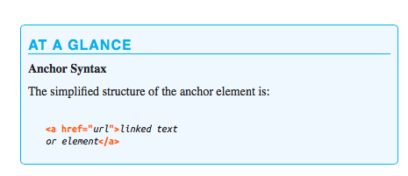

Slide 3
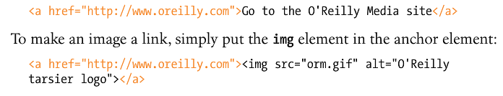

Slide 4
Absolute URLs
Usually points to an external website
href=“http://www.go.com/fun.html”

Slide 5
Relative URLs
Must point to a file on your server
href=“fun.html”
In the example above, fun.html must be in the same folder as the web page that contains the href above.

Slide 6
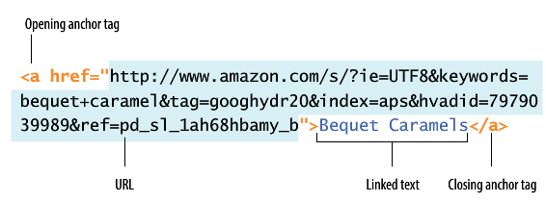
HREFs can be long

Slide 7
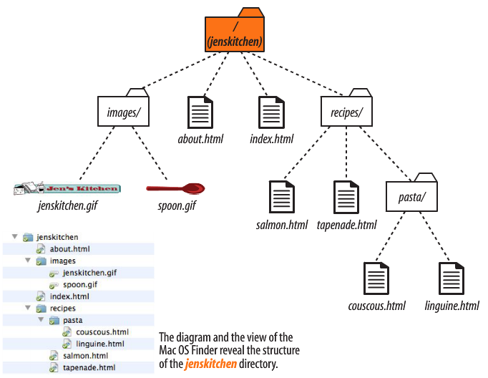

Slide 8
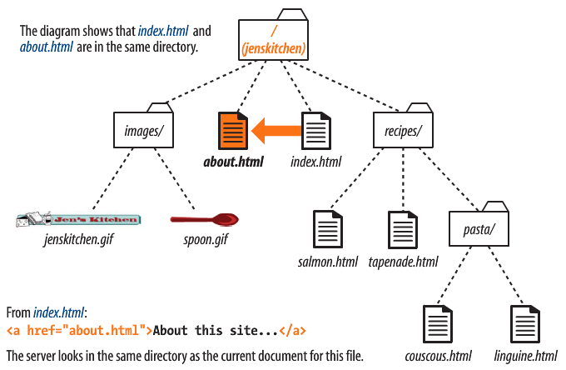

Slide 9
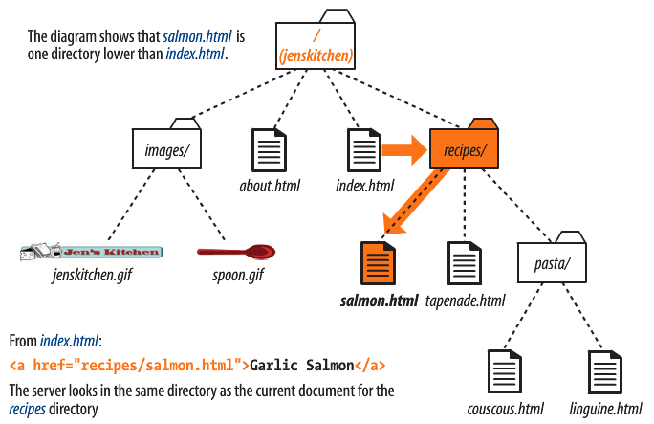

Slide 10
In index.html, link to linguine.html

Slide 11
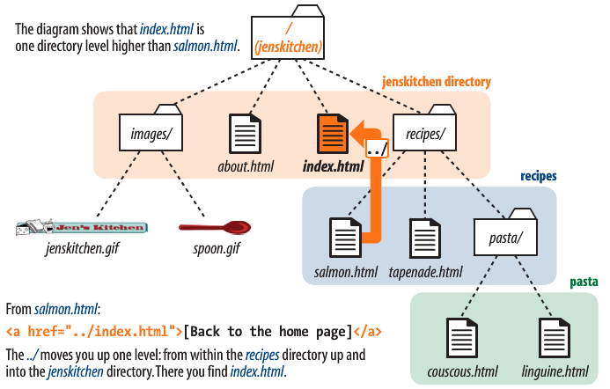

Slide 12
In linguine.html, link to about.html

Slide 13
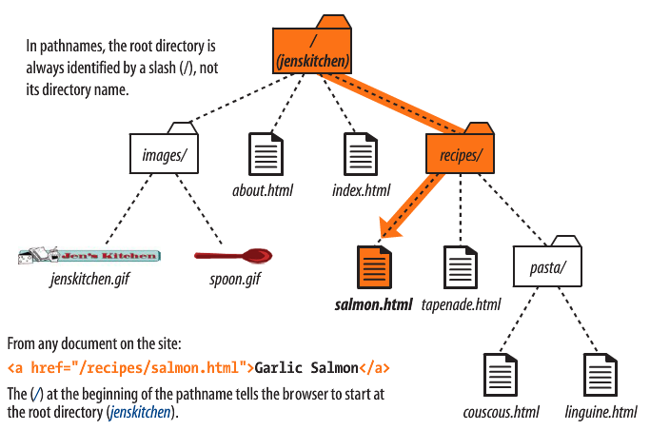

Slide 14
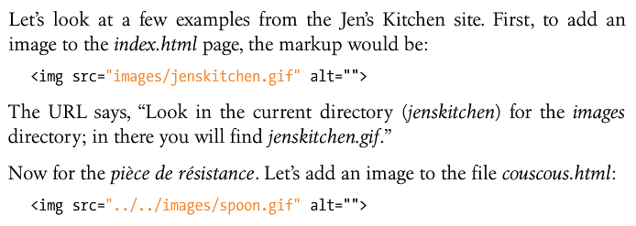
Inserting Images

Slide 15
In about.html, insert spoon.gif

Slide 16
In salmon.html, insert spoon.gif

Slide 17
In couscous.html, insert jenskitchen.html

Slide 18
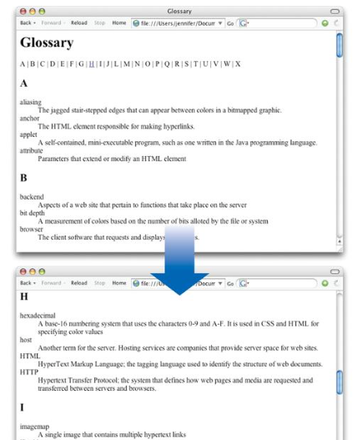
Linking inside a page

Slide 19
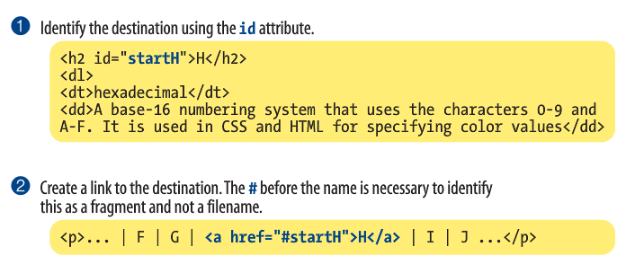
Linking inside a page

